Slide 1
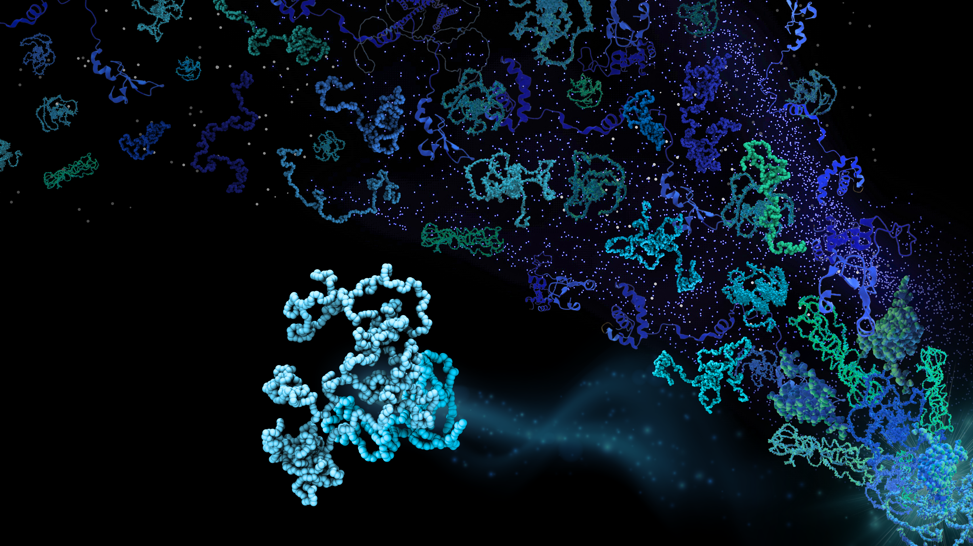
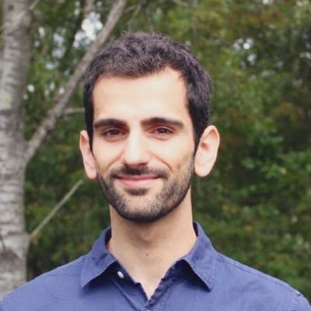
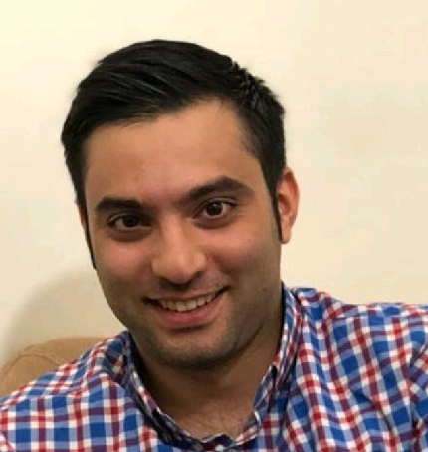
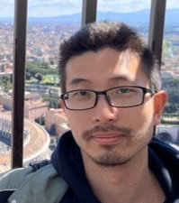

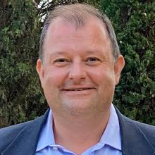
Conformational ensembles for multi-domain proteins from coarse-grained simulations
Giulio
Hamid
Fan
Emil
Kresten Lindorff-Larsen
Linderstrøm-Lang Centre for Protein Science
University of Copenhagen
@LindorffLarsen
lindorff@bio.ku.dk
Silvio

Slide 2
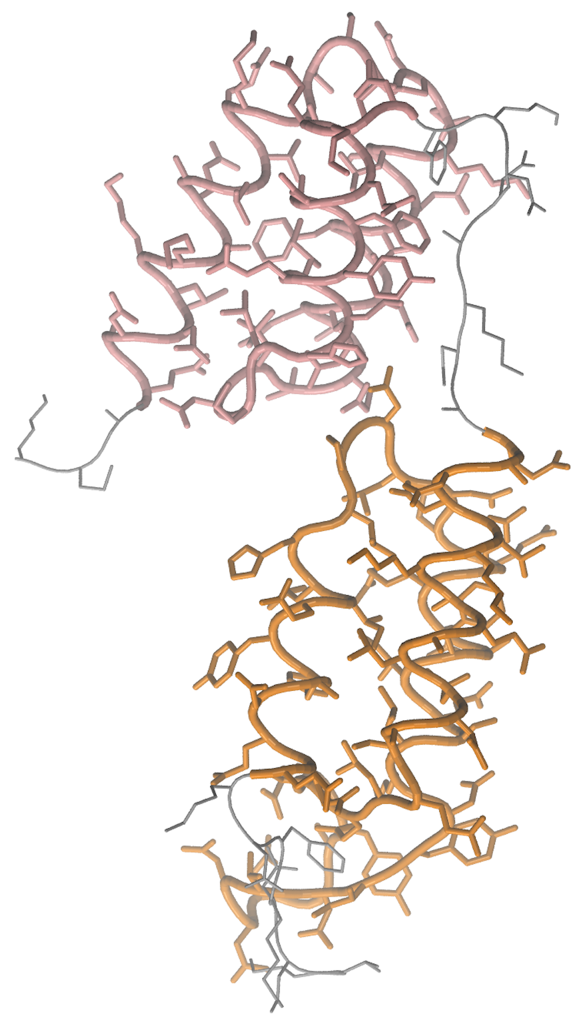
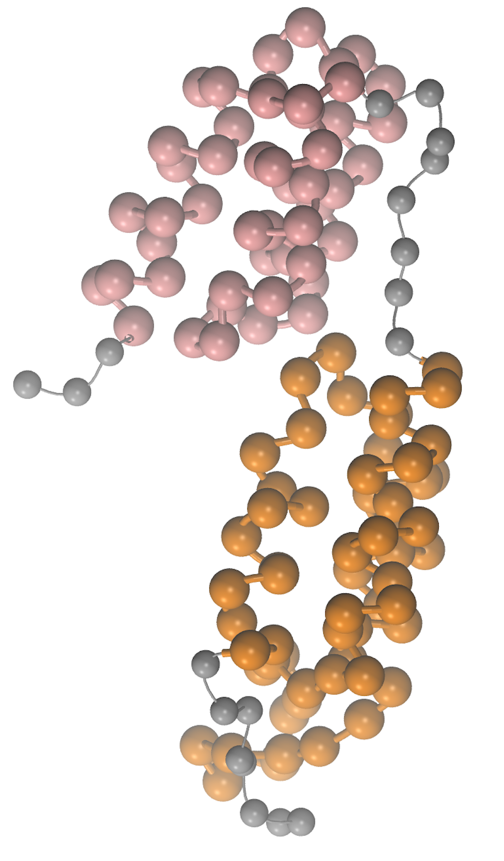
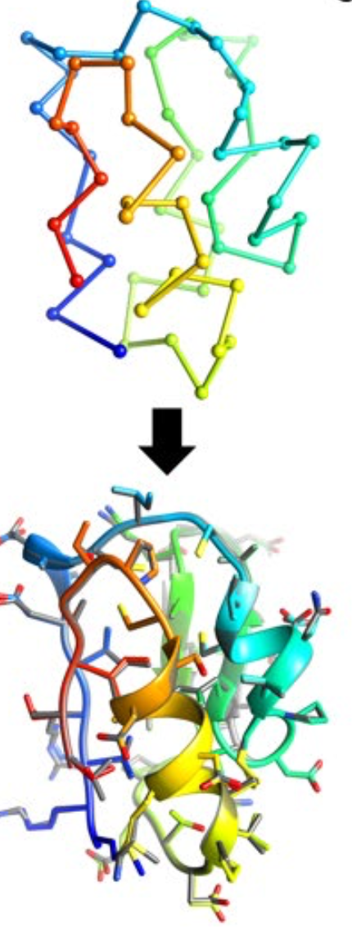
Strategy
Define semi-rigid domains to be constrained
Run molecular dynamics simulations with coarse-grained models
Convert to all-atom structures
cg2all (Heo & Feig, Structure, 2024)
Plus superpose folded domains
Built using AF using 2lr2 and 4npd as templates

Slide 3
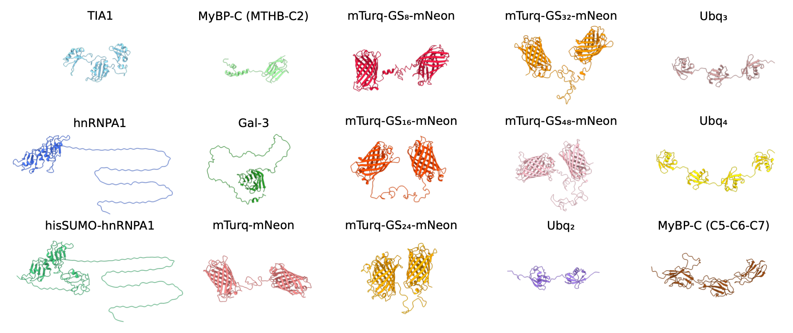

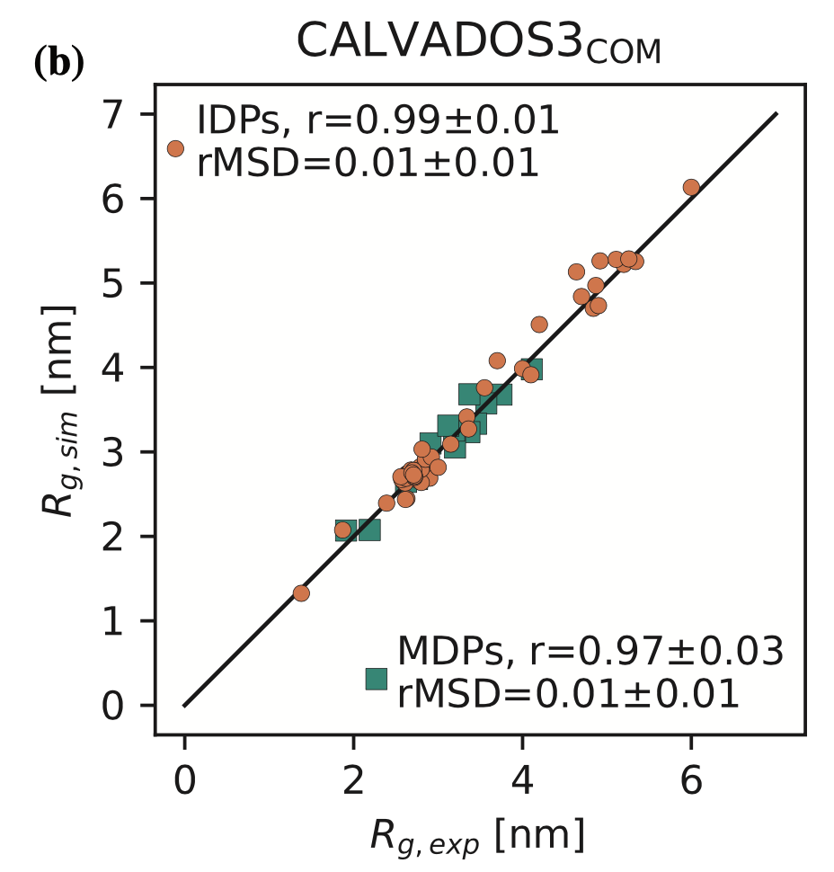
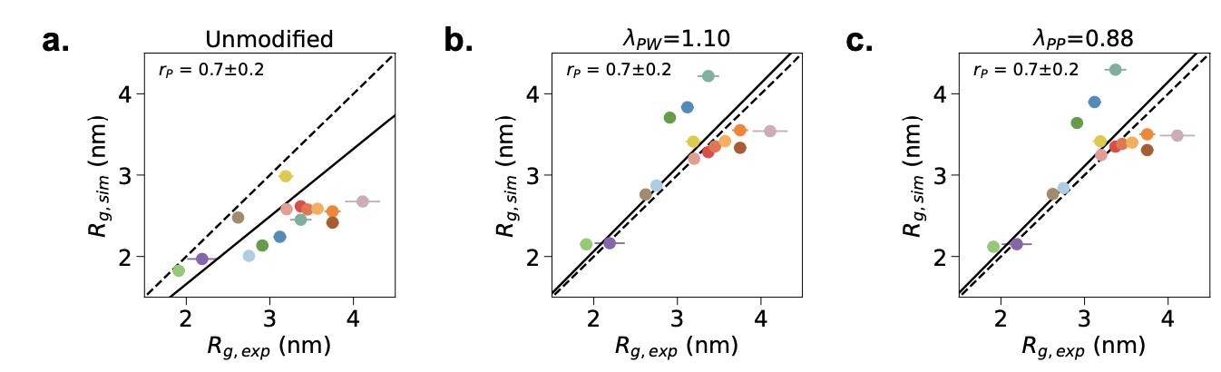
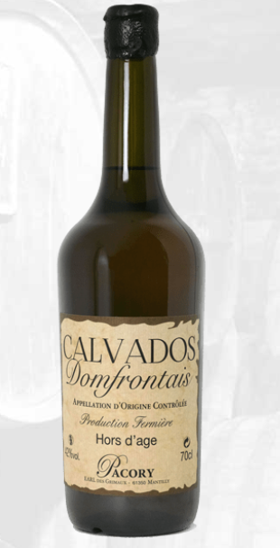
Improved coarse-grained models for flexible proteins
Martini, explicit solvent, 1 backbone bead & 1–5 side chain beads pr. residue
Focus on global structural properties (benchmark on SAXS, plot R_{g})
CALVADOS 3, implicit solvent, 1 bead pr. residue, CA/COM representation. Force field trained on experimental NMR+SAXS data
Souza, …, Marrink, Nat Methods, 2021
Thomasen et al, JCTC, 2022
Thomasen et al, Nature Comm, 2024
Tesei et al, PNAS, 2021
Tesei & KLL, Open Res Europe, 2022
Tesei, Trolle et al, Nature, 2024
Cao et al, Protein Science, 2024

Slide 4
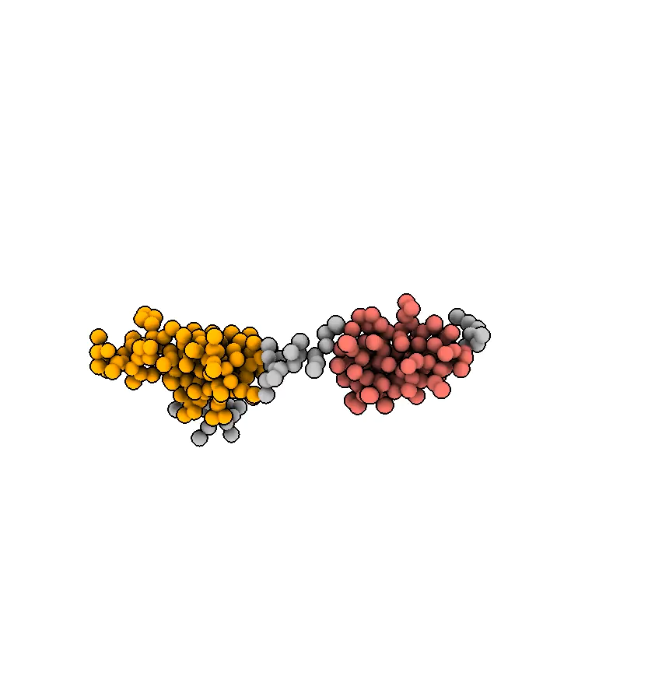
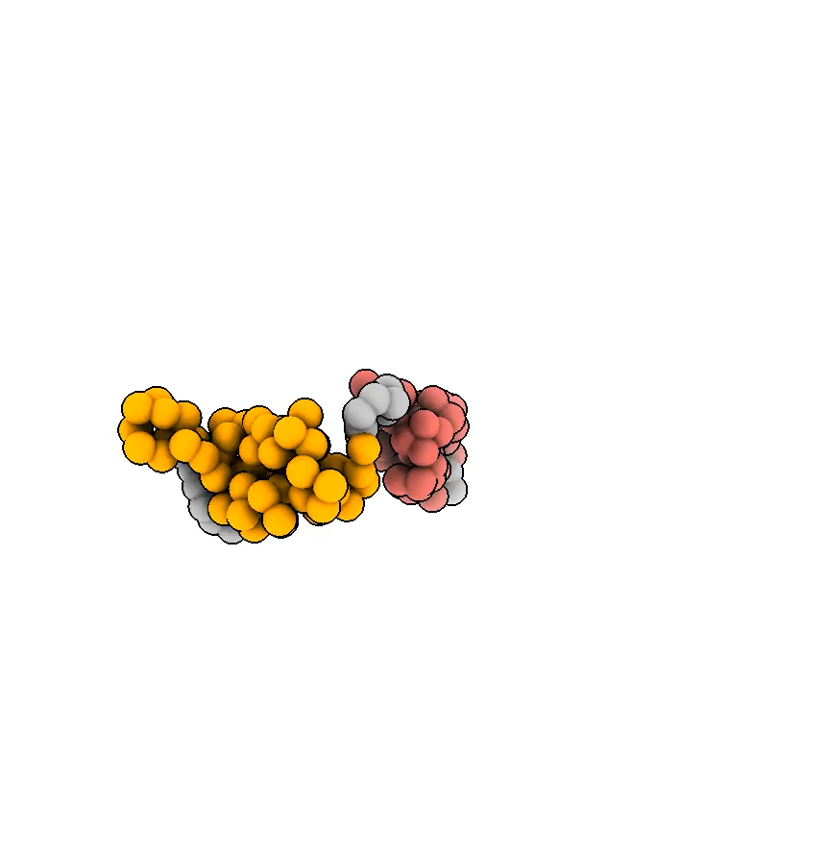
T1200/T1300
Harmonic restraints within [E9–Q68] & [N77–Q126] (but not between)
Scaled charges in D40, D44, E48, and E51 (-1.0 to -0.25) to account implicitly for the +3 lanthanide ion
[This is a movie though may not play in Google Slides]
[This is a movie though may not play in Google Slides]
2x 21 µs simulation/target
~ 3.5 GPU days/target
20x 63 ns simulation/target
~ 2 GPU hours/target
[github.com/KULL-Centre/ColabCALVADOS]

Slide 5
Strategy
Define semi-rigid domains to be constrained
Run molecular dynamics simulations with coarse-grained models
Convert to all-atom structures
cg2all; Heo & Feig, Structure, 2024
Plus a few other small tricks

