Slide 1

Evaluating Protein Ensemble Predictions with Small-Angle X-ray Scattering (SAXS)
Susan Tsutakawa, LBL
Feng Yu, LBL

Slide 2
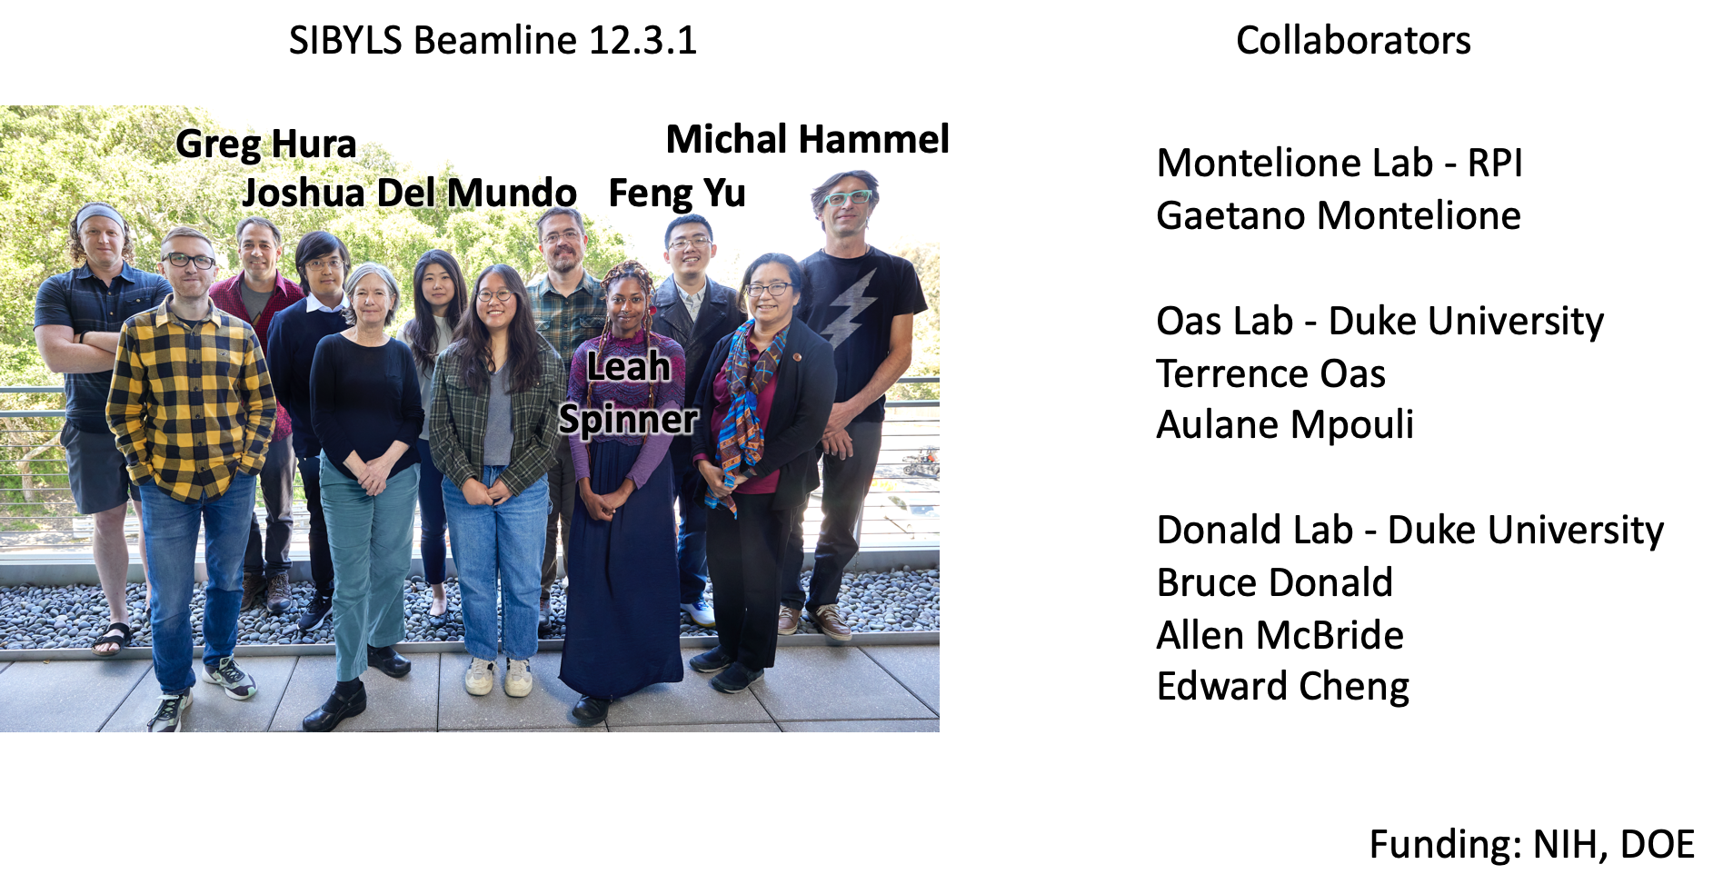

Slide 3


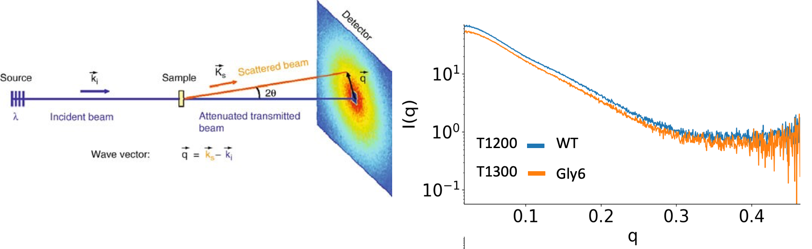
Grille, 2008

Slide 4
What does the experimental SAXS data say about the Protein A system
Is there a disordered linker or something else?

Slide 5
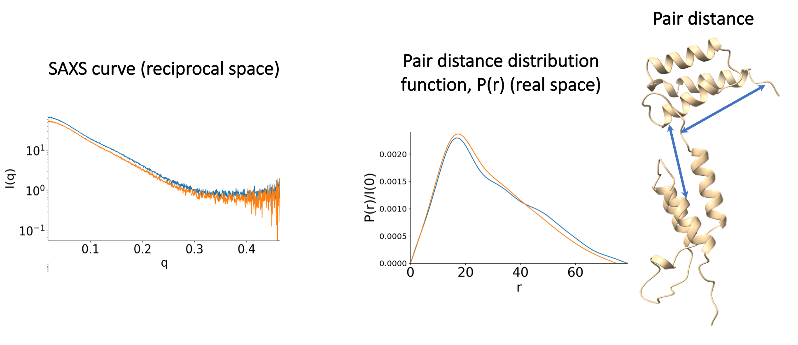
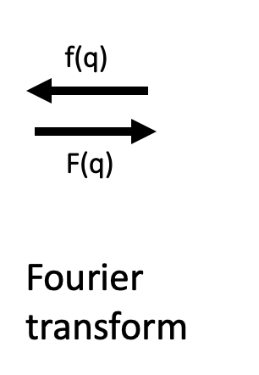
Experimental SAXS data of CASP targets T1200 and T1300 in reciprocal and real space show that WT and a Gly6 linker have subtly distinct conformations

Slide 6
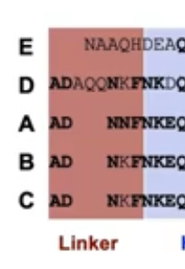
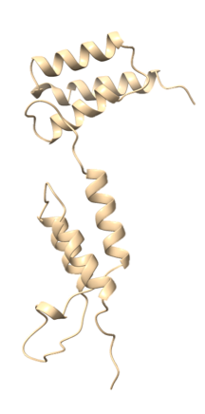

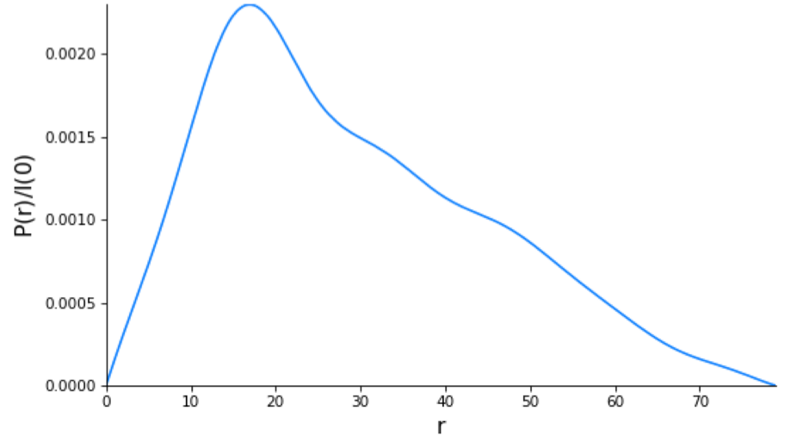
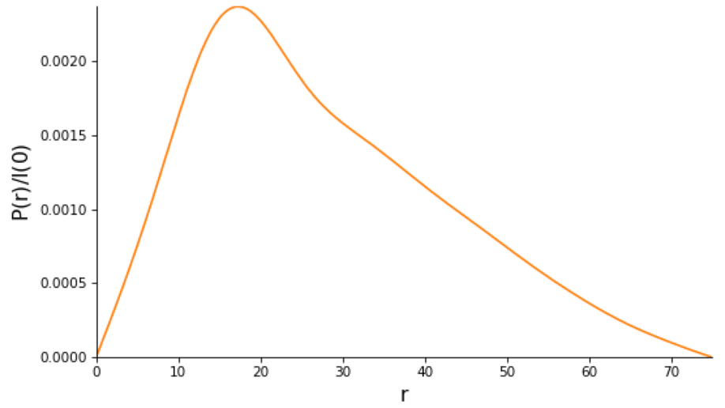


Real space curves more intuitively shows the subtle but significant difference between WT and Gly6 mutant.
Significantly reduced
The experimental data is indicating that the conserved “disordered” linker in WT is leading to preference in distances between domains.

Slide 7
How about the prediction ensembles?

Slide 8
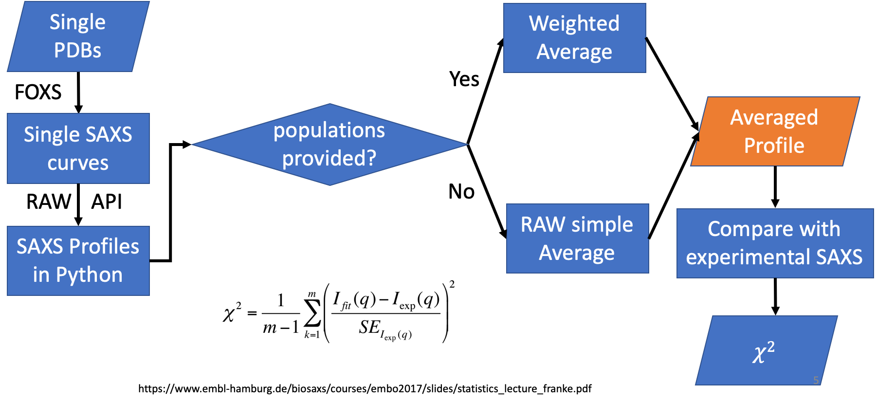
To compare predictor’s ensembles to SAXS data, we calculated theoretical SAXS curves from every PDB and obtained an averaged profile.

Slide 9
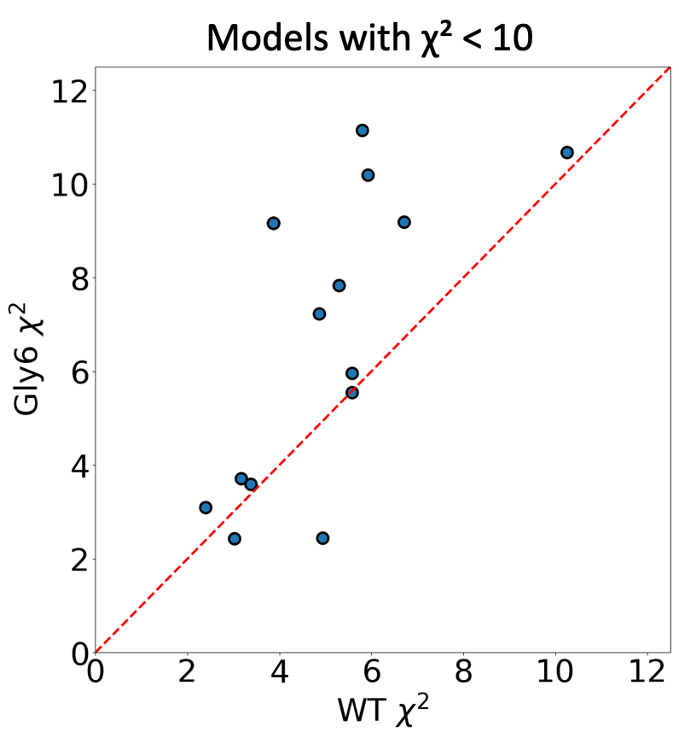
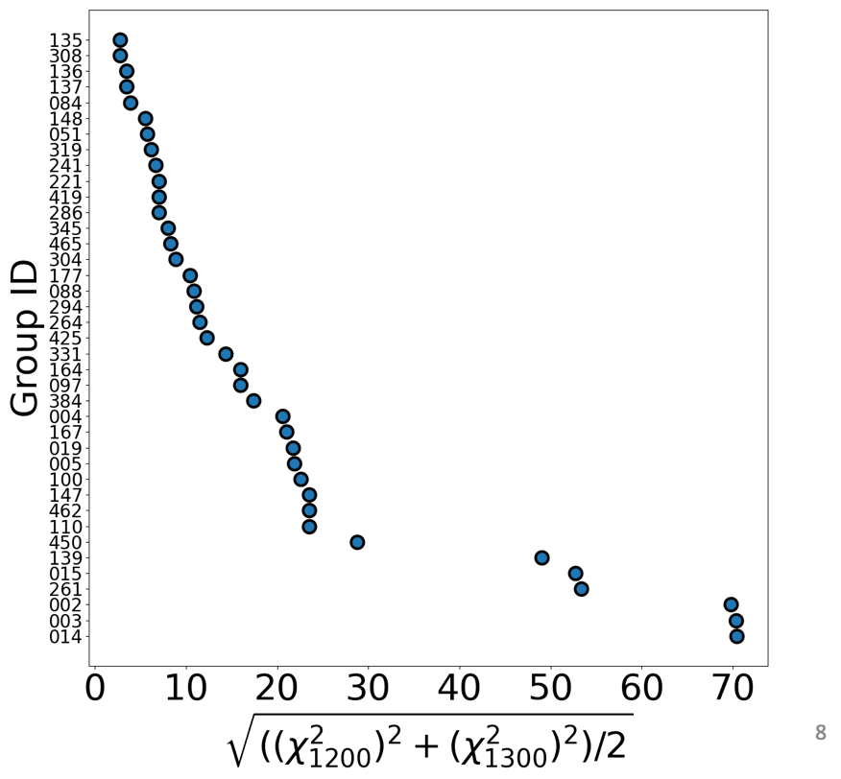
Using the chi² metric, we scored each group for the WT T1200 and the Gly6 mutant T1300.
Combined score
135 Lindorff-LarsenCLVDS
308 MoMAteam1

Slide 10
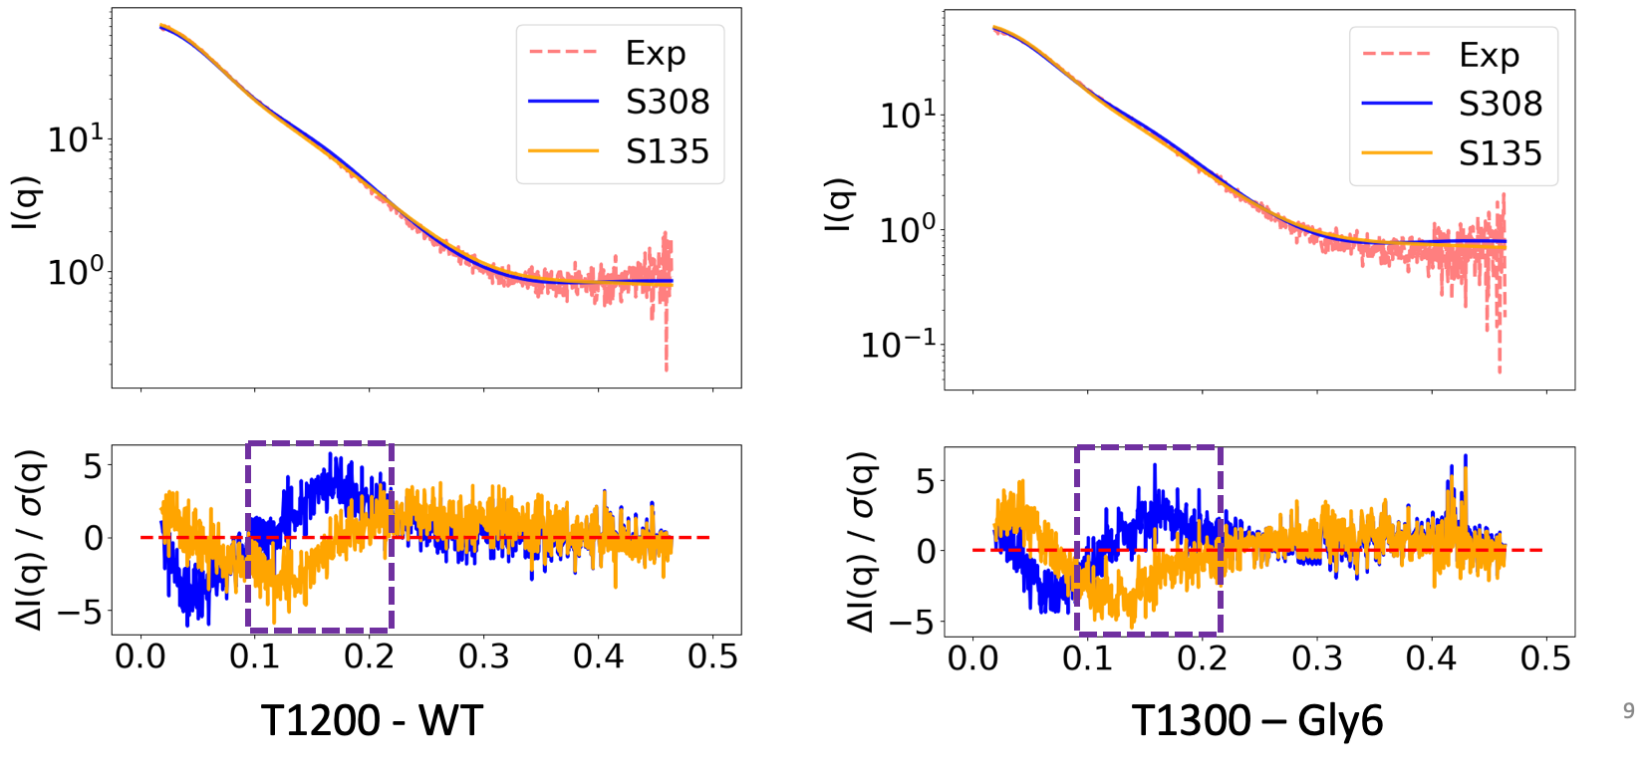
Top models show high residual bias at the low-mid q region of the SAXS curves, indicating ensemble does not represent experimental data.
308 MoMAteam1
135 Lindorff-LarsenCLVDS

Slide 11
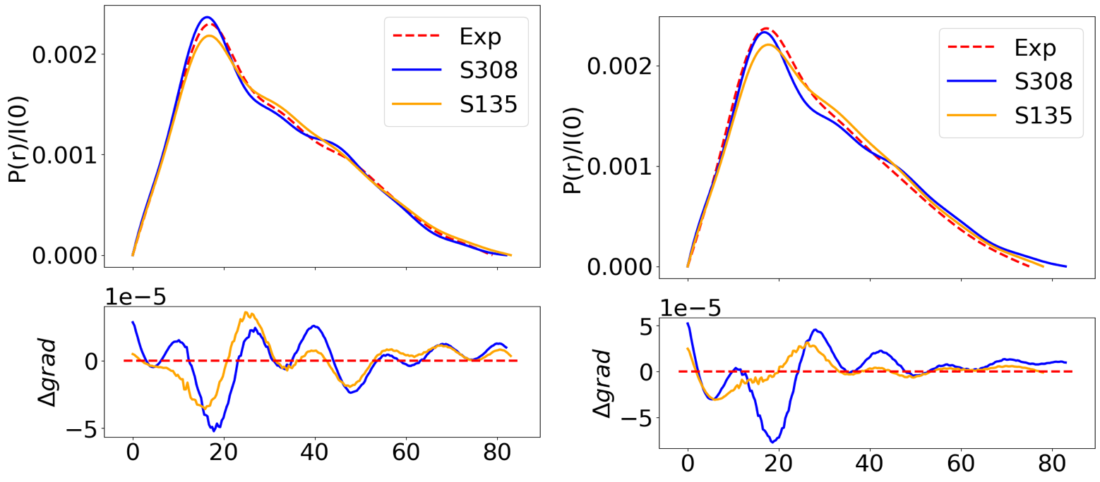
The Momateam1 showed preferred distances, but those preferred distances were not the same as the experimental data and was observed also in Gly mutant.
The Lindorff-Larsen team had a flatter slope, which better matches the Gly mutant, but did not capture the preferred distances in WT.
135 Lindorff-Larsen CLVDS
WT
Gly6
308 MoMAteam1

Slide 12
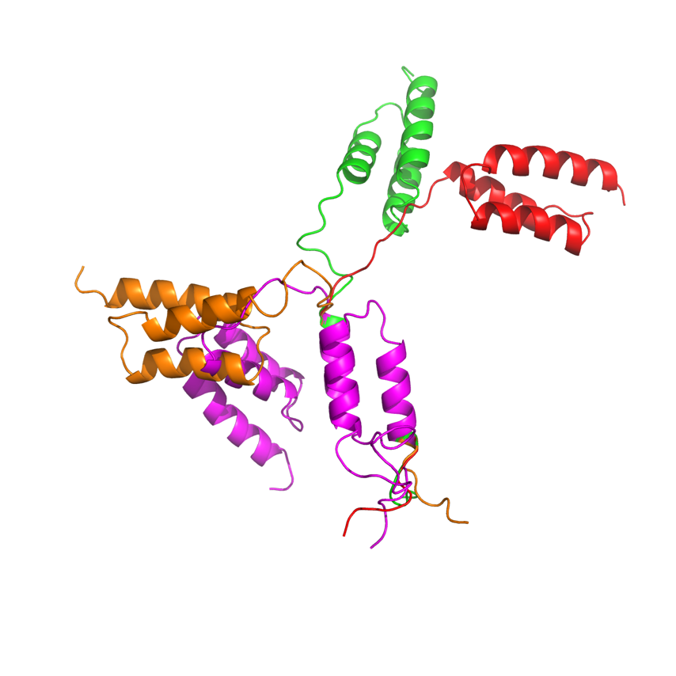
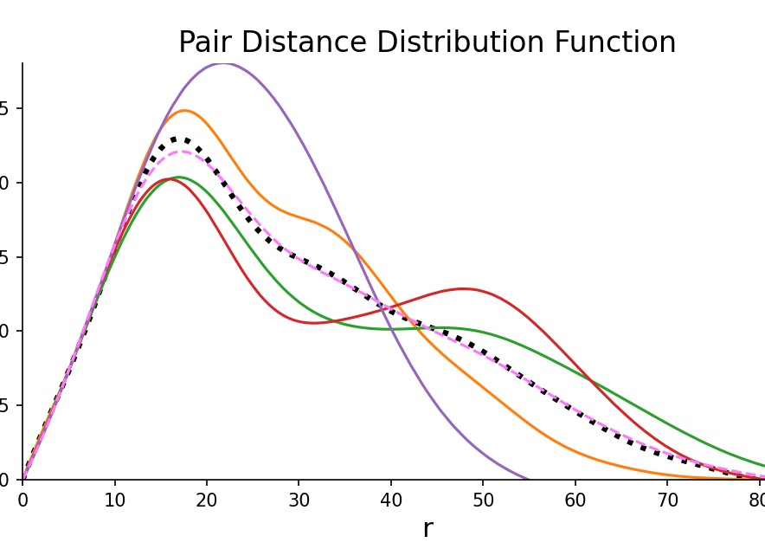
We can recapitulate the experimental data using distinct conformations based on the crystal/NMR structures, but these conformations are not consistent with NMR RDC data.
Experimental Data
Minimal ensemble
N-term ZLBT

Slide 13
SAXS showed that Protein A system ZLBT-C WT has preferred distances between domains despite having a flexible disordered linker, but loses those preferred distances with all glycine linker.
–Thoughts/Challenges for SAXS ensemble scoring
SAXS data for dynamic systems does not have a singular ground truth.
SAXS can capture the relative preferred distance but it was difficult to quantitatively measure differences with CASP predictor ensembles on such a subtle feature of the curve. Scoring methods of combined reciprocal and real space are needed to capture this information. No community-recognized methods for real space.
Even crystal-based models generated by SAXS-assisted simulation do not match the NMR RDC, suggesting that the SAXS solution may not be unique. We need to combine the NMR RDC with the SAXS data for better modeling of protein flexible regions and test if SAXS can distinguish NMR RDC-compatible models with our randomly generated models..

Slide 14
Questions for the Community - SAXS
Do CASP-rankings to cryoEM and crystal structures ground truths bias algorithms against solution conformations?
How can conformational space be fully explored (as opposed to only being along a trajectory), while also being able to remove states that could not occur. Is there a component of kinetics and not just equilibrium in allowed range of conformations.

