Slide 1
CASP16 - Ensemble and disorder challenge discussion
December 4 2024
(Before coffee)

Slide 2
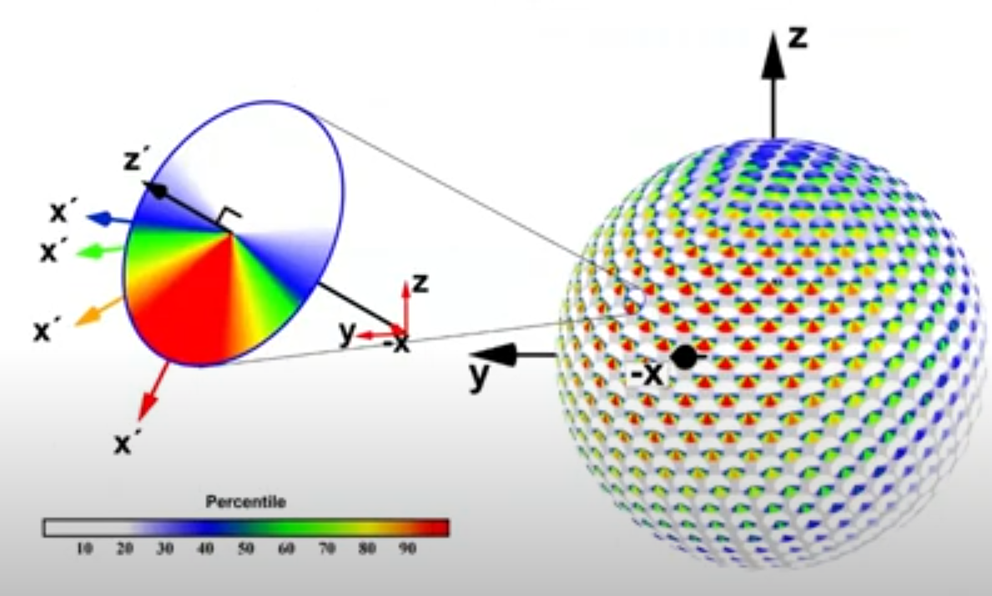
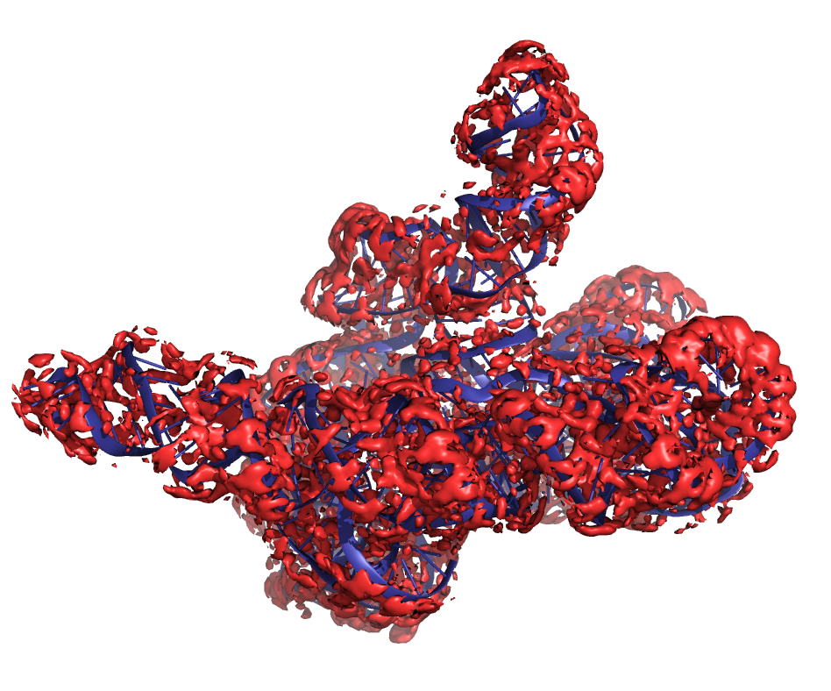
Getting comfortable with distributions in structural biology
Much of structural biology cannot be represented by a small, finite, set of discrete states
How to we measure, predict, and assess these distributions?
What detail of representation is sufficient for predictions to inform chemically or biologically interesting questions?
  Is discrete conformational ensemble necessary or are their more elegant representations?

Slide 3
Agenda
Flash talks and discussion on water/ion experiment
Flash talk and discussion on D-L-D experiment
Break
General discussion on ensemble and disorder

Slide 4
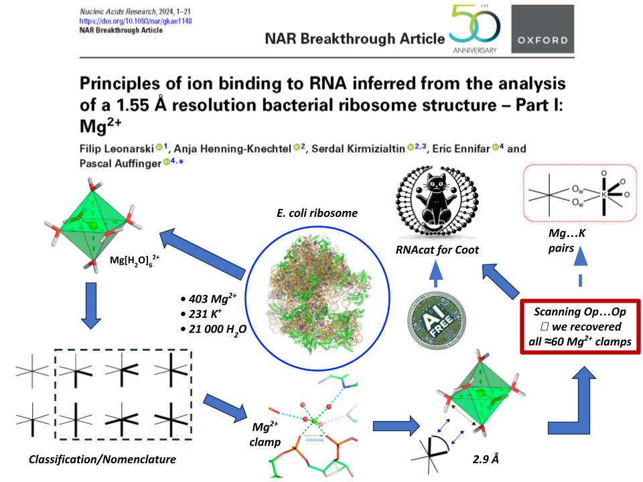

Slide 5
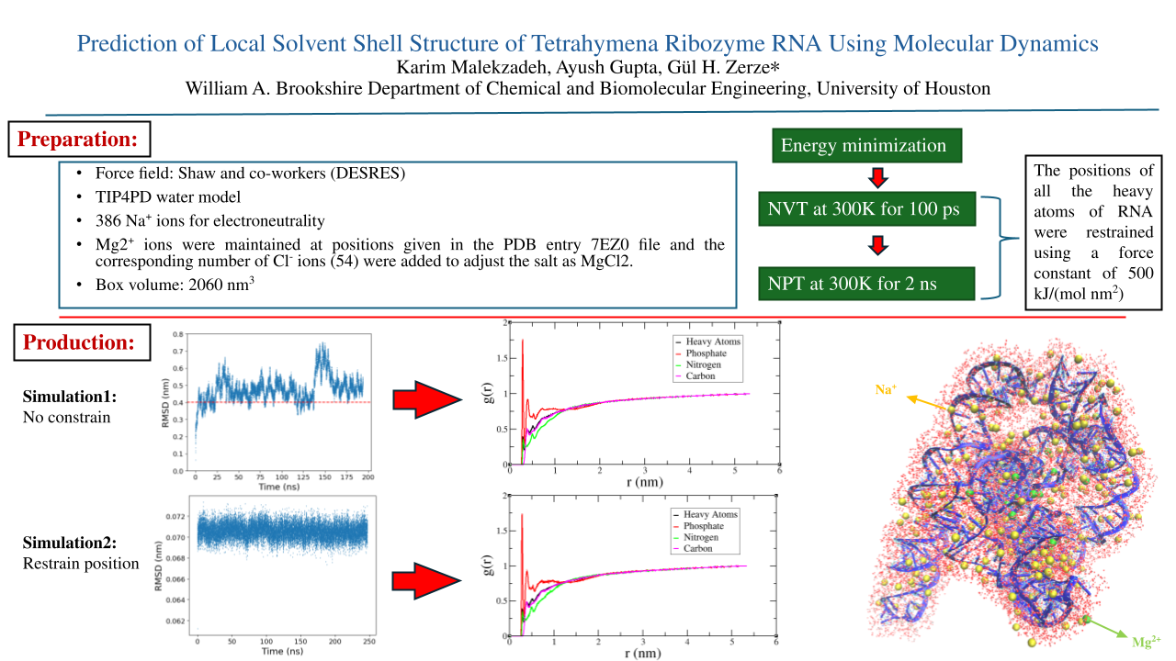

Slide 6
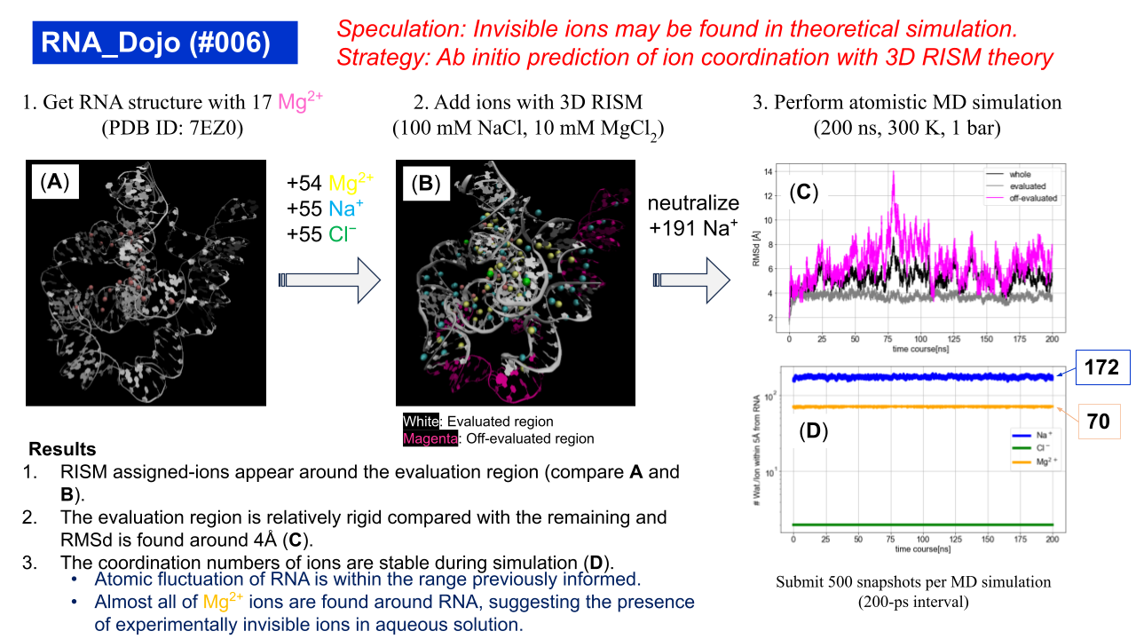

Slide 7
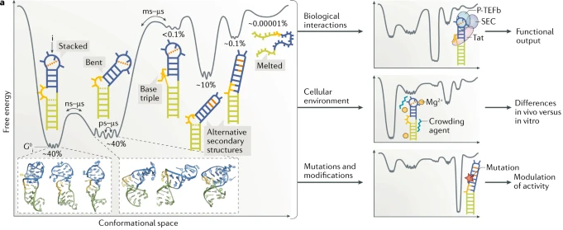
RNA solvation discussion
Relevance: Why would improving solvation prediction help your research?
Data: Is comparison to cryo-EM maps something you are/will be something you use to benchmark your methods? What about particle stacks, other data? What are advantages and disadvantages about this?
Are cryo-EM “cryo-ensembles” enough? Would multiple data sources improve feedback gained from evaluation?
Beyond density: Is solute/solvent identity prediction labels/evaluation of interest?
Ganser et al . 2019

Slide 8
CASP16 - Ensemble and disorder discussion
December 4 2024
(After coffee)

Slide 9
Ensemble discussion session 2 questions
How can blind prediction challenges address rugged landscape with multiple stable structure, which is particularly prevalent, but not unique to, RNA?
For foreseeable future, we will always compare to some experimental data, which defines what ground-truth is. What information is needed about the experiment for predictors to understand “ground-truth”?
What are the advantages and disadvantages to comparing to multiple orthogonal sources of “ground-truth” in (self-)assessment?
What sources of information (experimental ground-truth and prediction labels) are unutilized for improving ensemble prediction?
How can we foster closer collaboration between experimentalists and computationalists to move blind prediction challenged forward?
From an ensemble how can we identify the biological relevant states? Must this be done in two steps (1. Predict full ensemble 2. Identify functional states) or should we aim for end-to-end?

Slide 10
Questions for the Community - SAXS
Do CASP-rankings to cryoEM and crystal structures ground truths bias algorithms against solution conformations?
How can conformational space be fully explored (as opposed to only being along a trajectory), while also being able to remove states that could not occur. Is there a component of kinetics and not just equilibrium in allowed range of conformations.

