Slide 1
CASP16 SIGs
3 December 2024
AI SIG - Arne Elofsson, arne@bioinfo.se
Ensemble SIG - Guy Moneloni, montelionelab@rpi.edu
Nucleic acid SIG - Rachael Kretsch, rkretsch@stanford.edu

Slide 2
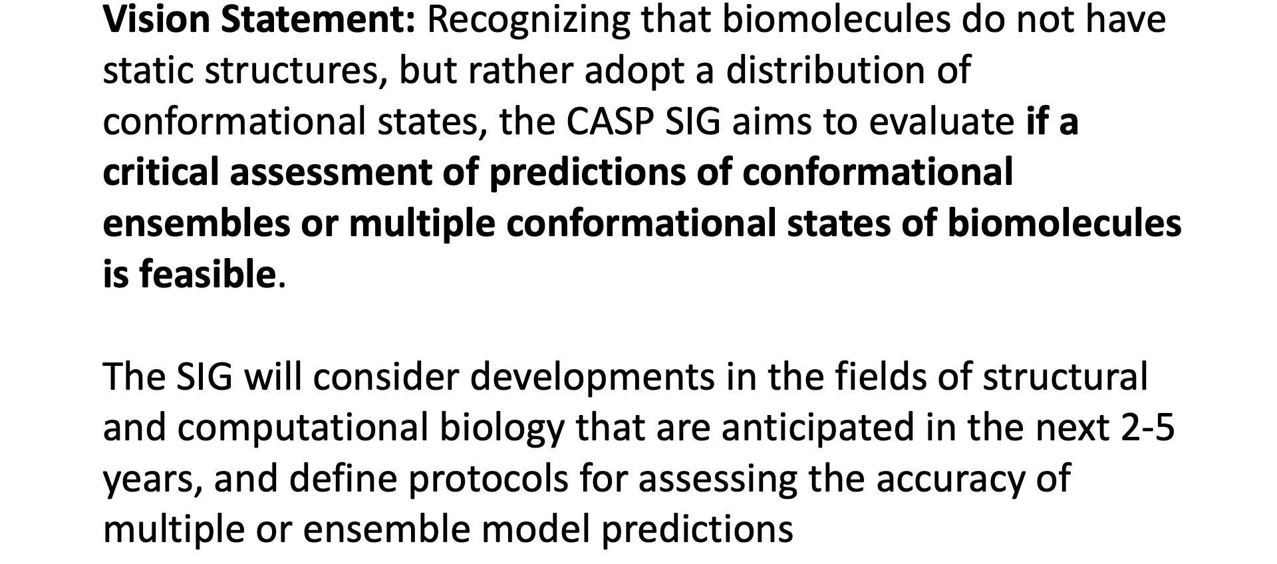
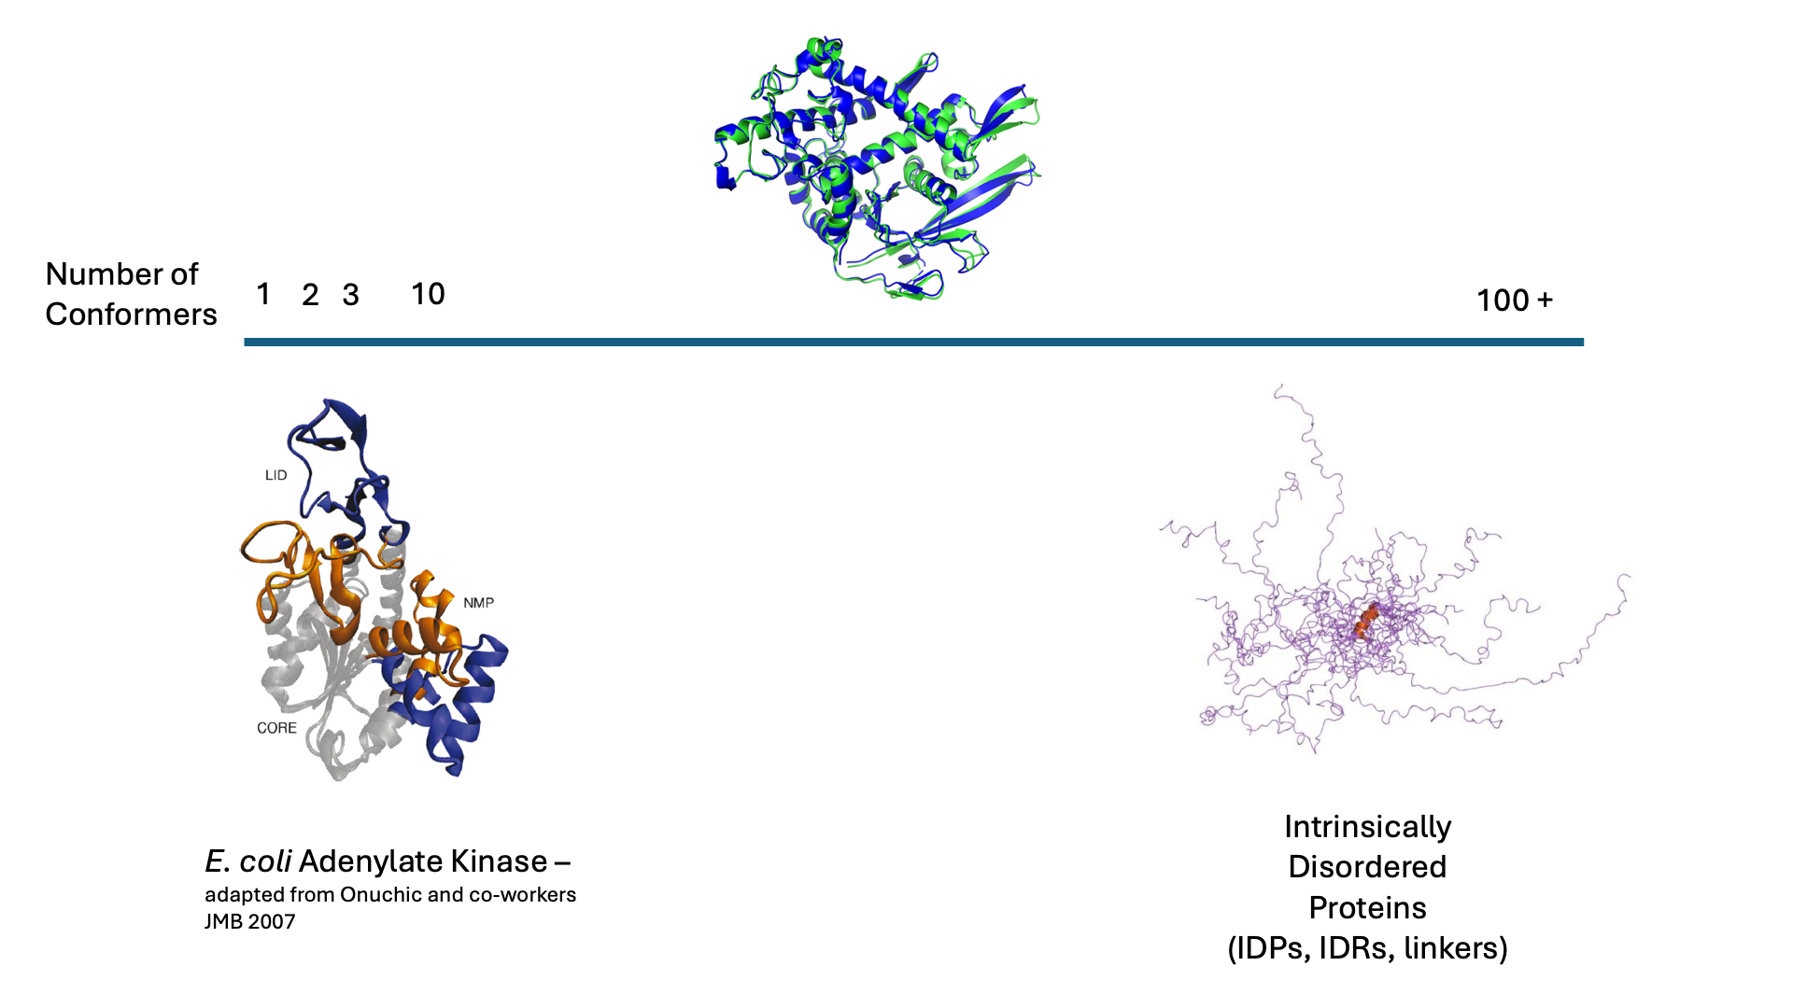
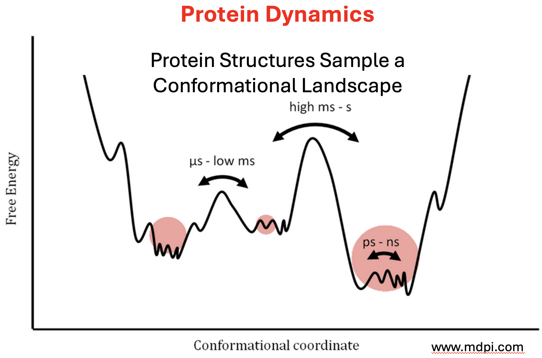
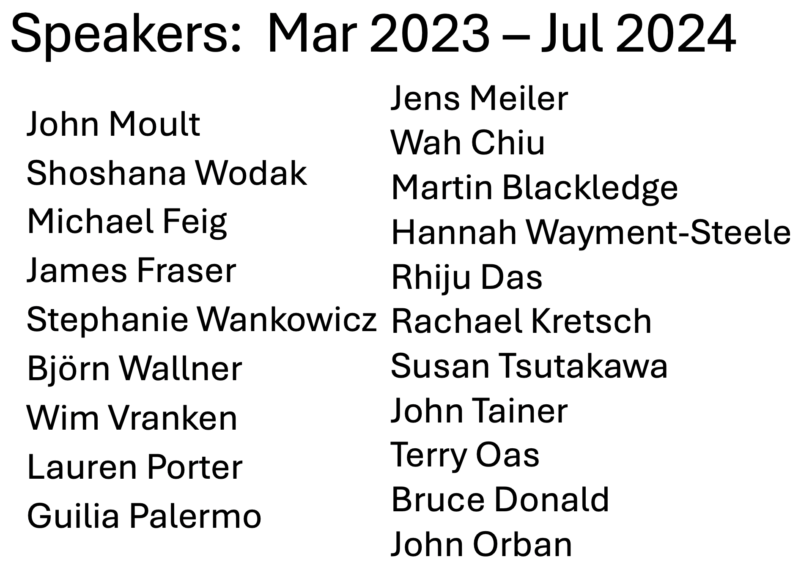
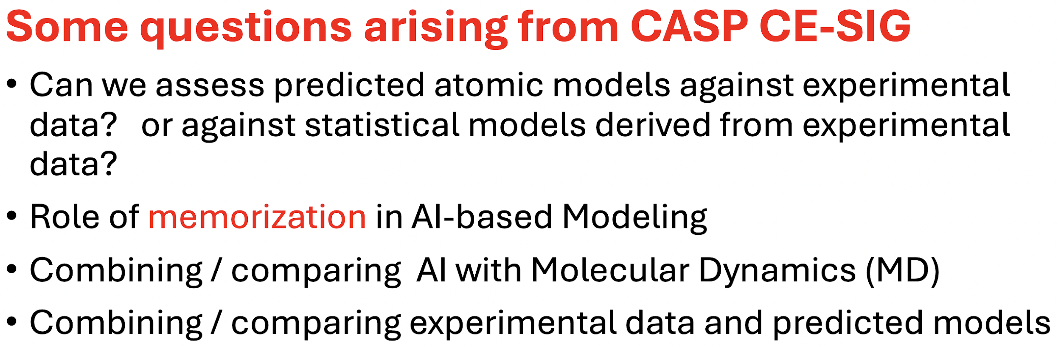
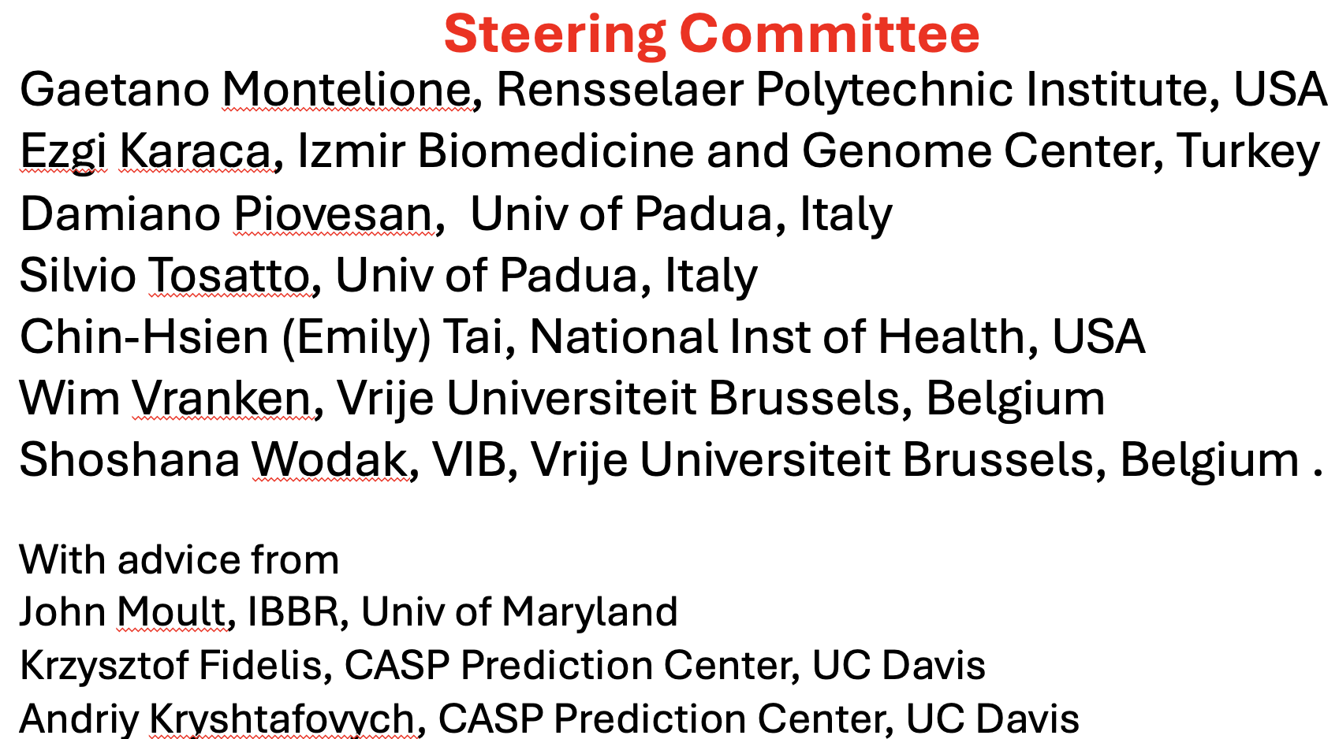
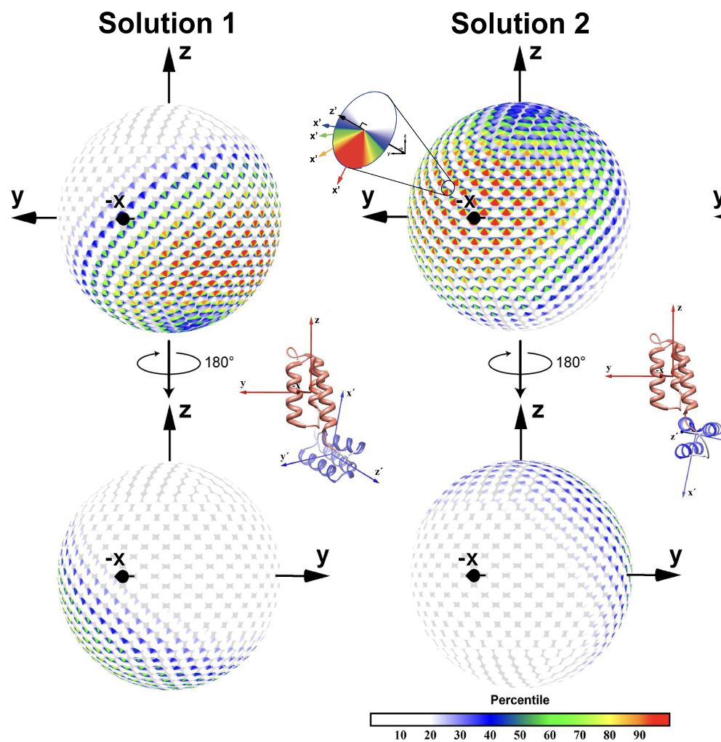
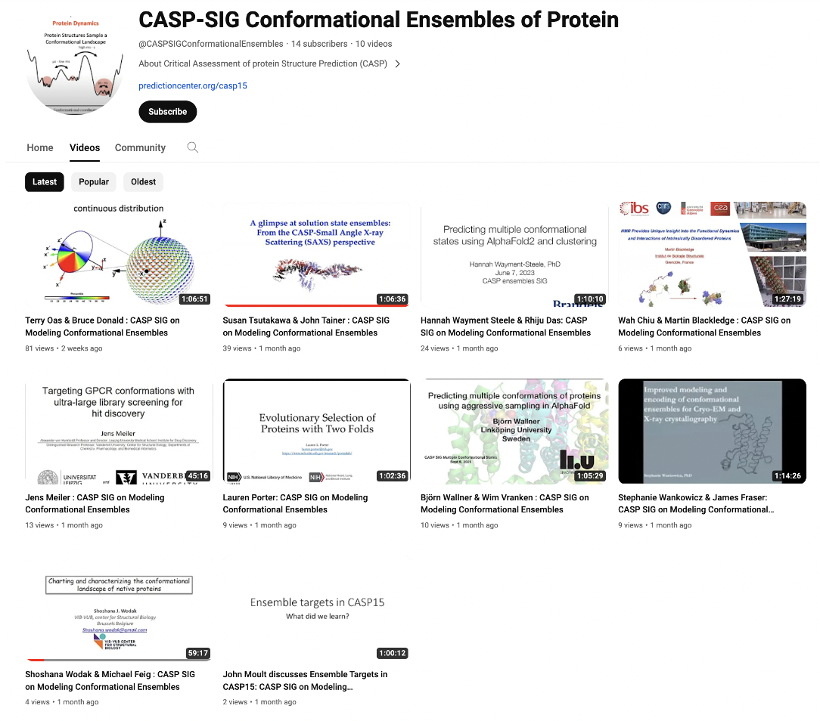
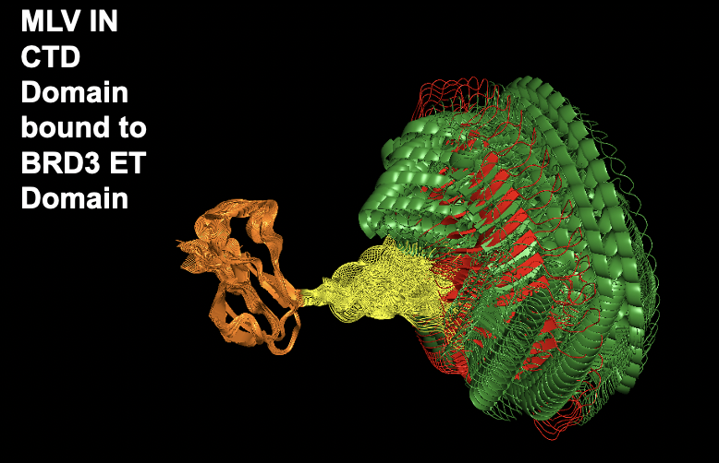
CASP SIG on Ensembles of Conformations
Bruce Donald
Terry Oas
Susan Tsutakawa
T1200 / T1300

Slide 3
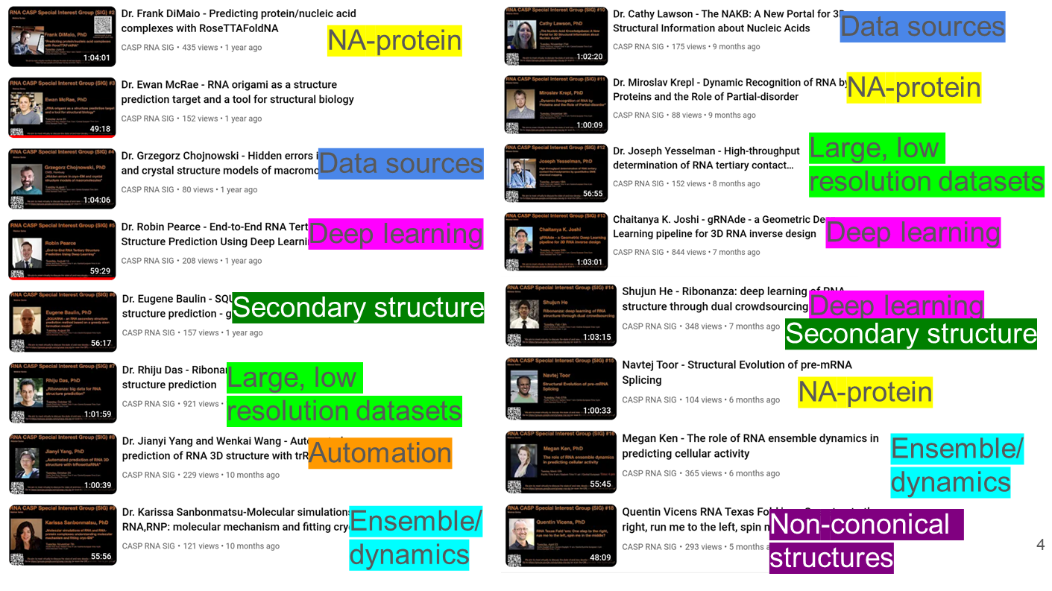
Nucleic Acid SIG - Rachael Kretsch and Marcin Magnus: rkretsch@stanford.edu
The Nucleic Acid Special Interest Group (NA-SIG) is a group of nucleic acid enthusiasts united by the common goal of producing predictive algorithms for nucleic acid 3D structure prediction. We aim to meet virtually regularly to discuss the state of new developments in our community, fostering an active discussion bringing together the diverse expertise necessary to tackle this problem.
Community members include those conducting research towards this goal including but not limited to
obtaining experimental data
building train and test sets
obtaining RNA sequence alignments
predicting RNA secondary structure
predicting RNA 3D structure
  contact prediction
  fragment assembly
  molecular dynamics
  structure scoring
  eeep learning
predicting ligand interactions
predicting protein interactions
predicting ensembles
Took break for CASP season
  Has been missed!
Bikweekly Thurs 8am PST
Looking for speakers for Jan onwards
Looking for new leadership as I graduate!
https://groups.google.com/g/casp-rna-sig and click "Ask to join group"

Slide 4
AI-sig https://casp.bioinfo.se/
  Jan 11: Discussion meeting
  Feb 8: Niccolò Zanichelli Video
  Mar 8: Björn Wallner and Peter Fredolino Video
  Apr 12: Tommi Jaakola
  May 10: Nazim Bouatta Video
  Jun 14: Minkyung Baek Video
  Jul 12 (14:00): Martin Steinegger
  Sep 13:(16:00): Mafalda Dias and Jonathan Frazer "Increasing diagnostic yield of patient sequencing with proteome-scale probabilistic modeling"Video
  Nov 8: Kevin Yang, Microsoft "Protein generation with evolutionary diffusion" Video
  Dec 13: Discussion Session Video
  Jan 10:Philip M. Kim, "Machine learning methods for de novo protein and peptide design" Video
  Feb 14: Frank DiMaio, "Generalized Biomolecular Modeling and Design with RoseTTAFold All-Atom" Video
  Mar 13: Sergey Ovchinnikov and Patrick Bryant "Modifying inputs to AF by examining the output" Video
  Apr 10:Janani Durairaj: "Protein-ligand complex prediction: Are we there yet" Video
  May 8: Kresten Lindorff-Larsen "Conformational ensembles of the huiman intrinsically disordered proteome." Video
  Jun 12: Cecilia Clementi. "Machine learning for potentials"Video
  Sep 10: Debbie Marks
  Nov 12:Michael Feig
Goal Discuss and present AI-structure related work
Started Jan 2023
  Monthly meetings Second Wed 17:00 Sweden.
Participation in beginning ~100 people now ~50
Positive aspects
  Good speakers
  Good attandence (at start)
Negative aspects
  Somehow turned into just another seminarieseries
  Limited feedback from participant / Leaders
  Difficult to find a time for Asia/US/Europe
Looking for new (co-)leaders
Looking for speakers
Looking for new initiatives.

Slide 5
Special Interest Groups Discussion
What aspects of the SIG have you found most valuable?
Are there topics/themes/perspectives you would like to see more of in the future?
Are there additional “special interests” not represented in the current SIGs?
Currently all SIGs are mostly seminar + Q&A based, are there other formats that could serve the community in the CASP-”break”?

