Slide 1


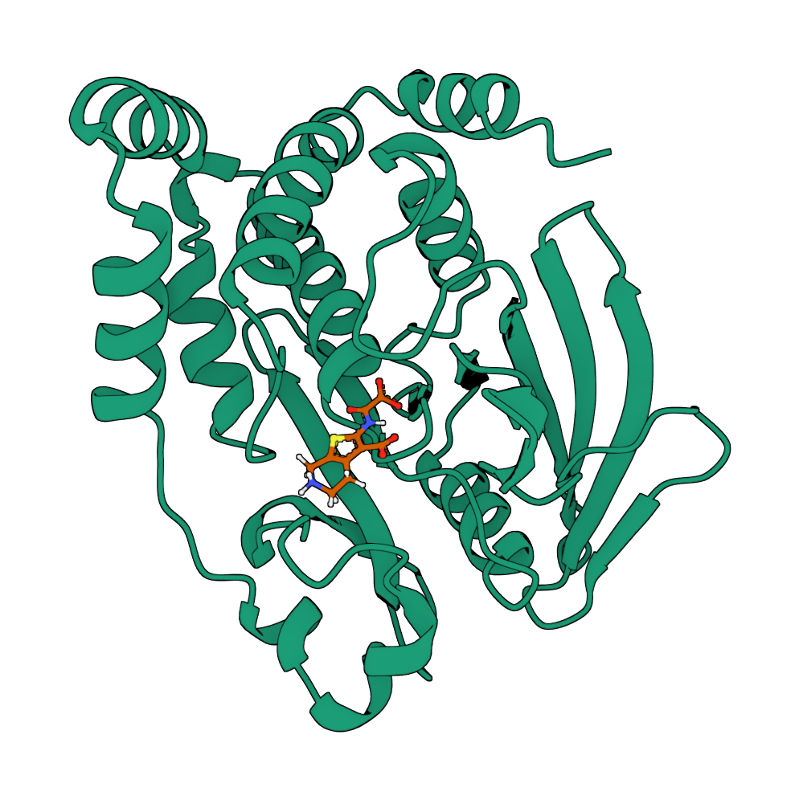
PoseBench & FlowDock
Deep Learning Docking Ensembling
& Generative Affinity Estimation
Alex Morehead
CASP16, December 3rd, 2024
Group ID: MULTICOM_ligand, LG207

Slide 2
Taxonomy of Methods for Protein-Ligand Modeling
Structure Prediction (e.g., AlphaFold 3, DiffDock-L, NeuralPLexer)
Affinity Prediction
(e.g., DeepAffinity, DeepDTA,
AutoDock Vina)
Hybrid
(e.g., DynamicBind,
FlowDock)
In this work, we posit that hybrid methods are best able to estimate binding affinities

Slide 3
Protein-Ligand Structure Prediction

Slide 4
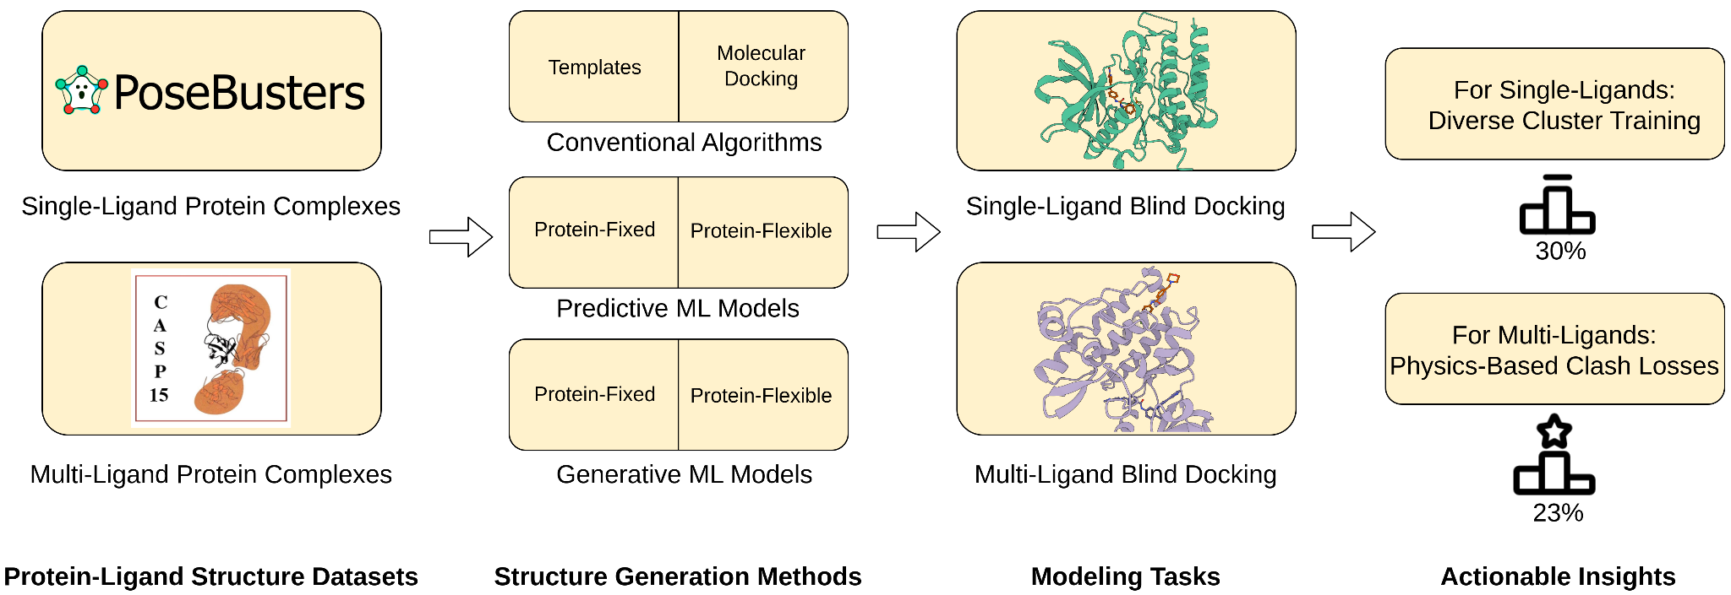
Ensembling Deep Learning Models for Docking
Deploying a deep learning (DL) ensemble for protein-ligand structure prediction based on our benchmark PoseBench
[1] A. Morehead. "Deep Learning for Protein-Ligand Docking: Are We There Yet?" ICML 2024 AI4Science.

Slide 5
Key Ideas
DL models are good at identifying common binding sites
Accurate pose predictions from DL models should be structurally similar to each other - the models should agree
Accurate poses must satisfy chemical sanity checks and avoid steric clashes

Slide 6
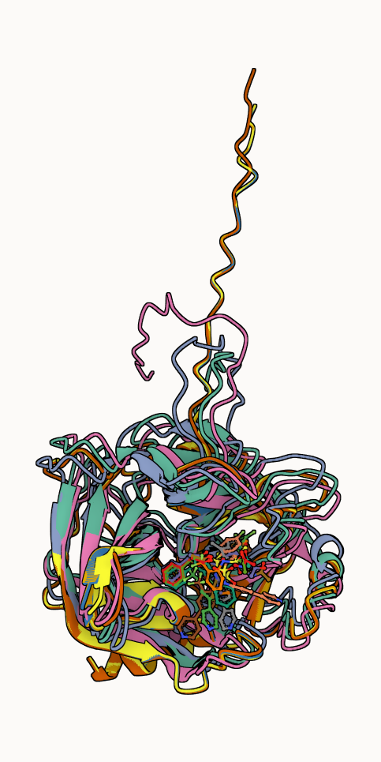
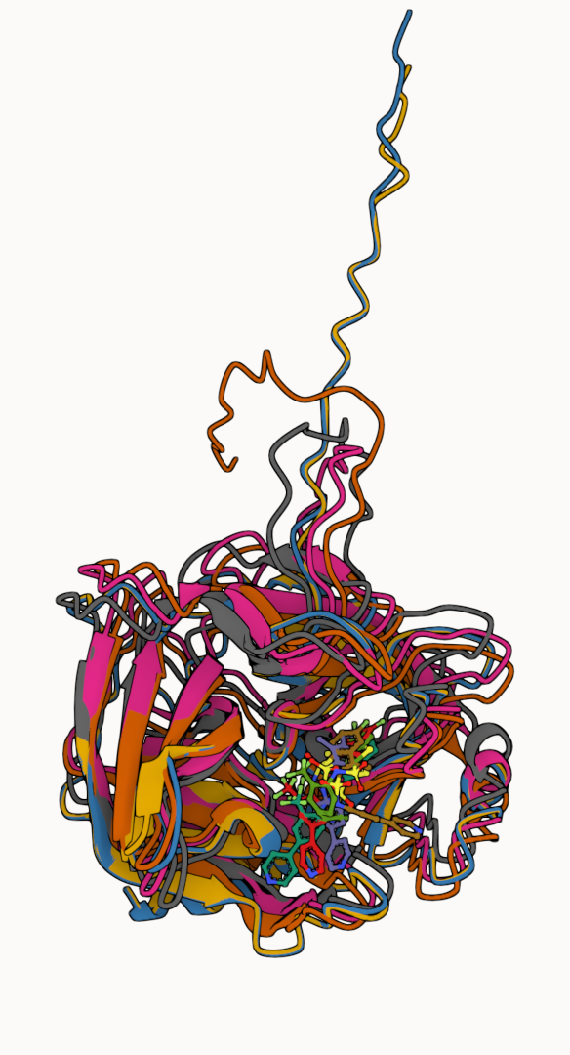
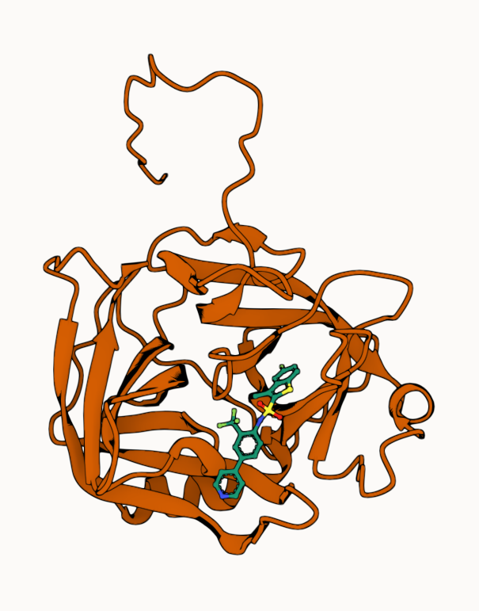
Structure Prediction Procedure (e.g., L1003)
1. Generate 100+
DL poses
2. Subset to top-5
per method
3. Select the pose with minimum pairwise RMSD

Slide 7
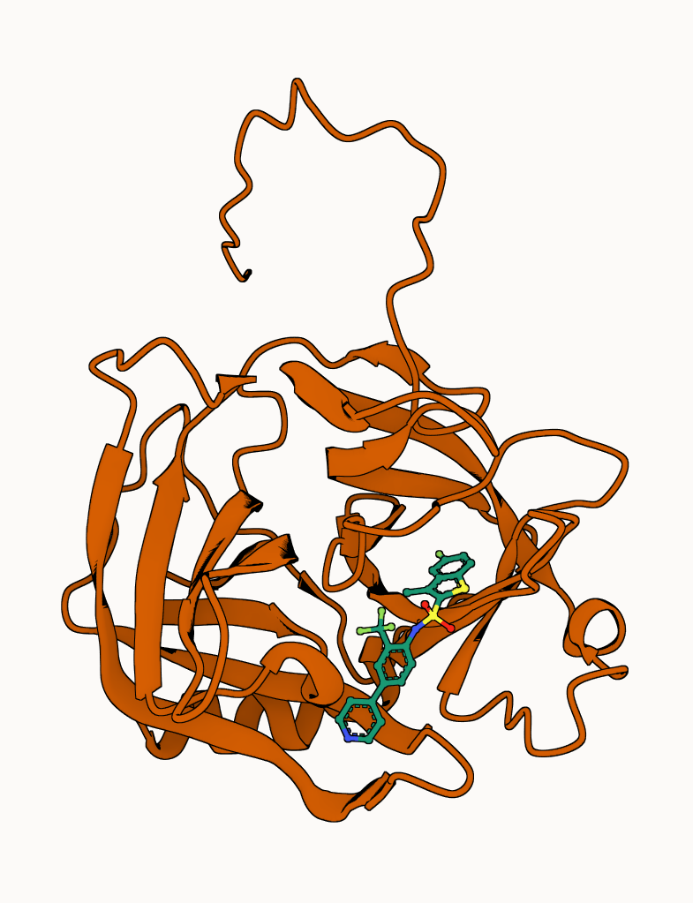
Structure Prediction Procedure (e.g., L1003)
4. Run PoseBusters chemical sanity checks
5. If failing any checks, try relaxing ligand in pocket
[2] M. Buttenschoen. "PoseBusters: AI-based docking methods fail to generate physically valid poses or generalise to novel sequences". Chemical Science 2024.

Slide 8
Protein-Ligand Affinity Estimation

Slide 9
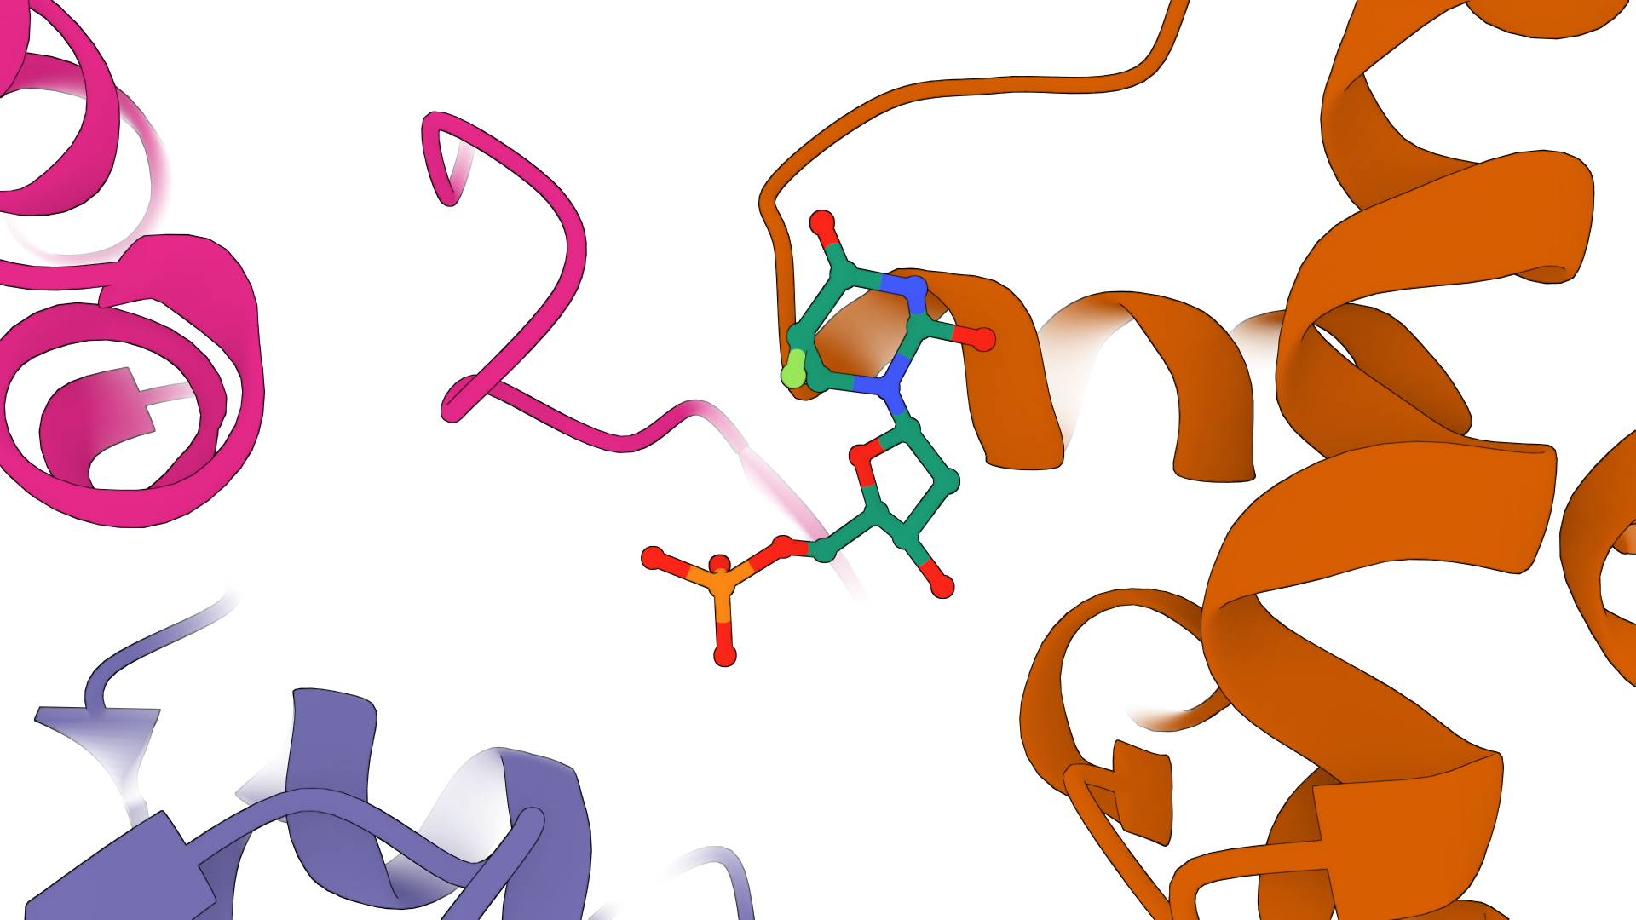
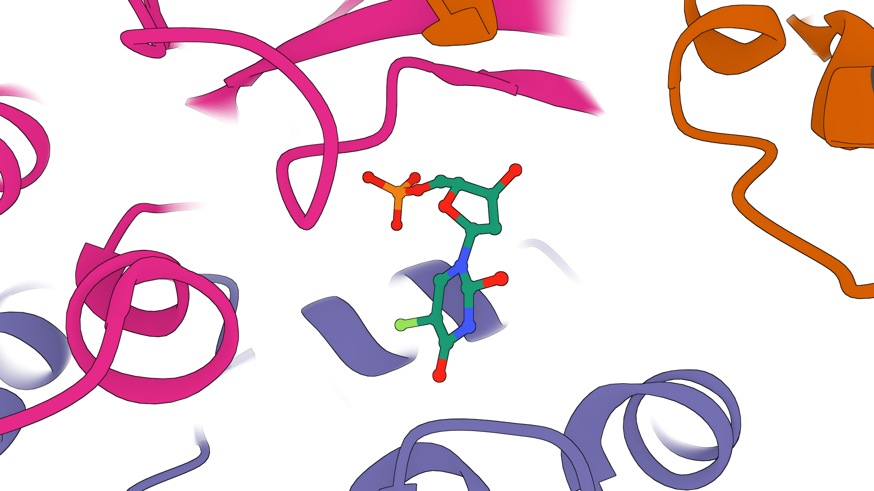
Generative Models Capture Molecular Details
DiffDock-L (Corso et al. 2024)
NeuralPLexer (Qiao et al. 2024)
In the past two years, deep generative models have demonstrated the ability to produce realistic protein-binding conformations of ligand molecules
[3] G. Corso. "Deep confident steps to new pockets: Strategies for docking generalization." ICLR 2024. [4] Z. Qiao. "State-specific protein–ligand complex structure prediction with a multiscale deep generative." Nature MI 2024.

Slide 10
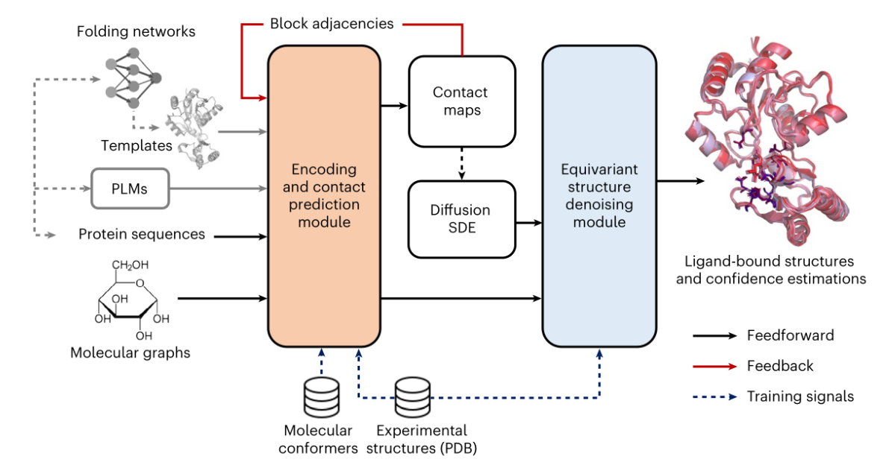
Do Generative Models Learn Meaningful Features?
NeuralPLexer (Qiao et al. 2024)
Key Insight: Generative structure prediction models, when pre-trained on large datasets of biomolecules, learn meaningful features that are readily adapted for binding affinity estimation
[4] Z. Qiao. "State-specific protein–ligand complex structure prediction with a multiscale deep generative." Nature MI 2024.

Slide 11
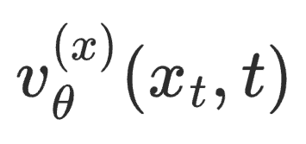
But What about Docking State Transitions?
→ Flow Matching in 3D
noise
target
We fine-tune NeuralPLexer as
our denoiser v_{θ}
The denoiser v_{θ} predicts
3D coordinate updates
x₁
x₀
3D Coordinates
t=0
t = 1
[5] Chen, Ricky TQ, and Yaron Lipman. "Flow matching on general geometries." ICLR 2024. [6] Jing, Bowen, et al. "AlphaFold Meets Flow Matching for Generating Protein Ensembles." ICML 2024.

Slide 12

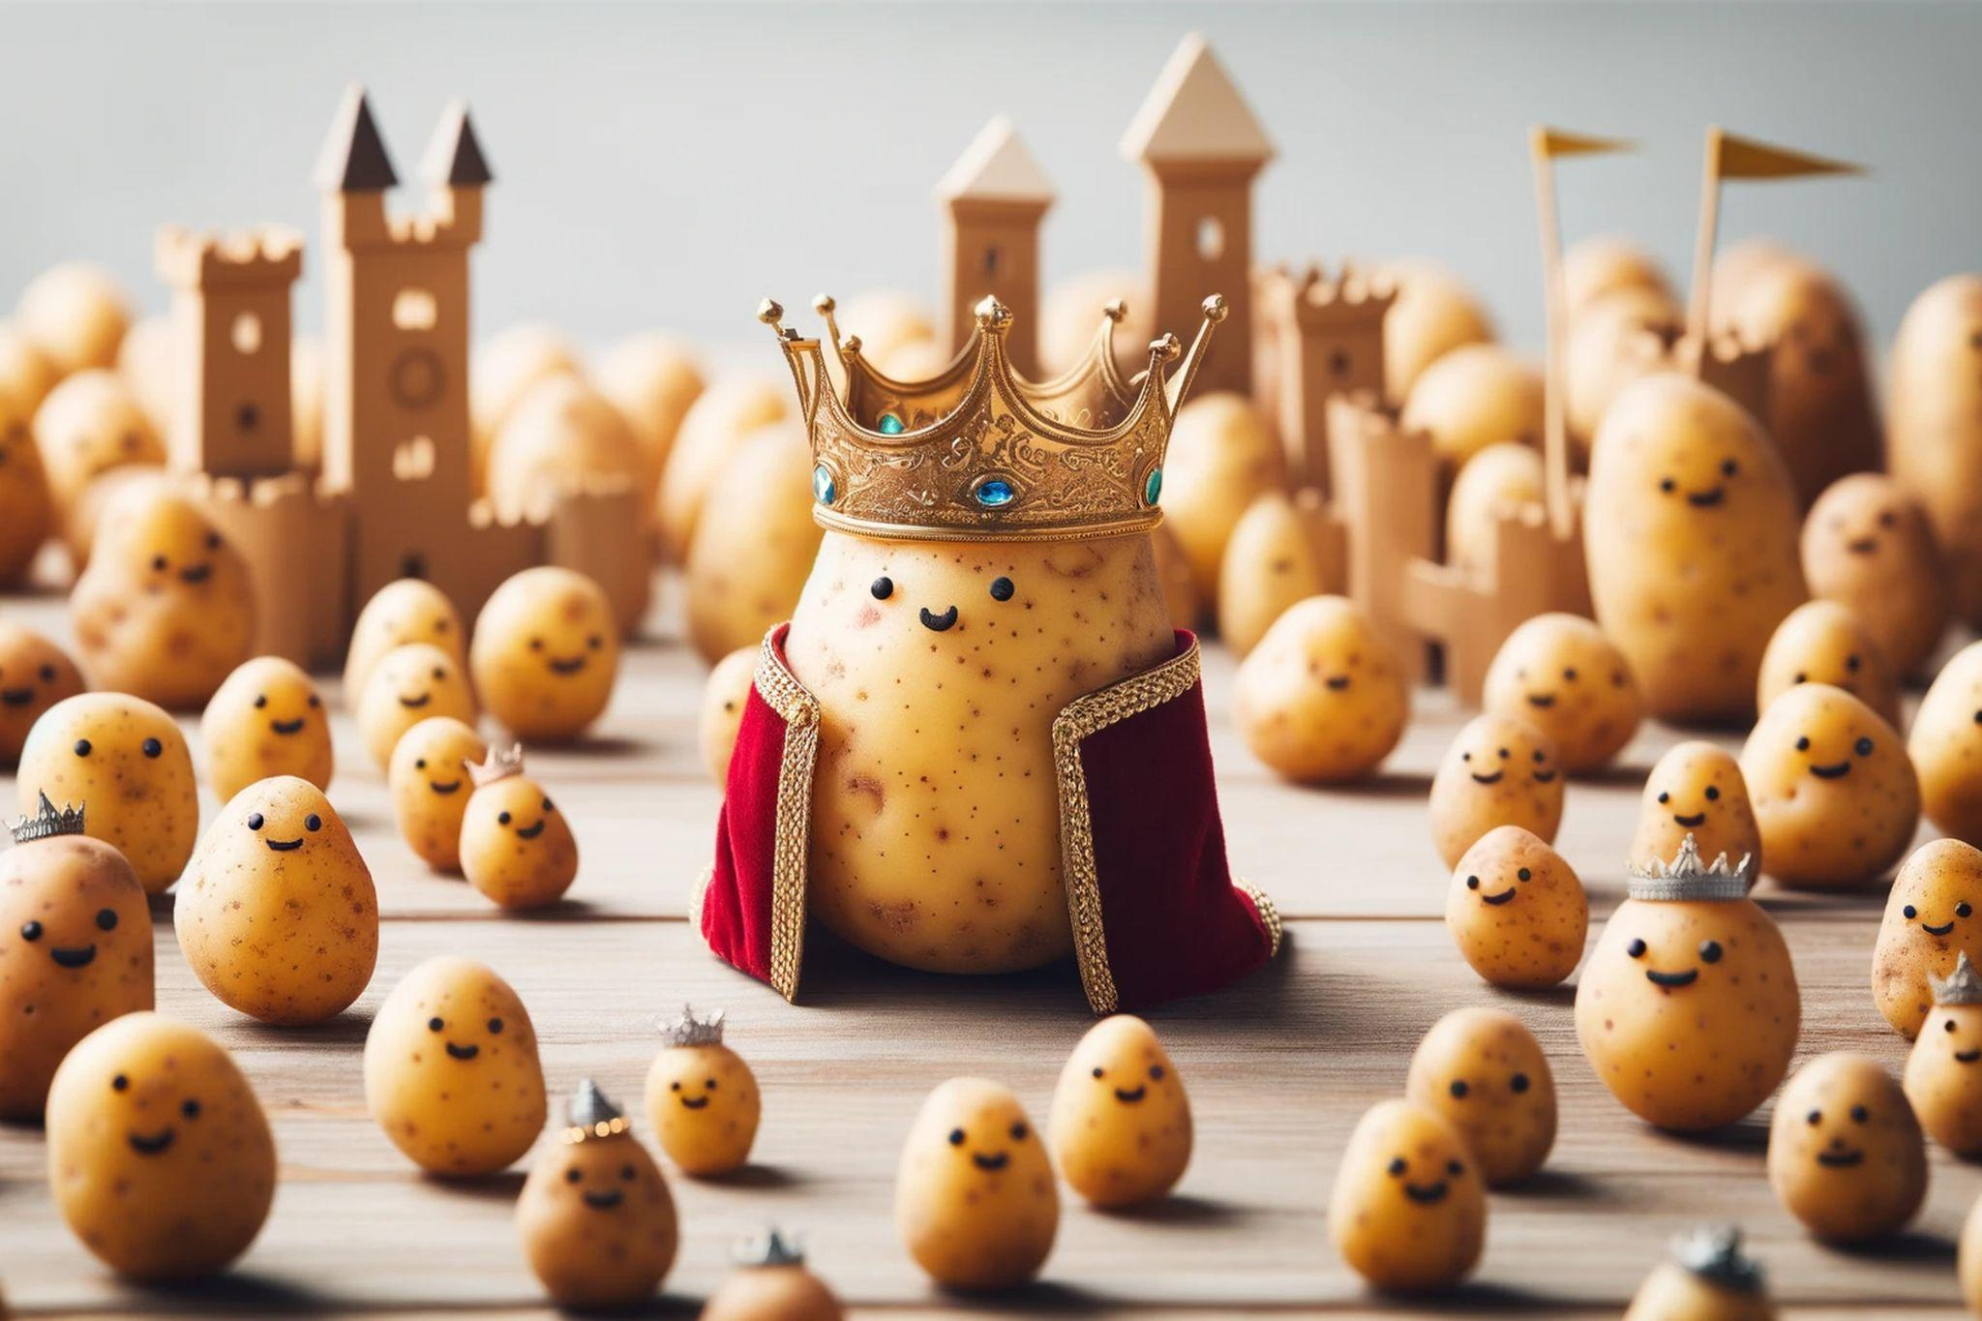
Another Angle on Flow Matching
Gaussian flow matching → a kingdom of potatoes?
[7] T. Fjelde. "An introduction to flow matching.” Cambridge University Engineering Blog. [8] P. Esser. "Scaling Rectified Flow Transformers for High-Resolution Image Synthesis." ICML 2024.

Slide 13
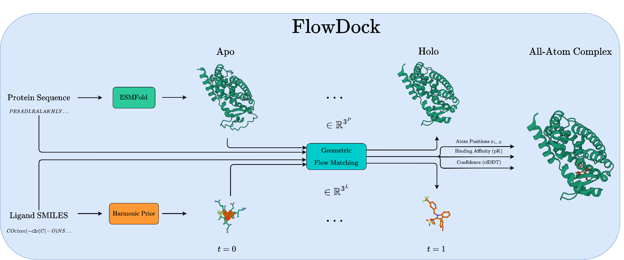
Binding Affinity Estimation Pipeline for CASP16
→ FlowDock
FlowDock fine-tunes NeuralPLexer with harmonic flow matching and a new affinity prediction head using PDBBind 2020
For CASP16, we simply convert FlowDock’s predicted binding affinities into nanomoles (nM), with multi-ligand affinities natively supported

Slide 14
FlowDock Visualizations

Slide 15
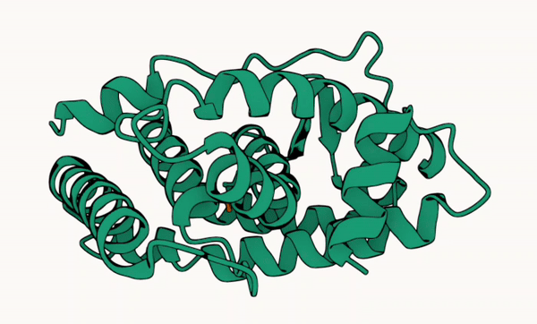
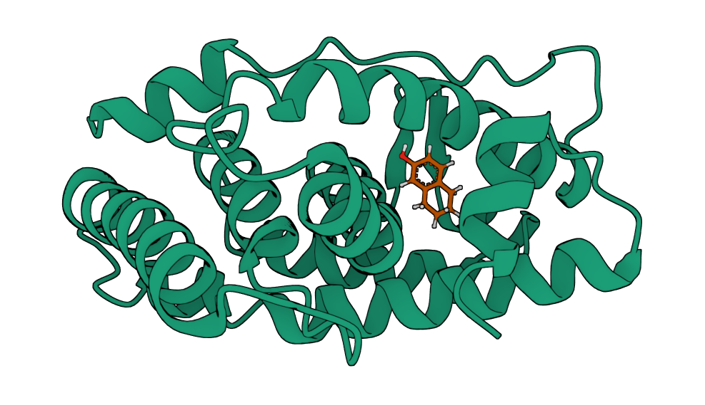
Accurate Sampling Trajectories
Generated Structure of 6I67
(Predicted Affinity: 6.05)
Crystal Structure of 6I67
(True Affinity 6.70)
Flow matching enables flexible docking via deep learning

Slide 16
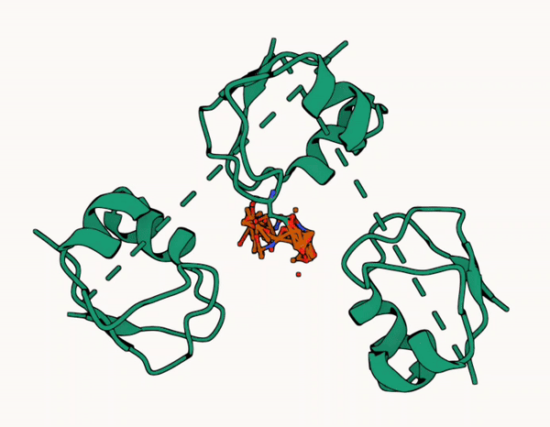
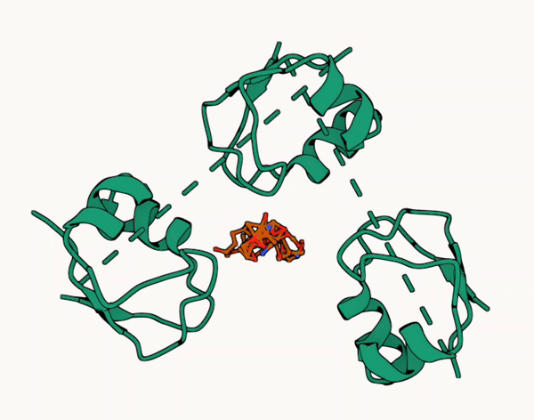
Diverse Sampling Trajectories
Generated Structure 1
of CASP15’s T1152
Generated Structure 2
of CASP15’s T1152
Flow matching enables flexible (multi-)docking via deep learning

Slide 17
In-House Results

Slide 18
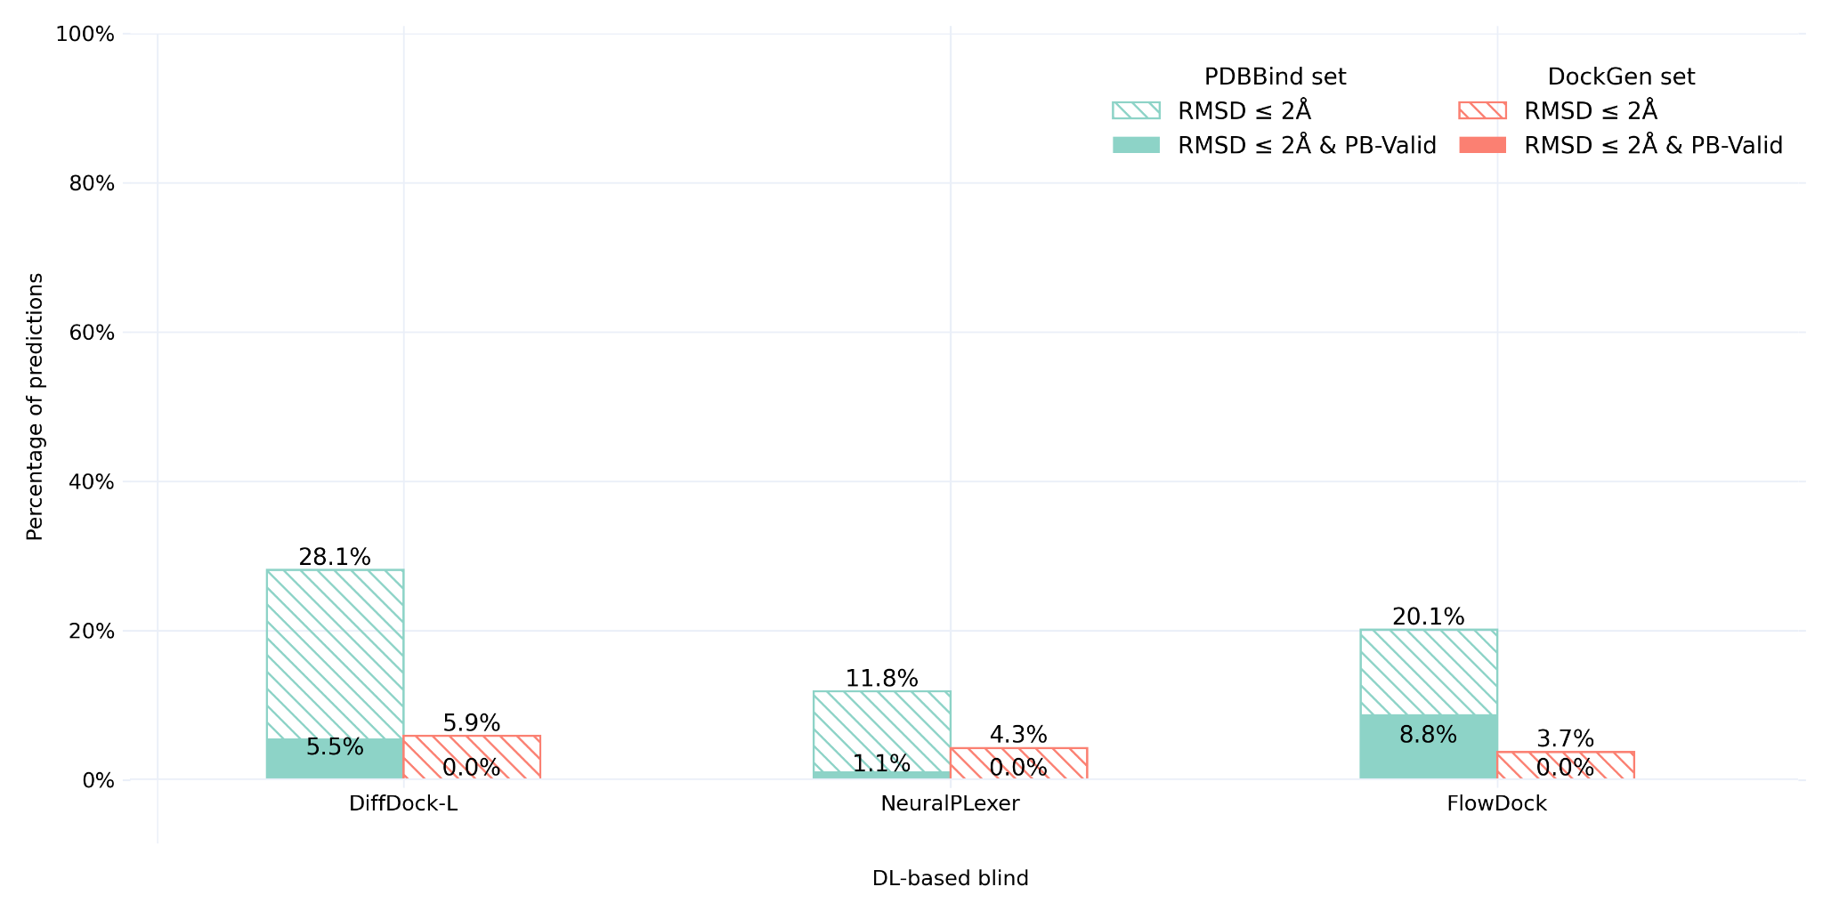
Docking Performance of FlowDock
FlowDock achieves an 8x improvement in PDBBind molecular docking accuracy and structural validity compared to the base NeuralPLexer model

Slide 19
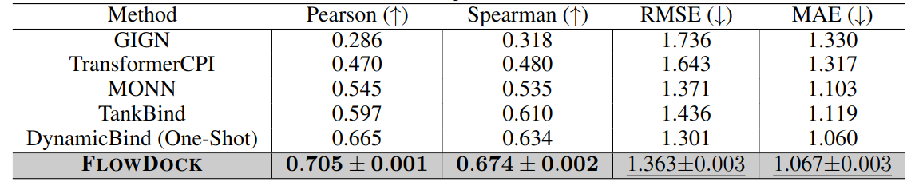
In-House Affinity Precision of FlowDock
FlowDock can jointly produce well-correlated and accurate affinity predictions

Slide 20
CASP16 Affinity Results (Stage 1)

Slide 21
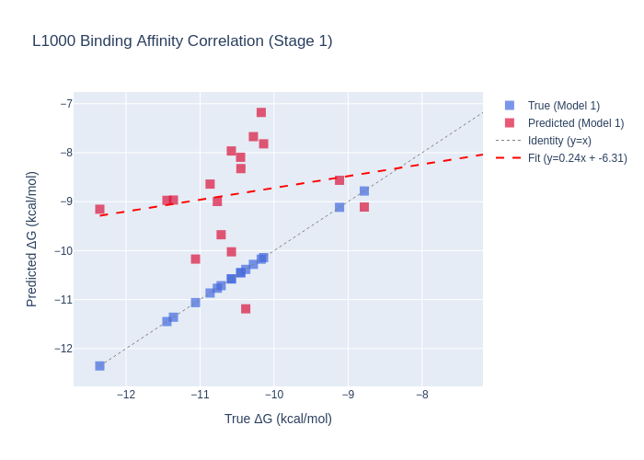
Affinity Correlation of FlowDock
We find FlowDock has a modest ~0.2 Pearson’s correlation for L1000 in Stage 1

Slide 22
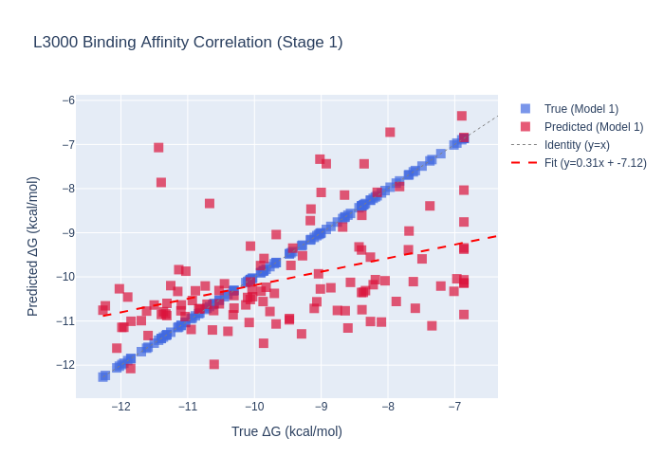
Affinity Correlation of FlowDock
For L3000 in Stage 1, the model yields a moderate ~0.42 Pearson’s correlation

Slide 23
Per-Target Affinity Metrics of FlowDock
Target | RMSE | Pearson's R | MAE | Median AE | Heavy Atom Correlation | Bond Correlation | Molecules
L1000 | 2.0512 | 0.1947 | 1.8388 | 2.2240 | -0.74 | -0.74 | 17
L3000 | 1.5798 | 0.4175 | 1.2189 | 0.8897 | -0.46 | -0.47 | 123
With only predicted structures available, L1000 proves to be challenging

Slide 24
Per-Model Affinity Metrics of FlowDock
Target | Model ID | RMSE | Pearson's R | MAE | Median AE | Heavy Atom Correlation | Bond Correlation | Molecules
L1000 | 1 | 2.0512 | 0.1947 | 1.8388 | 2.2240 | -0.71 | -0.7 | 17
L3000 | 1 | 1.5798 | 0.4175 | 1.2189 | 0.8897 | -0.48 | -0.49 | 123
L1000 | 2 | 2.0217 | 0.1420 | 1.6796 | 1.4632 | -0.75 | -0.73 | 17
L3000 | 2 | 1.6534 | 0.3863 | 1.3208 | 1.0266 | -0.47 | -0.48 | 123
L1000 | 3 | 2.1151 | -0.0882 | 1.7378 | 1.6168 | -0.72 | -0.72 | 17
L3000 | 3 | 1.5631 | 0.4211 | 1.2183 | 0.9579 | -0.48 | -0.49 | 123
L1000 | 4 | 2.2151 | -0.0906 | 1.8651 | 2.2563 | -0.7 | -0.71 | 17
L3000 | 4 | 1.5735 | 0.3971 | 1.2379 | 0.8645 | -0.43 | -0.43 | 123
L1000 | 5 | 2.0374 | 0.1922 | 1.7315 | 1.8495 | -0.84 | -0.85 | 17
L3000 | 5 | 1.5486 | 0.4231 | 1.2427 | 1.0021 | -0.45 | -0.45 | 123

Slide 25
CASP16 Affinity Results (Stage 2)

Slide 26
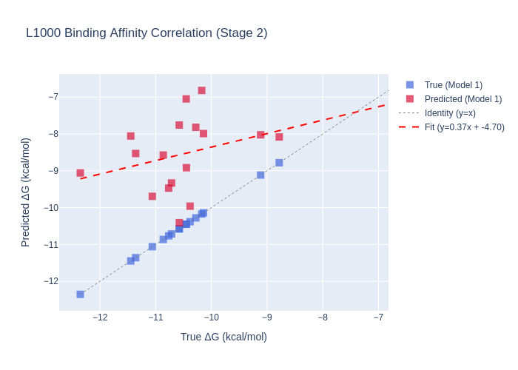
Affinity Correlation of FlowDock
Interestingly, in Stage 2, FlowDock’s L1000 correlation rises to ~0.3!

Slide 27
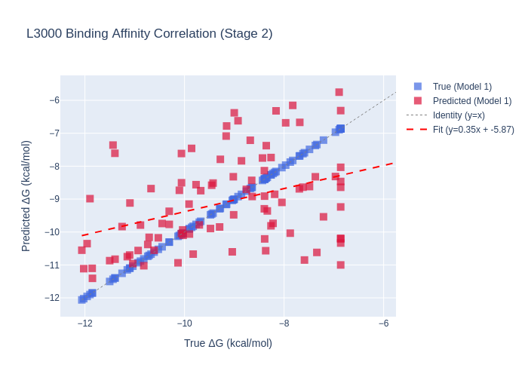
Affinity Correlation of FlowDock
But its L3000 correlation now drops from ~0.42 to ~0.38…
🤔

Slide 28
Per-Target Affinity Metrics of FlowDock
Target | RMSE | Pearson's R | MAE | Median AE | Heavy Atom Correlation | Bond Correlation | Molecules
L1000 | 2.2595 | 0.2995 | 1.9975 | 2.1510 | -0.71 | -0.71 | 17
L3000 | 1.6200 | 0.3861 | 1.2864 | 1.0178 | -0.51 | -0.53 | 93
The availability of crystal structures primarily impacts correlation

Slide 29
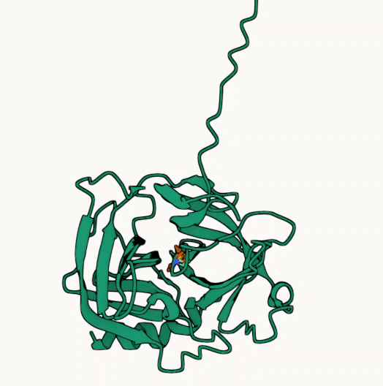
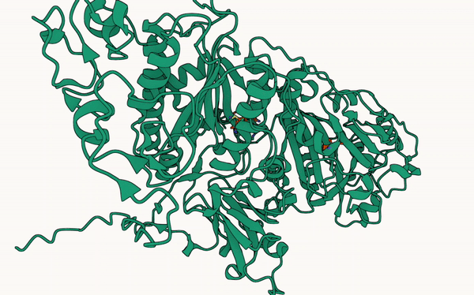
Examples from CASP16
L1003 Affinity AE: 0.01
L3132 Affinity AE: 4.58
In Stage 1, L1003 (L3132) was the best (worst) target for our method

Slide 30
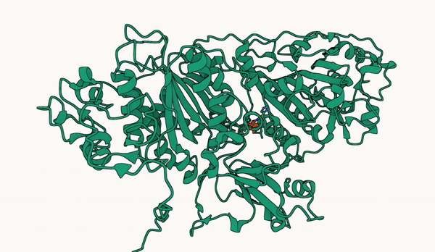
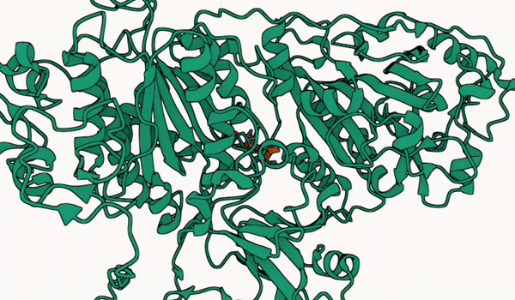
Examples from CASP16
L3158 Affinity AE: 0.02
L3068 Affinity AE: 4.14
In Stage 2, L3158 (L3068) was the best (worst) target for our method

Slide 31
Concluding Thoughts
Deep learning docking ensembles paired with structural consensus ranking performs well out-of-the-box, suggesting that similar top-ranked poses from different DL models are often structurally accurate
Correlation of affinity predictions for some complexes (e.g., L1000) (but not all) improves with more accurate conformational context, though additional targets are needed to verify this observation
Like previous binding affinity predictors, FlowDock’s predictions have a strong inverse relationship with the size of a binding molecule

Slide 32





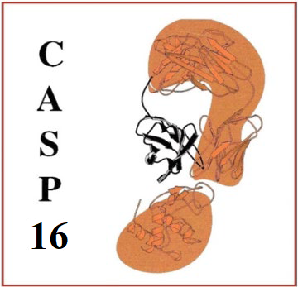



Summary
Thank you!
Nabin Giri
Jian Liu
Pawan Neupane
Jianlin Cheng
FlowDock is sufficiently expressive to jointly model protein-ligand structures and binding affinities. Lack of data diversity in the PDB is probably the biggest limitation.
Explicitly incorporate chemical bonding and inter-atomic potentials into the generation process to improve realism.
Include diverse positive and negative binding examples into the training process to improve affinity prediction.
Code
Benchmark

