Slide 1
Notes:
hello everyone, I’m Ren Kong from Codock group. I’d like to thank the orginizor to give us the opportunity to present here. today I will introduce the strategies and results of our group in ligand binding prediction in CASP16

Slide 2
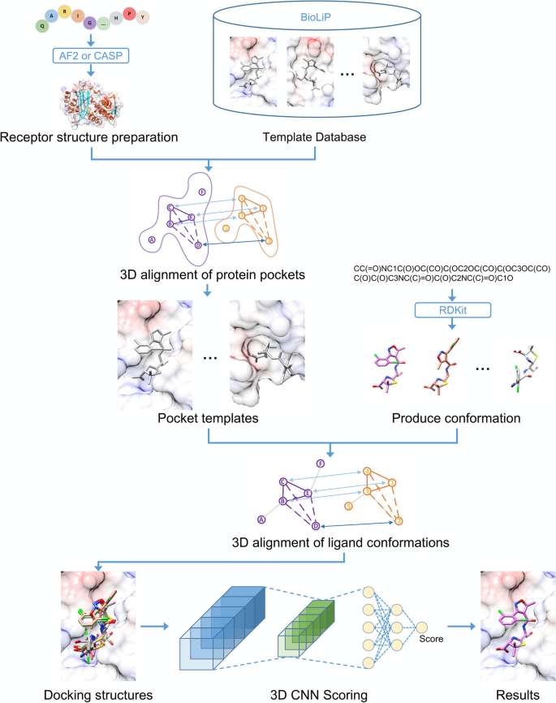
The flow chart of CoDock-Ligand
The comparison between AutoDock-Vina and CoDock-Ligand
 | Vina 1.2.2 （percent%） |  | CoDock-Ligand (percent%)
 | <2Å | <1Å | <2Å | <1Å
Top1 | 62.90 | 47.70 | 83.86 | 76.49
Top3 | 72.44 | 53.36 | 88.07 | 84.56
Top5 | 75.62 | 54.42 | 89.47 | 86.67
Top10 | 81.63 | 55.48 | 90.18 | 87.72
RMSD
Top
CASF-2016 testset：285 protein-ligand systems
Ref: Pang MW, He WQ, Lu XF, She YT, Xie LX, Kong R, Chang S. CoDock-Ligand: combined template-based docking and CNN-based scoring in ligand binding prediction. BMC Bioinformatics. 2023 Nov 23;24(1):444.
Notes:
Previously we have developed a protein-ligand docking program named as Codock-ligand. It used the information of binding pocket similarity and template similarity to guide the ligand docking pose generation, and a 3D CNN score for pose ranking. In the test on benchmark CASF-2016, it shows significant increasement for successful rates for top 1 to top 10 poses. We used both vina and codock-ligand for ligand binding prediction of CASP16.

Slide 3
Targets in ligand section of CASP16
Target ID | Name | Number of ligands | Type of prediction | Binding site information
L1000 | Human chymase | 17 | Pose and Affinity | Known binding site
L2000 | Cathepsin G | 2 | Pose only | Known binding site
L3000 | Autotaxin | 219 | Pose and/or Affinity | Known binding site
L4000 | Main protease of SARS-Cov-2 | 25 | Pose only | Known binding site
L5001v1 | WDR55_apo | 1 | Pose only | Unknown binding site
D1273 | RKEC1 | 1 | Pose only | Unknown binding site
R1261v1 | ZTP riboswitch | 1 | Pose only | Known binding site
R1262v1 | ZTP riboswitch with AICA | 1 | Pose only | Known binding site
R1263v1 | ZTP riboswitch with m-1-pyridinyl AICA | 1 | Pose only | Unknown binding site
R1264v1 | ZTP riboswitch with AICA derivative | 1 | Pose only | Unknown binding site
R1288 | SAMRUI | 1 | Pose only | Unknown binding site
T1214 | Pyrroloquinoline quinone transporter | 1 | Pose only | Known binding site
Notes:
There are totally 11 targets for ligand prediction. L1000-L4000 are pharma targets. They are theraputic targets, with more than one ligands to be predicted for each specific targets. For L3000, there are over 200 ligands to be prediction. However, the binding site are known for these targets. L5001 is protein target with unknown binding site. And there are several RNA/DNA targets.

Slide 4
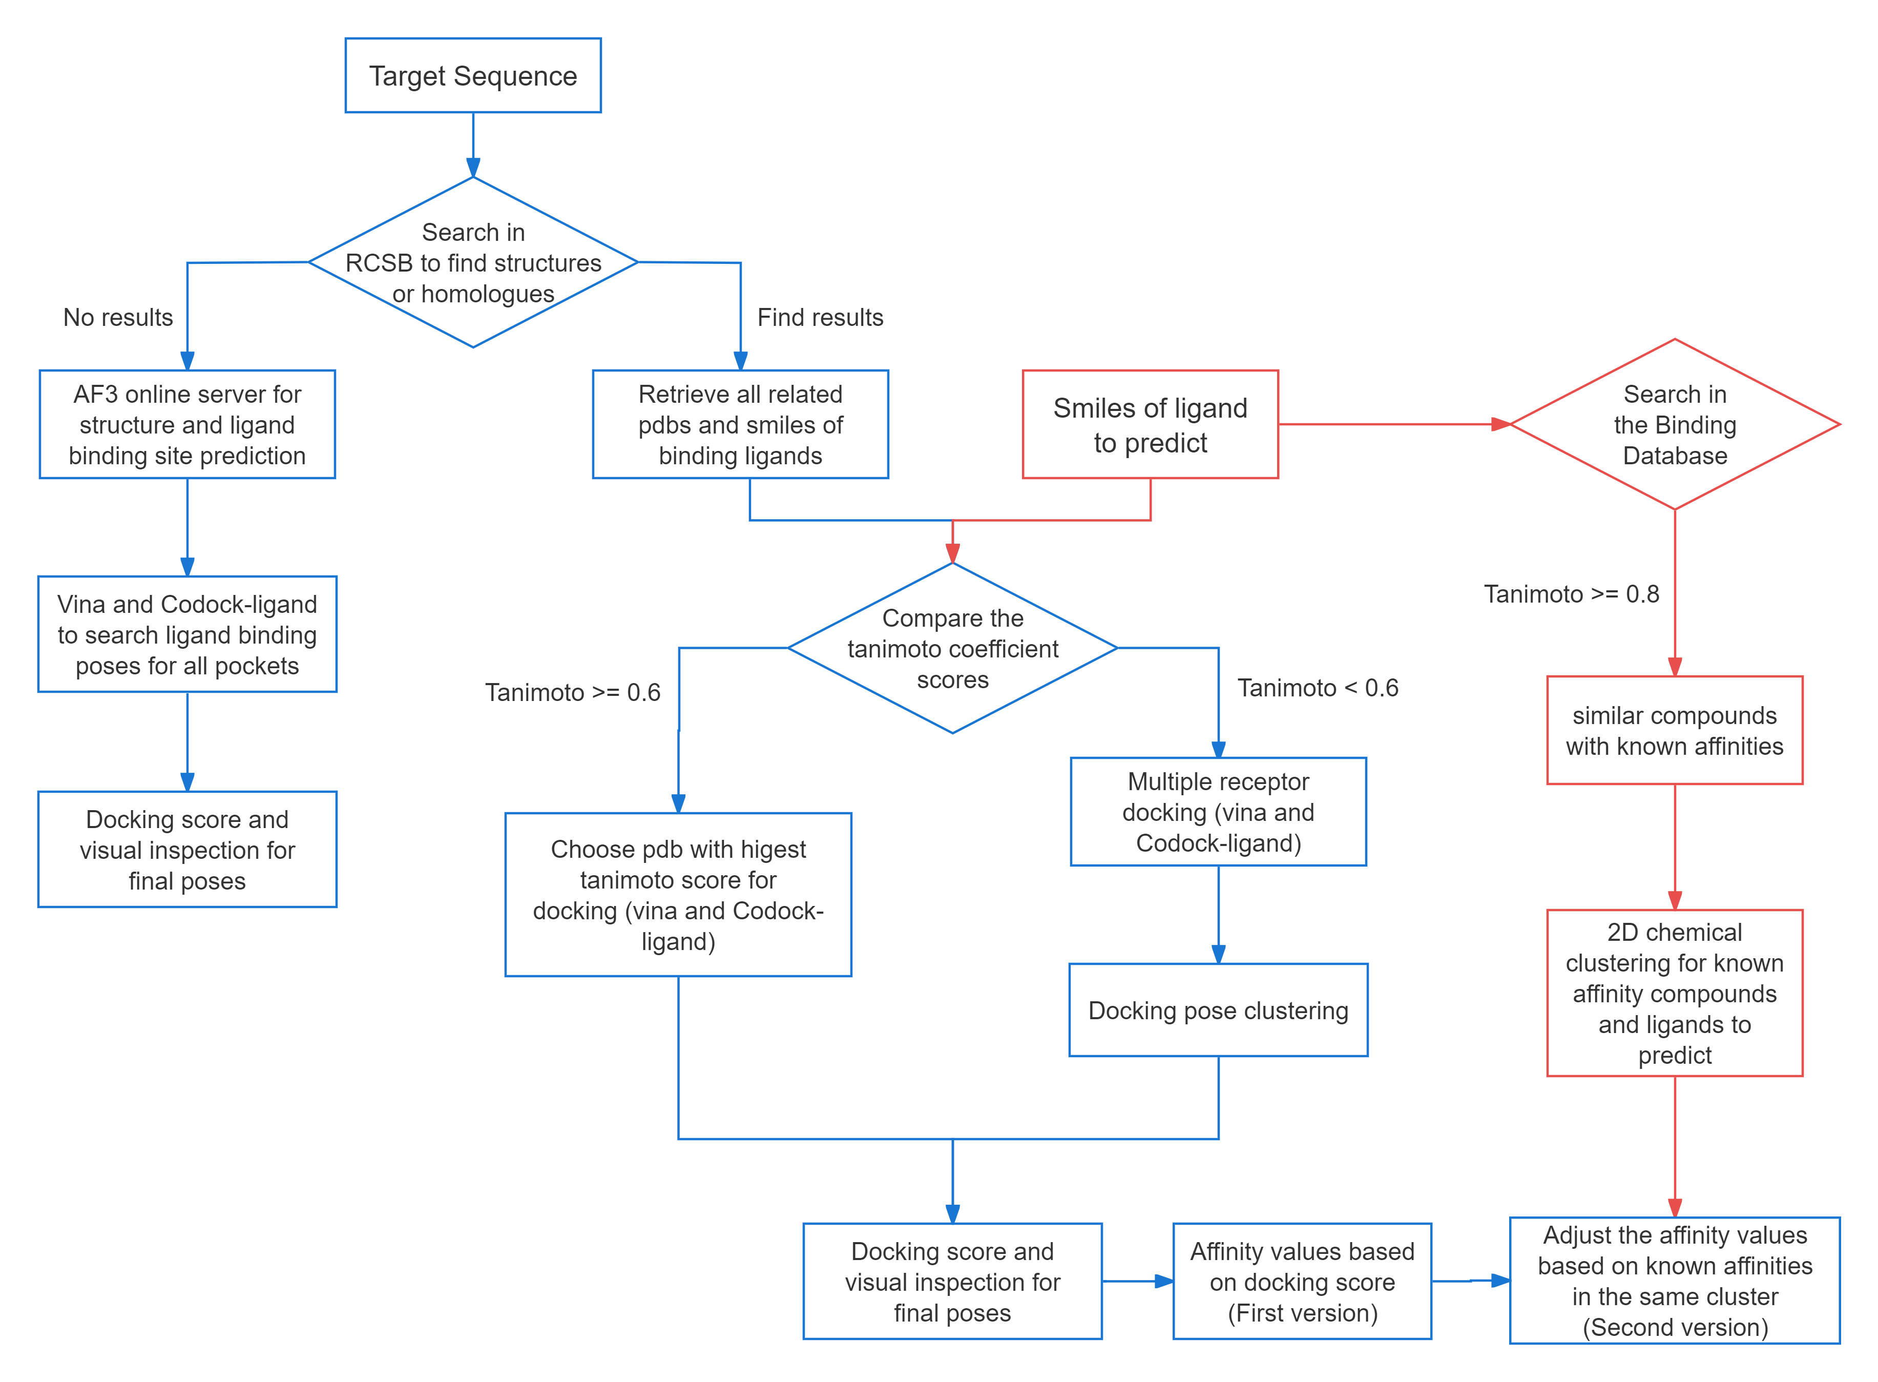
Workflow for ligand binding prediction
For L1000, L2000, L3000 and L4000
Select the pdbs of protein in complex with similar compounds for docking;
Use multiple conformations of the protein as receptor for docking;
Use vina and Codock-Ligand to generate docking poses;
Clustering the poses based on RMSD;
For affinity, use information from BDB to adjust the final values.
Notes:
Here is the workflow for ligand prediction. Firstly, we search the target sequence in the pdb bank to see if we can find any structures for the target itself or its homologues. If we can not find any information, AF3 is used to predict the target structure. The vina and codock-ligand are used to generate binding poses for all pockets. Docking score to rank the pose, and visual inspection to select the final pose. If we can find results, all related pdbs were retrieved and the simles of binding ligands are used to compare the tanimoto similarity with the smiles of ligand to be predicted. If the tanimoto score is larger than 0.6, the pdb with higest tanimoto score is selected and used for docking. If the similarity score is less than 0.6, multiple receptors are used for docking, and clustering the docking pose based on RMSD values. Finally, docking score and visual inspection to select the pose. For affinity part, the first version of affinity is directed calculated from docking score. We also search the binding database to retrieve all th compound with known activities for each targets. Then we cluster the compounds and ligand to be predicted based on 2D chemical clustering. The affinities are ajusted based on known values in the same cluster.

Slide 5
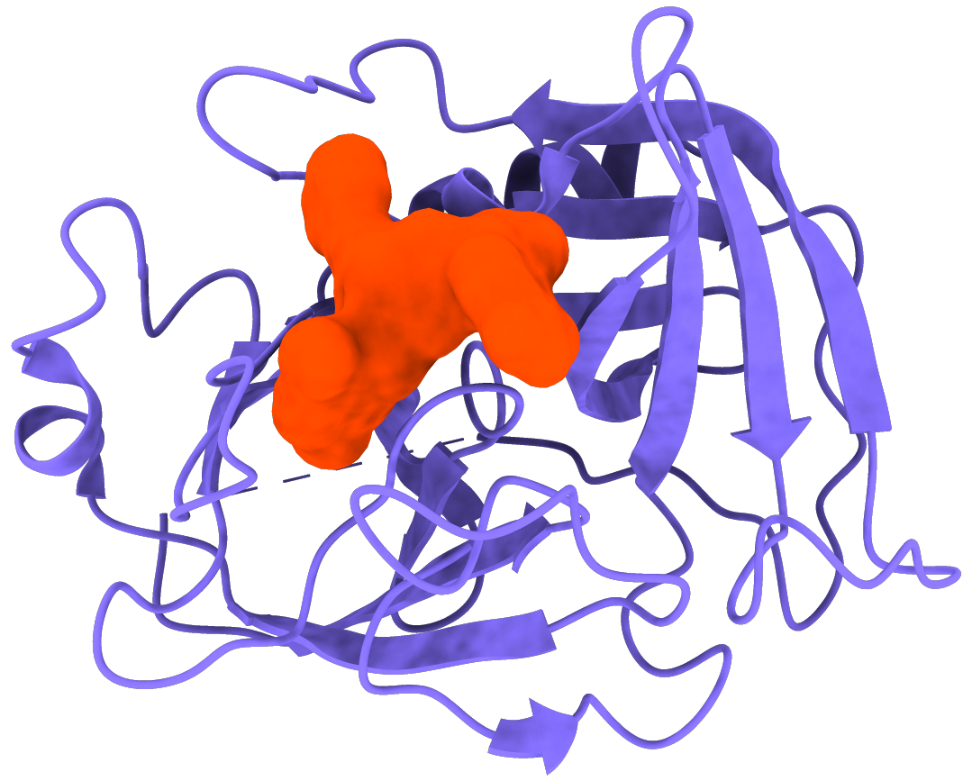
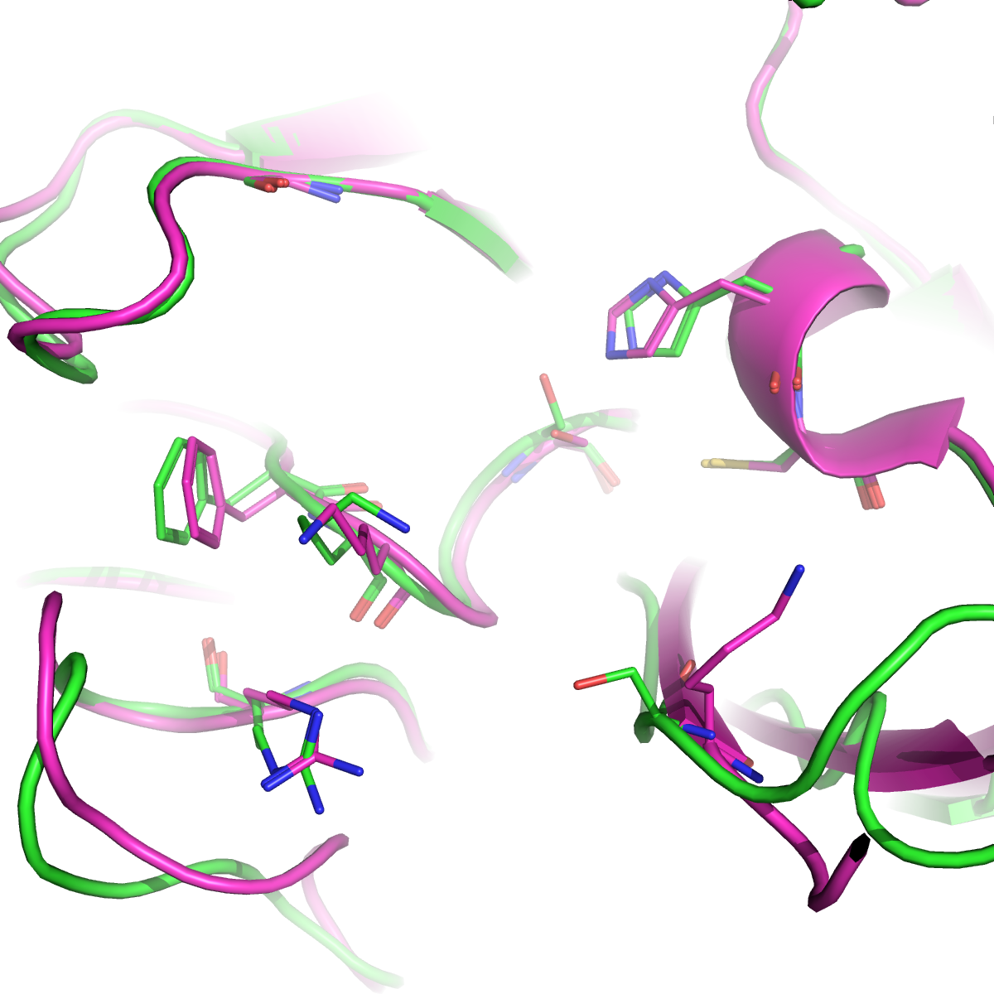
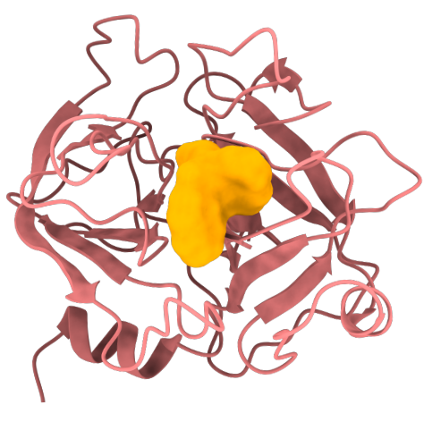
Pockets for L1000 and L2000
Chymase (L1000)
Cathepsin-G (L2000)
L1000 Chymase
L2000 Cathepsin-G
His-66
Phe-199
Ser-203
Lys-49
Lys-200
Arg-151
L1000 and L2000 are homology proteins with similar binding pockets
Notes:
We found out that L1000 and L2000 are homology proteins with similiar binding pockets.

Slide 6
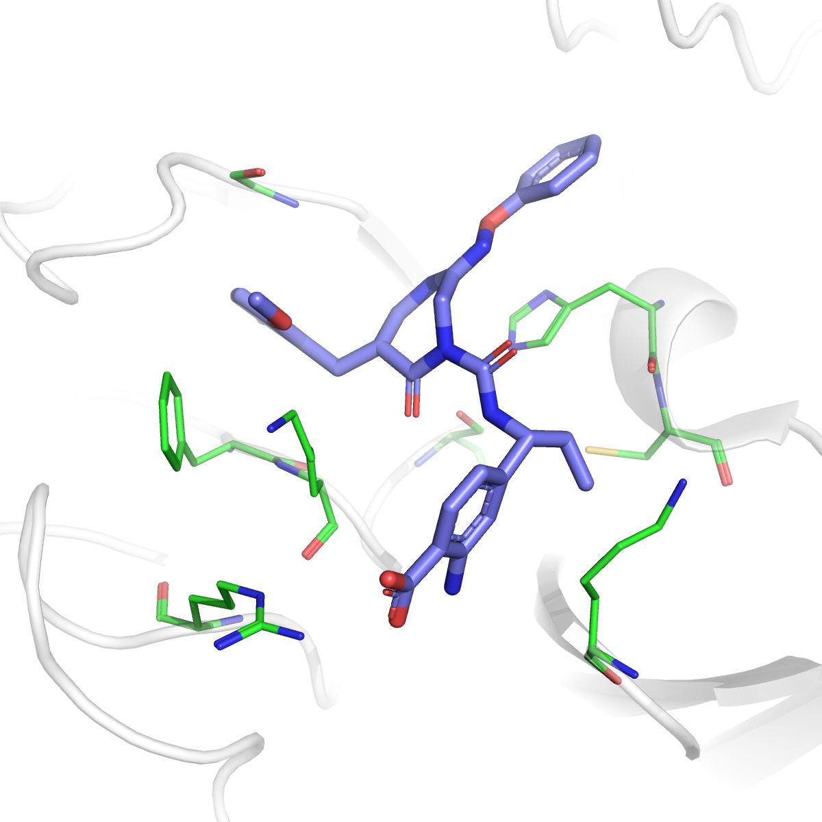
Key interactions for ligand binding in L1000 and L2000
L1000 Chymase
π interaction and
H bond donor
π interaction
His-66
Phe-199
Lys-200
Ser-203
Arg-151
Lys-49
Strong electronegativity
PDB ID: 5YJM
Notes:
Here is the typical binding of ligand inside the pocket: Phe and his provide pi interactions, ser arg and lys provide electronic interactions or hydrogen bond with the ligand.

Slide 7
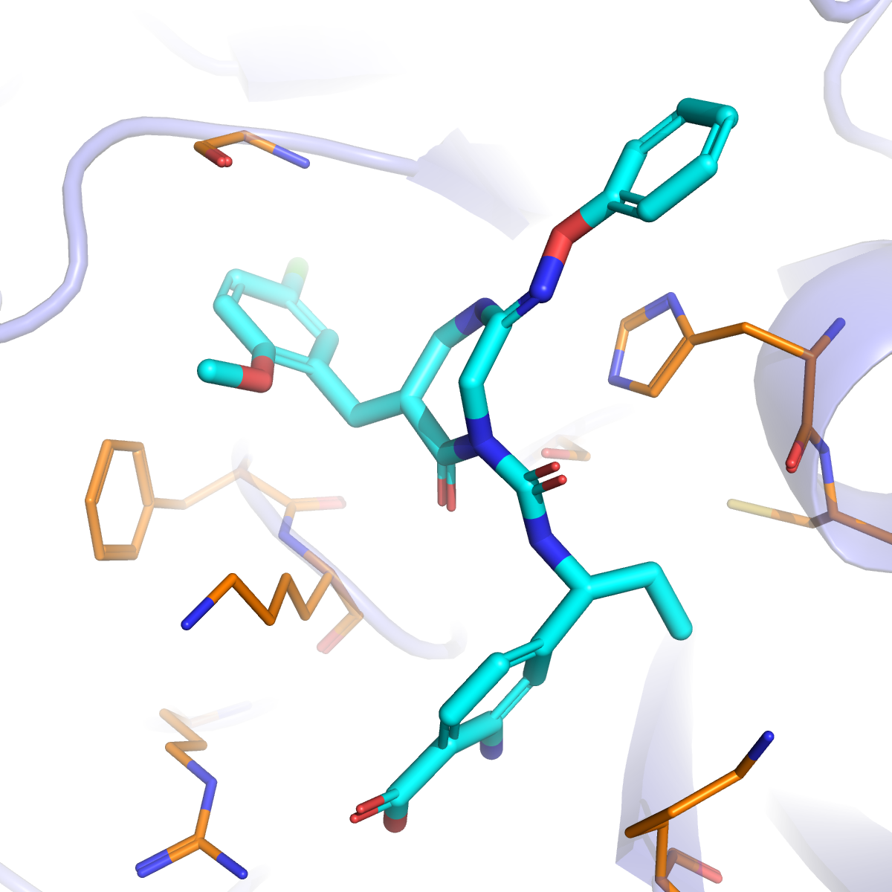
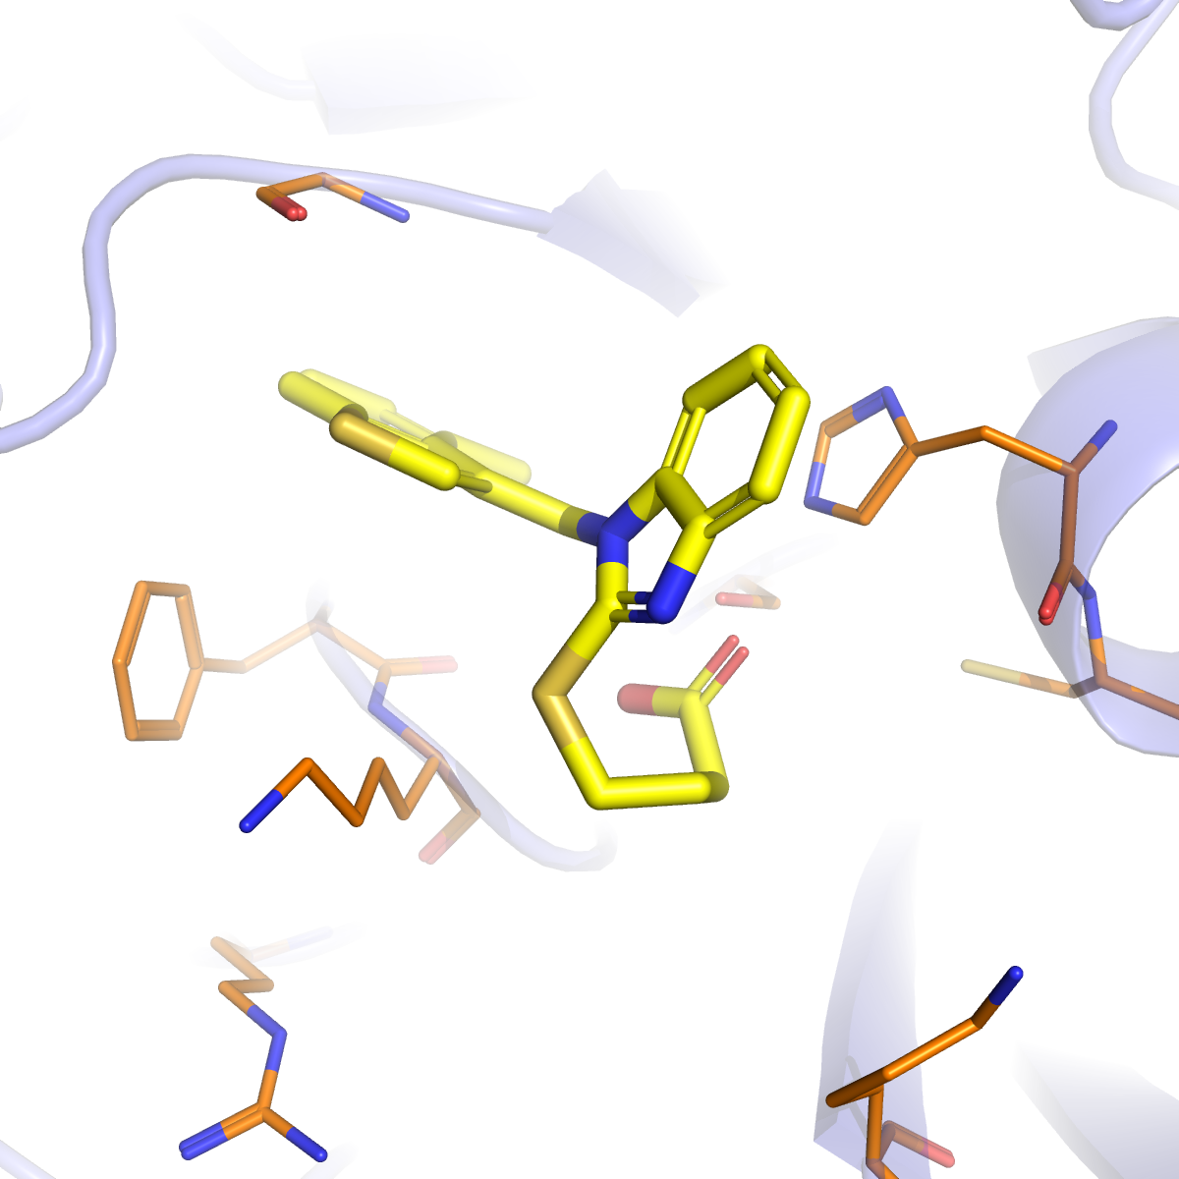
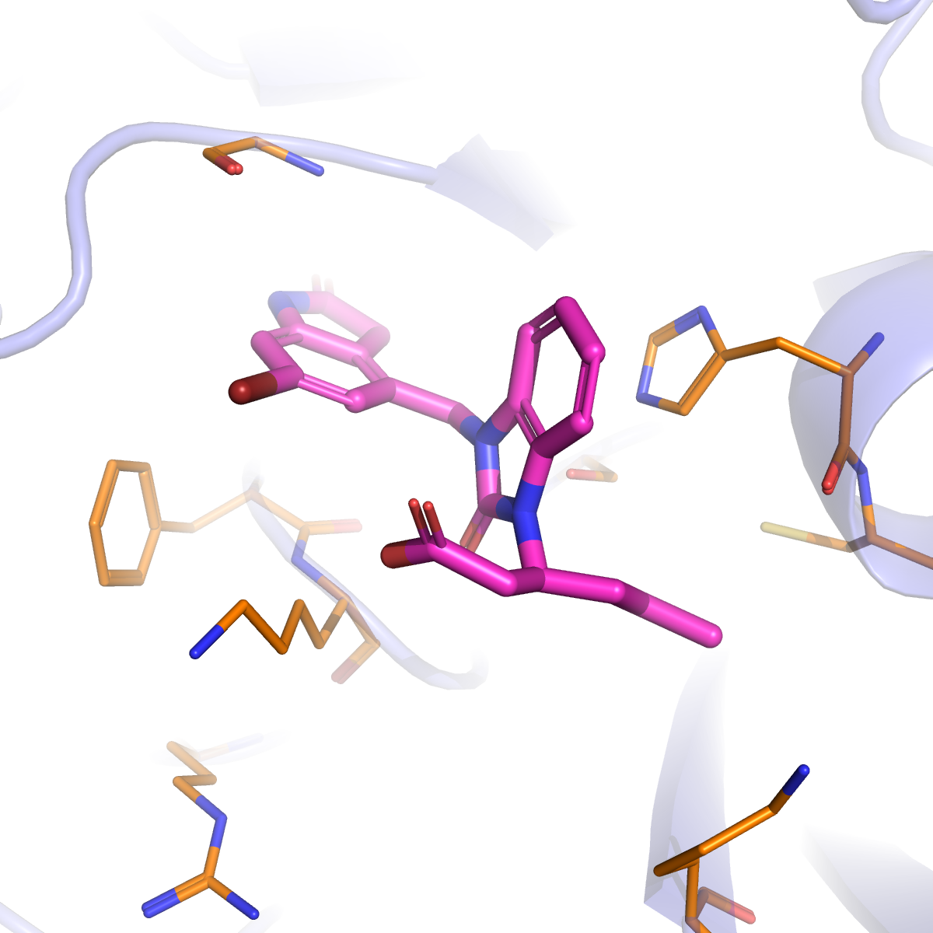
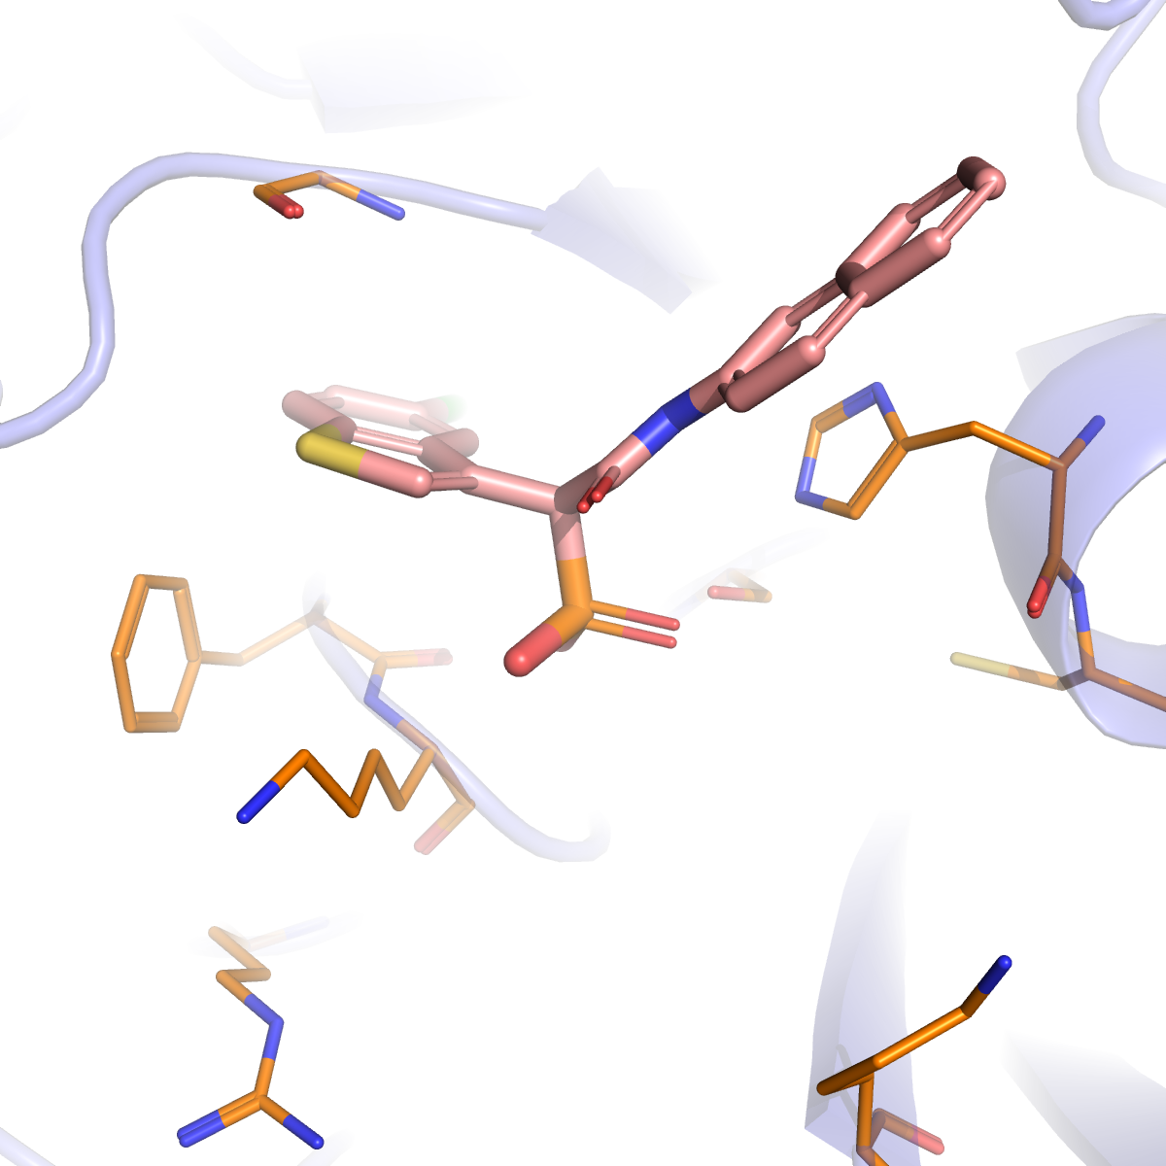
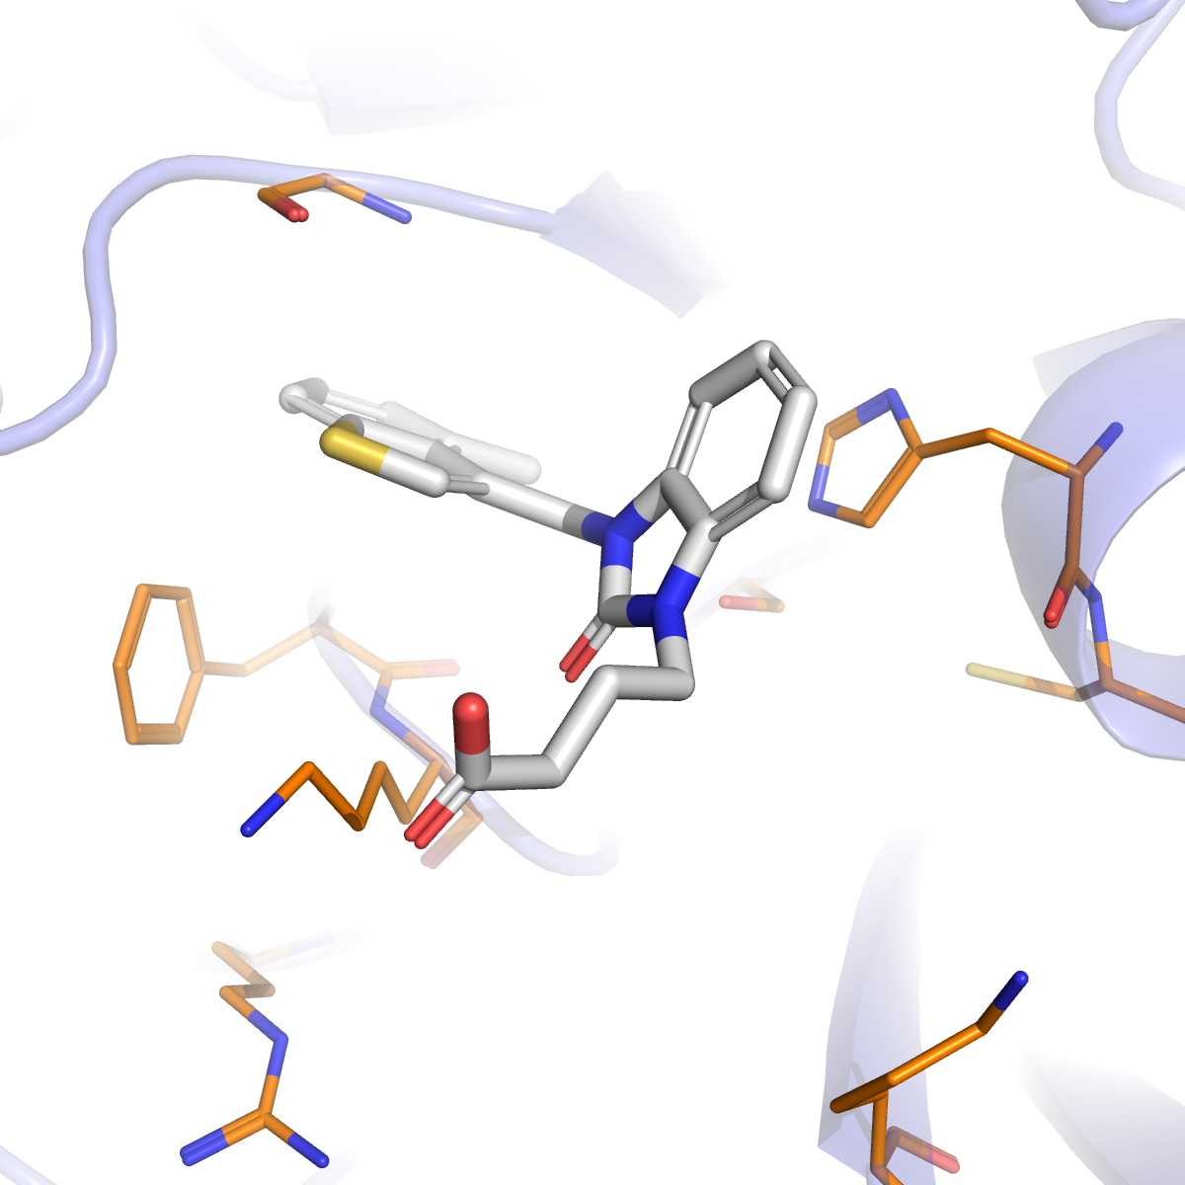
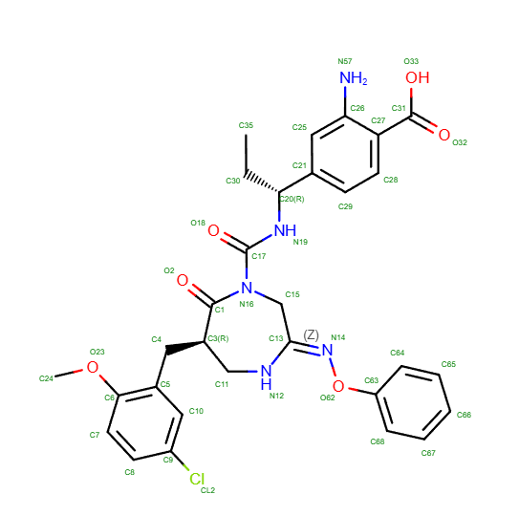
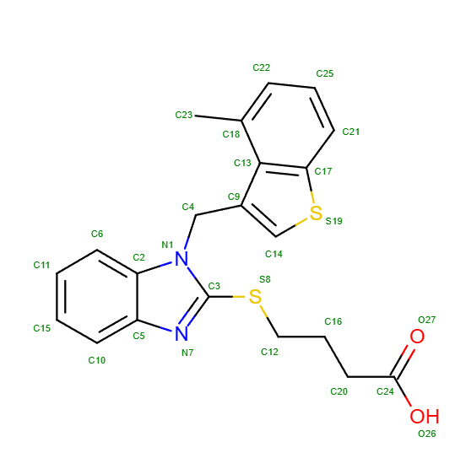
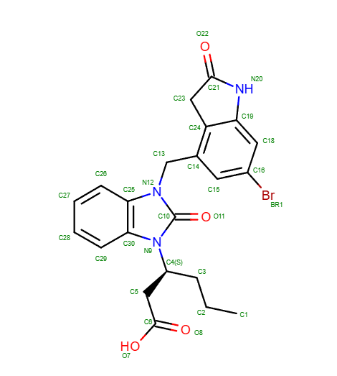
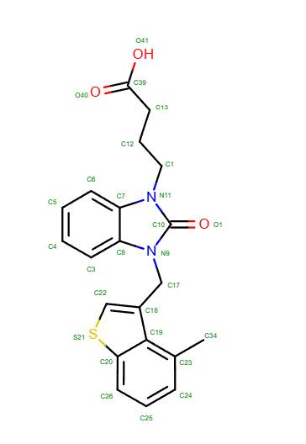
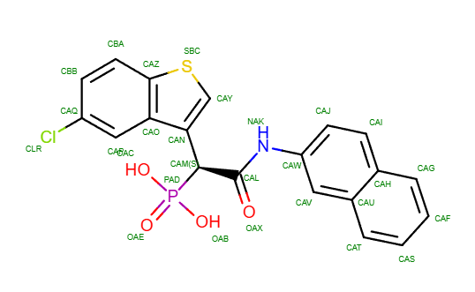
PDBs with different ligands binding (L1000 and L2000)
π interaction
Strong electronegativity
π interaction and H bond donor
5YJM
4KP0
4K69
2HVX
3S0N
Notes:
We explore several pdbs and found out the ligand bound with the protein with similiar interaction partterns. especially the interactions with phe and his.

Slide 8
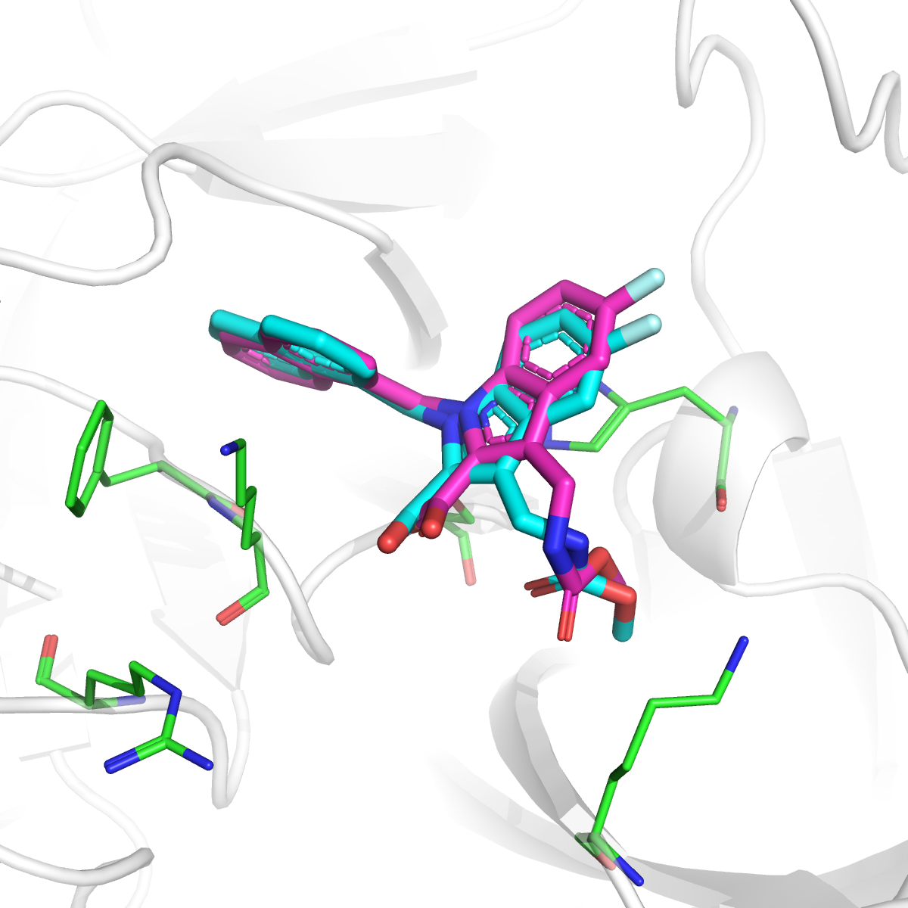
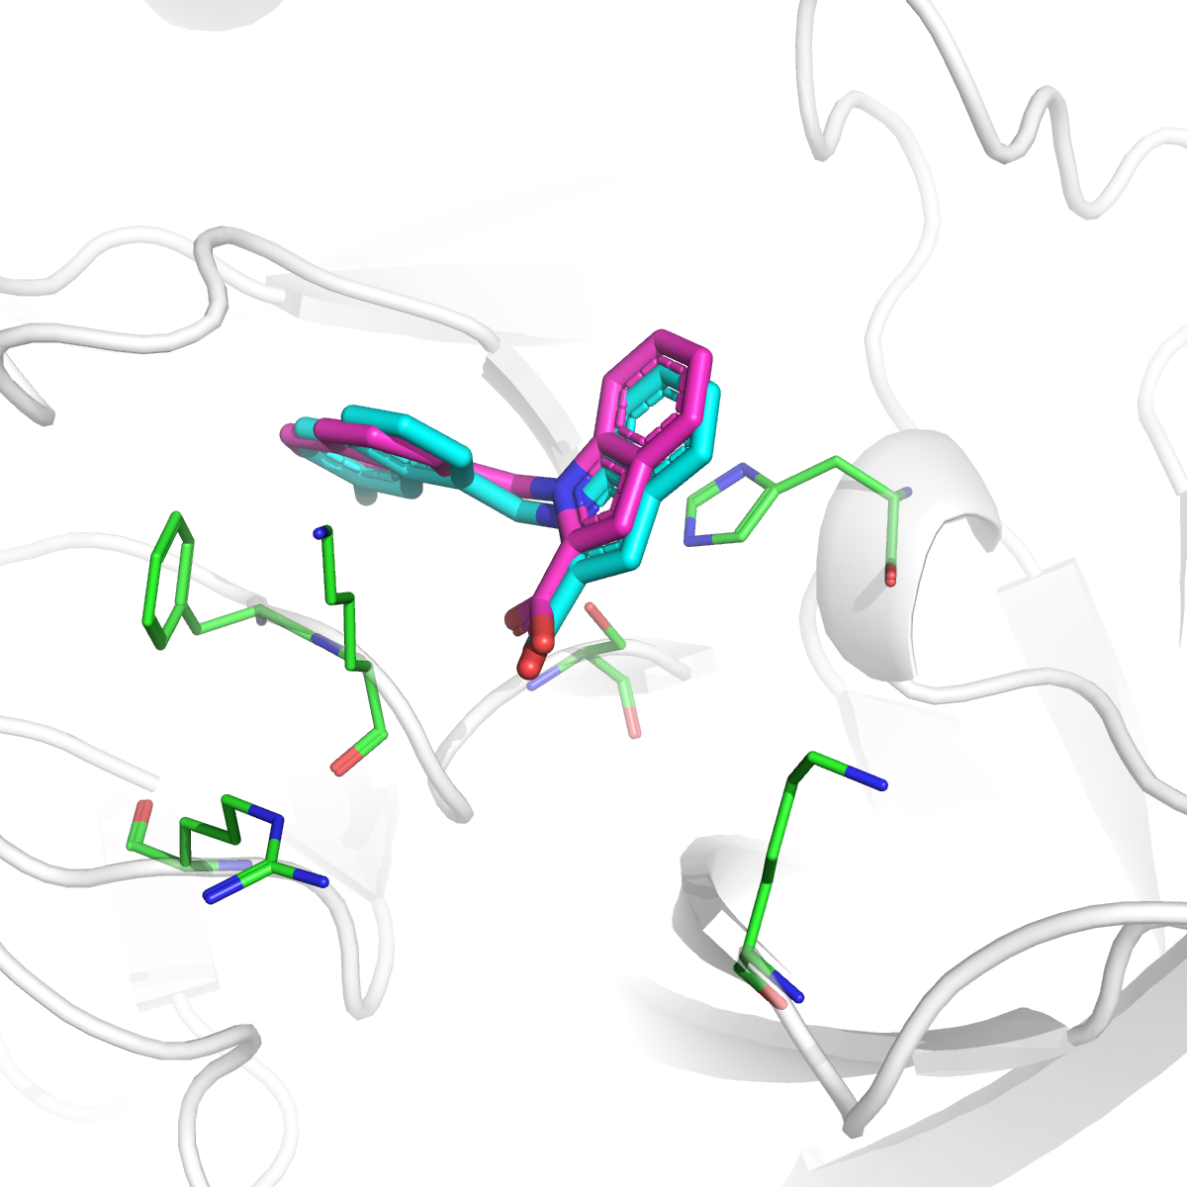
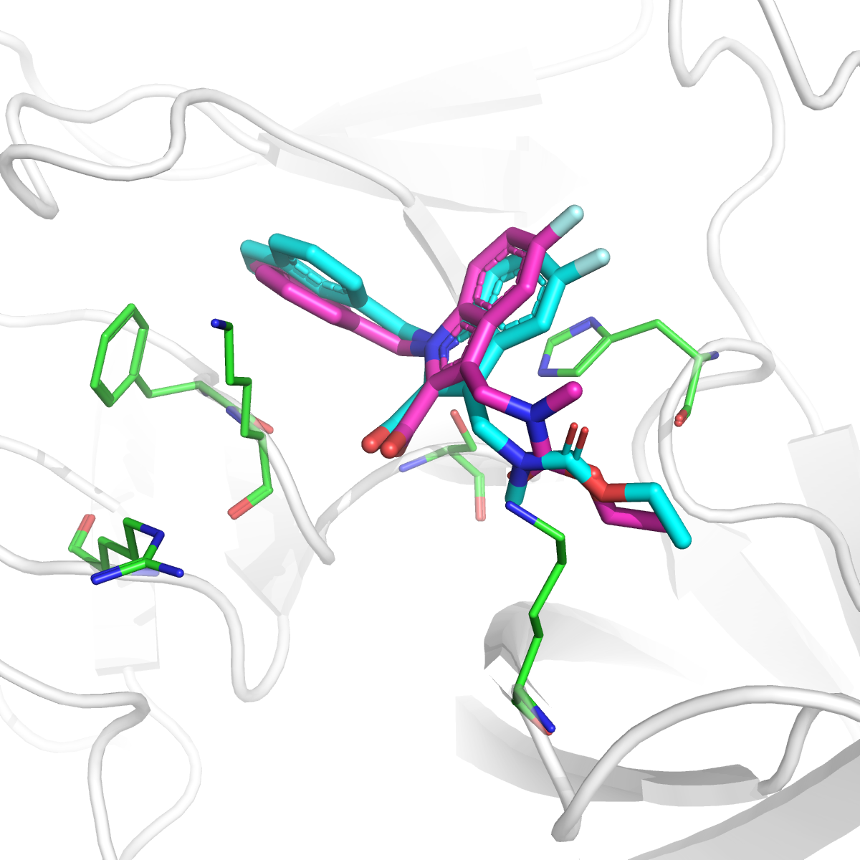
Positive examples for L1000 prediction
Crystal Ligand Pose
Prediction Ligand Pose (Top 1)
L1001
L1005
L1010
RMSD 1.27 Å
RMSD 0.84 Å
RMSD 0.64 Å
Notes:
Based on the knowledge of known experimental binding poses, poses with low RMSD are selected, for L1001, L1005, L1010.

Slide 9
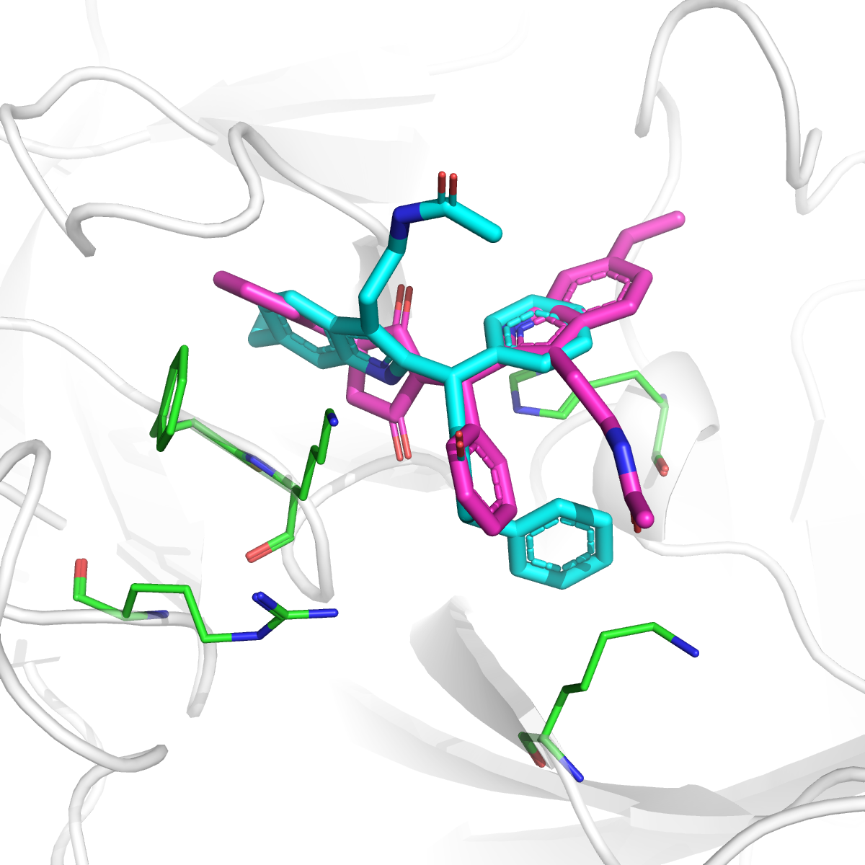
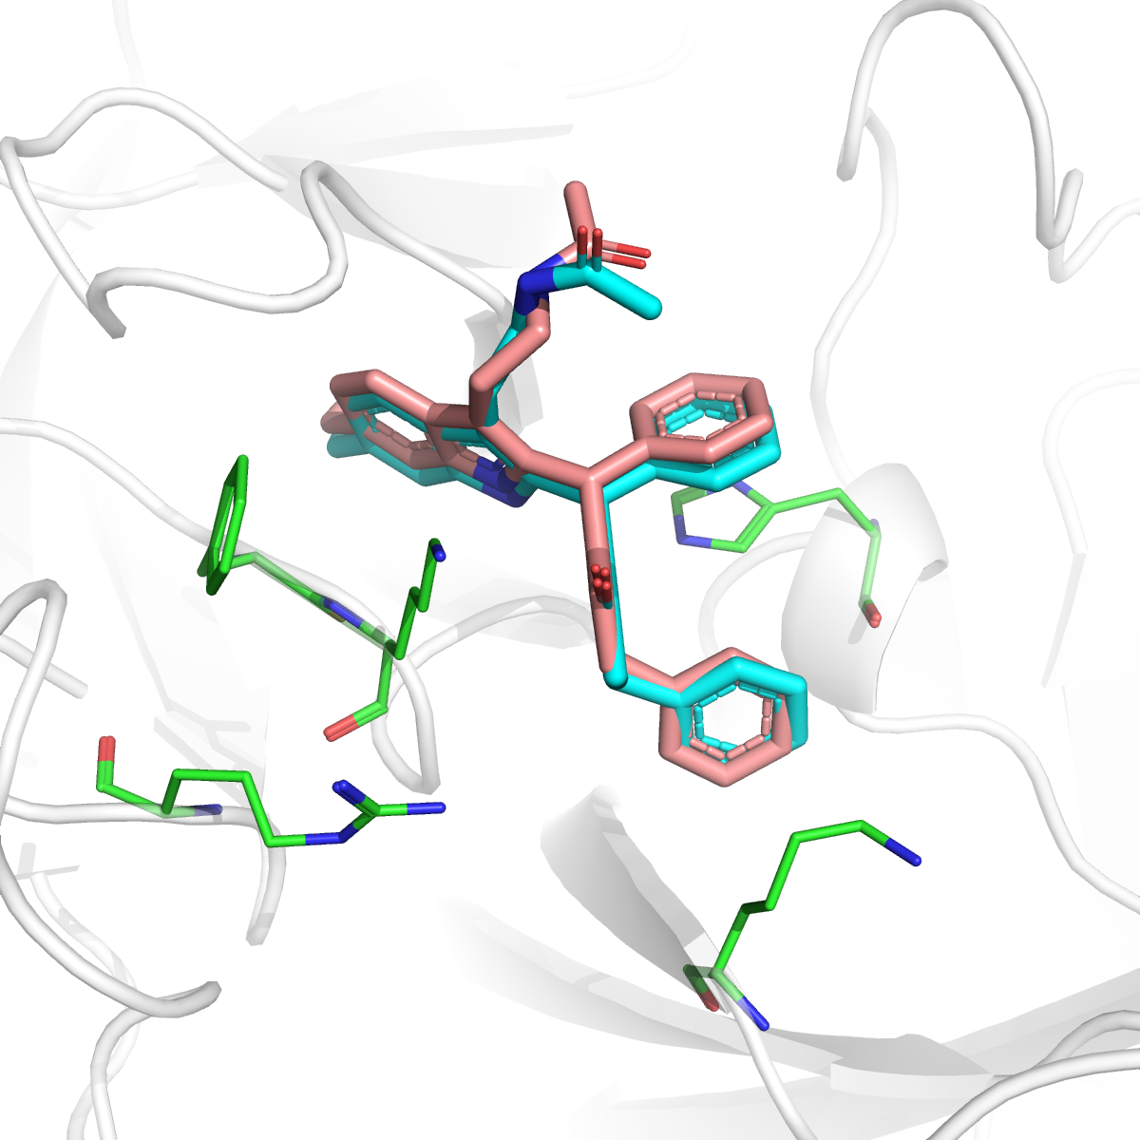
Negative examples for L1000 prediction
Crystal Ligand Pose
Prediction Ligand Pose (Top1)
Prediction Ligand Pose (Top3)
L1002
Prediction Pose 1
Prediction Pose 3
RMSD 7.81 Å
RMSD 1.07 Å
The lowest RMSD pose was ranked in top 3
Notes:
For L1002, although the near native pose is generated and submitted, it is ranked as pose 3. For this compound, it’s a little hard to discriminate the pi-pi stacking between phe and his. So we made the mistake to select the wrong pose as top 1.

Slide 10
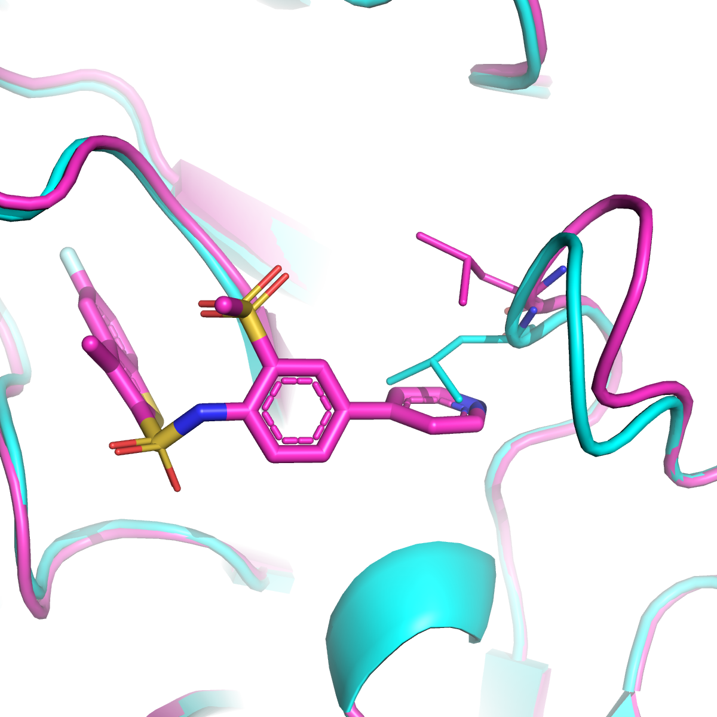
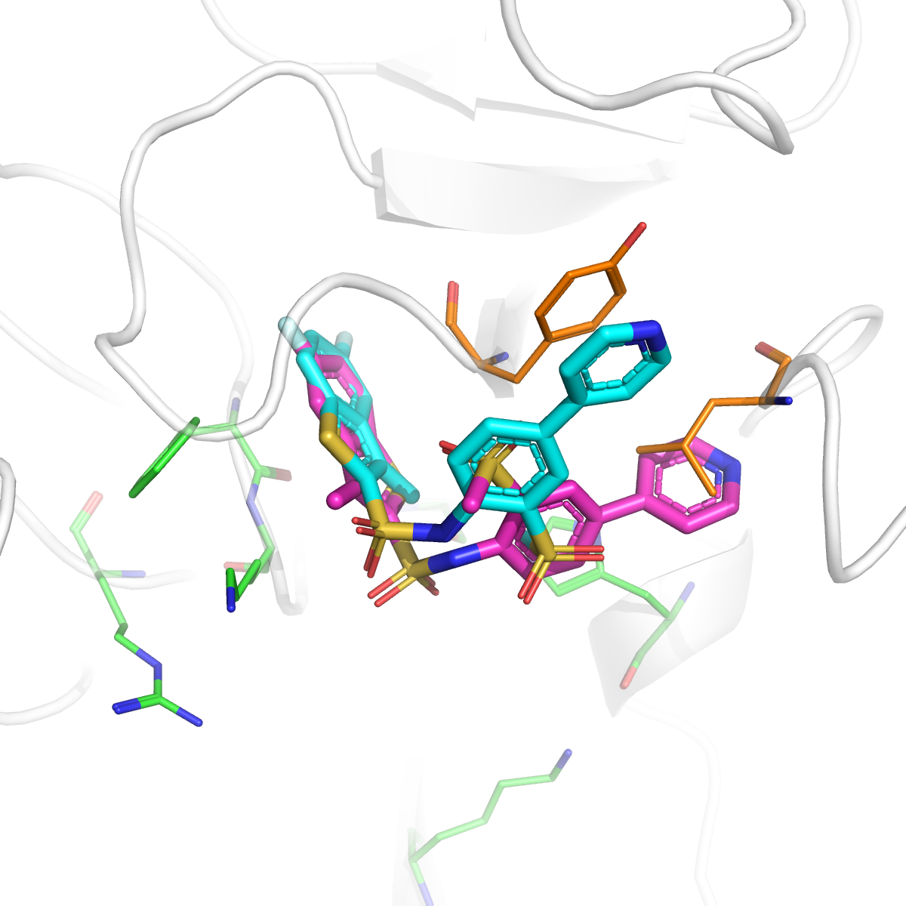
Negative examples for L1000 prediction
Crystal Ligand Pose
Prediction Ligand Pose
L1015
Leu-107 flip
RMSD 4.08 Å
Crystal receptor
Receptor for docking
The pose was not correctly generated due to the binding site flexibility
Notes:
For L1015, the pose was not correctly generated due to the binding site flexibility. We can see here, the Leu (leucine) side chain fliped upon the compound binding.

Slide 11
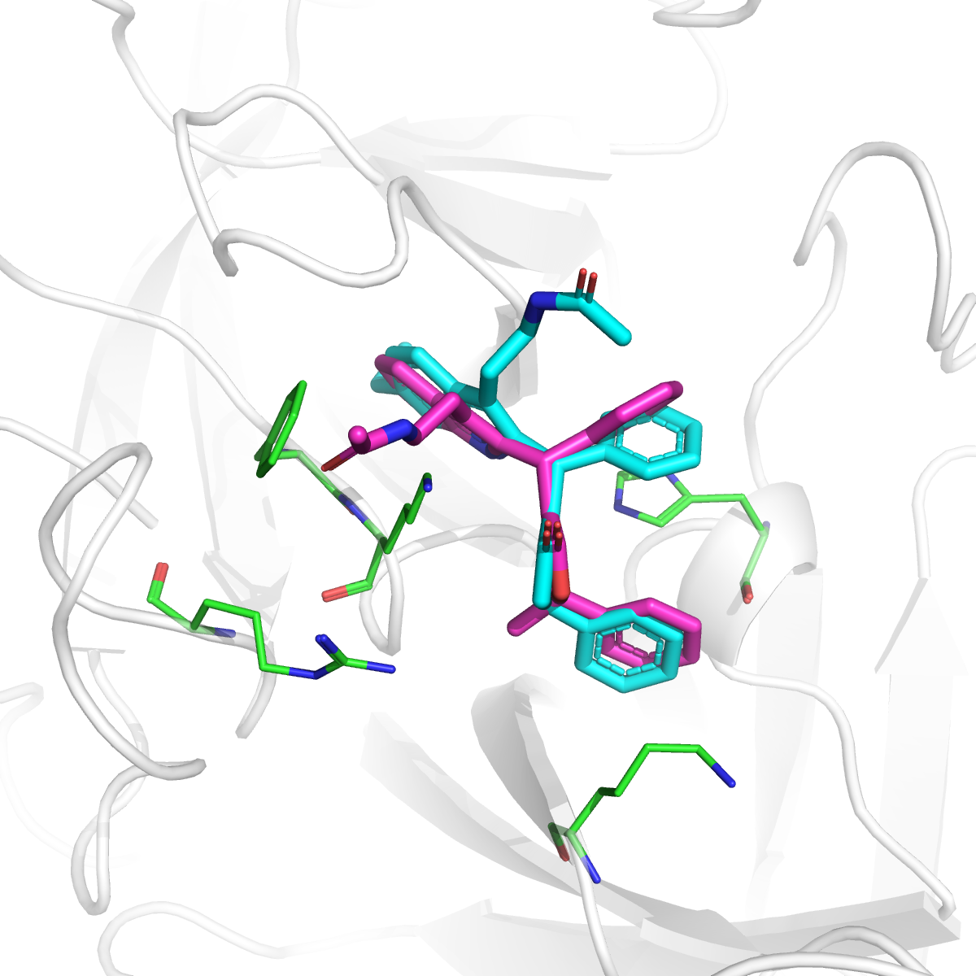
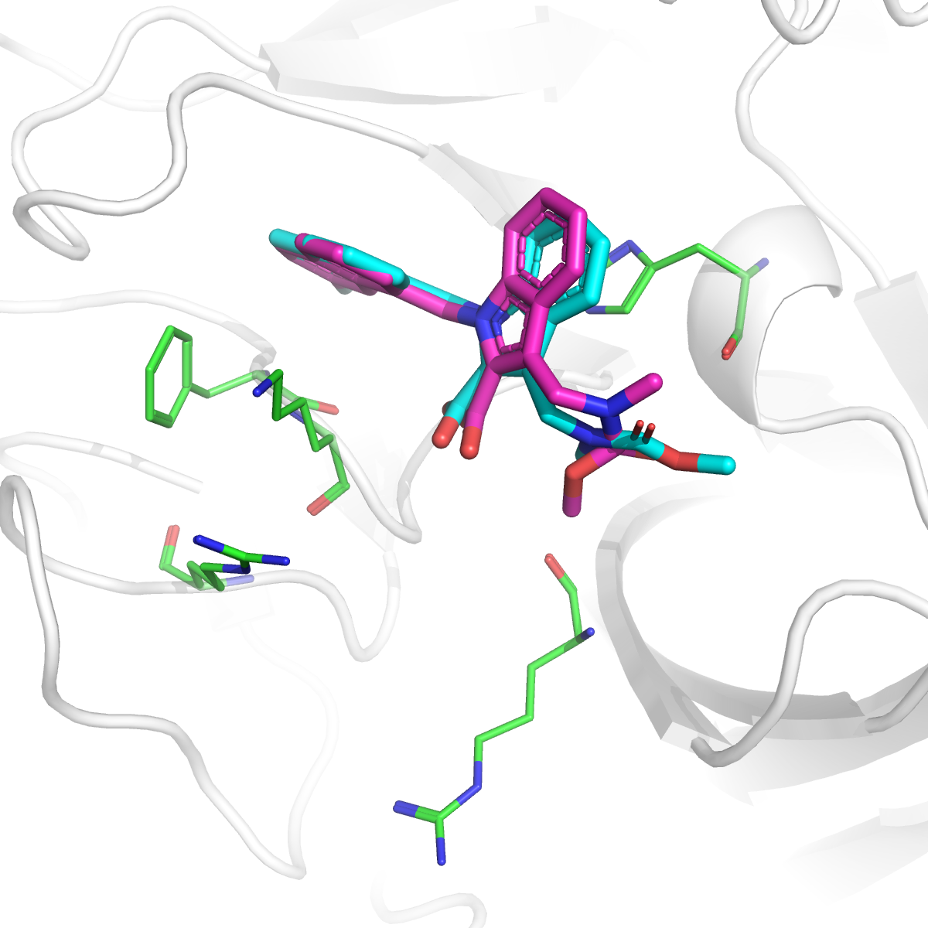
Predictions for L2000
Crystal Ligand Pose
Prediction Ligand Pose
L2001
L2002
RMSD 2.78 Å
RMSD 1.39 Å
Notes:
For L2000, both of the compound are correctly predicted.

Slide 12
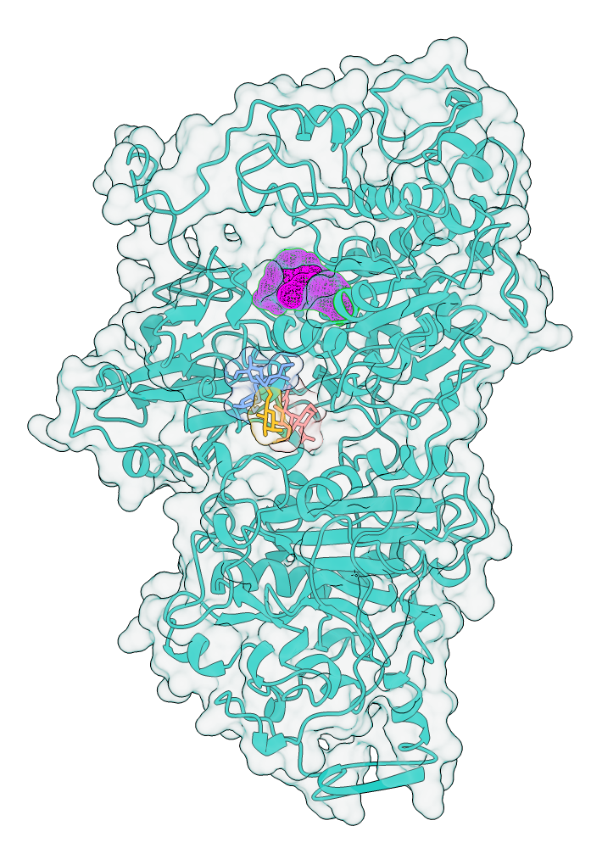
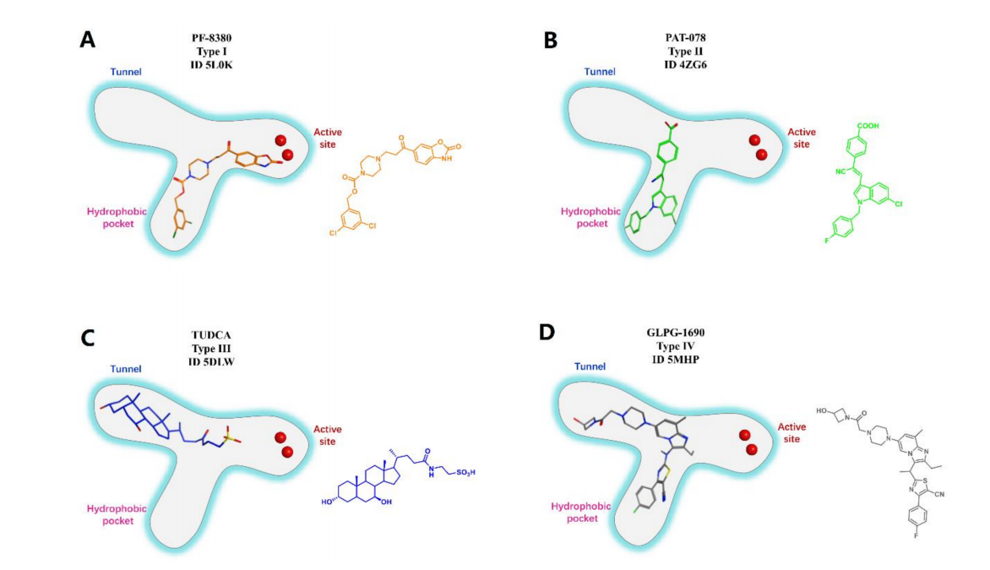
Binding pockets for L3000
Binding Pocket
Glycosylation
Anastassis, J. Lipid. Res. 2014.
Notes:
For target L3000, a lot of pdb structures and literatures are available, both for binding poses and for activities. There is glycosylation site here, and its location is not nearby the binding pokcet, we do not consider the glycoslation during the docking. The binding pocket is relative large as a T shape. It seems different compound bound to different subpockets.

Slide 13
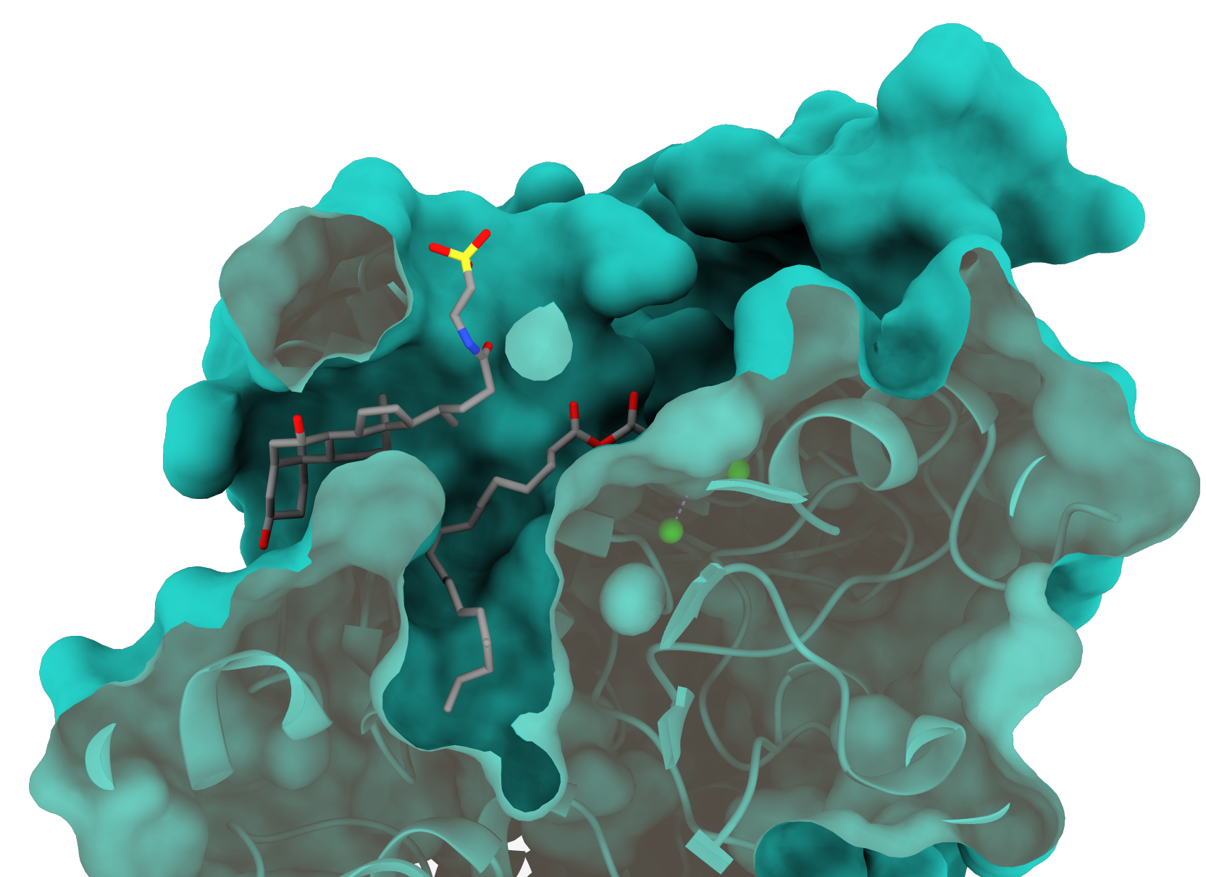
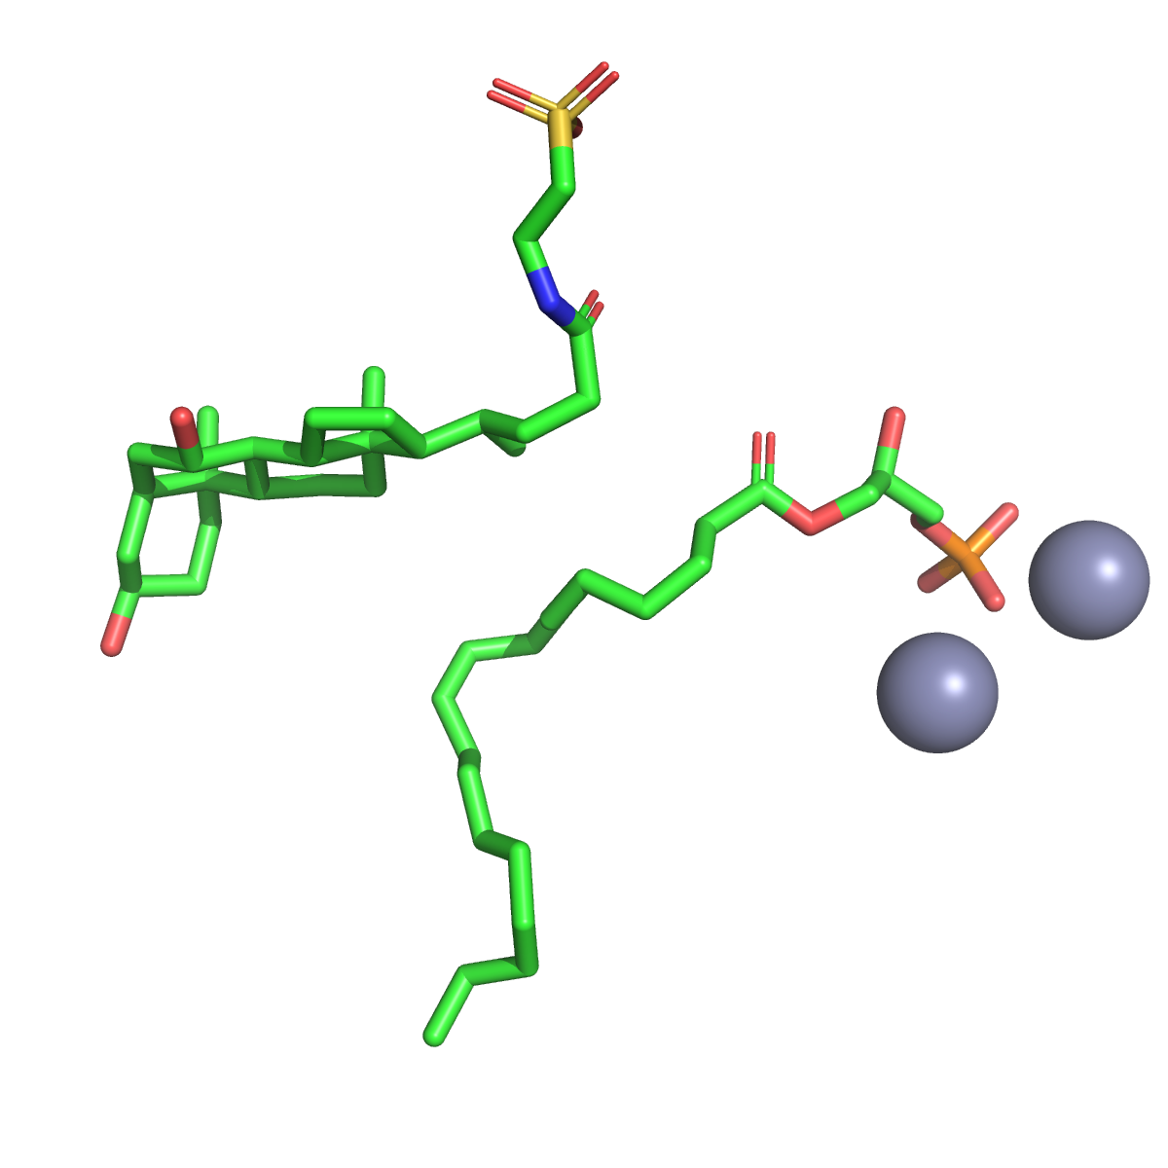
5DLW as example for ligand binding analysis
Pose in protein (PDB ID: 5DLW)
Active Site
Active Site(Zn²⁺)
Tunnel
Tunnel
Hydrophobic pocket
Hydrophobic pocket
1. Partially solvent available “Tunnel”;
2. Aliphatic chain binding hydrophobic pocket;
3. Zn²⁺ site to form strong electronic interactions.
Notes:
Here the pocket of 5DLW is shown here for example. The partially solvent available tunnel bound the compound with mutiple saturated rings. Here is the highly hydrophobic pocket boud wht the aliphatic chain. and the catalystic site composed by two zinc ions provide strong electronic interactions with solfate group or electronic negative group from the compound.

Slide 14
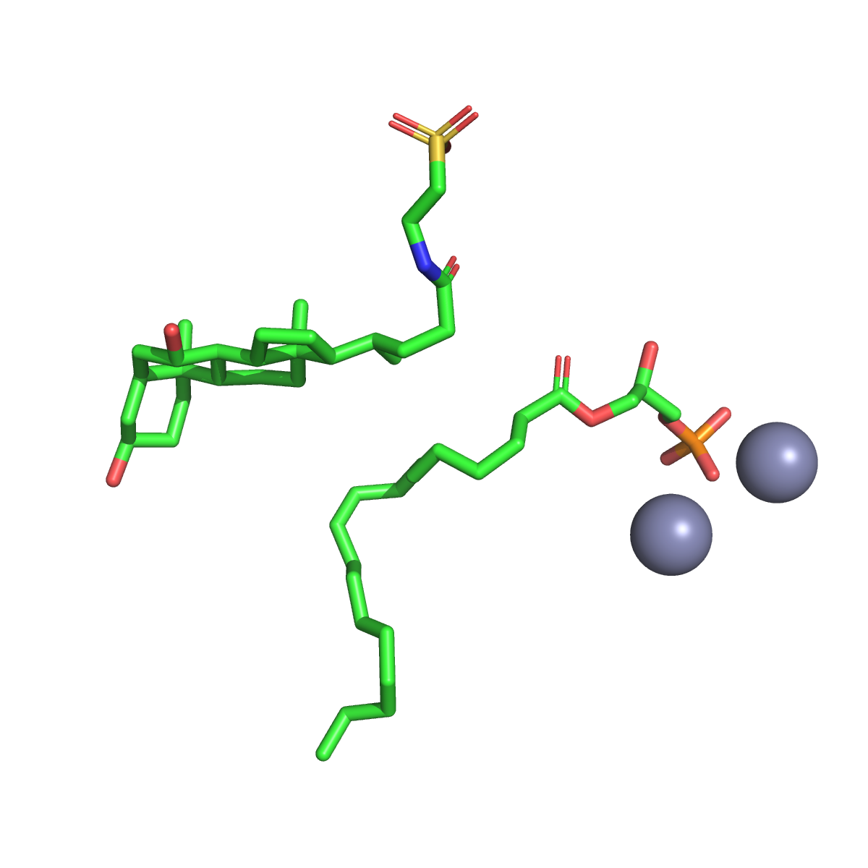
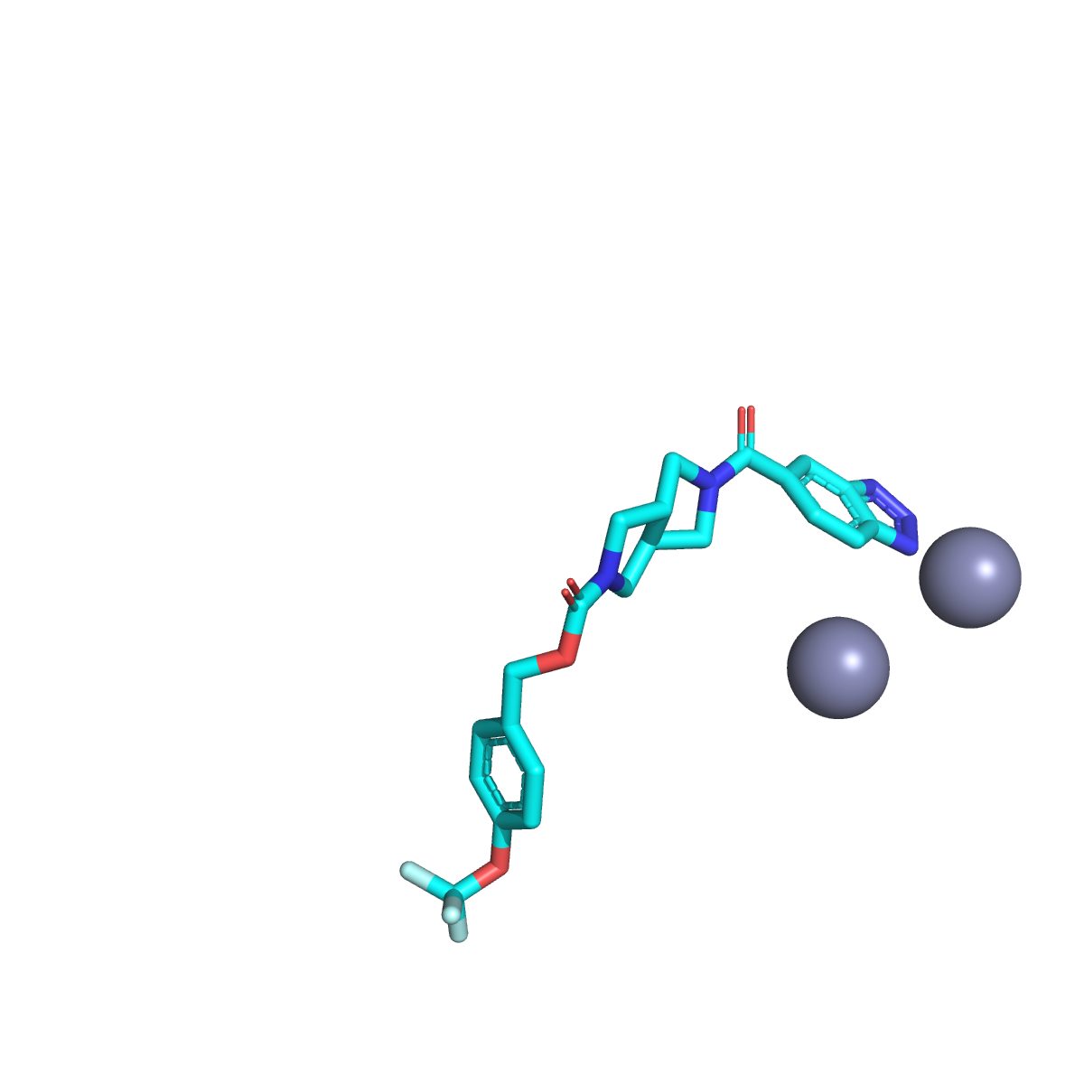
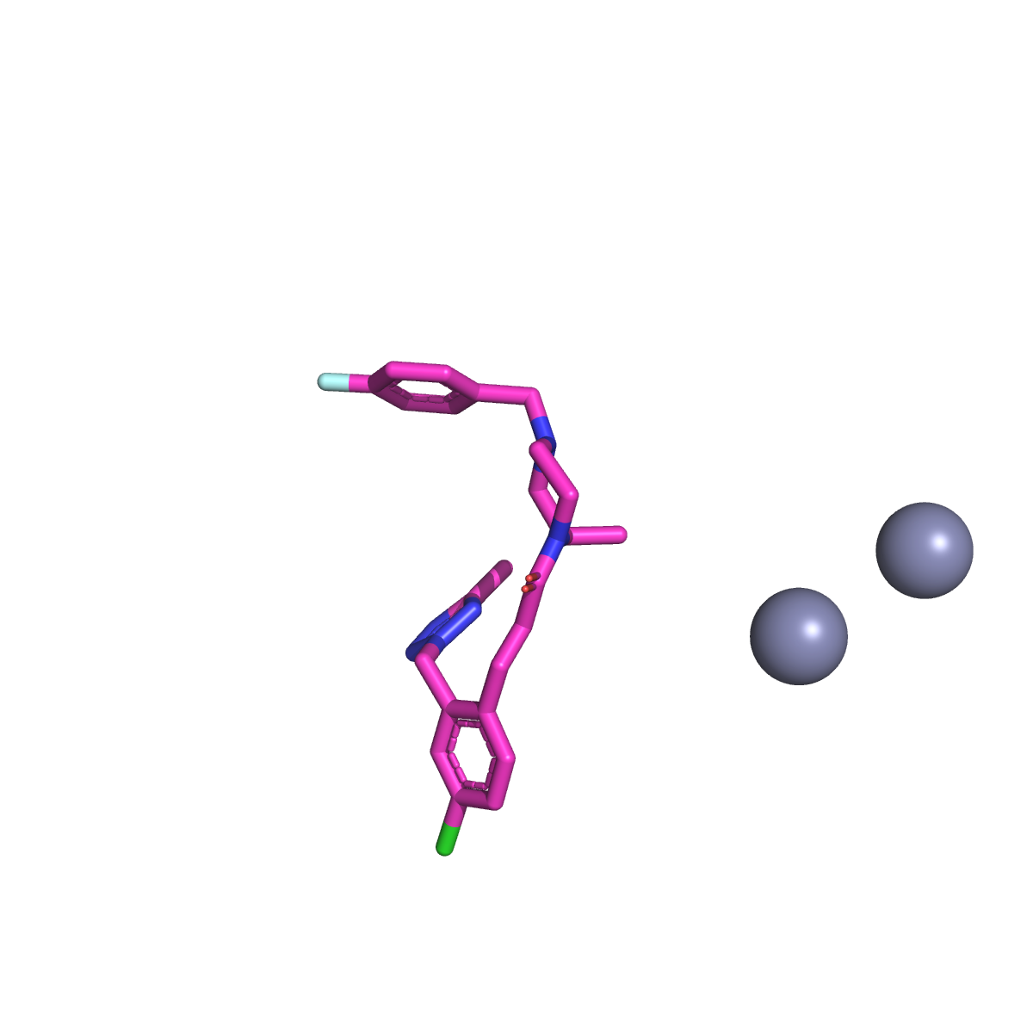
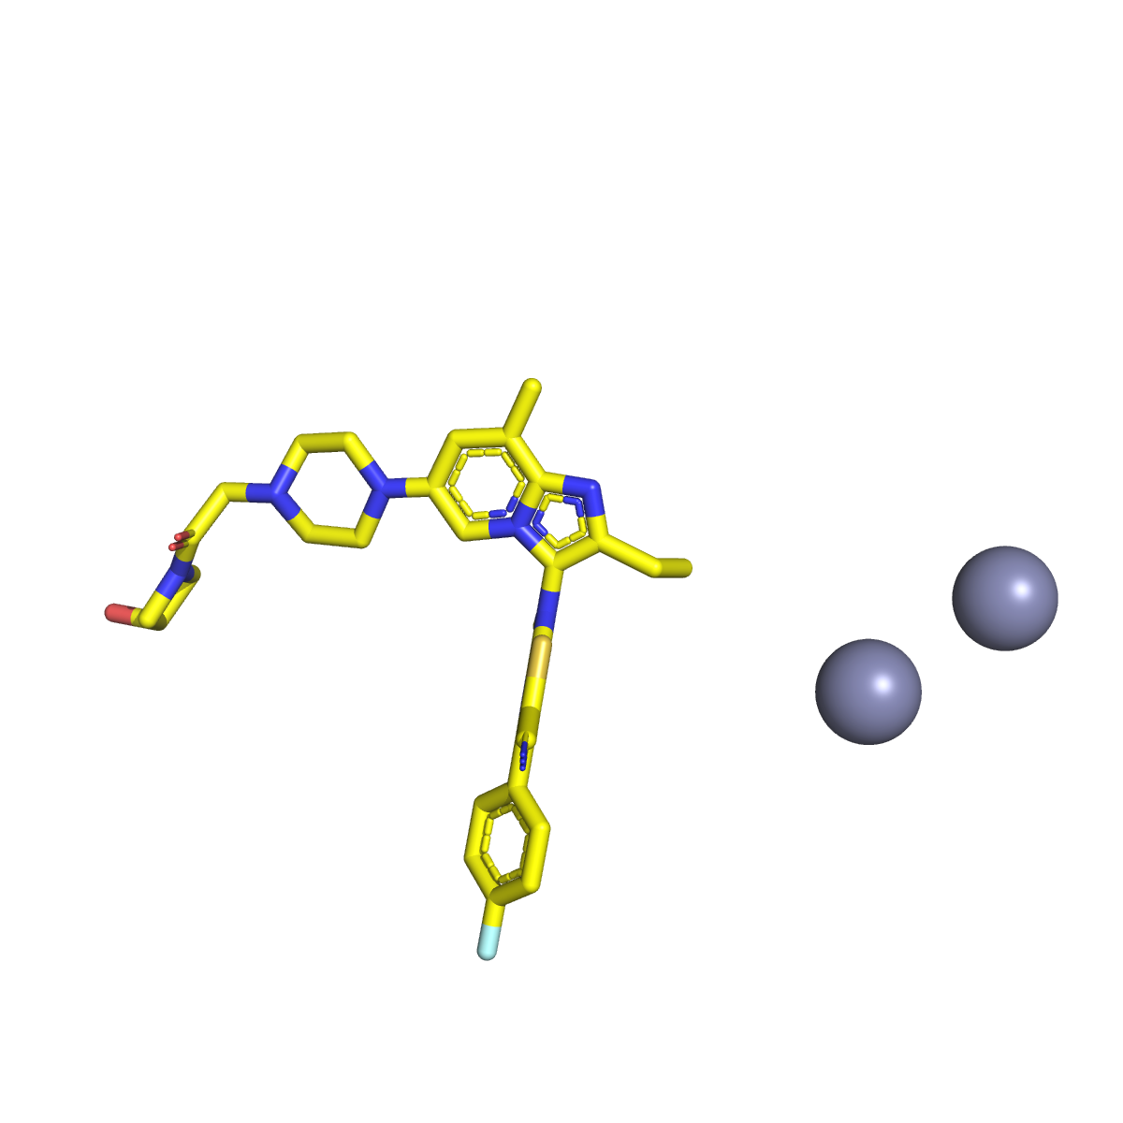
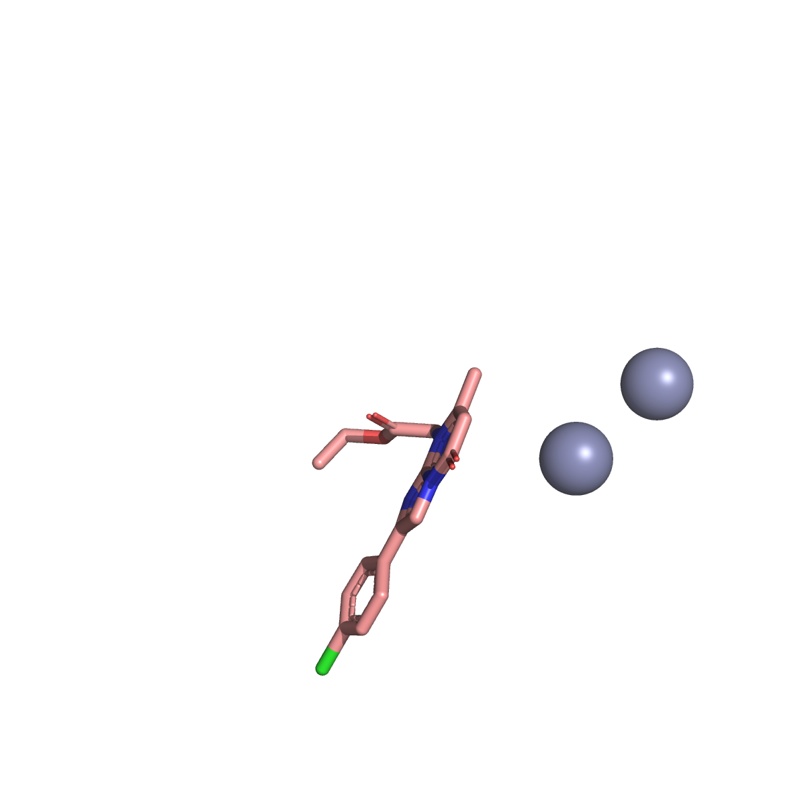
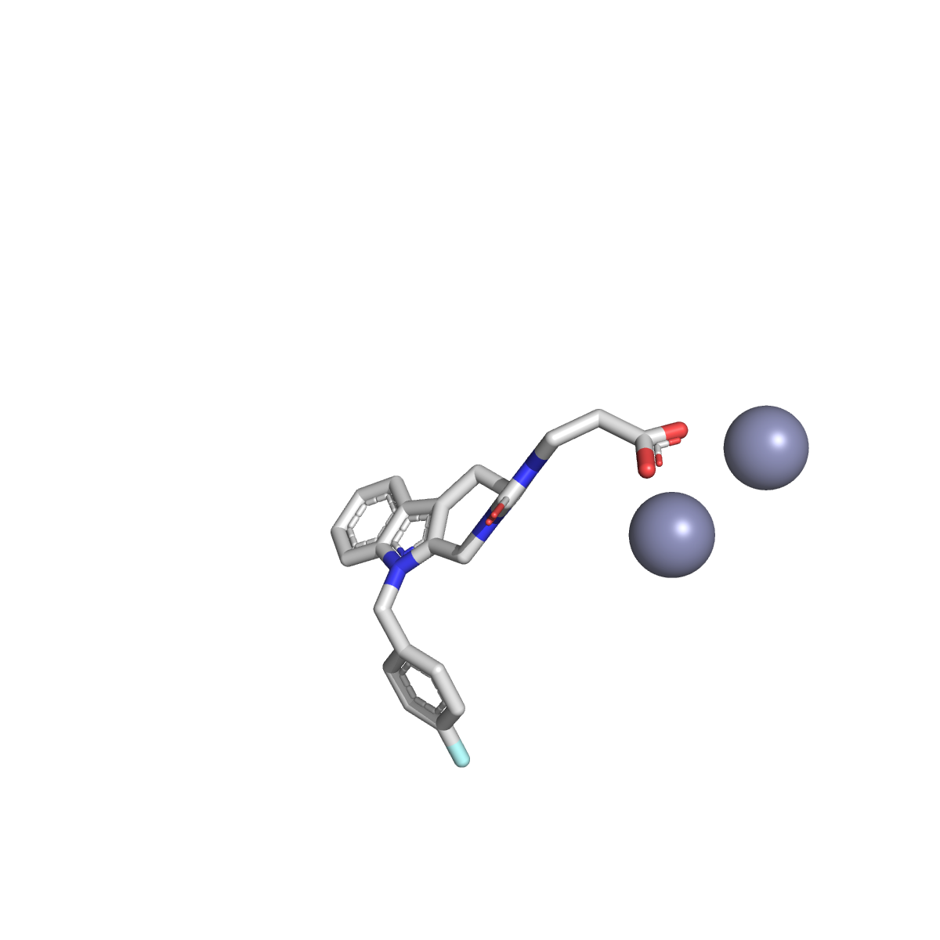
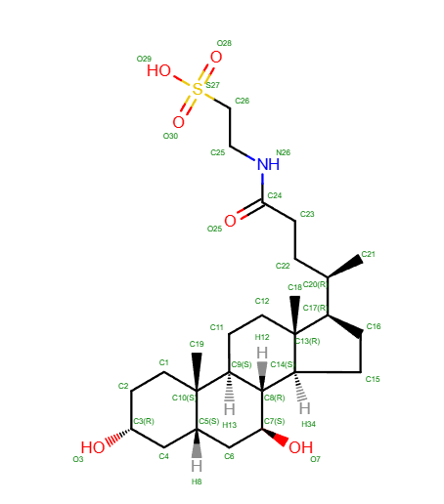
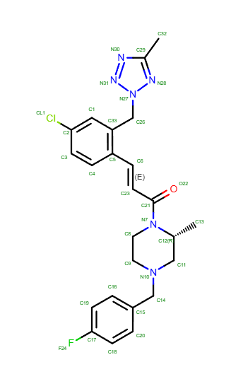
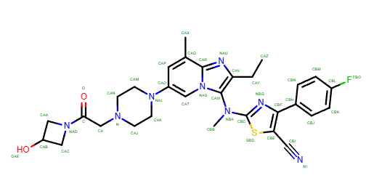
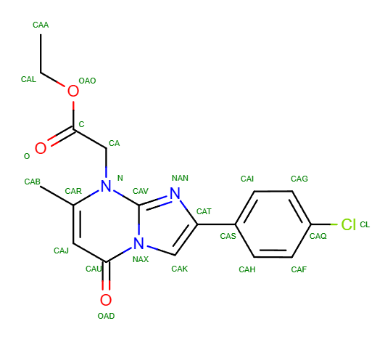
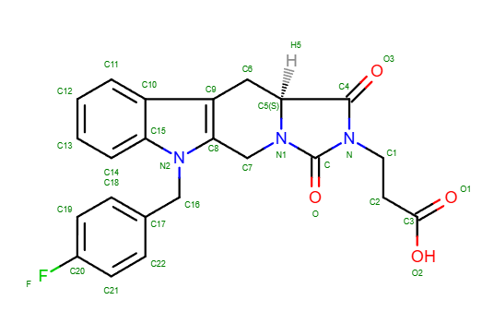
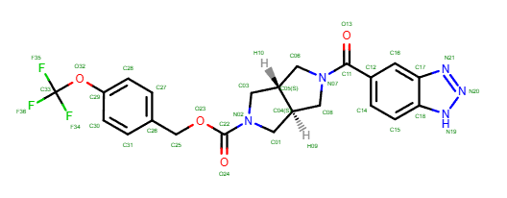
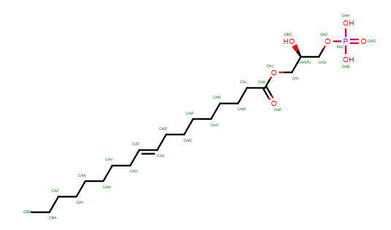
PDB structures used for docking
Hydrophobic pocket
Active Site
Tunnel
5DLW
5S9N
6Y5M
5MHP
6LEH
4ZG9
PDBs identified by compoud 2D similarity search
Notes:
Here we show the pdb structures used for docking, identified by compound 2D similarity search.

Slide 15
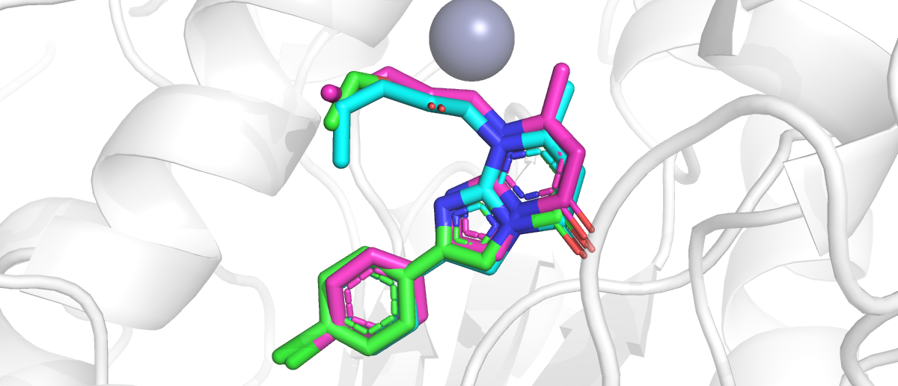
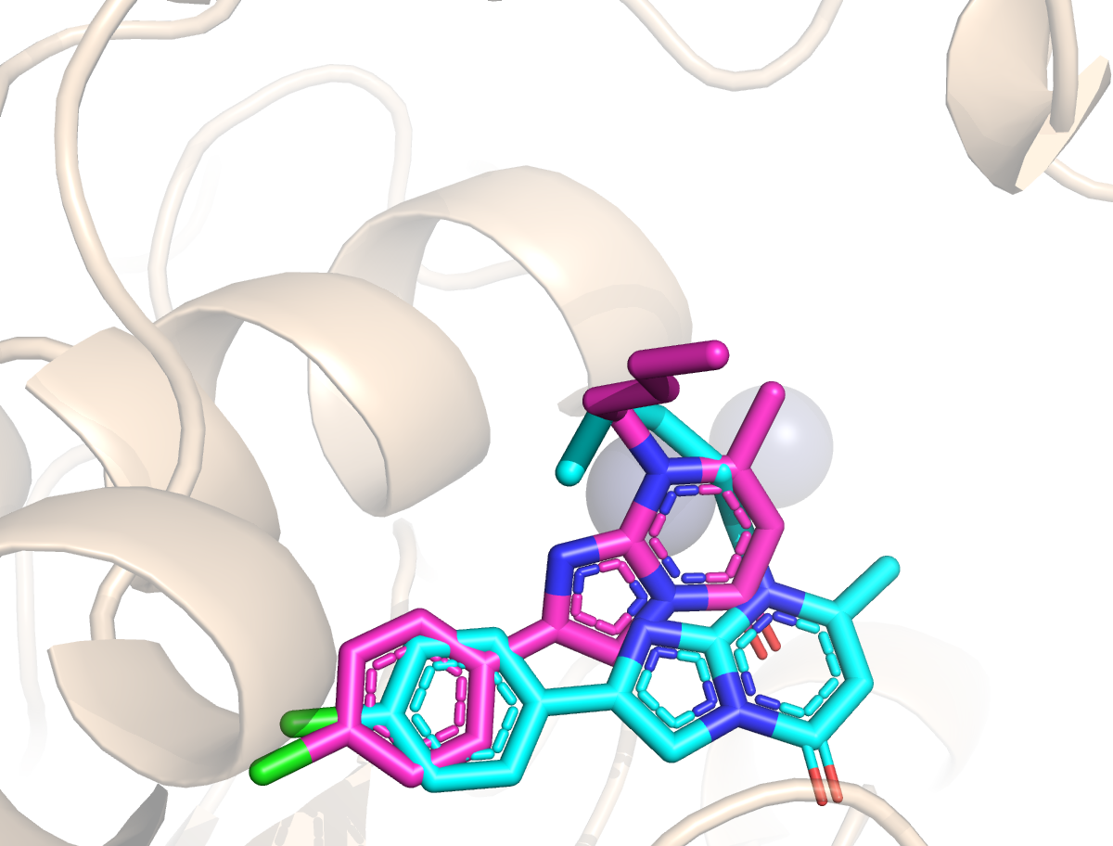
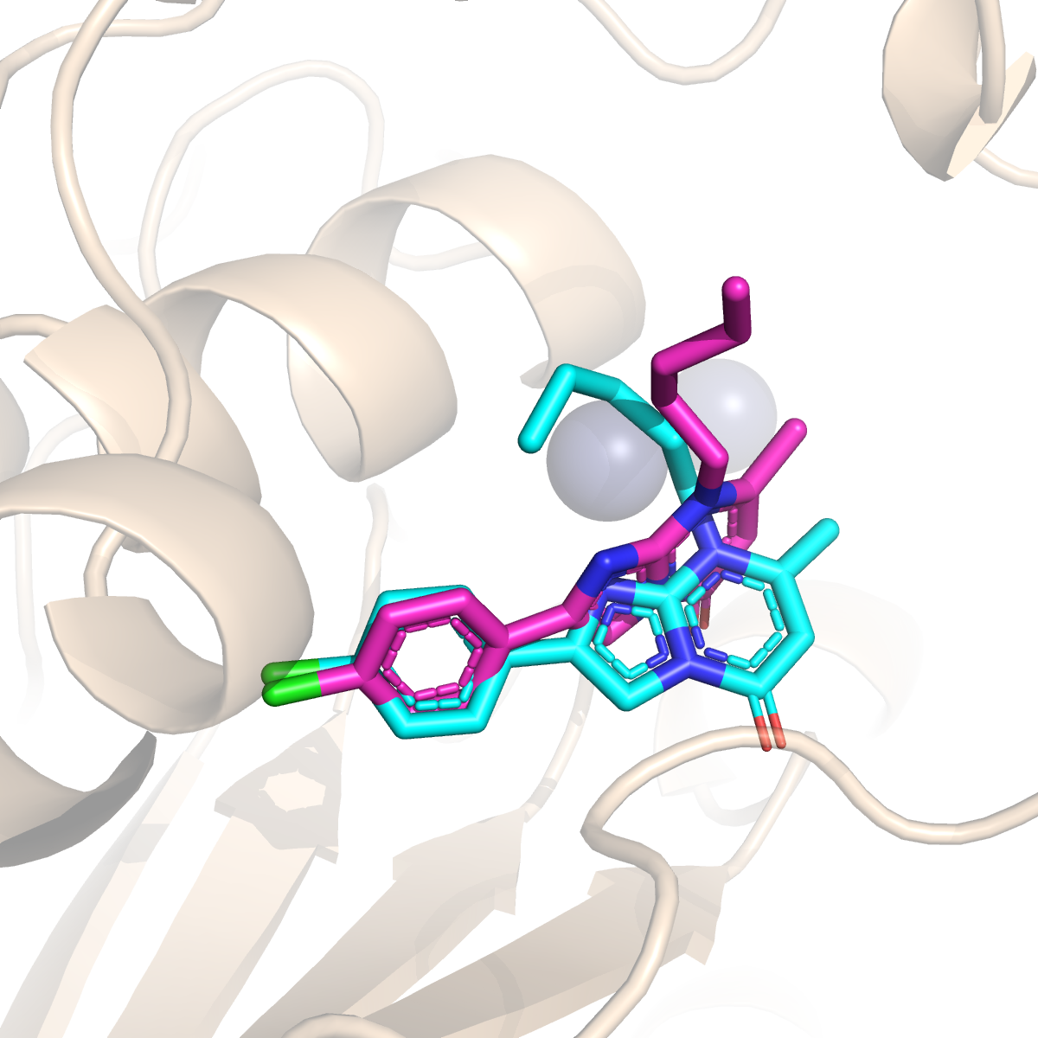
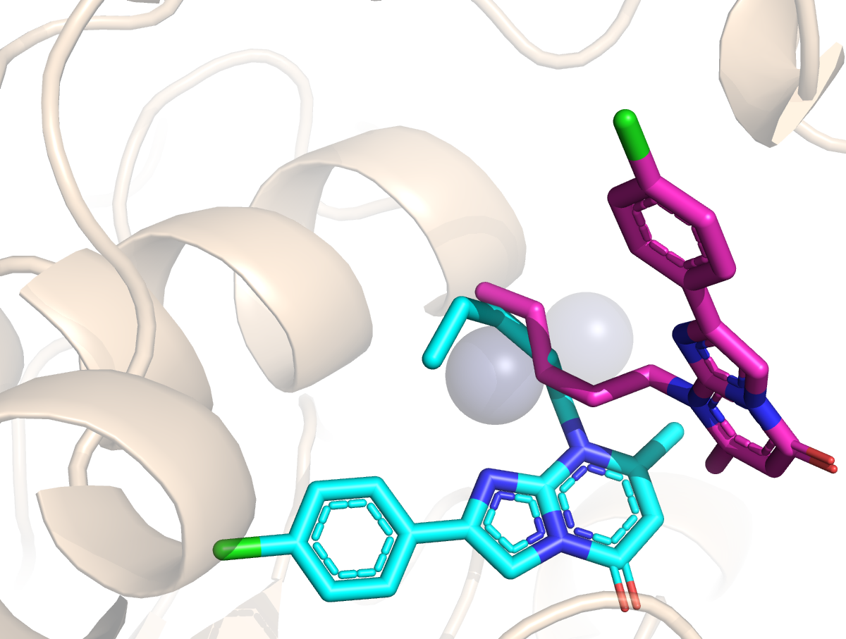
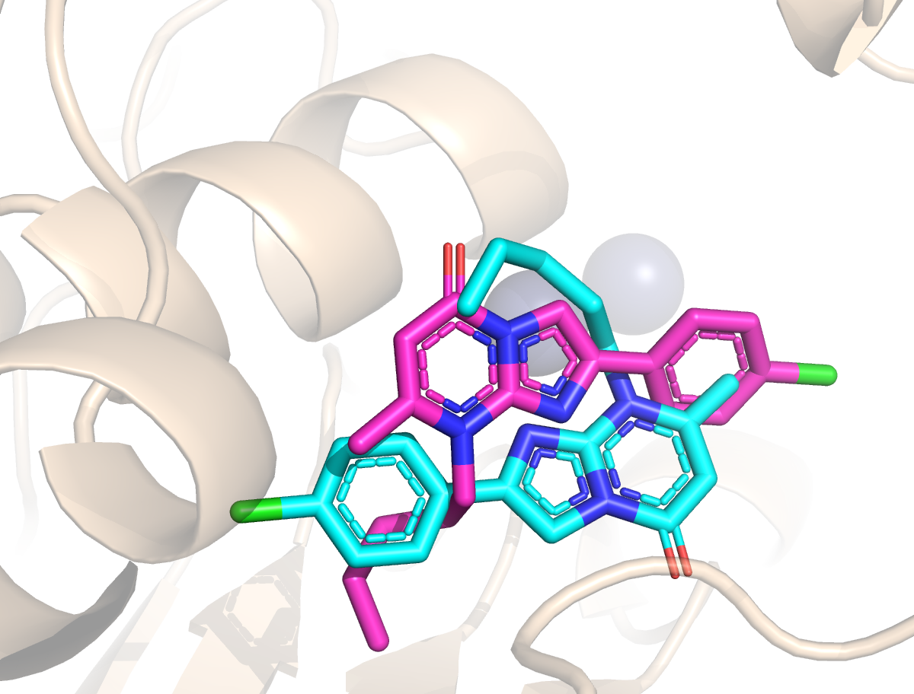
Using high similiar compound PDB structure enhances the accuracy for pose prediction compared to random selected PDB
Template Ligand Pose
Crystal Ligand Pose
Prediction Ligand Pose
Prediction #1
RMSD: 0.73 Å
L3177
Template (6LEH)
Ligand to be Predicted
Docking Score = -10.8 kcal/mol
Template similarity: 0.87
Using the template receptor (6LEH) for Docking
#2
2.80 Å
#3
2.43 Å
#4
7.83 Å
#5
7.43 Å
-8.51 kcal/mol
-7.16 kcal/mol
-6.94 kcal/mol
-7.54 kcal/mol
Using the general receptor (5DLW) for Docking
Notes:
We found that using high similiarity compound pdb structures enhances the accuracy for pose prediction than the ramdon selected pdbs. Here is the structure for L3177, which shows 87% similarity with compound in 6LEH. When use protein from 6LEH for docking, we obtained a pose with quite low RMSD, and better docking score. However, if we use the general receptor 5DLW for docking, the RMSD increases a lot, and the docking score is not as good as 6LEH. We think it is caused by the binding site strucure ajustment induced by the ligand binding.

Slide 16
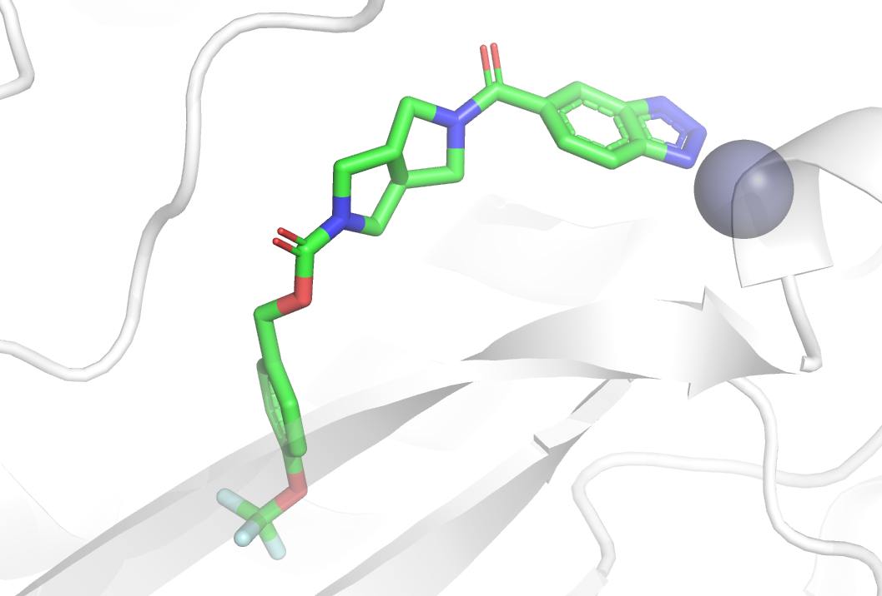
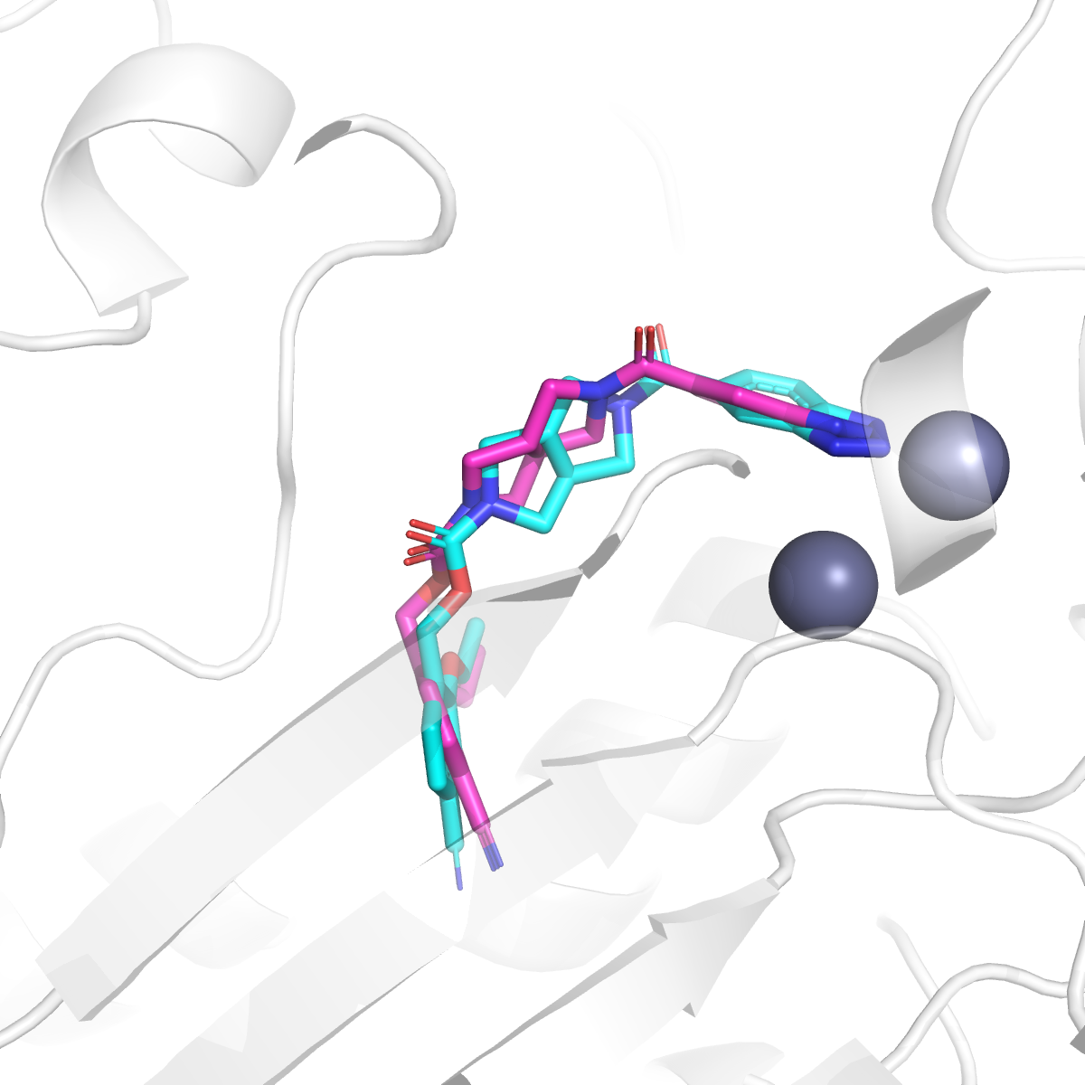
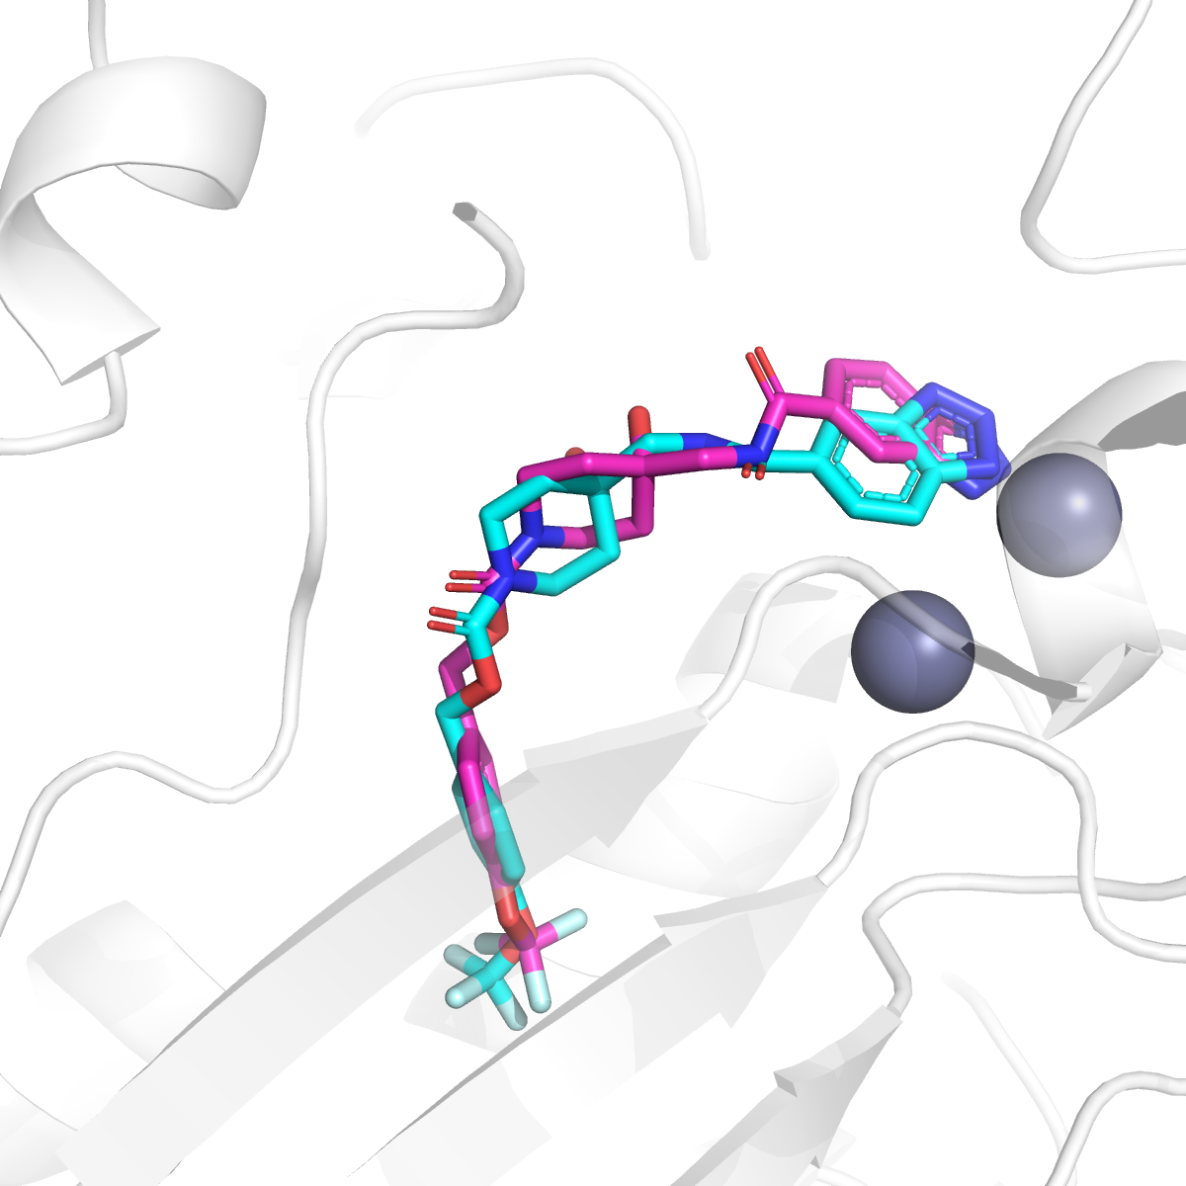
Positive examples for L3000 prediction
Template Ligand Pose
Crystal Ligand Pose
Prediction Ligand Pose
Template PDB ID: 5S9N
L3123
L3127
Template similarity: 0.80
Template similarity: 0.80
RMSD: 1.20 Å
RMSD: 1.58 Å
Notes:
There are quite a few of ligands showed similarity to native ligand from 5S9N. For these ones, we got quite good results.

Slide 17



Positive examples for L3000 prediction
Template Ligand Pose
Crystal Ligand Pose
Prediction Ligand Pose
Template PDB ID:6Y5M
L3184
L3186
Template similarity: 0.57
Template similarity: 0.56
RMSD: 1.32 Å
RMSD: 2.00 Å
Notes:
We also found some ligands share similiar substructures with compound from 6Y5M, they are colored in blue. Although the similarity score for whole compound is not larger than 0.6, we still use this structure to dock this series of compounds. Such as L3184 and L3186, for examples.

Slide 18


Negative examples for L3000 prediction
Template Ligand Pose
Crystal Ligand Pose
Prediction Ligand Pose
L3002
L3003
Template similarity: 0.47
Template similarity: 0.52
RMSD: 7.19 Å
RMSD: 7.09 Å
L3004
L3005
Template similarity: 0.44
Template similarity: 0.40
RMSD: 7.41 Å
RMSD: 10.03 Å
Notes:
However, for these compounds, although the similar substructure are docked quite well in the binding site, the rmsd for whole molecule is quite large. Due to the wrong directions for 硫胺基团. we intend to put this group nearby the zinc ions, however, it is pointed to the other side in crystal structures.

Slide 19


Pockets for L4000
Catalytically active center
Hydrogen bond acceptors and hydrogen bond donors
Main protease from the SARS-Cov-2
Zhao et al. PNAS, 2022
Hydrophobic pocket and π interaction
Notes:
L4000 is the main protease from SARS-2. We are quite familiar with this target because we have done a project about it. Here listed the key residues of the binding pocket.

Slide 20



Pockets flexiblity for L4000
PDB ID: 7SI9
PDB ID: 7VU6
Alignment & Comparison
Phe-139
Cys-144
His-162
Glu-165
His-41 flip
His-41
Pfizer PF-07321332
Shionogi S-217622
Notes:
There are two drugs on market for Mpro. The pfizer’s compound and the shionogi’s compound. Here we aligned the pokcet structures of both compounds and found that the side chain of his 41 fliped. So we use both of the pdbs for general docking.

Slide 21

The similarity search identified five ligands with available PDB structures in the RCSB database
Crystal Ligand Pose
Prediction Ligand Pose
L4006
Ligand-ID | Ligand Similarity | Template PDB ID | RMSD
L4006 | 100% | 7GS2 | 0.08
L4007 | 100% | 7GRR | 0.31
L4008 | 100% | 7GRW | 0.16
L4009 | 100% | 7GRH | 0.58
L4010 | 100% | 7GRI | 1.37
RMSD：0.08Å
Notes:
We are lucky that, by the ligand similarity seach, we found 5 compounds with pdb structures available. We just submitted the crystal structure downloaded from RCSB.

Slide 22



Positive examples for L4000 prediction
Template Ligand Pose
Crystal Ligand Pose
Prediction Ligand Pose
Template PDB ID：8DIG
L4027
L4028
RMSD: 0.69 Å
Template similarity: 0.75
RMSD: 1.57Å
Template similarity: 0.82
Notes:
Here are positive examples, high similarity template, good results.

Slide 23


Positive examples for L4000 prediction
Crystal Ligand Pose
Prediction Ligand Pose
L4001
L4002
His-162
Hydrogen
bond
His-41
Hydrophobic pocket and π interaction
RMSD: 1.97 Å
RMSD: 1.00 Å
Notes:
L4001 and L4002 formed hydrogen bond with his162, and pai-pai or hydrophobic interactions with his41, which are typical features for mpro inhibitor binding.

Slide 24
RMSDs for L1000, L2000, L3000 and L4000
RMSD distribution for Top 1 pose
Lowest RMSD distribution for Top 5 pose
Notes:
Here is the RMSD for all the ligand prediction for L1000 to L4000. It seems that L4000 is the best one, and L3000 is not that good. The lowest RMSD distribution for top 5 is better than top1 for all the targets. It is indicated that for some ligand we may generated correct poses, but could not rank it as No. 1 pose.

Slide 25


L5001v1 prediction (unknown binding site)
Crystal Ligand Pose
Prediction Ligand Pose
L5001v1
Pocket Prediction 2
Pocket Prediction 1 (Correct one)
RMSD : 2.64 Å
Notes:
For L5001, we docked the ligand to two possible binding pockets. Based on the docking score and binding pose analysis, luckly, we selected the pose with RMSD of 2.64 A. We think it is a good results for blind docking.

Slide 26



T1214 prediction
Crystal Ligand Pose
Prediction Ligand Pose
Initial guess conformation
T1214
Comparion of Modeling and our Prediction
Tyr-99 flip
Tyr-99 π interaction
RMSD : 0.80 Å
Tyr-99 in crystal structure forms π interaction with the ligand
Notes:
For T1214, the ligand is quite plane with triple aromatic rings. We ajust the Tyr-99 in the binding site manually, to make it feasible to form pi-pi interactions with the ligand. The crystal structure proved that this residue does undergo the conformational change upon ligand binding.

Slide 27


Positive examples for RNA-ligand prediction
Crystal Ligand Pose
Prediction Ligand Pose
Template
Crystal Receptor
Prediction Receptor
Similarity: 1.00
R1261v1
PDB ID: 6OD9
RMSD: 0.90 Å
Notes:
For R1261, we found compounds with 100% similarity. The RMSD is quite low.

Slide 28


Positive examples for RNA-ligand prediction
Crystal Ligand Pose
Prediction Ligand Pose
Template
（same with R1261v1）
Crystal Receptor
Prediction Receptor
R1262v1
PDB ID: 6OD9
RMSD: 0.59 Å
Notes:
For R1262, we use the same template as 1261, because the ligand to predict share the same substructure with the template.

Slide 29



Negative examples for RNA-ligand prediction
Crystal Ligand Pose
Prediction Ligand Pose
Template Ligand Pose
Crystal Receptor
Prediction Receptor
Template Receptor
R1263v1
RMSD: 51.49 Å
R1264v1
prediction binding site
real binding site
Template information：
RMSD: 50.33 Å
PDB ID：4XW7
Sequence identity：100%
Notes:
For these two targets, we found pdb with 100% sequence identity, and use the ligand binding site from this structure. However, is not the real binding site. We are totally wrong for this target.

Slide 30



Negative examples for RNA-ligand prediction
Crystal Ligand Pose
Prediction Ligand Pose
Crystal Receptor
Prediction Receptor
D1273
RMSD: 6.60 Å
Notes:
For D1273, and

Slide 31





Negative examples for RNA-ligand prediction
Crystal Ligand Pose
Prediction Ligand Pose
Crystal Receptor
Prediction Receptor
R1288
RMSD: 21.32 Å
Notes:
And for R1288, the target structure is not correclty predicted, it seems not possible to obtain a good result for ligand prediction.

Slide 32
Summary
Useful Strategies:
Utilizing PDB structures in complex with highly similar compounds as receptor significantly improves the accuracy of pose prediction compared to randomly selected PDBs.
Conformational changes in the active site, particularly involving aromatic side-chain residues, have a substantial impact on binding pose prediction.
Employing multiple receptor structures can facilitate the generation of a diverse set of binding poses.
Existing protein-ligand complex structures of the target protein or its homologues can serve as valuable references for binding poses selection.
Challenges:
The accurate pose can not be generated correctly due to the binding site flexibility or incorrect identification of the binding pocket.
Although the correct pose may be generated, it may not be ranked as the top No. 1 pose.
Receptor structure prediction, especially for RNA/DNA structures, remains challenging and prone to inaccuracies.
Binding affinity predictions exhibit low accuracy across different approaches, including physical-based, semi-empirical docking scores and AI-based affinity predictions.
Notes:
For summary.

Slide 33




Acknowledgement and contributions
Acknowledgement
Prof. Chun Chan (Xi’an Jiaotong-Liverpool University)
Prof. Liangxu Xie (Jiangsu University of Technology)
Prof. Xiaoqin Zou (University of Missouri)
Primary Biotechnology Inc. for providing the computational resources
Finacial support from National Natural Science Foundation of China (62373172)
Contributions
Prof. Ren Kong (JSUT): Supervisor, workflow design, docking, data analysis and pose selection.
Prof. Shan Chang (JSUT): Supervisor, coding, pose selection, data analysis and file format processing.
PhD. student Zunyun Jiang (NJAU): Docking, data analysis and pose selection.
Senior engineer Xufeng Lu (PMR): Coding, data analysis and file format processing.

