Slide 1
Protein-ligand Structure Prediction by Template-guided Ensemble Docking
Application to CASP16 Ligand Tasks
Keqiong Zhang, Qilong Wu, Sheng-You Huang*
Dec. 03, 2024
School of Physics
Huazhong University of Science and Technology
Wuhan, China

Slide 2
Outline
Method used for CASP LG tasks
CASP experience
Cases we went right
Cases we went wrong
What we learn from CASP16

Slide 3
Outline
Method used for CASP LG tasks
CASP experience
Cases we went right
Cases we went wrong
What we learn from CASP16

Slide 4
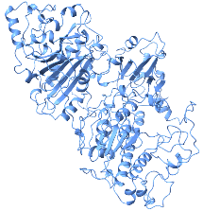
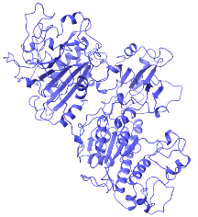
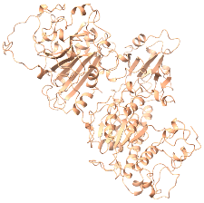
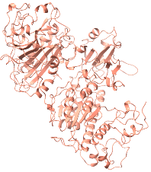
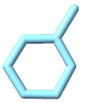
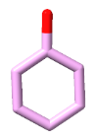
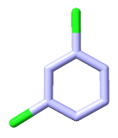
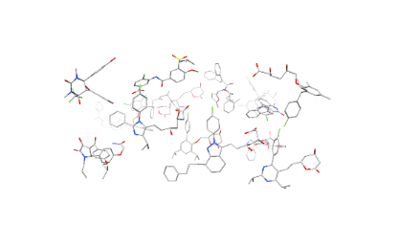

Method used for CASP LG tasks
Generation of receptor ensemble
De novo modelling
AF3
“3D structure ensemble”
sequence
KRAEWDSPW···
Homology modelling
MODELLER
…
Final
pose
have template
Ligand alignment
ITScore
Human check
PDB
···
SMILE
LSalign + Human
c1ccccc1
Search template
seqID, LigTC
qMCS, tMCS
no template
Molecular docking
MDock, XDock, HcovDock

Slide 5
Method used for CASP LG tasks
Search reliable templates
Sequence identity: ≥ 30% (≥ 60% for RNA-Ligand tasks)
Required
Ligand similarity: Tanimoto coefficient ≥ 0.30
Satisfy one of the conditions
Maximum common substructure (MCS) on query: ≥ 0.50
MCS on template: ≥ 0.50
Definition of MCS-coverage:
&
qMCS
tMCS
Ligand alignment
alignment: LSalign (Rigid & Flexible) + human adjust rotatable bonds
energy minimized: XDock (flexible minimization), MDock (Rigid minimization)
RDKit: Open-Source Cheminformatics Software. https://www.rdkit.org.

Slide 6
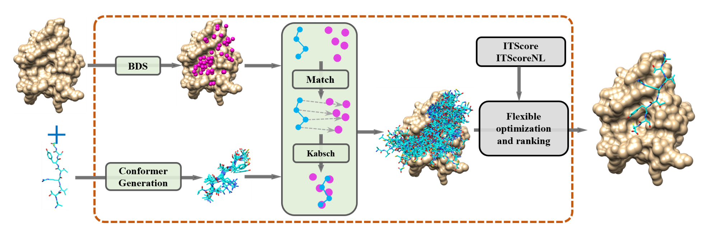
Method used for CASP LG tasks
For tasks without relable templates
XDock
Wu Q, Huang S Y. XDock: A General Docking Method for Modeling Protein–Ligand and Nucleic Acid–Ligand Interactions[J]. Journal of Chemical Information and Modeling, 2024.

Slide 7
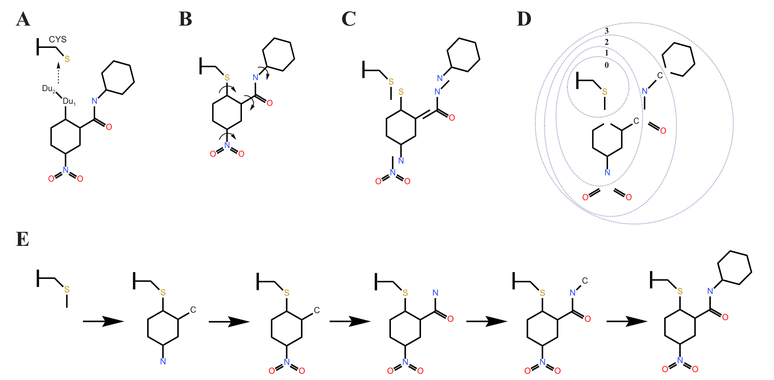
Method used for CASP LG tasks
HcovDock
Wu Q, Huang S Y. HCovDock: an efficient docking method for modeling covalent protein–ligand interactions[J]. Briefings in Bioinformatics, 2023, 24(1): bbac559.

Slide 8
Outline
Method used for CASP LG tasks
CASP experience
Cases we went right
Cases we went wrong
What we learn from CASP16

Slide 9
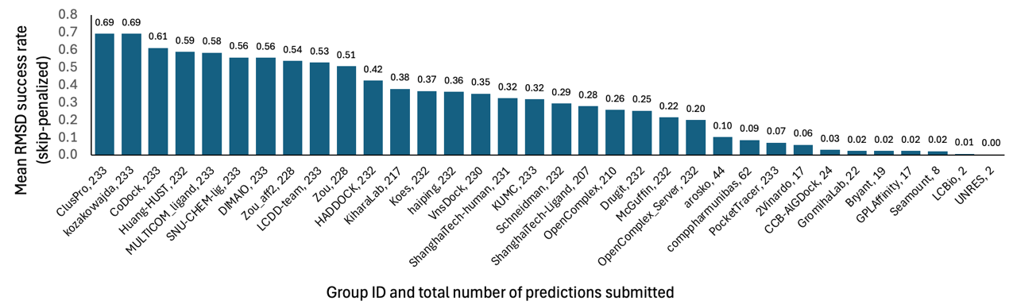
CASP experience
Performance in binding pose prediction

Slide 10
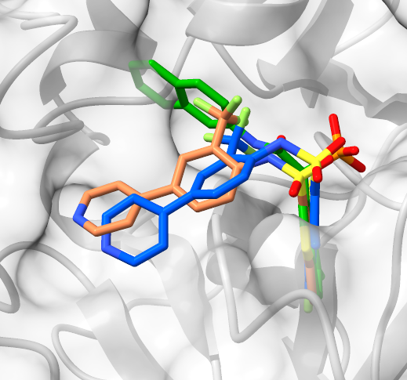
CASP experience
What we went right ?
L1003 RMSD= 1.914
Crystal structure
“misleading” template 2HVX
Our prediction (XDock)

Slide 11
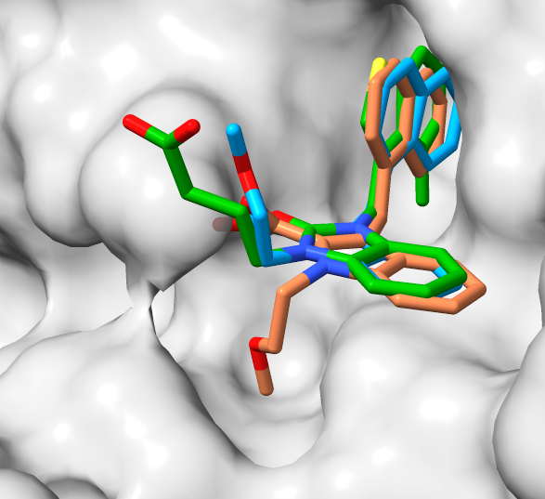
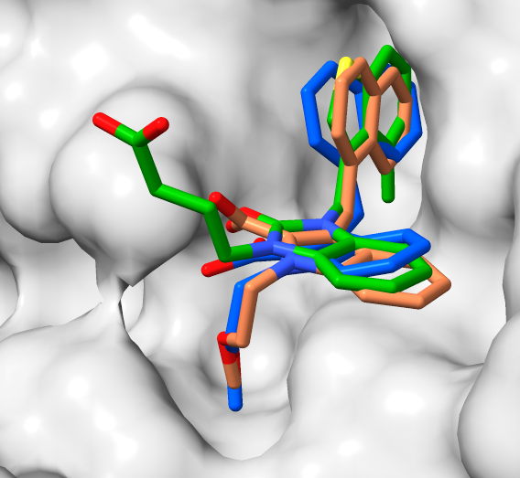
CASP experience
What we went right ?
Direct alignment
Our prediction
(LSalign + human adjust)
L1013 RMSD= 1.057
Crystal structure
template 3S0N

Slide 12
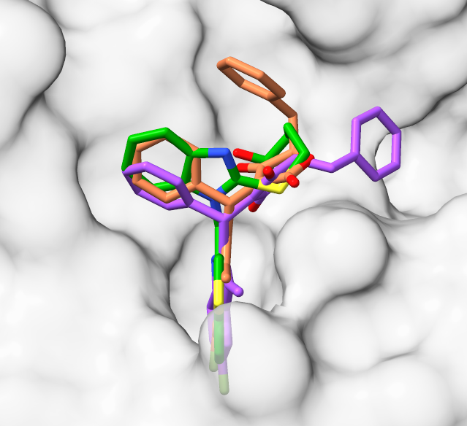
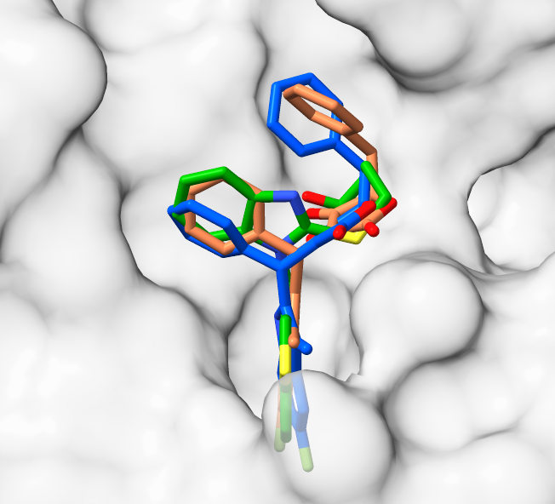
CASP experience
What we went right ?
Direct XDock
Our prediction
(LSalign + human adjust)
L1009 RMSD= 1.469
Crystal structure
template 4KP0

Slide 13
Outline
Method used for CASP LG tasks
CASP experience
Cases we went right
Cases we went wrong
What we learn from CASP16

Slide 14
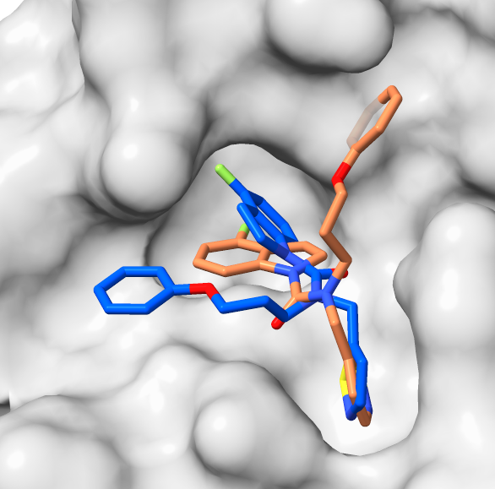
CASP experience
What we went wrong ?
L4026 RMSD= 5.66
Crystal structure
（ no reliable template ）
Our prediction (XDock)
Clash in the pocket leads to wrong docking poses !

Slide 15
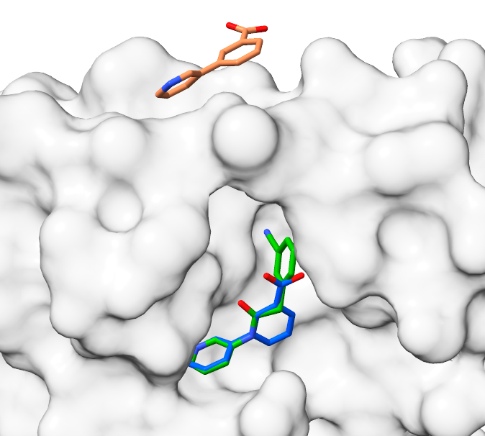
CASP experience
What we went wrong ?
L4006 RMSD= 16.511
Crystal structure
“good” template 5RGZ
Our prediction (LSalign+ITScore)
Other potential binding sites were overlooked!

Slide 16
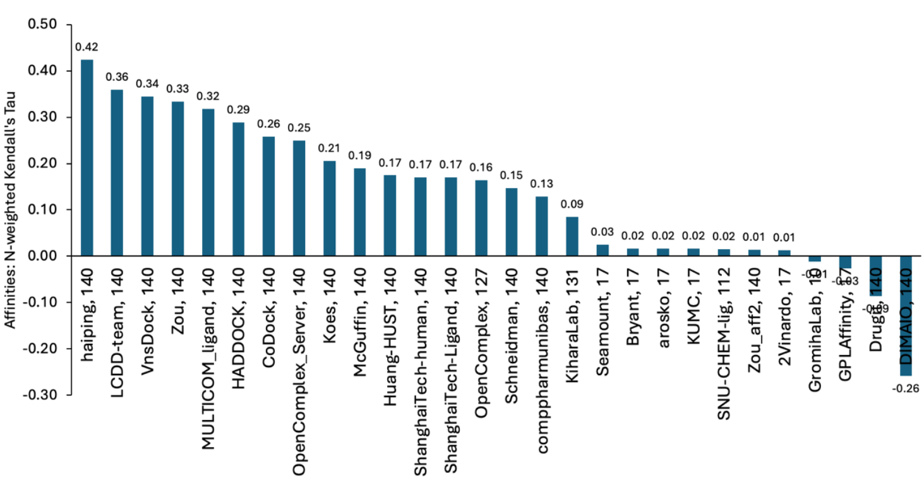
CASP experience
What we went wrong ?
binding affinity prediction

Slide 17
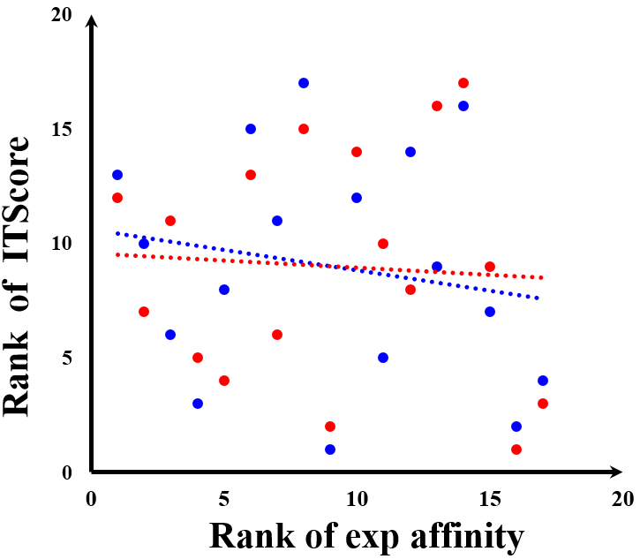
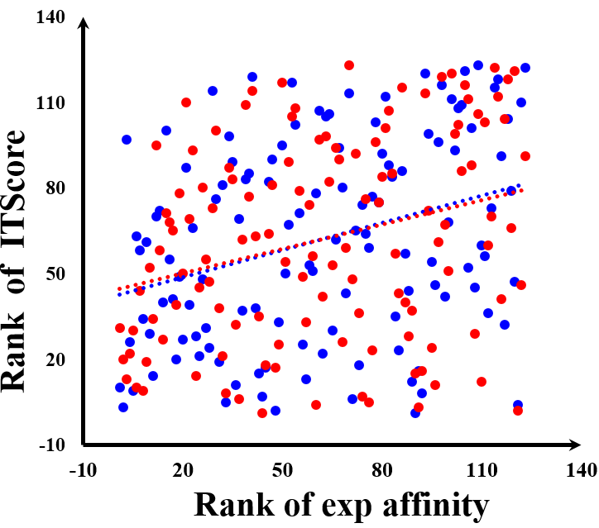
CASP experience
What we went wrong ?
L1000 (n=17)
L3000 (n=123)
0.32
-0.06
0.28
-0.18
Stage 1
Stage 2

Slide 18
Outline
Method used for CASP LG tasks
CASP experience
Cases we went right
Cases we went wrong
What we learn from CASP16
Notes:
So, what we have learned from CASP16 experiments?

Slide 19
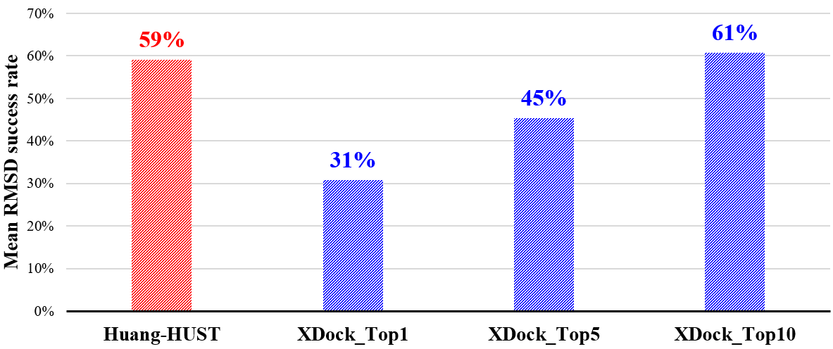
What we learn from CASP16
“Docking” or “Template-based” ?
CASP16 success rate: 59%
“Template-based + Docking + Human” vs. “Docking with native protein”

Slide 20
What we learn from CASP16
Lessons we have learned
Although the receptor ensemble docking can to some extent provide a description of protein flexibility, flexible protein-ligand docking algorithms remain a challenge.
Template-based methods are not always accurate. Further evaluations with traditional docking methods and manual inspection is essential. Combining different methods is necessary.
Binding affinity prediction is much more challenging than binding pose prediction. There is an urgent need to develop an accurate scoring method for binding affinity prediction.

Slide 21
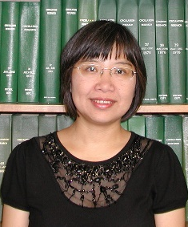
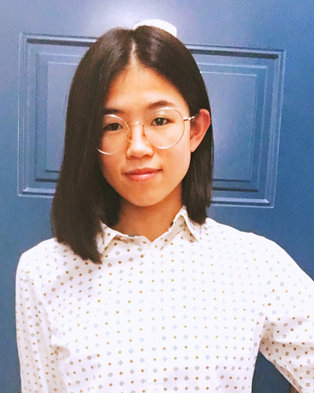
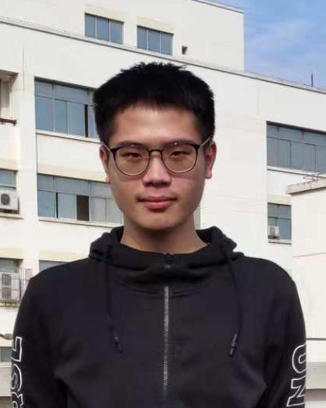



Acknowledgements
Prof. Xiaoqin Zou
University
of Missouri
at Columbia
Keqiong Zhang
Qilong Wu
Protein-ligand prediction:
Dr. Keqiong Zhang: kqzhang@hust.edu.cn
Dr. Qilong Wu: d202180088@hust.edu.cn
Prof. Sheng-you Huang: huangsy@hust.edu.cn

Slide 22
Thanks!

