Slide 1


CASP 16 Ligand Performance
Kozakov/Vajda (LG274) and ClusPro (LG494)

Slide 2
Acknowledgements
Stony Brook University:
Sergei Kotelnikov
Ryota Ashizawa
Stan Xiogang Li
Xin Cao
Yimin Zhu
Ernest Glukhov
George Jones
Dr. Dzmitry Padhorny
Prof. Mark Lukin
Prof. Dima Kozakov
Boston University:
Omeir Khan
Masha Lazou
Ayse Bekar
Prof. Diane Joseph-McCarthy
Prof. Sandor Vajda
Funding:
R35GM118078 RM1135136 from NIGMS
20

Slide 3
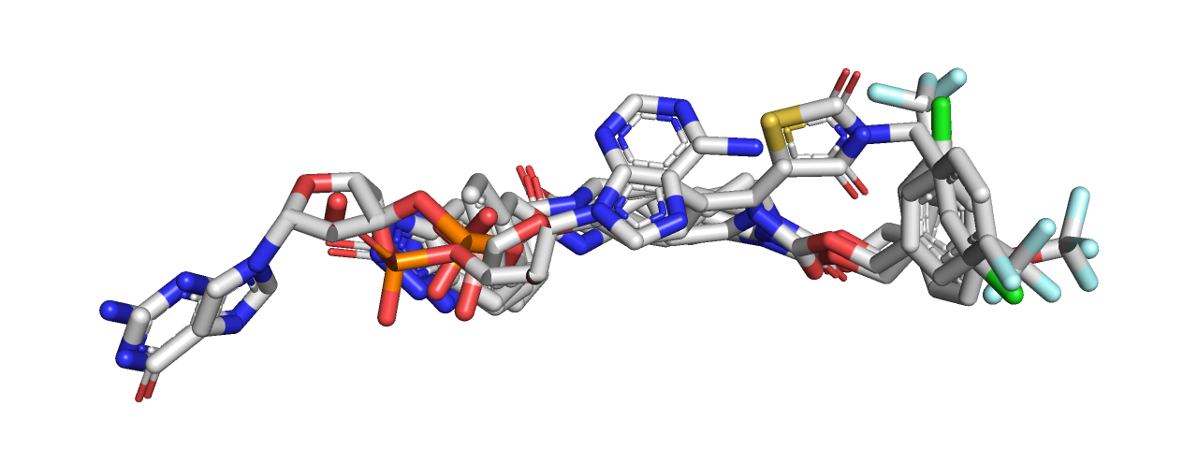
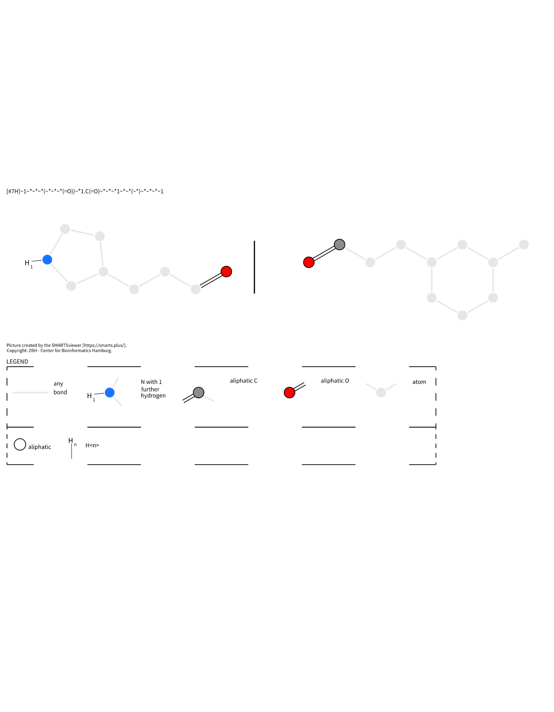
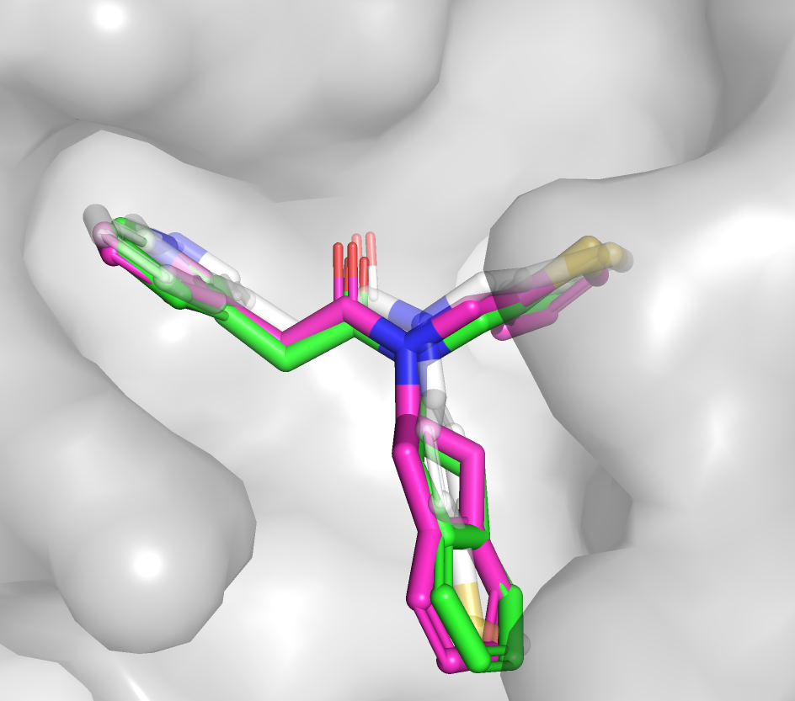
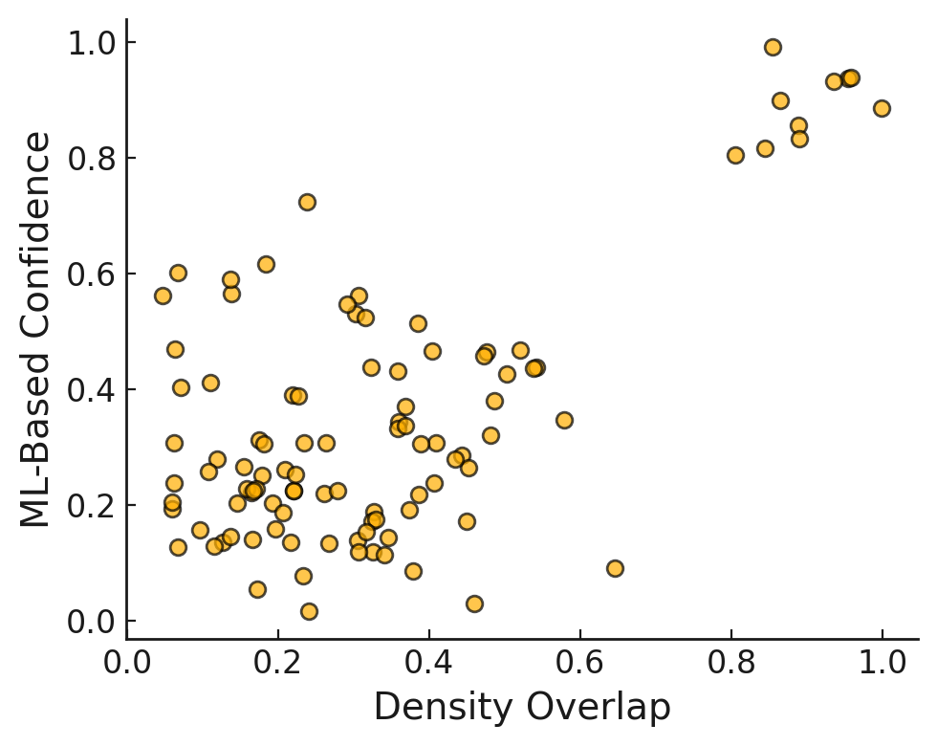
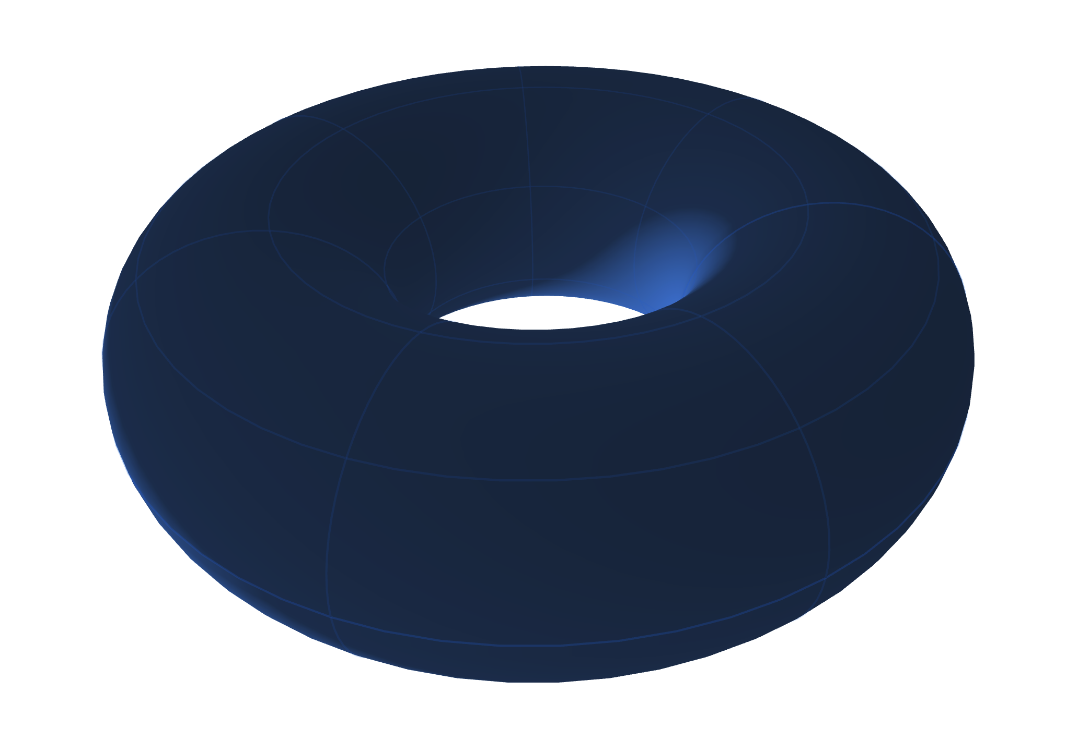
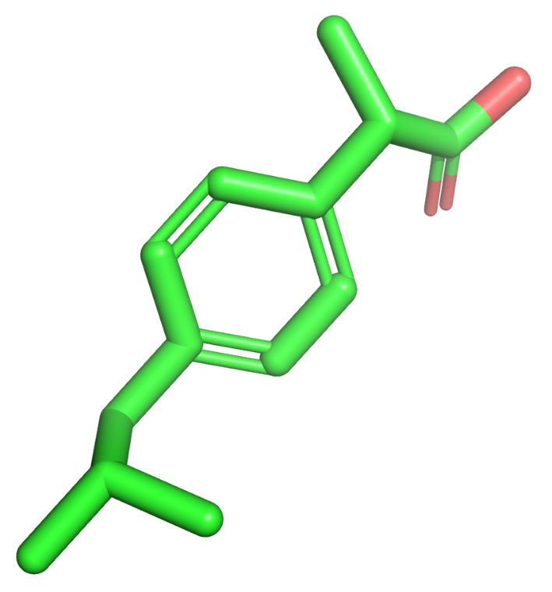
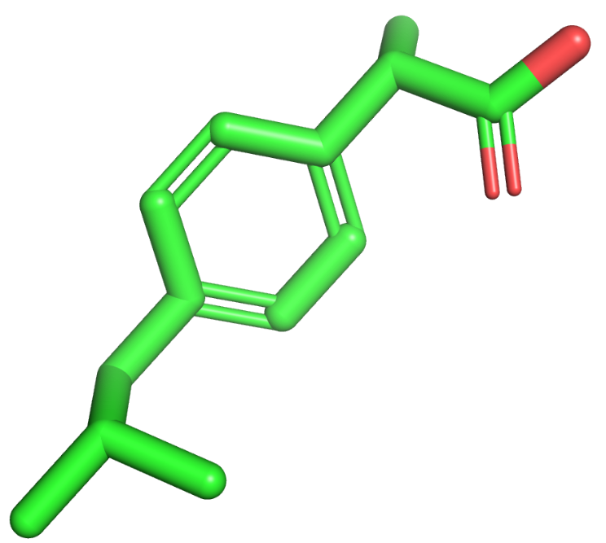
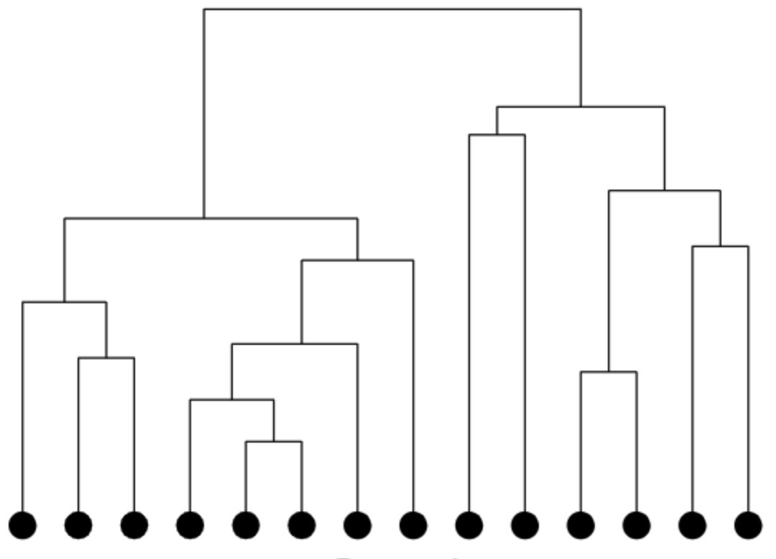
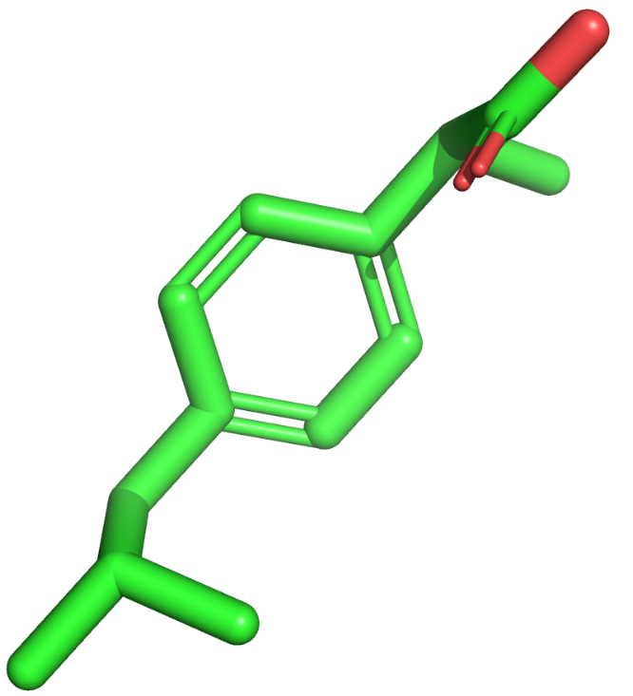
Overview of the ClusPro LigTBM diffusion pipeline (inspired by D3R)
Template search and ligand identification
Anchor mapping
Torsion sampling with positional constraints
Physics-based sampling
Diffusion model sampling
Scoring
Clustering by RMSD
1
Notes:
Mention ClusPro LigTBM, and how for this CASP we created a new protocol which utilized the underlying principles of the LigTBM method

Slide 4
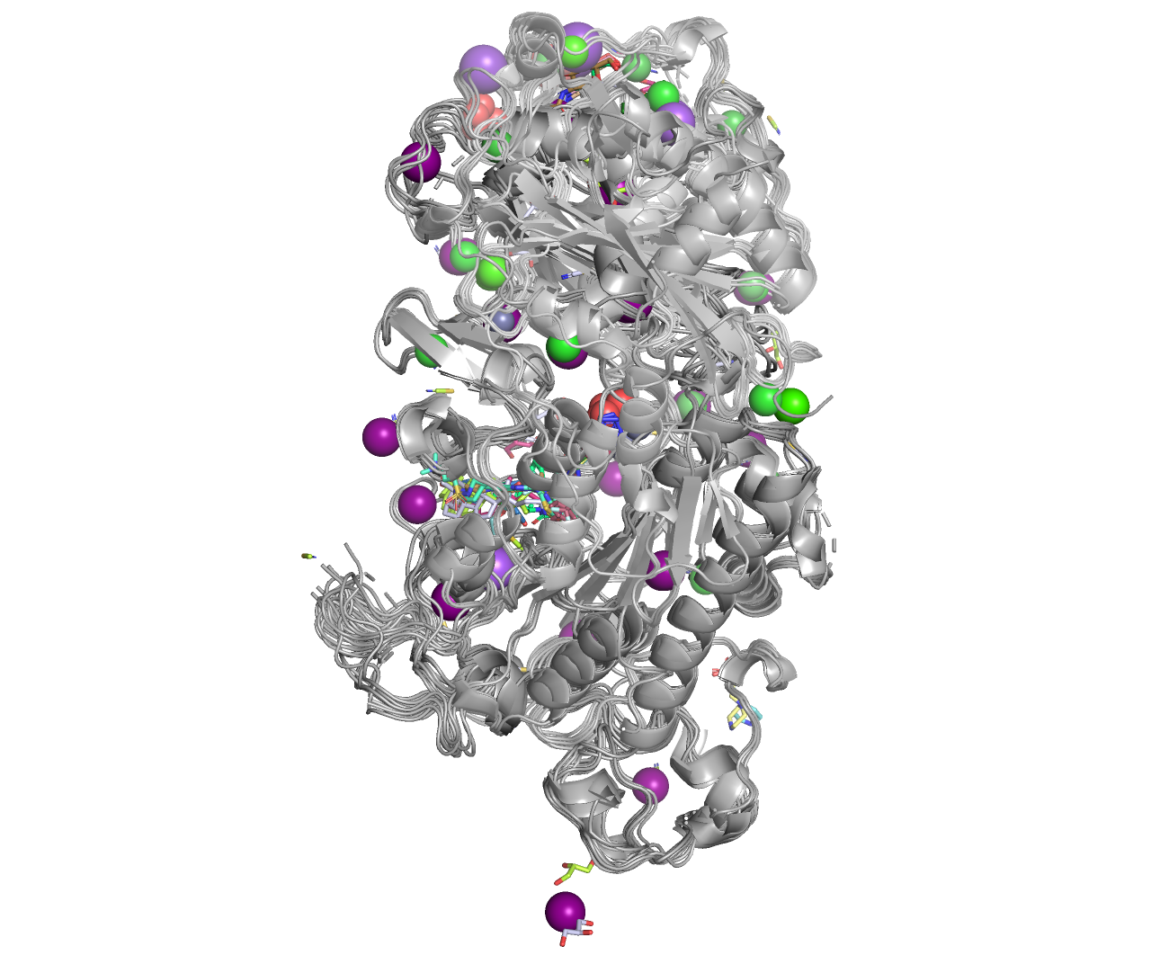
Step 1. Identify homologous holo structures in the PDB
Inputs:
Protein Sequence: FTASRIKRAEWDEGPPTVLSDSPWTATSGSCKGRCFELQEVGP…
Ligand SMILES: COc1cc(C(=O)N2C[C@@H]3CN(C(=O)c4ccc5[nH]nnc5c4)C[C@H]3C2)cc2ccccc12
≥ 50% sequence identify
Identify conserved interaction sites in the ensemble of bound ligands
Ensemble of homologous receptors
2
Notes:
Use L3124 as the example

Slide 5
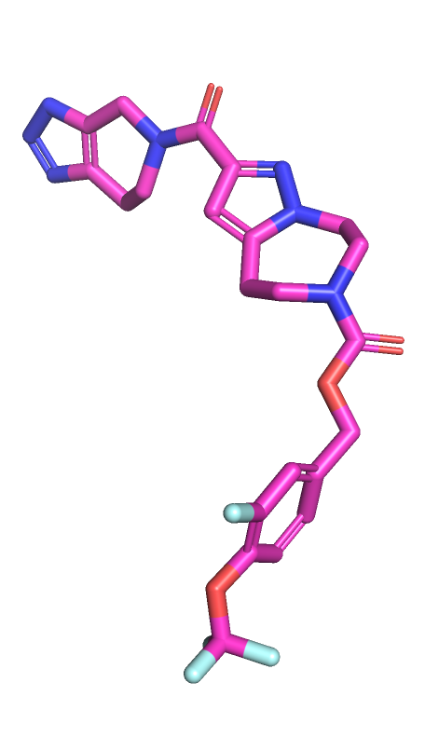
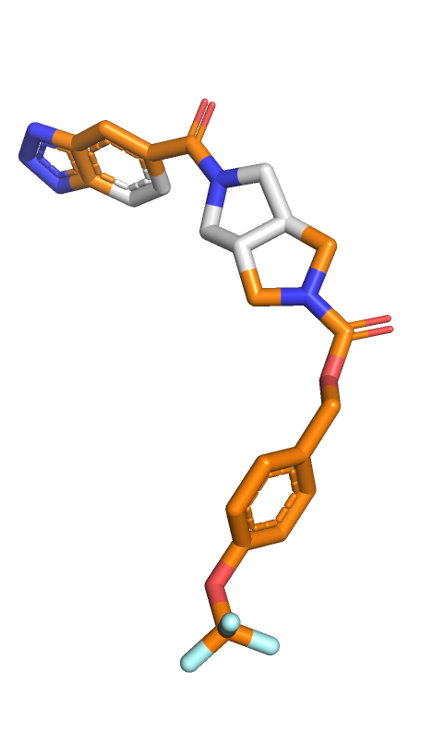
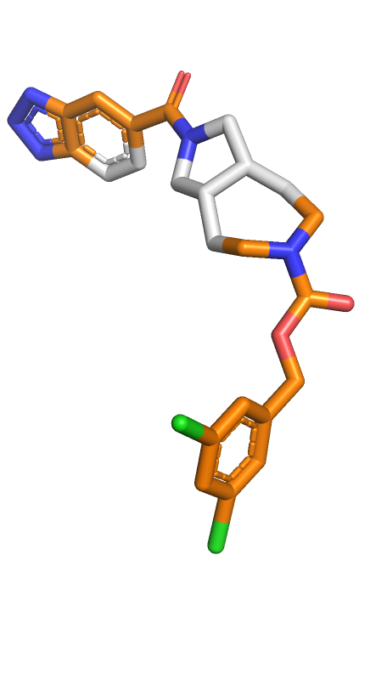
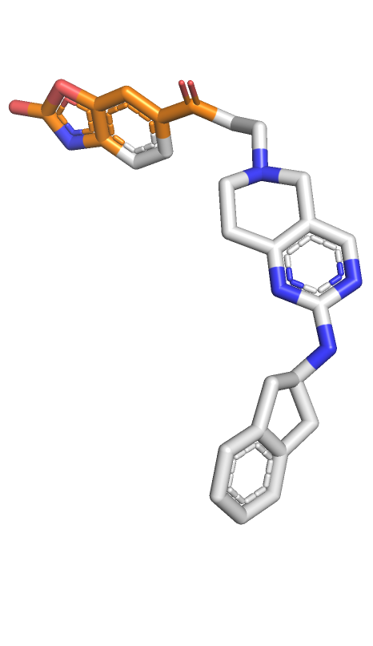
Step 2. Identify similar ligands in the ensemble
Identify conserved motifs in crystallized ligands that resemble motifs in the target ligand
Similar motifs in holo structures
…
Target ligand
Template 1
Template 2
Template 3
3
Notes:
Anchor selection can be informed by the ensemble of template ligands

Slide 6
Step 3. Select anchor atoms for docking
Write a SMARTS pattern to describe shared motifs
SMARTS patterns map template atoms to target ligand atoms
Use these atoms to anchor docked poses on template atoms with the specified substructure
Anchor SMARTS pattern:
Target ligand
Templates with Best Similarity
[#7H]~1~*~*~*(~*~*~*(=O))~*1.C(=O)~*~*~*1~*~*(~*)~*~*~*~1
4
Notes:
We write smarts patterns to describe shared motifs that also form interactions that are conserved in the ligand ensemble

Slide 7
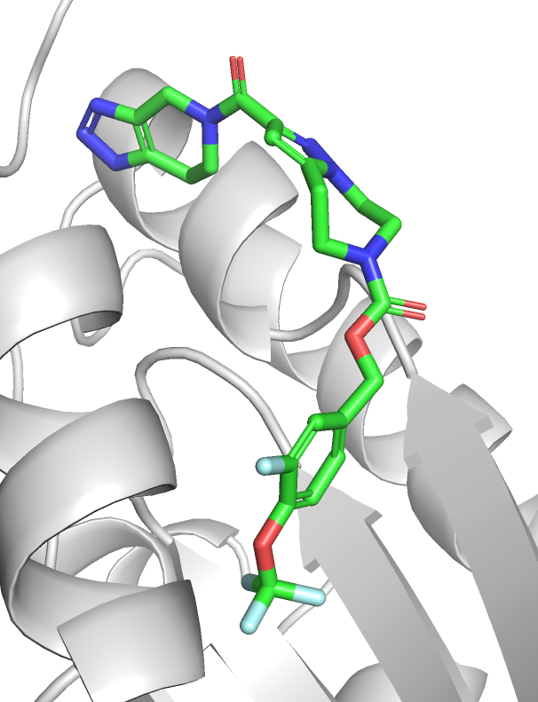
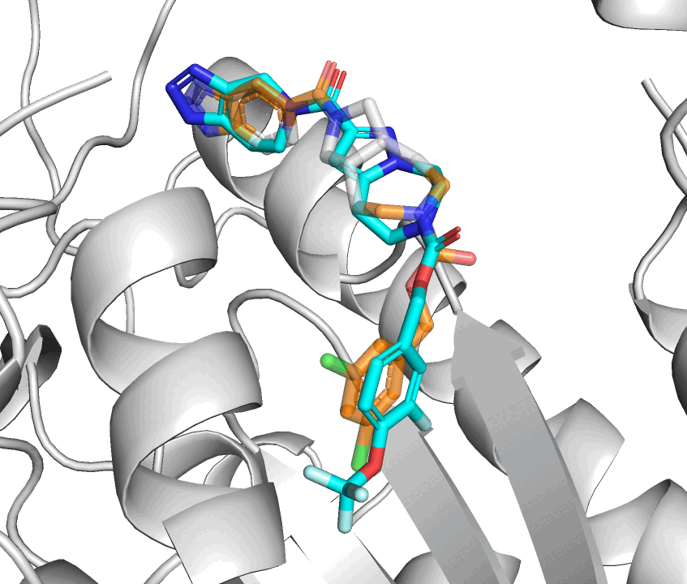
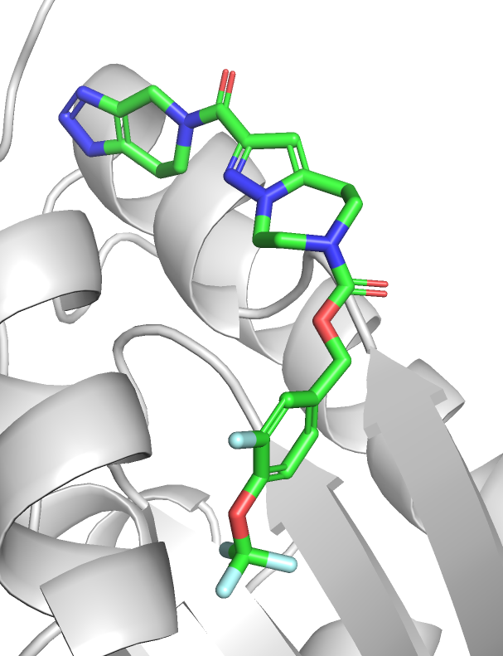
Step 4. Constrained docking protocol
Physics and diffusion-based conformer generation with constrained anchor atom positions
Minimization
+
Clustering
Protein FF: Amber 14
Solvent Model: OBC2
Ligand FF: SMIRNOFF
Aligned conformers
Diverse Low Energy Poses
5
Notes:
Typically, this goes from hundreds of poses to < 20 poses that can be further analyzed
Generate conformers with constrained anchor atom positions
Remove poses which clash with receptor atoms
Minimize aligned conformers in implicit solvent
Cluster minimized poses by RMSD, keep the lowest energy member of each cluster

Slide 8
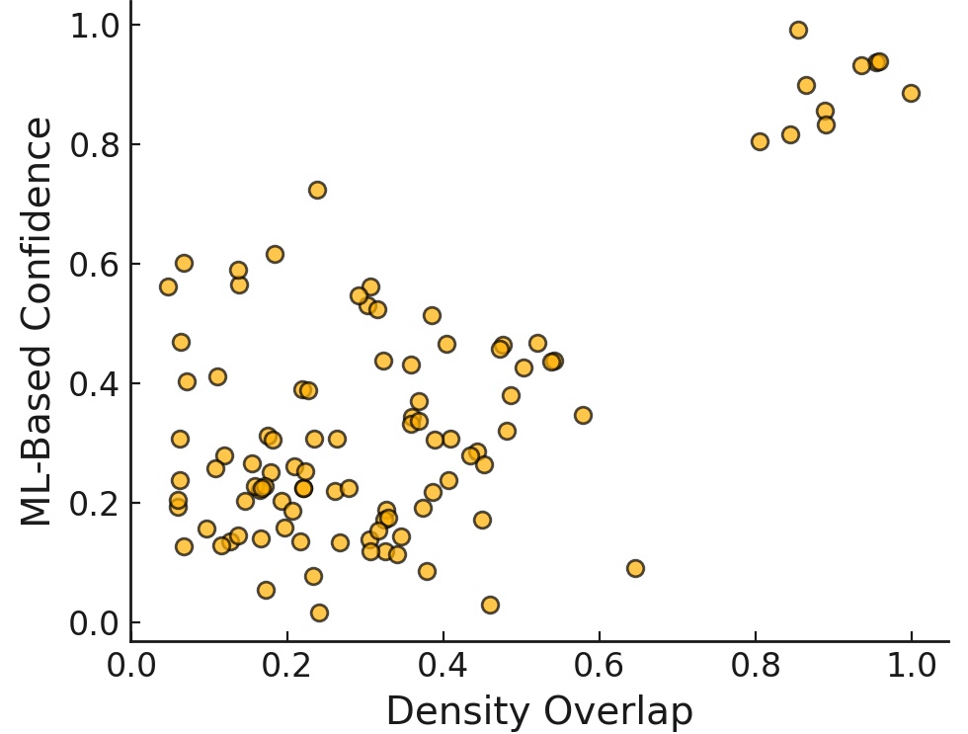
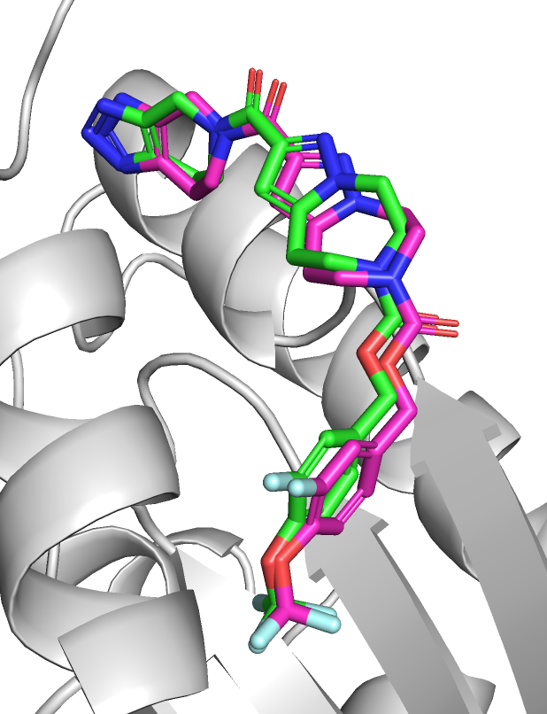
Step 5. Ranking and selecting poses
Poses are scored using a combination of orthogonal metrics:
Diverse Low Energy Poses
Metric
Selected Poses
Final poses score well in multiple metrics!
6

Slide 9
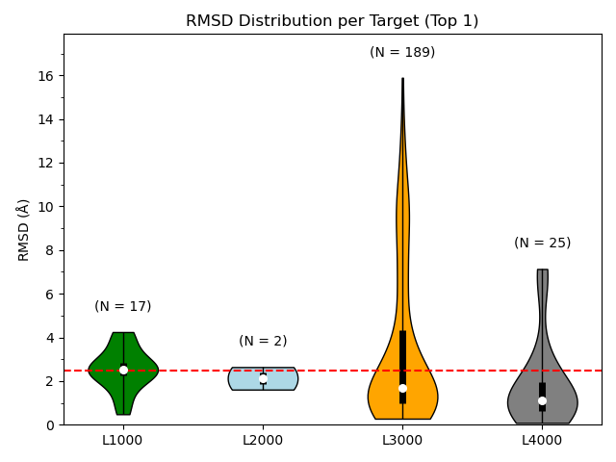
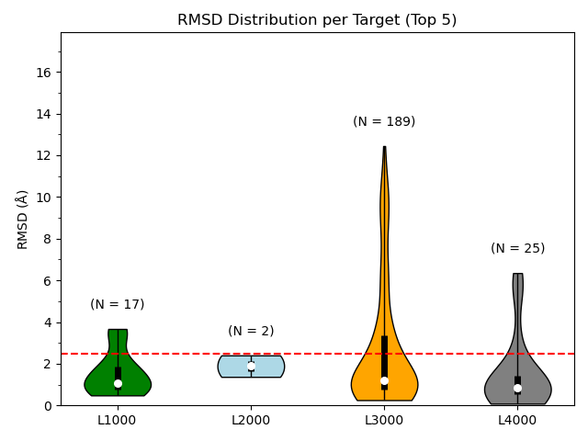
Overall success rates in CASP16 (Pharma Ligands)
Success Rates (Top1/Top5 < 2.5Å RMSD):
L1000: 42/82% L2000: 50/100% L3000: 61/65% L4000: 80/84%
7
Notes:
Scoring can be improved, but sampling is good

Slide 10
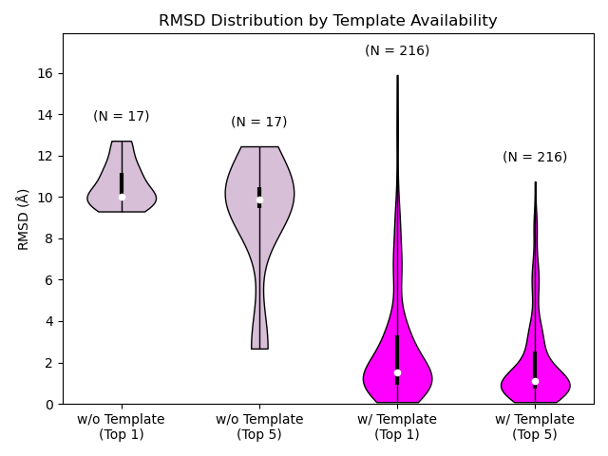
Model quality is dependent on template availability
When a template is available, low RMSDs are typically achieved!
When no robust template was available,we could not accurately mode target ligands
8

Slide 11
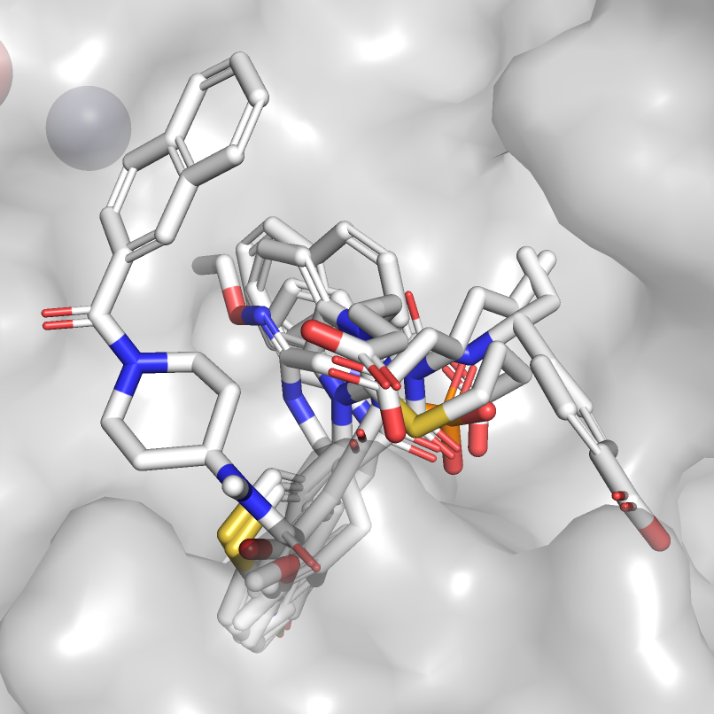
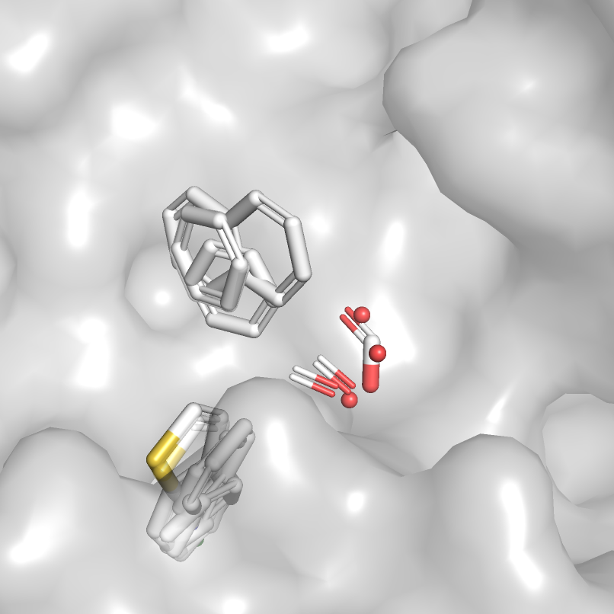
Conserved motif identification (L1000/L2000)
Identifying conserved aromatic groups and HBA/Anionic groups assisted with anchor selection
Ensemble of template ligands
Conserved interaction sites
9

Slide 12
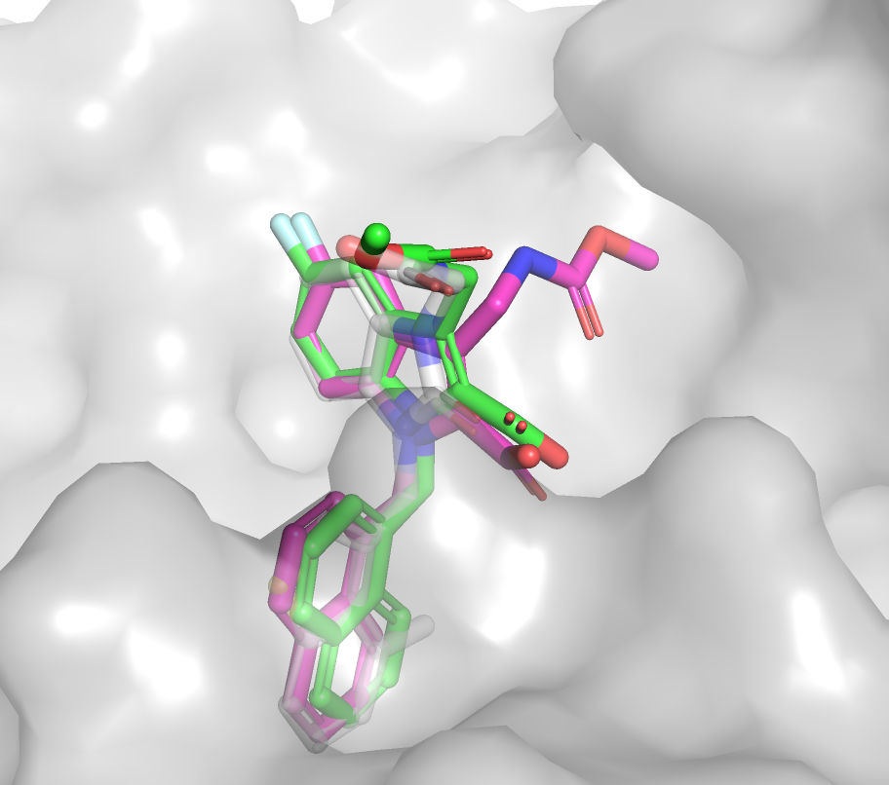
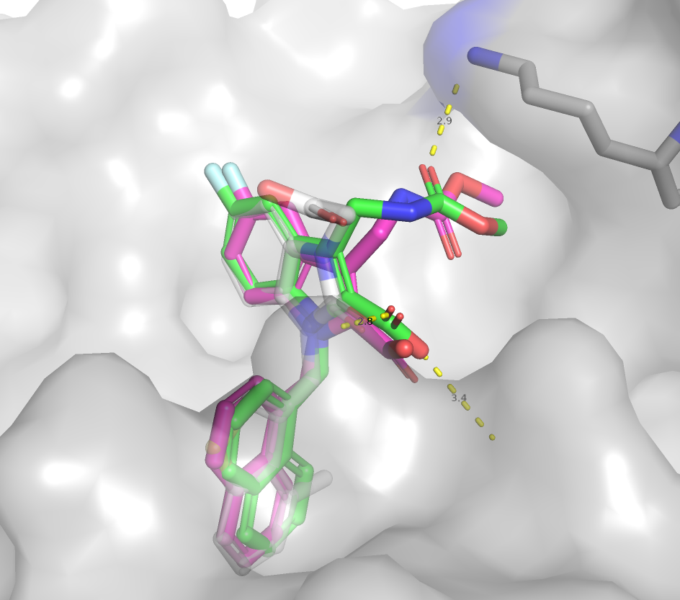
What went right: L1005
Diverse pose selection improved results
Model 1 RMSD: 2.8 Å
Template PDB: 4K69 (Rec) 3S0N (Lig)
Model 3 RMSD: 0.9 Å
Template PDB: 4K69 (Rec) 3S0N (Lig)
10
Key: Template Ligand, Model Ligand, Experimental ligand
Notes:
4K69 was chosen as the receptor to dock to because it was 100% sequence ID to Chymase and it was in a conformation where LYS was exposed

Slide 13
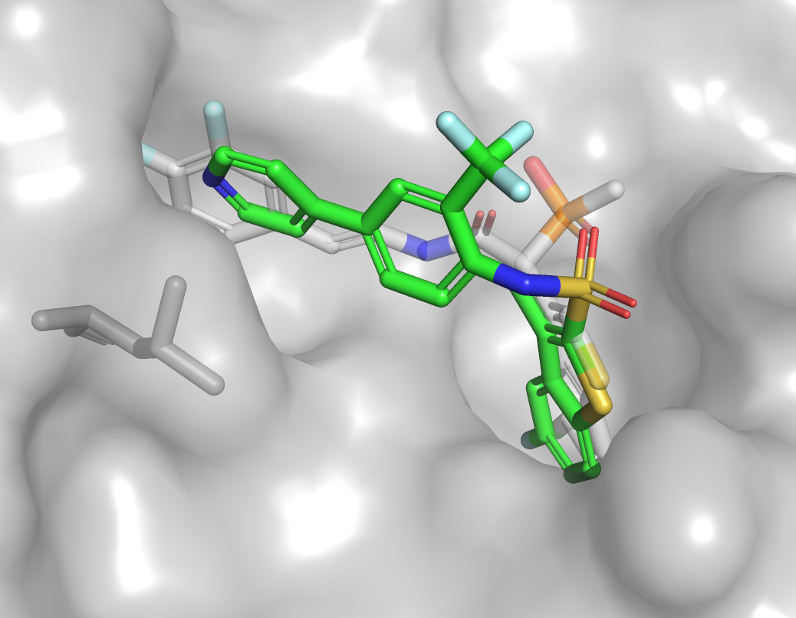
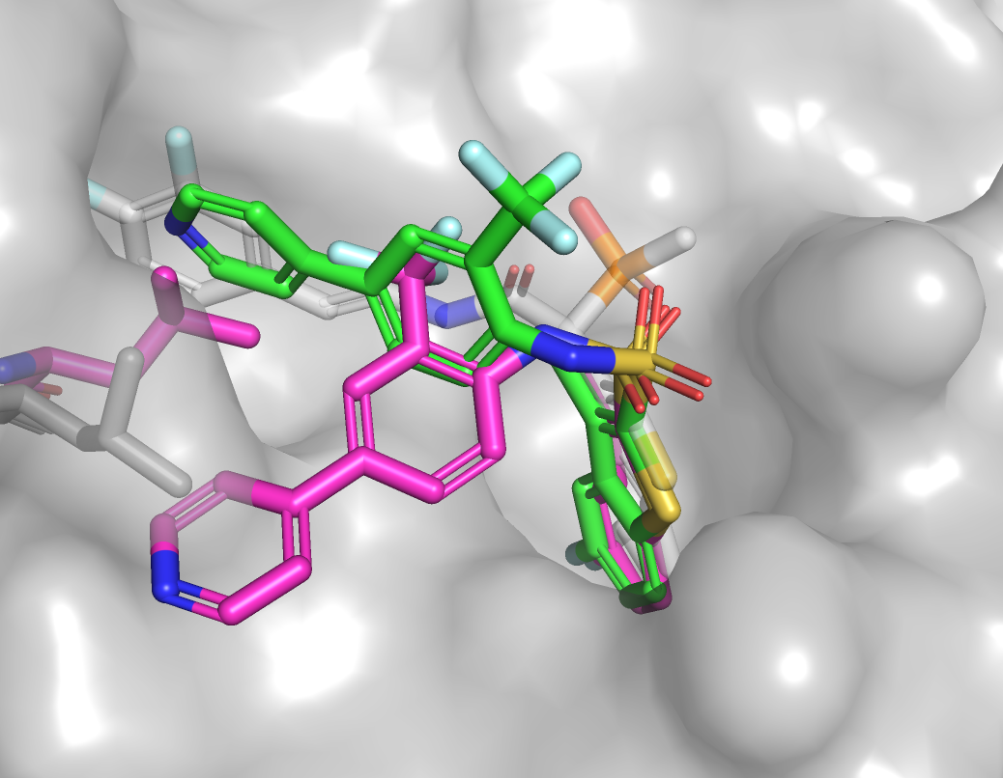
What went wrong: L1003
The pose of the template ligand did not reflect the experimental structure
A conformational change for LEU107 was not modeled
Template PDB: 3N7O
Best RMSD = 3.6 Å
11
Key: Template Ligand, Model Ligand, Experimental ligand
Notes:
Template ligand 8C30

Slide 14
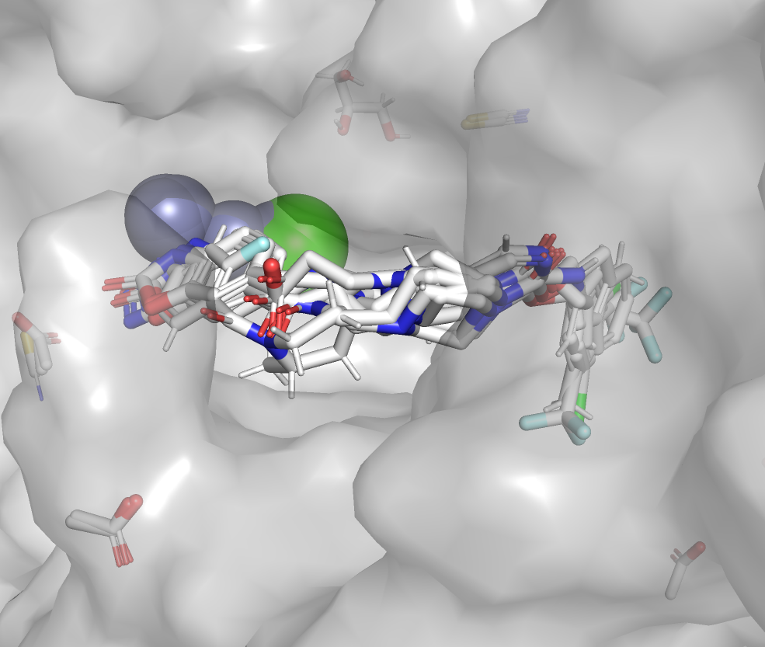
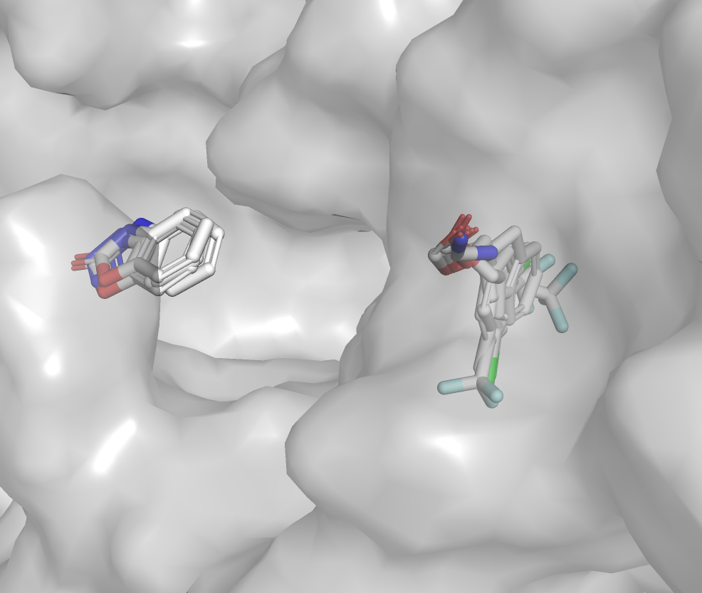
Conserved motif identification (L3000)
Conserved motifs in the metal binding domain and hydrophobic pocket were used to design anchor SMARTS patterns
Ensemble of template ligands
Conserved interaction sites
12
Notes:
Template ligand 8C30

Slide 15
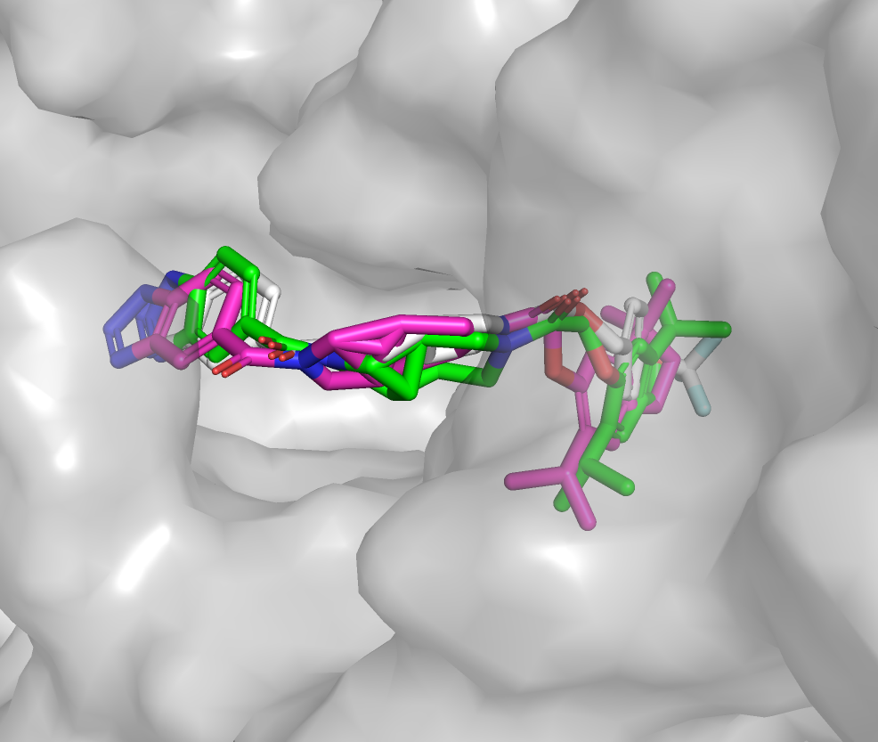
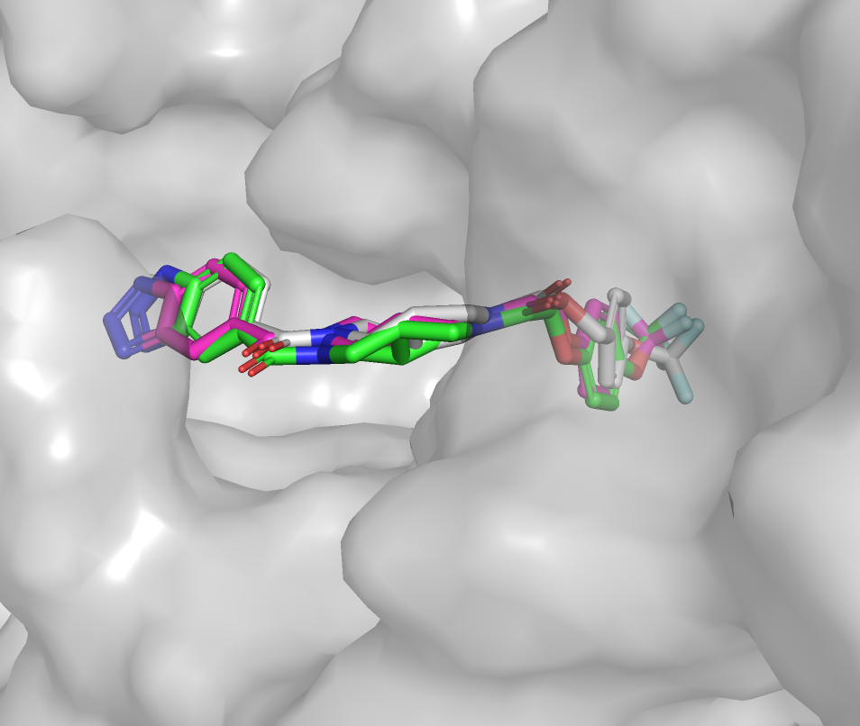
What went right: L3103, L3107
Accurate poses were produced for most models containing these motifs
L3103
L3107
Model 1 RMSD: 1.1 Å
Template PDB: 5S9N/5OHI
Model 3 RMSD: 0.4 Å
Template PDB: 5S9N
13
Key: Template Ligand, Model Ligand, Experimental ligand
Notes:
Template ligand 8C30

Slide 16
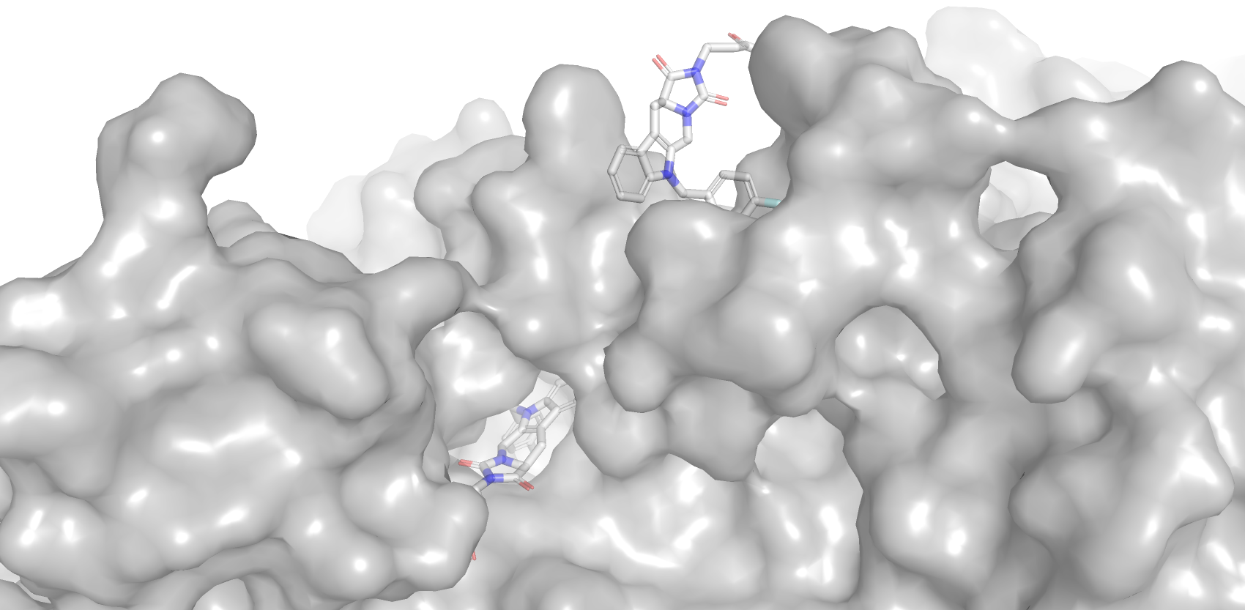
What went wrong: L3118
There was no appropriate templates which bound two similar ligands
Template PDB: 4ZG9
14
Key: Template Ligand, Model Ligand, Experimental ligand
Notes:
Template ligand 8C30

Slide 17
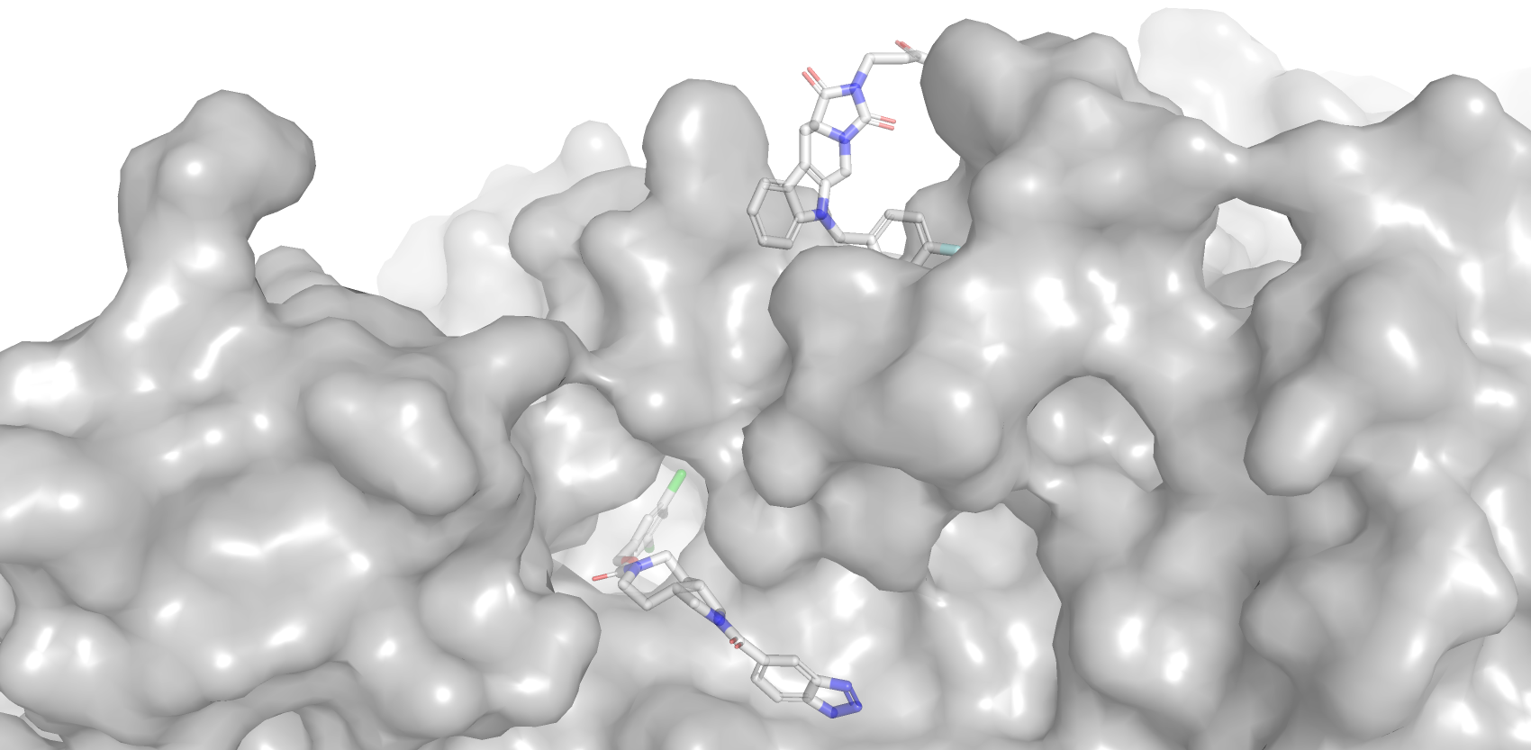
What went wrong: L3118
There was no appropriate templates which bound two similar ligands
Replace template ligand in the main pocket
15
Template PDB: 5S9M + 4ZG9
Key: Template Ligand, Model Ligand, Experimental ligand
Notes:
Template ligand 8C30

Slide 18
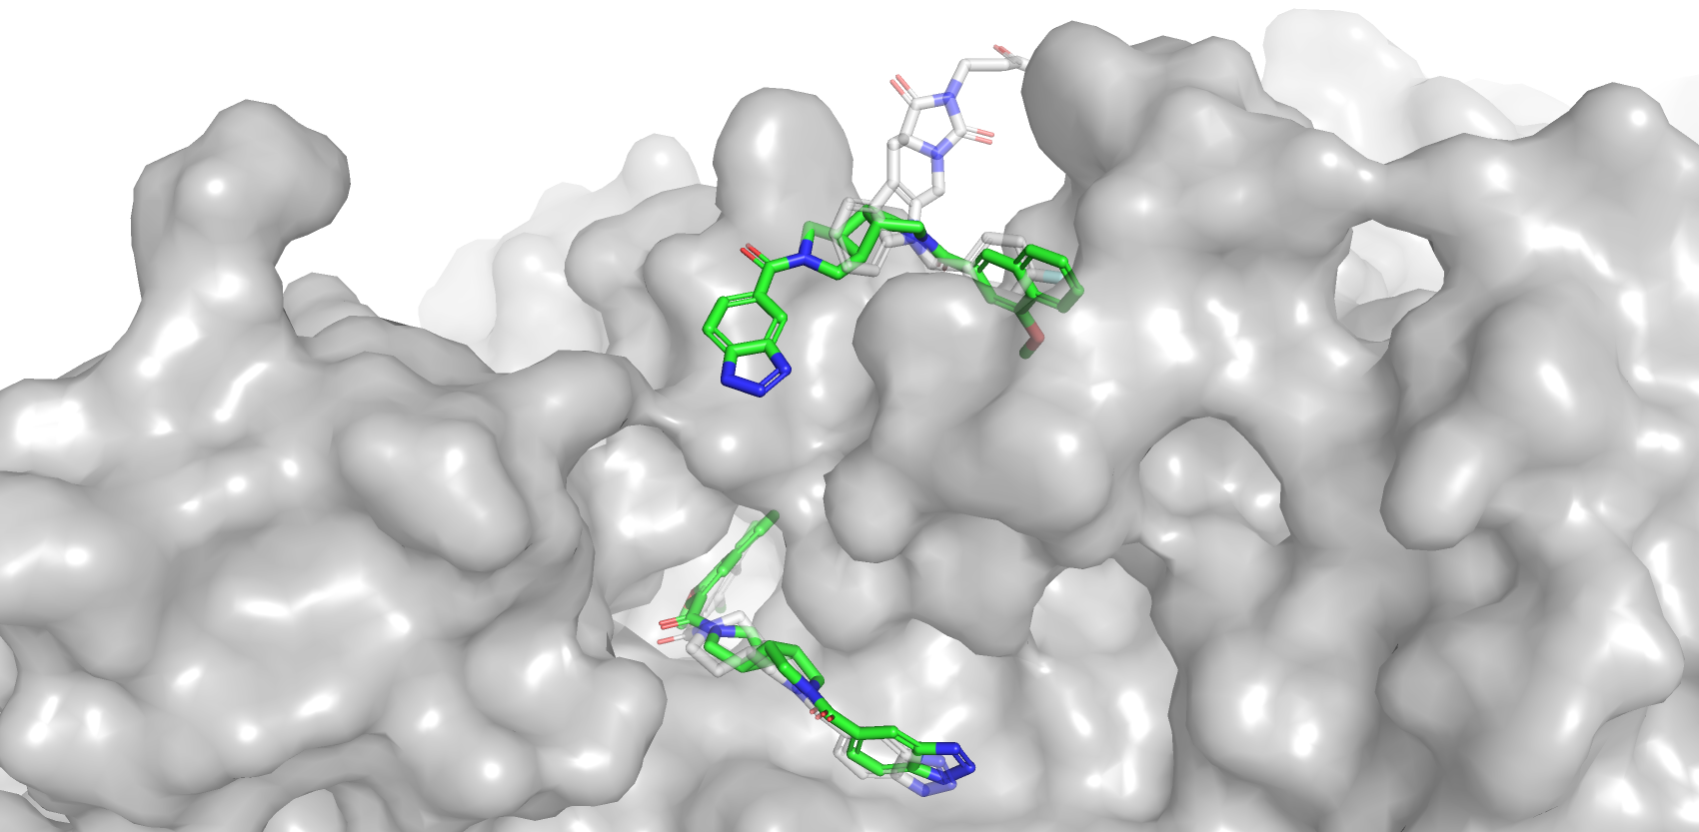
What went wrong: L3118
There was no appropriate templates which bound two similar ligands
15
Template PDB: 5S9M + 4ZG9
Key: Template Ligand, Model Ligand, Experimental ligand
Notes:
Template ligand 8C30

Slide 19
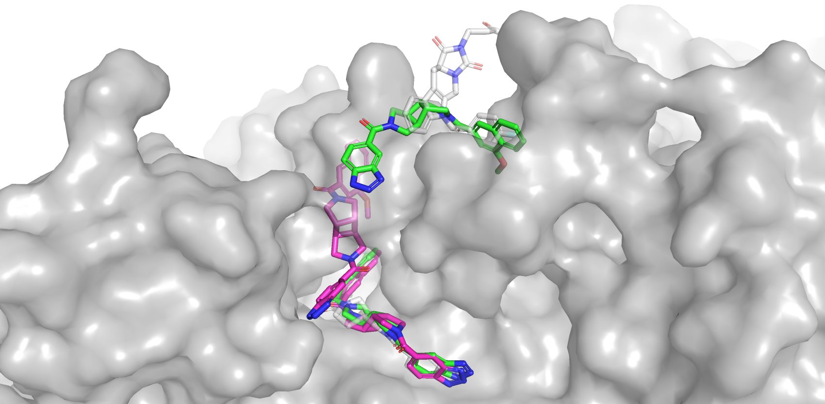
What went wrong: L3118
There was no appropriate templates which bound two similar ligands
RMSD = 9.4 Å
RMSD = 1.0 Å
15
Template PDB: 5S9M + 4ZG9
Key: Template Ligand, Model Ligand, Experimental ligand
Notes:
Template ligand 8C30

Slide 20
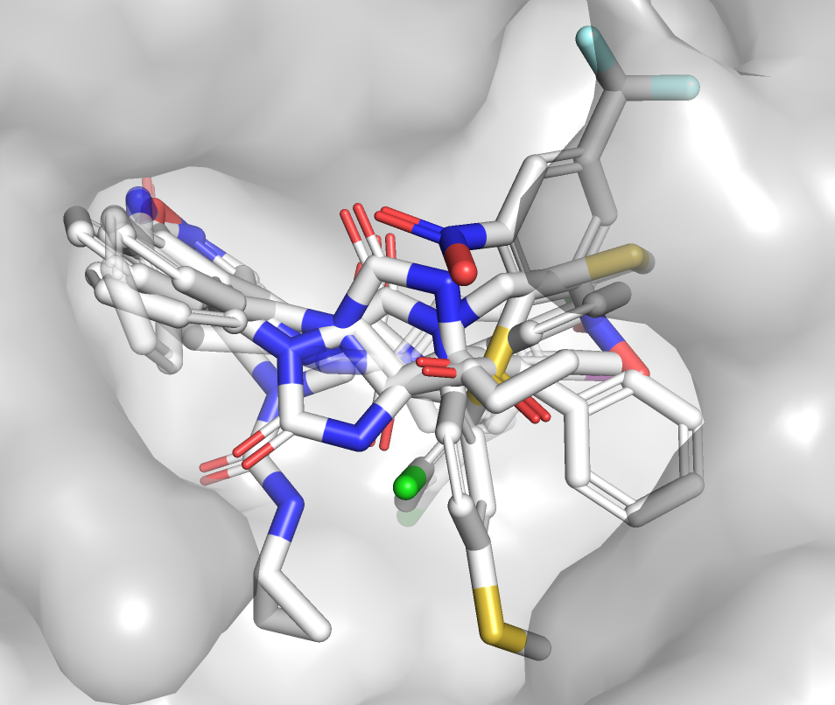
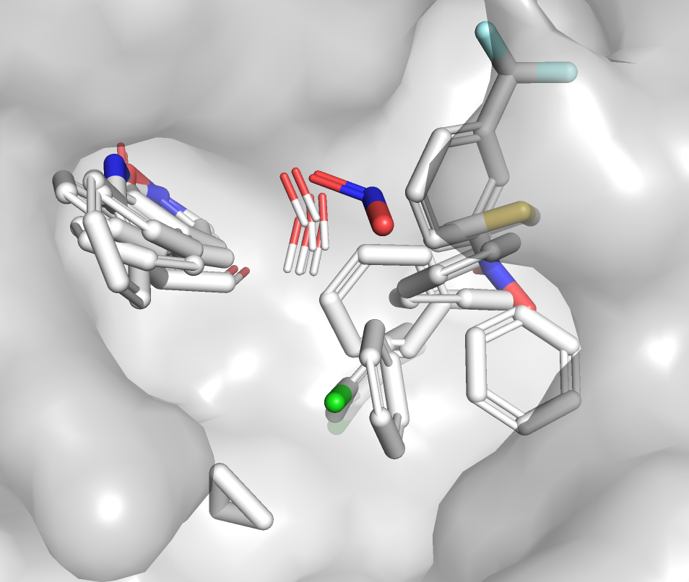
Conserved motif identification (L4000)
Clusters of aromatic rings with HBA atoms, carbonyl groups, and hydrophobic aromatic rings were identified from template ligands
Ensemble of template ligands
Conserved interaction sites
16
Notes:
Template ligand 8C30

Slide 21
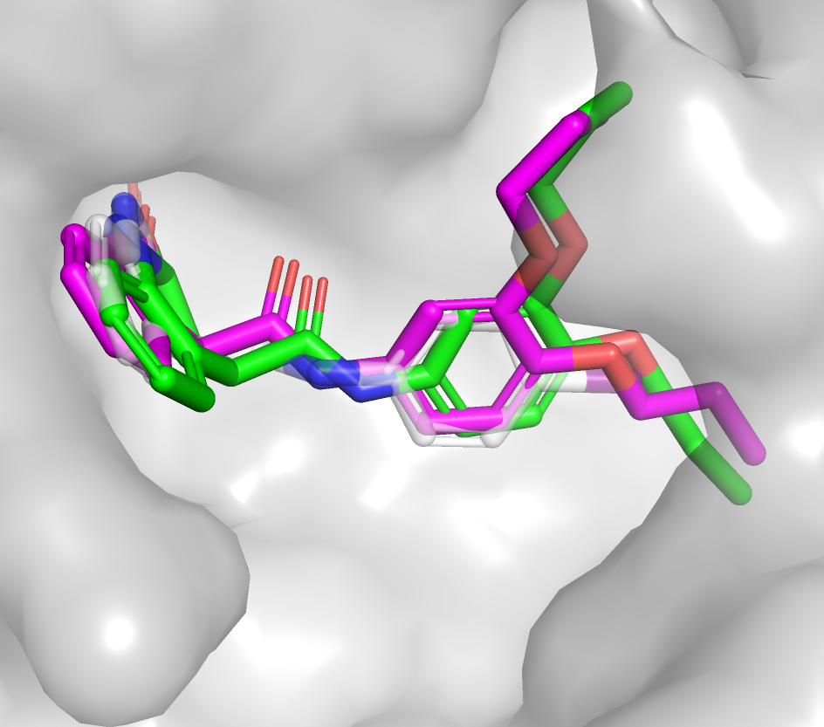
What went right: L4011, L4015
Models agreeing with the pharmacophore are accurate
L4011
L4015
Model 1 RMSD: 0.9 Å
Template PDB: 7P2G
Model 1 RMSD: 0.3 Å
Template PDB: 8CYZ
17
Key: Template Ligand, Model Ligand, Experimental ligand
Notes:
Through conformer generation we were able to accurately model the tails in L4011

Slide 22
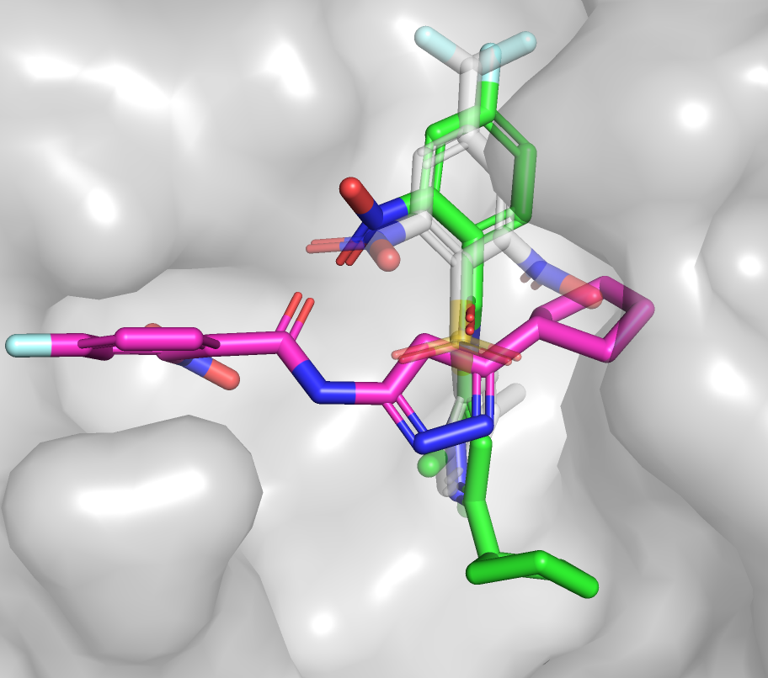
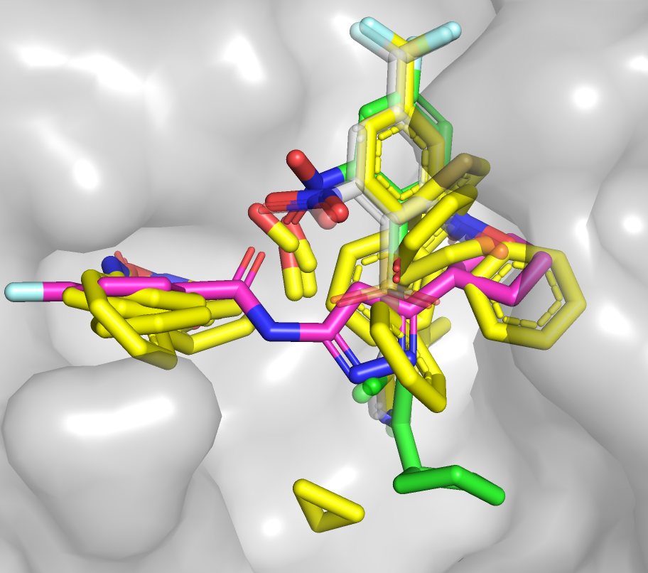
What went wrong: L4002
The template ligand deviated from the pharmacophore
The experimental pose followed conserved motif density
L4002
L4002 + Conserved Motifs
Model 1 RMSD: 7.1 Å
Template PDB: 2GZ7
Model 1 RMSD: 7.1 Å
Template PDB: 2GZ7
18
Key: Template Ligand, Model Ligand, Experimental ligand, Conserved motifs
Notes:
Template ligand 8C30

Slide 23
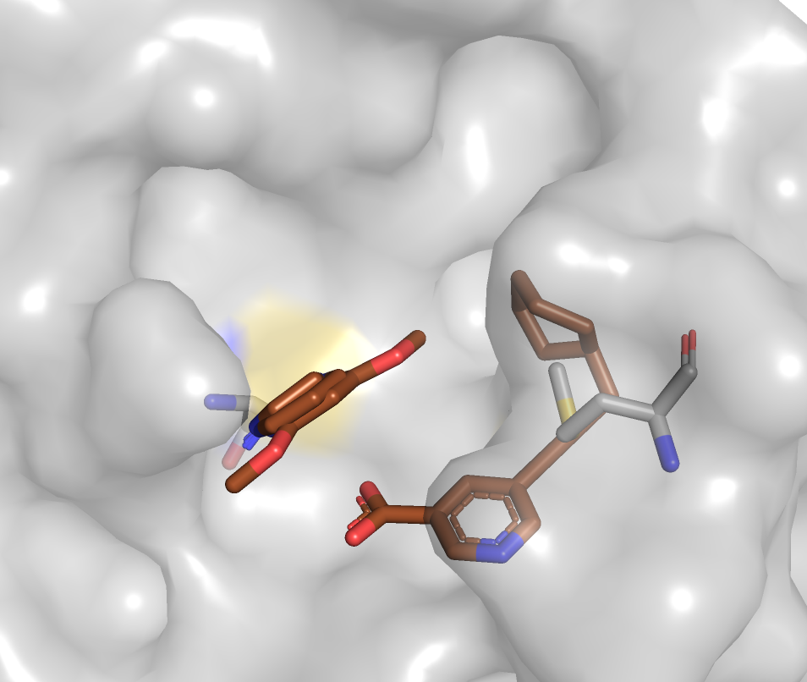
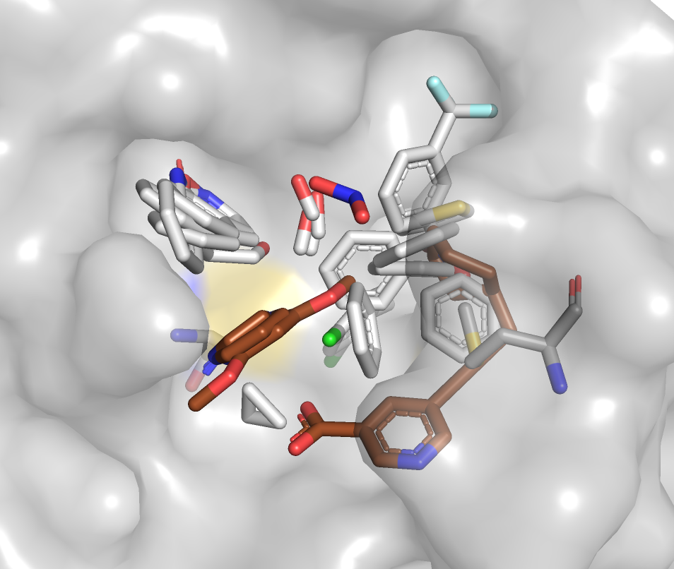
Conserved motif identification (L4000 covalent ligands)
Templates containing covalent ligands were used to identify attachment points
Covalent Ligands Templates + Conserved motifs
Covalent Ligand Templates
19
Notes:
Template ligand 8C30

Slide 24
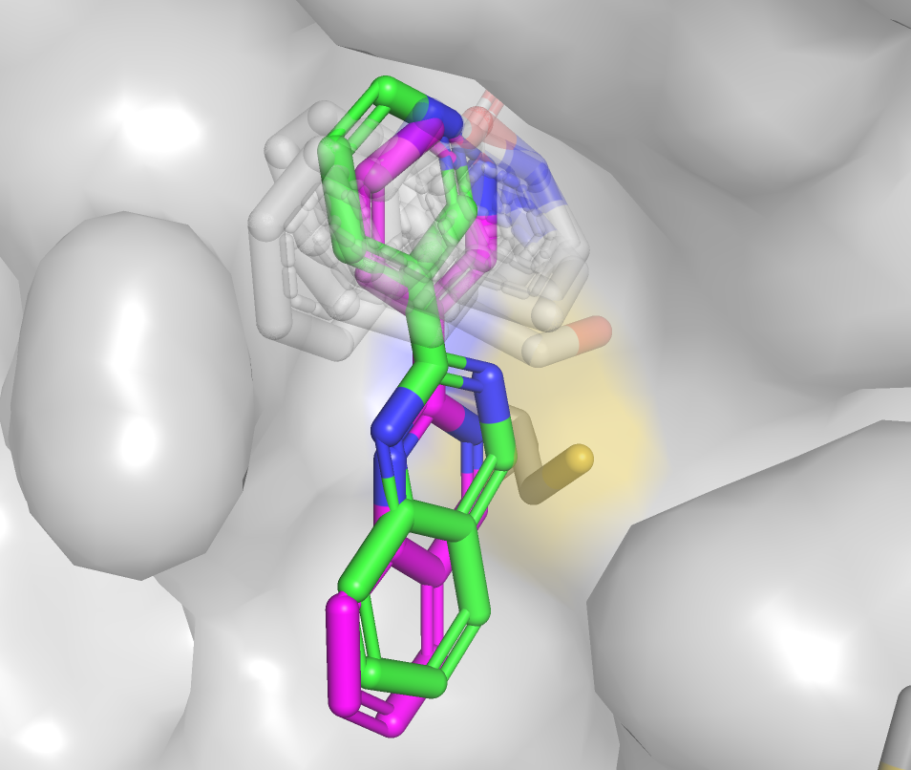
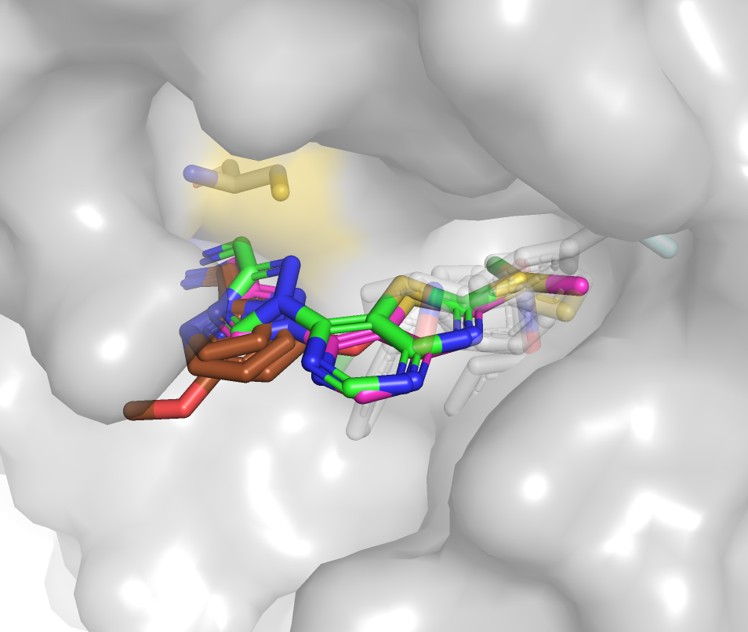
What went right: L4003, L4013
Docked poses were anchored near attachment points and poses which docked into conserved motifs were selected
L4003
L4013
Model 1 RMSD: 1.1 Å
Template PDB: 5RHB
Model 1 RMSD: 0.9 Å
Template PDB: 5RHB
20
Key: Model Ligand, Experimental ligand, Conserved Motifs, Covalent Ligands
Notes:
Template ligand 8C30

Slide 25
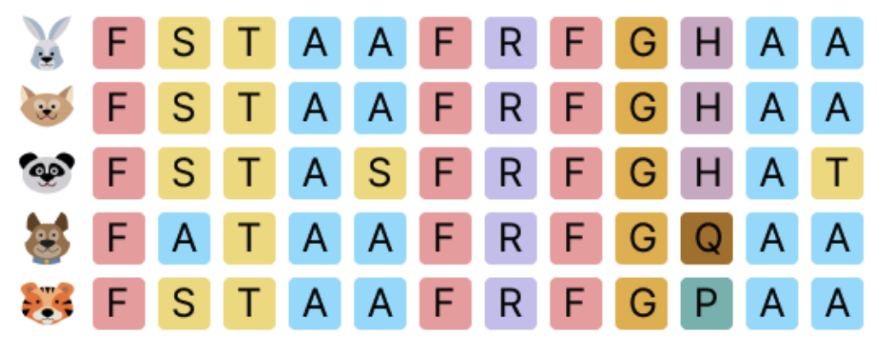
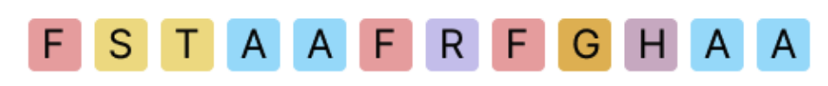
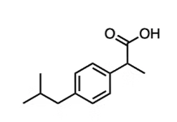
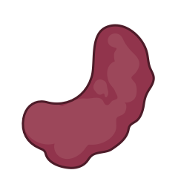
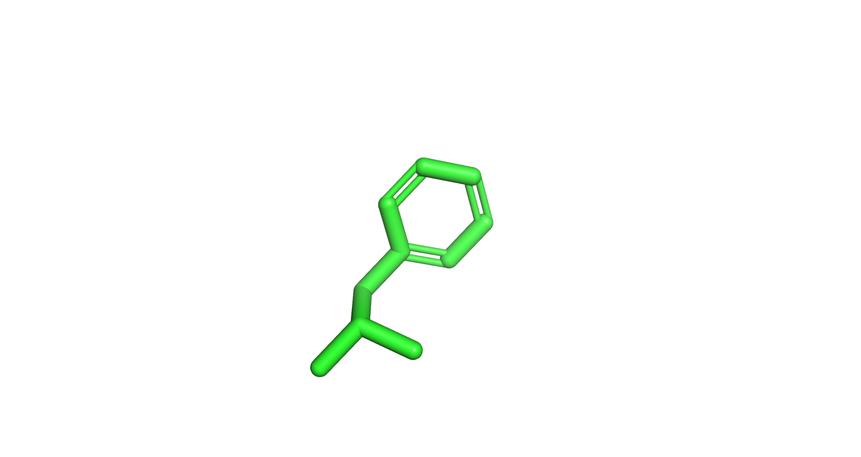



Future Steps: Complete template-based protein-ligand structure prediction
MSA search
Evoformer
Structure module
Protein sequence
Protein template
Anchor
LigTBM search
Torsional Diffusion
Protein - anchor complex prediction
Confidence score
21
Notes:
Try to integrate these steps into a complete alphafold-style architecture which does not require a real crystal structure for the receptor

Slide 26
Summary
Using partial match substructures beyond maximum common substructure improves the results
Anchoring docked poses on conserved substructures improves chances of generating successful models
Our results demonstrate the usefulness of integrating machine learning with physics-based sampling
The approach is useful when there is a robust set of partial templates
22

Slide 27
Extra slides

Slide 28

Overall success rates in CASP16 (Pharma Ligands)

Slide 29

Model quality is dependent on template availability
When a template is available, low RMSDs are typically achieved!
No templates were found for 17 L3000 ligands

Slide 30


What went right: L2002
Diverse pose selection improved results
Model 2 RMSD: 2.9 Å
Template PDB: 1T32 (Rec) 4K69 (Lig)
Model 4 RMSD: 1.4 Å
Template PDB: 1KYN (Rec) 4K69 (Lig)
11
Key: Template Ligand, Model Ligand, Experimental ligand
Notes:
1T32 is a Cathepsin receptor, but 4K69 is a Chymase ligand

Slide 31


What went wrong: L3109
Anchor atom positions in the template ligand were not conserved in the experimental binding pose
Template PDB: 8C3O
Best RMSD = 10.8 A
Key: Template Ligand, Model Ligand, Experimental ligand
Notes:
Template ligand 8C30

Slide 32


Performance is dependent on ligand flexibility

Slide 33


Success rates in L1000 (Pharma Ligands)

Slide 34


Success rates in L2000 (Pharma Ligands)

Slide 35


Success rates in L3000 (Pharma Ligands)

Slide 36


Success rates in L4000 (Pharma Ligands)

Slide 37
Slide with L4000 covalent ligand examples

Slide 38
Step 5. Ranking and selecting poses
Poses are scored using a combination of orthogonal metrics:
Diverse Low Energy Poses
Metric
Best Poses
Selected Poses
Overlap with volume of template ligands
Selection by chemists
DiffDock confidence model
Cluster Size
Final poses score well in multiple metrics!
6

