Slide 1
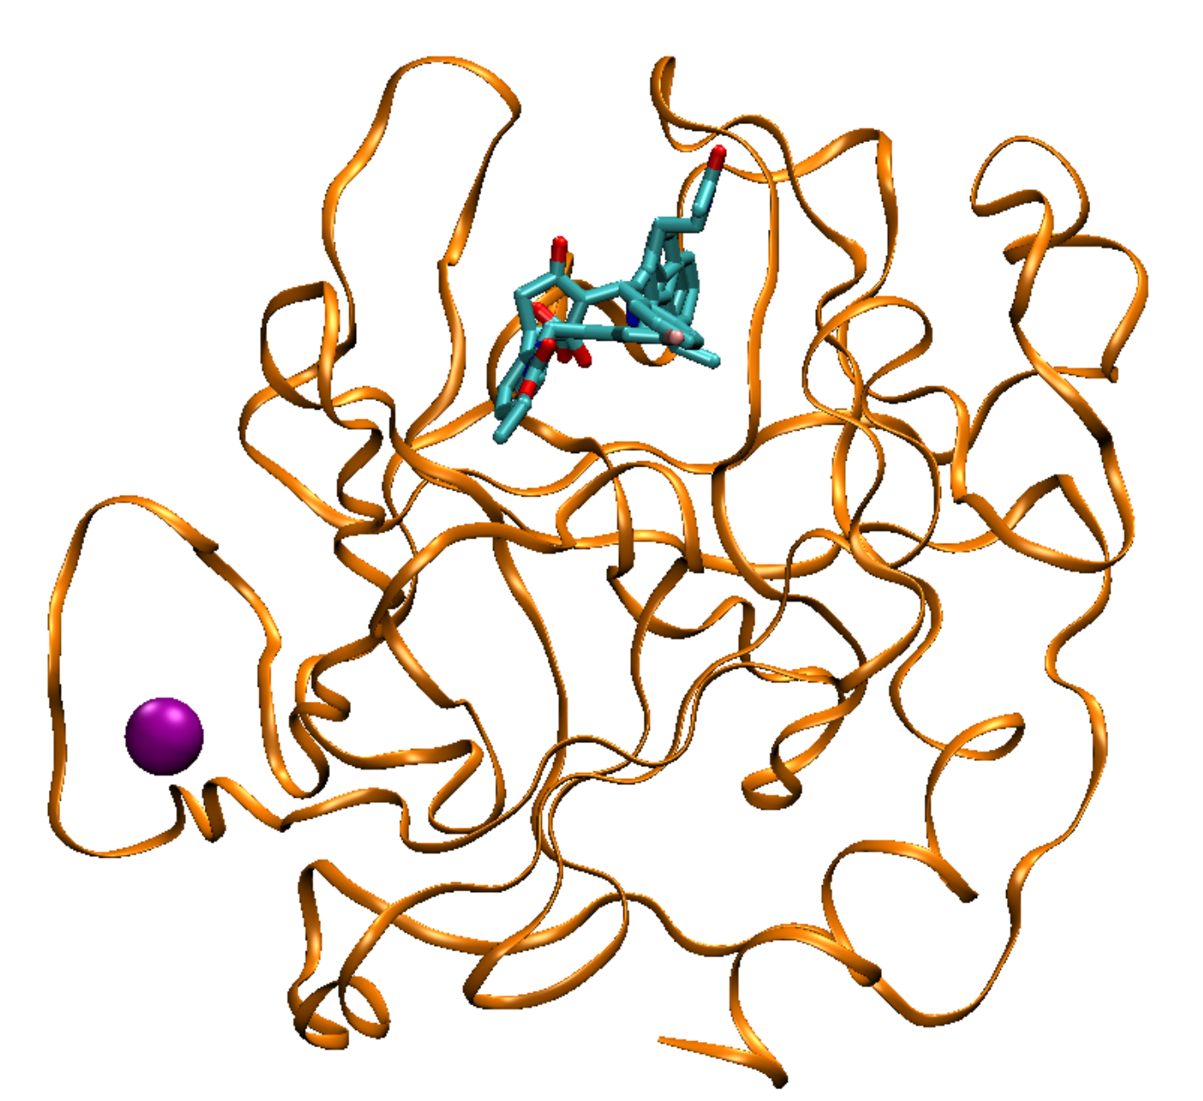

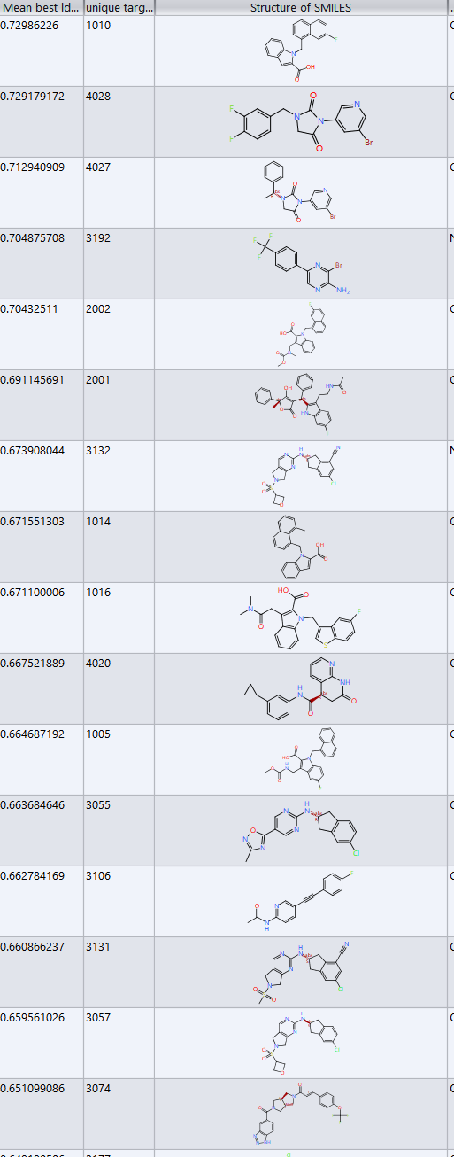
CASP16 Pharmaceutical Protein-Ligand Challenge
ligand poses and affinities
Mike Gilson
mgilson@ucsd.edu

Slide 2
Acknowledgements
Data Contributors
Hoffman La Roche
Christian Kramer
Andreas Tosstorff
Idorsia Pharmaceuticals Ltd
Florent Chevillard
Julien Hazemann
Aengus MacSweeney
Structural Genomics Consortium
Aled Edwards
Matthieu Schapira
Levon Halabelian
Analysts and Organizers
Jerome Eberhardt, U Basel
Xavier Robin, U Basel
Sebastian Bittrich, RCSB PDB, UCSD
Jose Duarte , RCSB PDB, UCSD
Andriy Kryshtafovych, UC Davis
John Moult, U. Maryland
CASP16 Participants

Slide 3
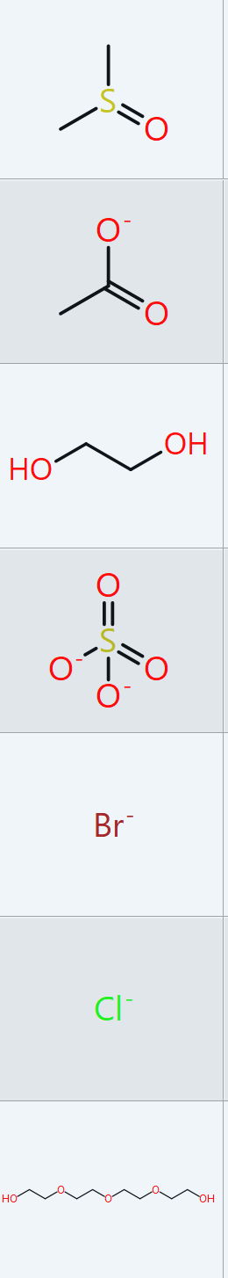
Four Challenge Types
Poses of pharma ligands: 3D structure of small molecules in protein binding sites Also the structure of the binding site, but this ends up being secondary
Affinities of pharma ligands: binding affinity of protein with a drug-like molecule
Poses of incidental ligands in pharma structures (e.g. DMSO)
Self-assessment of pose-prediction accuracy

Slide 4
Outline
Mike Gilson – 40 min/slides
Jerome Eberhardt – 10 min/slides
Challenge overview
Pose prediction results
Affinity prediction Results
Reliability
Speaker selection
Performance of off-the-shelf
“baseline” methods

Slide 5
CASP16 Pharma Challenge Targets
Supertarget ID | Protein | N_{Pose} | Resol (A) | N _{Affinity} | Affinities | Notes
L1000 (Roche) | Chymase (human) | 17 | 1.1-2.2 mean 1.7 | Stage 1: 17 Stage 2: 17 | 1-400 nM -12.4 to -8.8 kcal/mol | Racemic ligands
L2000 (Roche) | Cathepsin G (human) | 2 | 1.2, 1.2 | 0 |  | Racemic ligands
L3000 (Roche) | Autotaxin (rat) | 189 | 1.3-2.7 mean 1.9 | Stage 1: 123 Stage 2: 93 | 1nM-10uM* -12.4 to -6.9 kcal/mol | Zn enzyme No stereo centers 5 incidental ligands included in challenge Some structures had two independent ligand poses. Others had alternative (A/B) confs of the ligand. We scored all predictions against all xtal poses and gave the one best score.
L4000 (Idorsia) | Mpro (SARS-CoV-2) | 24** | 1.3-1.9 mean 1.7 | 0 | NA | Stereochem provided Four ligands covalently bound to Cys. Details provided to participants 16 incidental ligands included in challenge
L5000 (SGC) | WDR55 (human) | 1 | 1.95 | 0 | NA | Pilot from SGC’s Target 2035 project, aiming for a small molecule modulator of every human protein by 2035. Scored separately due to lateness.
*: includes 11 reported K_{D} values of 10 uM, which are likely non-quantitative
**: was 25 but one target excluded because ligand L4006 was outside binding site at an xtal contact

Slide 6
Chymase
Supertarget 1000, 17 poses and affinities
Targets L1001, L1002
structural Zn

Slide 7
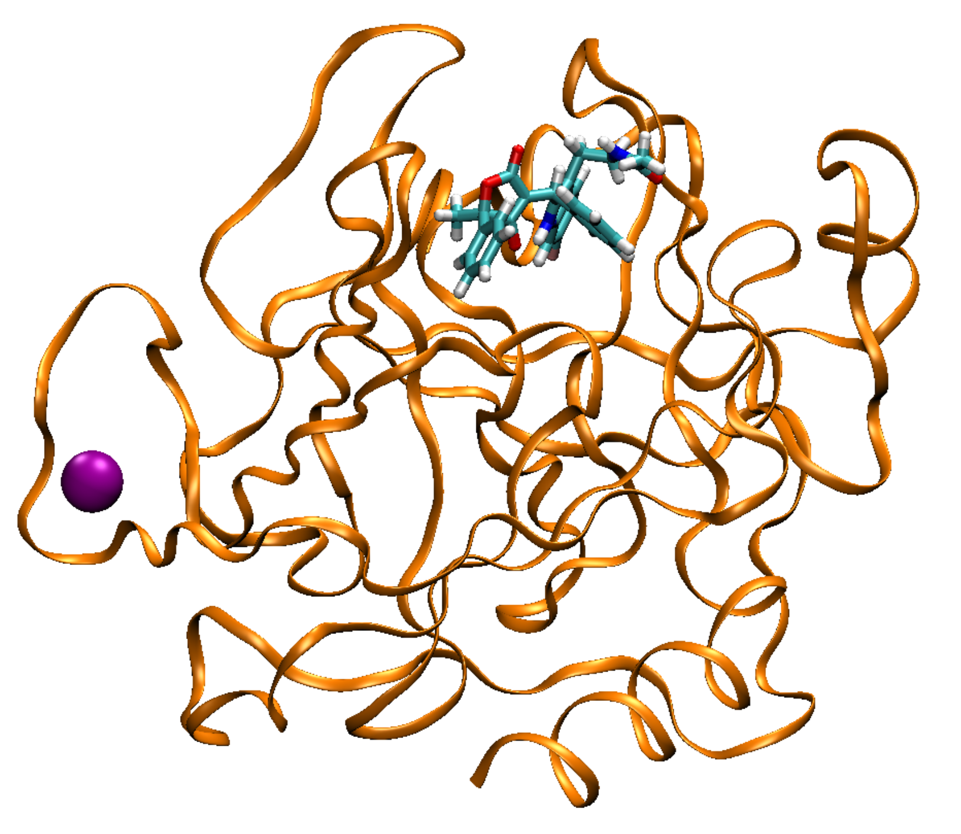
Cathepsin G
Supertarget 2000, 2 poses
Target 2001

Slide 8
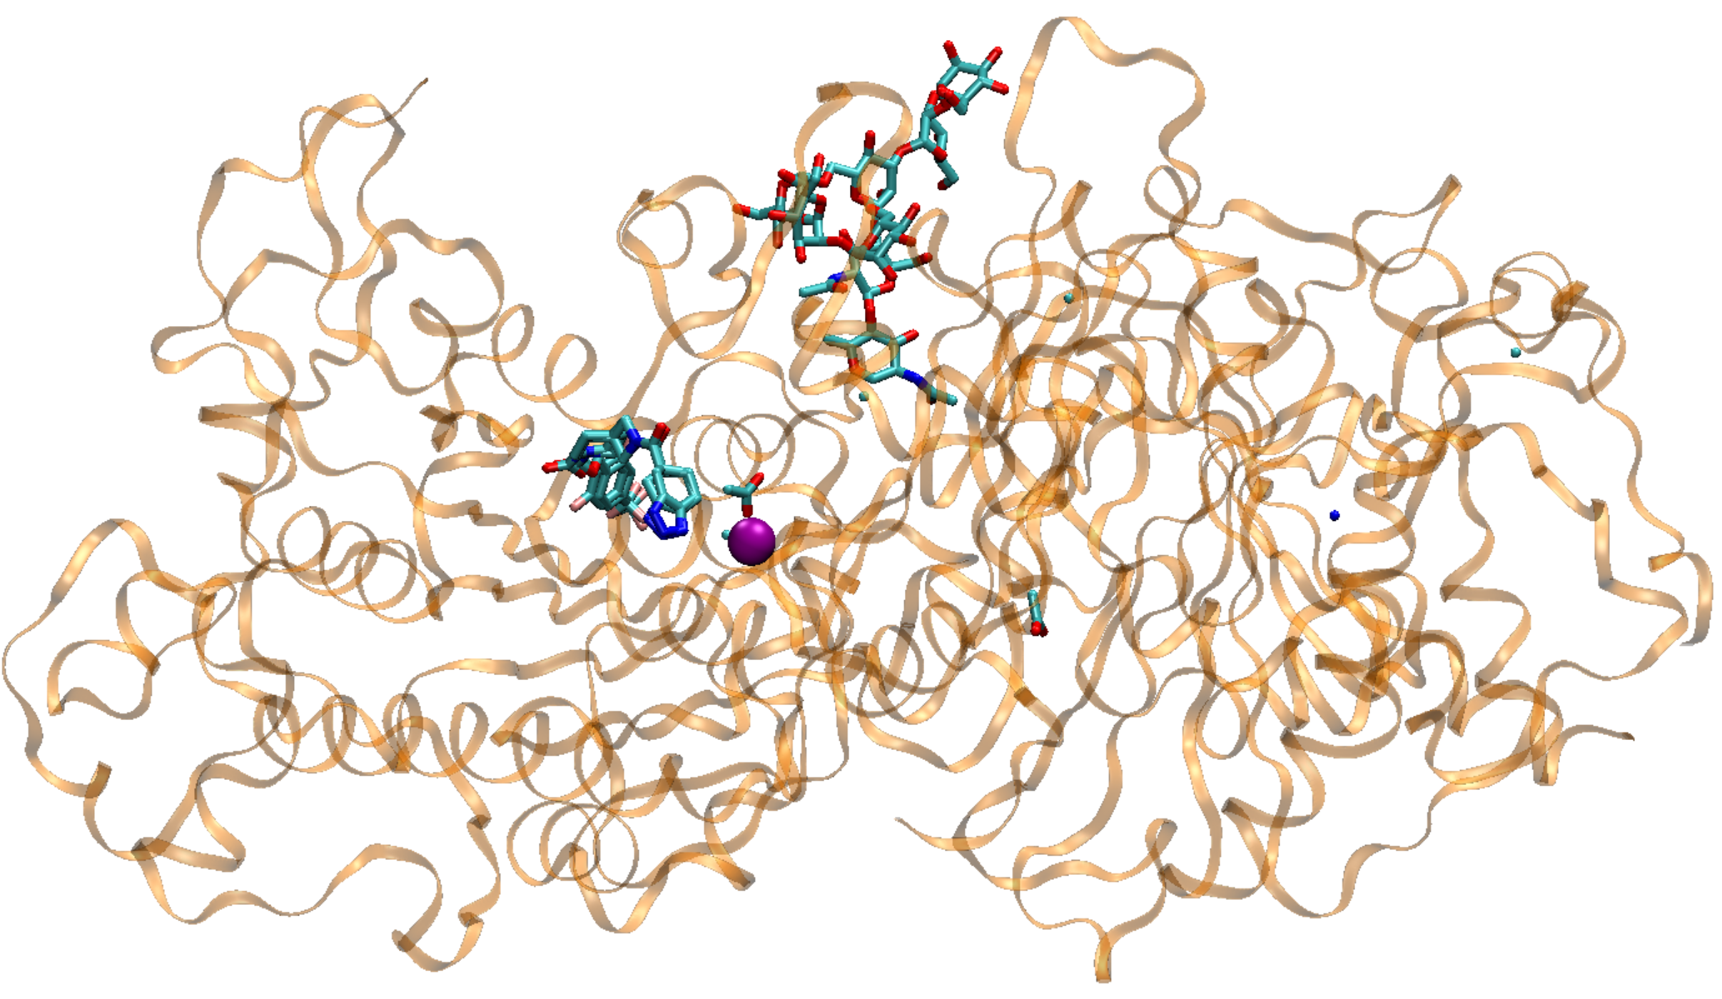
Autotaxin
Supertarget 3000, 189 poses, 123 affinities (93 in common)
Alternate ligand conformations
Zn in/near binding pocket
Mannose chain
Target 3053

Slide 9
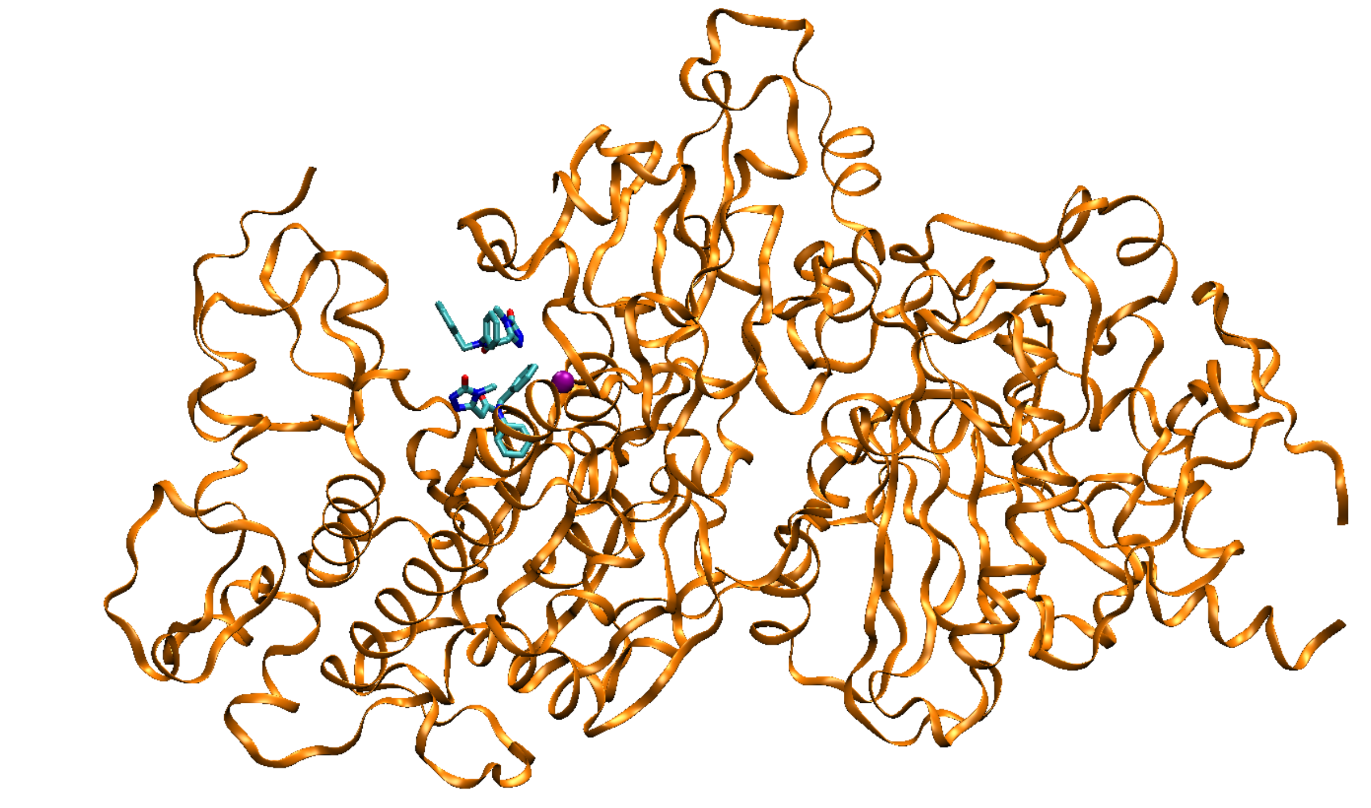
Six Autotaxin Targets Had Two Independent Ligand Poses
participants were challenged to predict both
best score was credited
L3081

Slide 10
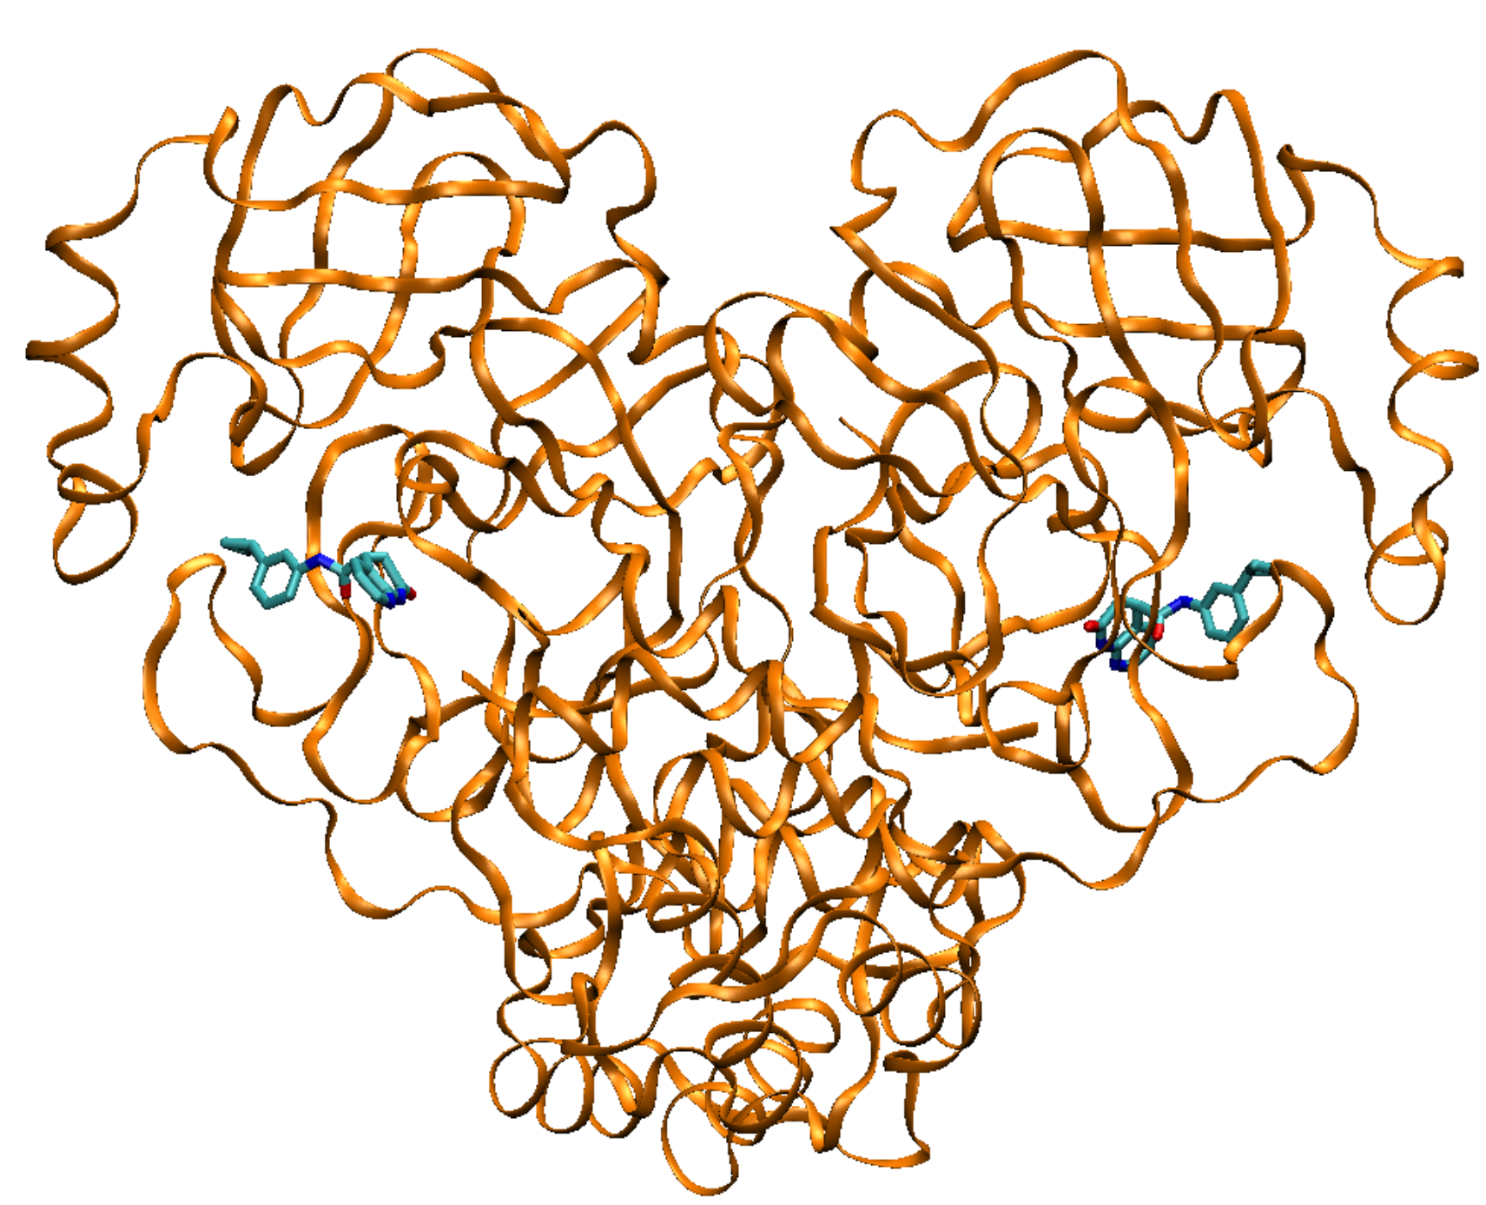
SARS-Cov-2 Mpro
Supertarget 4000, 24 poses
Target 4020
Two chemically equivalent, but not crystallographically equivalent, chains, each with a bound ligand
CASP invited docking to both sites but some participants submitted only one. We credited the best pose of two across both sites when two were provided, and the best score of both sites when only one submitted

Slide 11
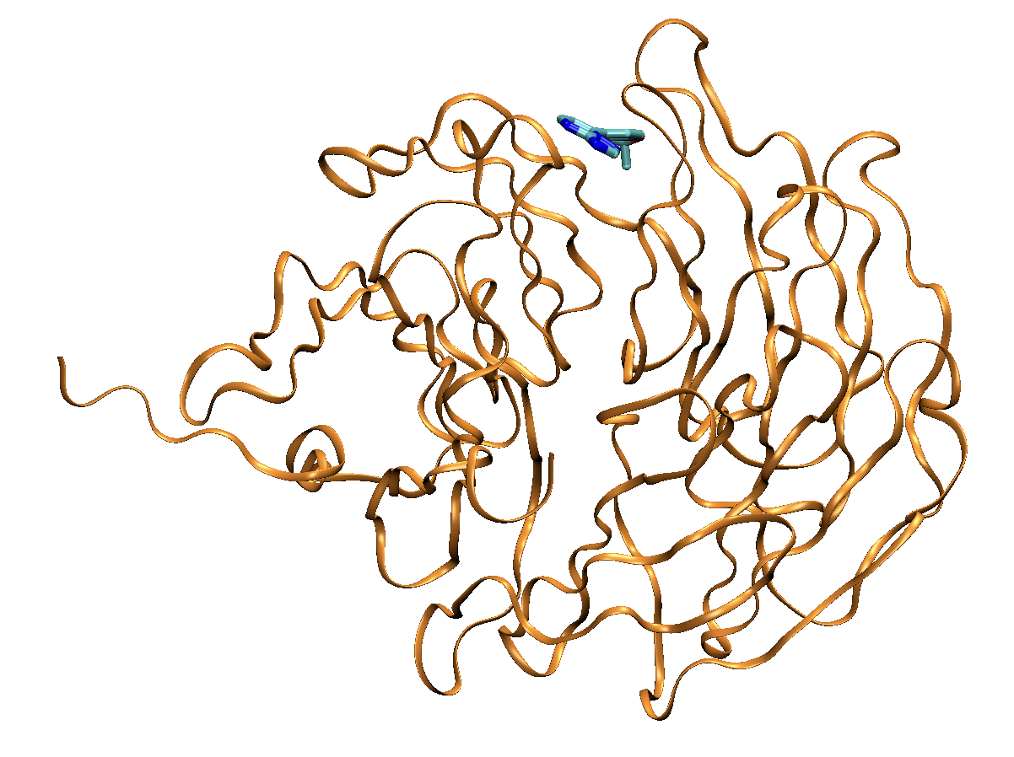
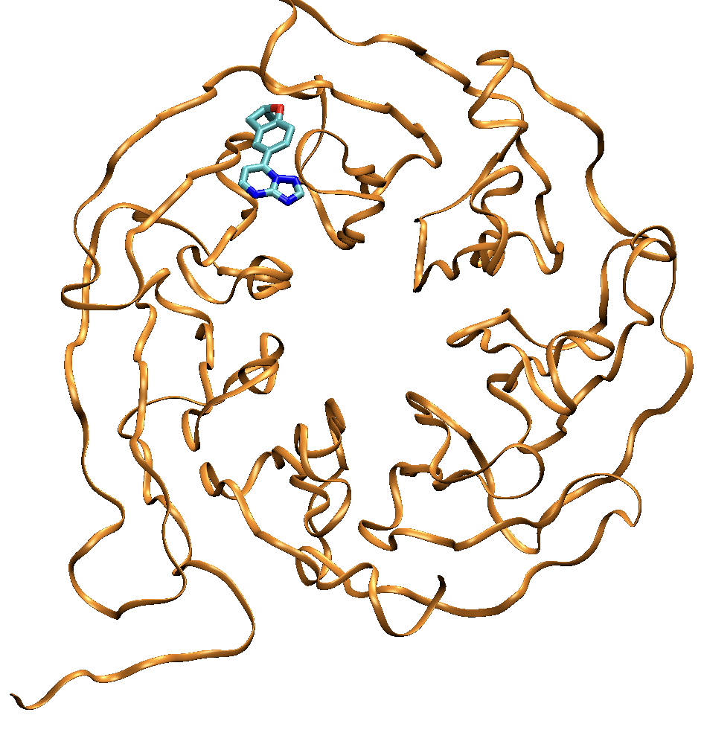
WDR55
Supertarget 5000, 1 pose
Target 5001 (two viewpoints)
Notes:
Comment on the source of this and why it was included.

Slide 12

How Hard Are These Challenges?
For each CASP16 autotaxin ligand, the maximum Tanimoto similarity to any ligand in a protein in the PDB with $≥$70% sequence similarity
24% $≥0.5$ similarity
Sebastian Bittrich, Jose Duarte, RCSB PDB
Notes:
20 different ligands in 26 PDB structures

Slide 13
Main Information Provided to Participants
Data
Protein sequence
Ligand SMILES string
Whether to predict pose, affinity, or both
List of any nearby (<4.5 A) incidental ligands
Instructions: submit up to five model predictions, with Model 1 your favorite

Slide 14
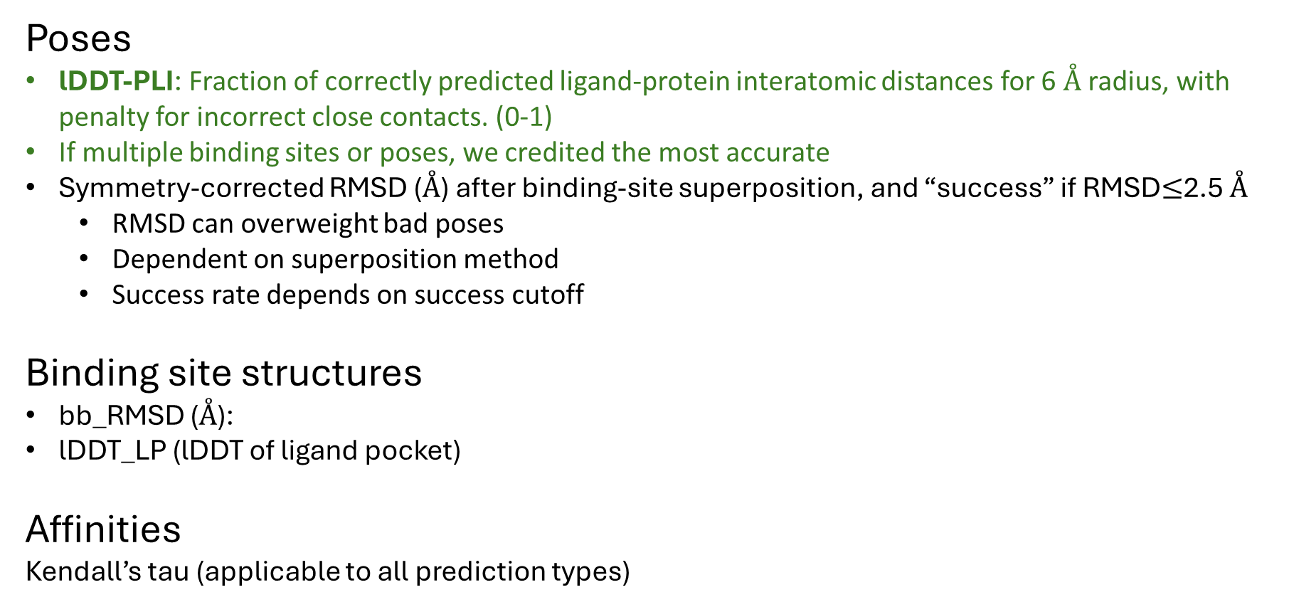
Metrics
Poses
lDDT-PLI: Fraction of correctly predicted ligand-protein interatomic distances for 6 Å radius, with penalty for incorrect close contacts. (0-1)
If multiple binding sites or poses, we credited the most accurate
Symmetry-corrected RMSD (Å) after binding-site superposition, and “success” if RMSD$≤$2.5 Å
  RMSD can overweight bad poses
  Dependent on superposition method
  Success rate depends on success cutoff
Binding site structures
bb_RMSD (Å):
lDDT_LP (lDDT of ligand pocket)
Affinities
Kendall’s tau (applicable to all prediction types)
Structural metrics computed with OST (openstructure.org)

Slide 15
Comparison of RMSD <2.5 Success rate and lDDT_PLI
using skip-penalized means, just for Model 1
each point a group
These two statistics tell the same story, at least for any predictions
worth much attention (i.e., not the very lower left of the graph).

Slide 16
Pose Accuracy vs Binding Site Accuracy
Model 1 Pose Predictions
Low RMSD implies low bb_RMSD
Low bb_RMSD does not imply low RMSD

Slide 17
Methods Used by Participants
Physics-based, AI-based, template-based, etc.
Often hard to categorize; e.g., might use a ligand template if available and physics-based docking otherwise, then score poses with an AI method
Mix of home-made software and other open-source and commercial software, often in one method; e.g. one that includes OMEGA2, Chimera, AutoDock Vina, Glide, and at least two others
No companies participated
One method relied essentially entirely on citizen-scientist docking with DockIt

Slide 18
Assessment of Pose Predictions
initial focus on Model 1 predictions
34 CASP groups
32 distinct research groups

Slide 19
Accuracy of Predictions vs Number of Targets Predicted
N=17, chymase
274 and 494: (0.75, 0.76 chymase)
207: 0.83 chymase)
The top-scoring groups on the left should be ranked well below the top-scoring groups on the right
➔ skipped predictions may be treated as “unsuccessful” predictions (lDDT_PLI=0, RMSD>2.5)

Slide 20
Mean lDDTI_PLI for each CASP Group
Model 1, skip-penalized mean across all 233 pose targets
Citizen-scientists (DrugIt)
Top Groups: ClusPro, Kozakov/vajda, CoDock, Huang-HUST, MULTICOM_ligand
Notes:
Corrected LG408 data

Slide 21
Consistency of Model 1 Performance Across Supertargets
Focus on chymase (N=17), autotaxin (N=189), Mpro (N=24)
Raw mean lDDTI_PLI

Slide 22
Are Some Pose-Prediction Targets More Difficult?
Average Model 1 lDDT_PLI
4019
4003
1, 2
3=Autotaxin
3=Mpro
5
Target ID
4013
4023
1: chymase
2: cathepsin G
3: autotaxin
4: Mpro
5: WDR55
Covalent ligands
No skip penalty
Notes:
Corrected group 408

Slide 23
Mean Best-of-5-Models Predictions vs Model 1 Predictions
skip mean lDDT_PLI
mean improvement from Model 1 alone is 0.08
N.B.: not all groups submitted >1 model
Notes:
Erroneous group 408, but should not matter much at all

Slide 24
Pose Accuracy vs Ligand Size and Flexibility
mean, raw, best-of-five lDDT_PLI
Raw means

Slide 25
Pose Accuracy vs Ligand Affinity
mean, raw, best-of-five lDDT_PLI
Notes:
Please find attached the Tanimoto coefficients between all SMILES provided by L3000 and the 4 highly similar ligands present in the PDB (6ZM (5L0B, rat), YV1 (5s9m, rat), YVS(5S9N, rat), EAR (6LEH, mouse)). Computed with OpenEye, using OEFPType_Tree as fingerprint.

Slide 26
Pose Accuracy vs Available Template Similarity
Autotaxin, mean, raw, best-of-five lDDT_PLI
PDB ligands of rat and mouse autotaxin structures
5LOB, 5S9M, 5S9N, 6LEH
Notes:
Please find attached the Tanimoto coefficients between all SMILES provided by L3000 and the 4 highly similar ligands present in the PDB (6ZM (5L0B, rat), YV1 (5s9m, rat), YVS(5S9N, rat), EAR (6LEH, mouse)). Computed with OpenEye, using OEFPType_Tree as fingerprint.

Slide 27
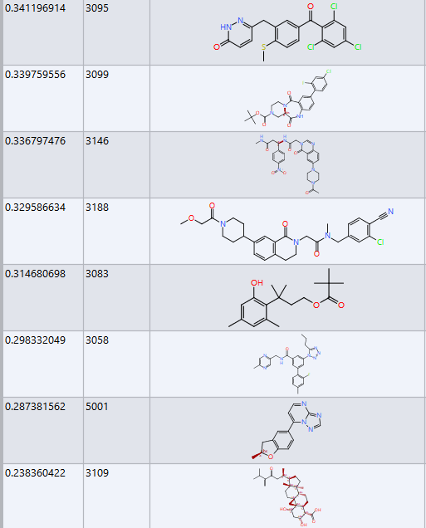
Easiest
Hardest

Slide 28
NonPharma (“Incidental”) Ligands in Autotaxin and Mpro
pose prediction

Slide 29
Incidental Ligands in Pharma Targets
Accuracy of Model 1 Pose Predictions, not skip-penalized
(maximum was 0.69 for pharma ligands)
Top Groups: arosko, Huang-HUST, kozakovvajda, ClusPro

Slide 30
Assessment of Affinity Predictions
28 unique groups participated
Included Stage 1 (no exptl poses) and Stage 2 (exptl poses provided)
Focus here on Model 1 only, for brevity
Kendall’s tau allows comparison across prediction types
  absolute affinities
  relative affinities
  affinity rankings

Slide 31
Ranking of Stage 1 Affinity Predictions for Both Targets by Group
N- weighted Kendall’s tau: (N_{a}KT_{a} + N_{c}KT_{c})/140
Top Groups: haiping, LCDD-team, VnsDock, Zou, MULTICOM_ligand

Slide 32
No Correlation of Model 1 KT Values for Chymase and Autotaxin
stage 1; each point a group
?
haiping

Slide 33
Stage 2 Affinity Predictions were made after release of experimental poses
93 autotaxin affinity predictions and 17 chymase predictions made with knowledge of the 93 & 17 respective cocrystal structures
Not fully representative of a real-world application
Presumably easier--?

Slide 34
Stage 1 vs Stage 2 Accuracy
no improvement
Autotaxin
Chymase
21 stage 1 and 24 stage 2 submissions
93 affinity targets
28 stage1 groups, 27 stage 2 groups
17 affinity targets

Slide 35
Reliability scores (LSCORE)
Each group predicts their own accuracy across their submitted models
Group | N | Kendall’s 𝛕
HADDOCK | 1292 | 0.43
McGuffin | 1295 | 0.29
Bryant | 85 | 0.24
MULTICOM_ligand | 1295 | 0.19
haiping | 1295 | 0.11
Zou | 1225 | 0.11
Zou_aff2 | 1225 | 0.11
Koes | 959 | 0.06
CoDock | 1295 | 0.04
GromihaLab | 22 | -0.16

Slide 36
Looked for Groups…
Best at pose-prediction
Best at affinity prediction
Best overall, including LScore

Slide 37
Summary Scores
Pose: 0.75 pharma-lDDT_PLI + 0.25 incidental-lDDT_PLI
Affinity: 0.75 Stage 1 + 0.25 Stage 2
  Each stage: 1/3 Chymase + 2/3 autotaxin
Overall: Overall pose + Overall affinity + 0.25 LSCORE

Slide 38
Selection of Groups By Three Criteria
 | Group | Pharma lDDT_PLI | Incidental lDDT_PLI | S1 Chymase | S1 Autotaxin | S1 Summary (1/3 chymase, 2/3 autotaxin) | S2 Chymase | S2 Autotaxin | S2 Summary (1/3 chymase, 2/3 autotaxin) | Affinity Summary: 0.75 S1 +0.25 S2 | Lscore | Summary statistic: 3/4 * p-lDDT_PLI + 1/4i-lDDT_PLI + 3/4 S1 Summary + 1/4 S2 Summary + 0.25* Lscore | Summary normalized to max of 1
POSE Best p-lDDT_PLI | 494 | 0.70 | 0.39 |  |  | 0.00 |  |  | 0.00 | 0.00 |  | 0.62 | 0.28
 | 274 | 0.70 | 0.39 |  |  | 0.00 |  |  | 0.00 | 0.00 |  | 0.62 | 0.28
 | 262 | 0.61 | 0.12 | -0.25 | 0.33 | 0.14 | -0.21 | 0.15 | 0.03 | 0.11 | 0.11 | 0.63 | 0.28
 | 91 | 0.59 | 0.39 | -0.12 | 0.22 | 0.11 | -0.03 | 0.20 | 0.12 | 0.11 |  | 0.65 | 0.29
 | 207 | 0.58 | 0.13 | 0.25 | 0.33 | 0.30 | 0.19 | 0.28 | 0.25 | 0.29 | 0.30 | 0.83 | 0.37
 | 432 | 0.55 |  | 0.04 | -0.30 | -0.19 | 0.03 | -0.03 | -0.01 | -0.14 |  | 0.27 | 0.12
 | 420 | 0.54 |  | -0.21 | 0.04 | -0.04 | -0.24 | 0.14 | 0.01 | -0.03 | 0.16 | 0.42 | 0.19
 | 55 | 0.53 | 0.18 | 0.12 | 0.39 | 0.30 |  |  | 0.00 | 0.22 |  | 0.67 | 0.30
AFFINITY Best Overall Affinity | 16 | 0.36 | 0.17 | 0.29 | 0.44 | 0.39 | 0.21 | 0.28 | 0.26 | 0.36 | 0.15 | 0.71 | 0.31
 | 207 | 0.58 | 0.13 | 0.25 | 0.33 | 0.30 | 0.19 | 0.28 | 0.25 | 0.29 | 0.30 | 0.83 | 0.37
 | 204 | 0.51 |  | 0.19 | 0.35 | 0.30 | 0.24 | 0.18 | 0.20 | 0.27 | 0.13 | 0.69 | 0.31
 | 82 | 0.35 |  | 0.16 | 0.37 | 0.30 |  |  | 0.00 | 0.23 |  | 0.49 | 0.22
 | 55 | 0.53 | 0.18 | 0.12 | 0.39 | 0.30 |  |  | 0.00 | 0.22 |  | 0.67 | 0.30
 | 386 | 0.28 |  | 0.35 | 0.15 | 0.22 | 0.35 | 0.16 | 0.22 | 0.22 |  | 0.43 | 0.19
 | 298 | 0.32 | 0.00 | 0.35 | 0.15 | 0.22 | 0.35 | 0.16 | 0.22 | 0.22 |  | 0.46 | 0.20
 | 167 | 0.25 | 0.02 | 0.32 | 0.16 | 0.21 | -0.07 | 0.32 | 0.19 | 0.21 |  | 0.40 | 0.18
OVERALL Best Summary Score | 207 | 0.58 | 0.13 | 0.25 | 0.33 | 0.30 | 0.19 | 0.28 | 0.25 | 0.29 | 0.30 | 0.83 | 0.37
 | 16 | 0.36 | 0.17 | 0.29 | 0.44 | 0.39 | 0.21 | 0.28 | 0.26 | 0.36 | 0.15 | 0.71 | 0.31
 | 204 | 0.51 |  | 0.19 | 0.35 | 0.30 | 0.24 | 0.18 | 0.20 | 0.27 | 0.13 | 0.69 | 0.31
 | 55 | 0.53 | 0.18 | 0.12 | 0.39 | 0.30 |  |  | 0.00 | 0.22 |  | 0.67 | 0.30
 | 91 | 0.59 | 0.39 | -0.12 | 0.22 | 0.11 | -0.03 | 0.20 | 0.12 | 0.11 |  | 0.65 | 0.29
 | 262 | 0.61 | 0.12 | -0.25 | 0.33 | 0.14 | -0.21 | 0.15 | 0.03 | 0.11 | 0.11 | 0.63 | 0.28
 | 494 | 0.70 | 0.39 |  |  | 0.00 |  |  | 0.00 | 0.00 |  | 0.62 | 0.28
 | 274 | 0.70 | 0.39 |  |  | 0.00 |  |  | 0.00 | 0.00 |  | 0.62 | 0.28

Slide 39
Speakers
Sandor Vajda, ClusPro (494)& kozakovvajda (274): Template based, both whole-ligand and ligand fragments.
(Ryota Ashizawa, Omeir Khan, Sergei Kotelnikov, Maria Lazou, Xiaognang Li, UsmanGhani, Dzmitry Padhorny, Dmitri Beglov, Sandor Vajda, Dima Kozakov)
Shan Chang, CoDock, (262): template-guided docking, AI-based scoring.
(author list unavailable)
Shengyou Huang, Huang-HUST (91): template based, traditional docking if no template.
(Keqiong Zhang, Qilong Wu, and Sheng-You Huang)
Haiping Zhang, haiping (16): Conventional docking followed by a graph-based neural network method to identify the best docked poses.
(author list unavailable)
Alex Morehead, MULTICOM_ligand (207) : PoseBench script invoking multiple DL methods (e.g. DiffDock and Neuralplexer) and then some method of choosing models.
(Alex Morehead, Jian Liu, Pawan Neupane, Jianlin Cheng)

Slide 40
Lessons Learned
It is difficult to make predictions, especially about the future.
-- Berra? Bohr?
It is difficult to make predictions about the future, but it is impossible to make predictions about anything else.
-- Gilson

Slide 41
Performance of Baseline Methods
Jerome Eberhardt, U Basel

Slide 42
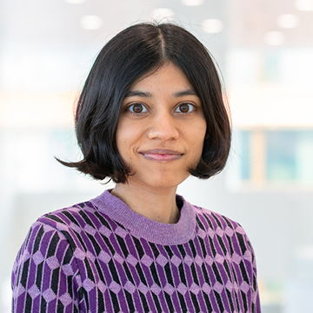

Without thinking too much, how far would we go?
Fully automated method v.s. manual tweaking / expert knowledge
Gives an idea on how hard or easy was this CASP ligand category
To know if it is time to change the baseline…
Pose prediction baselines:
  Stage 1: AlphaFold3, Boltz-1, RosettaFold All-Atom, Chai-1 and naïve docking
Affinity prediction baselines:
  Stage 1: Molecular weight, LogP, ML (public data) or AutoDock-Vina scores
  Stage 2: AutoDock-Vina or GNINA docking scores
Janani Durairaj
Peter Škrinjar

Slide 43


Pose prediction baselines
RosettaFold All-Atom, AF3 & Boltz-1
“Naive” docking
FASTA
SMILES / (SDF | CCD)
SMILES
FASTA
MSA
(RFAA: make_msa.sh,
Boltz-1: MSA from AF3)
Scrubber
(3D, protonation)
1 protein model
RFAA, AF3 or Boltz (v0.1 and v0.3, but ATX only)
(default parameters,
AF3: 5 seeds x 5 models, Boltz v0.3: 25 samples with 10 recycling steps)
Meeko
Autodock-Vina
(Default parameters, box centered on main known pocket)
Thanks to
Gabriele Corso and
Jeremy Wohlwend!
Model
(AF3: best model)
Best model
(PDBQT to mol, Meeko)

Slide 44
Affinity prediction baselines
Naïve baselines (stage 1):
  Molecular weight (interaction surface) or LogP (hydrophobicity)
Machine-Learning baselines (stage 1):
  Gaussian Process + RBF kernel + MAP4 fingerprint (Capecchi et al., 2020)
  Either trained on ChEMBL or patent data (P task) (Autotaxin only)
Molecular docking baselines (stages 1 and 2):
  Stage 1: AutoDock-Vina docking scores from the “naïve docking” baseline
  Stage 2: AutoDock-Vina and GNINA scoring functions

Slide 45
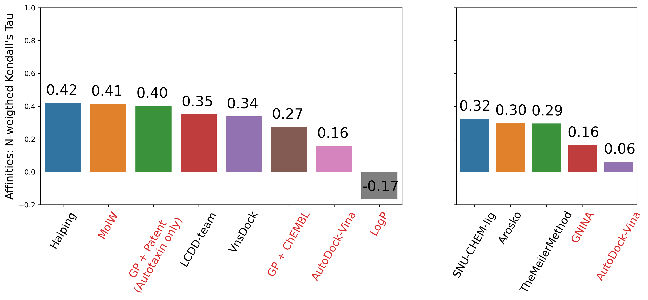
Molecular weights is correlated to binding affinities (L1000/L3000)
Stage 1
Stage 2

Slide 46
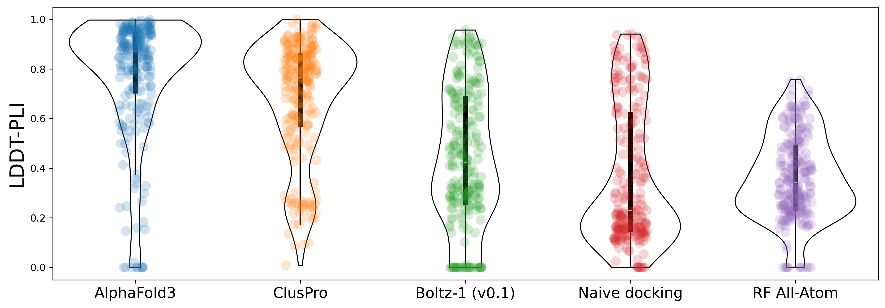
Overall LDDT-PLI performances per docking method
Conversion issues, Mpro covalent binders ignored
Conversion issues, Mpro covalent binders ignored
Mpro covalent
binders ignored
Conversion issues, Mpro covalent
Binders ignored
IT DOES NOT MEAN THAT IT IS GENERALIZABLE!

Slide 47
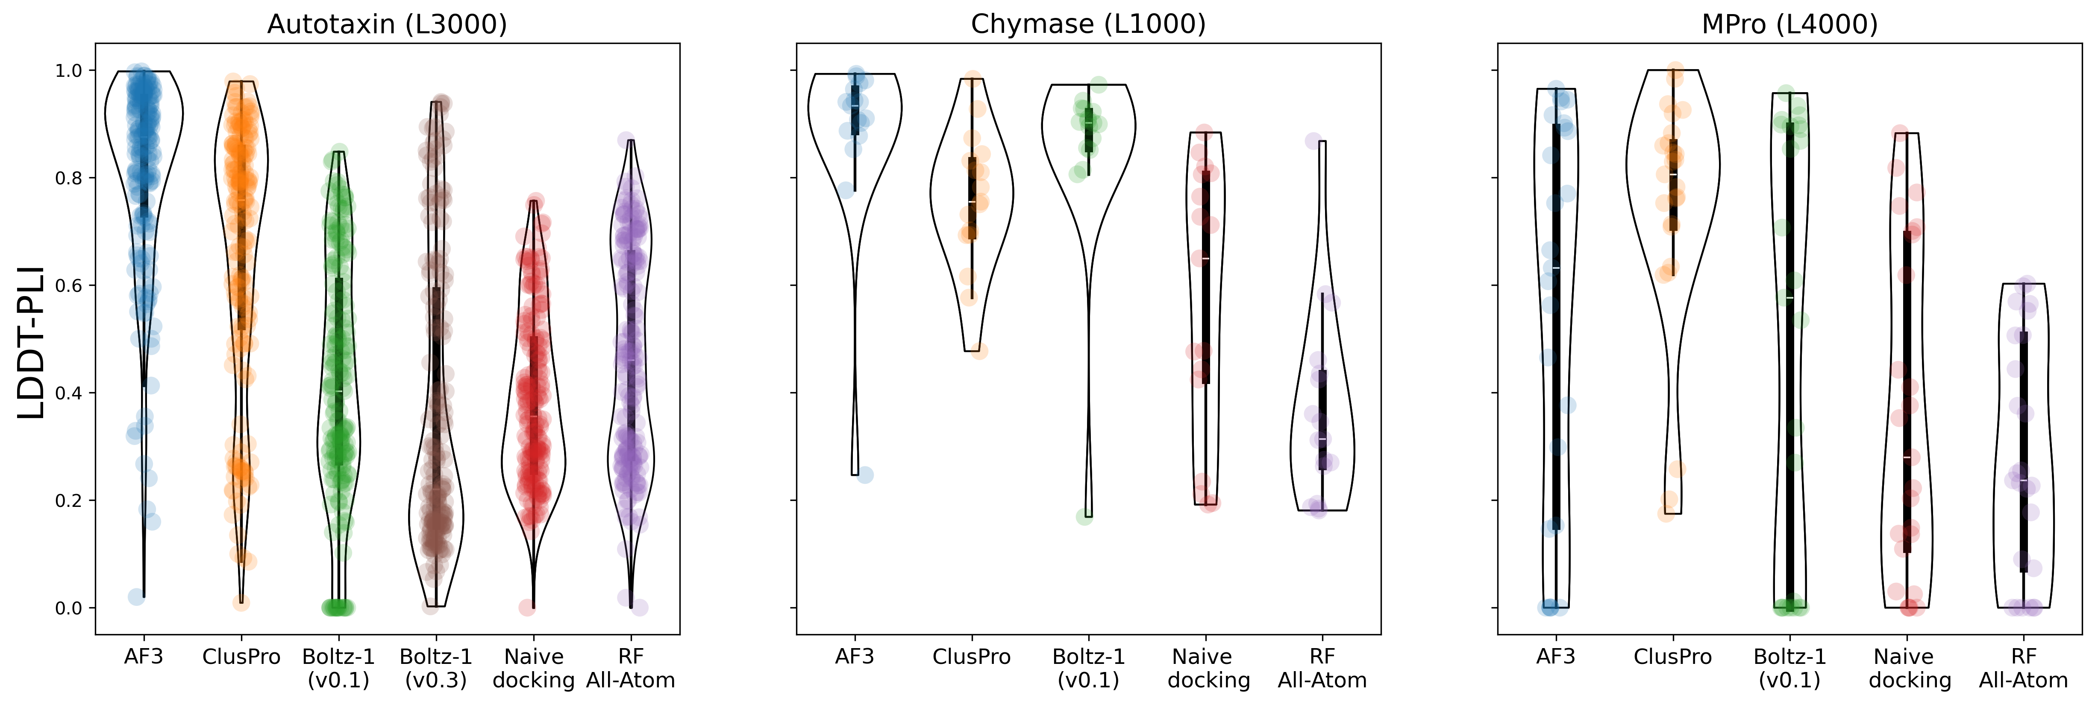
Overall LDDT-PLI performances per target protein
Ignored covalent binders!
REALLY, IT DOES NOT MEAN IT IS GENERALIZABLE!

Slide 48
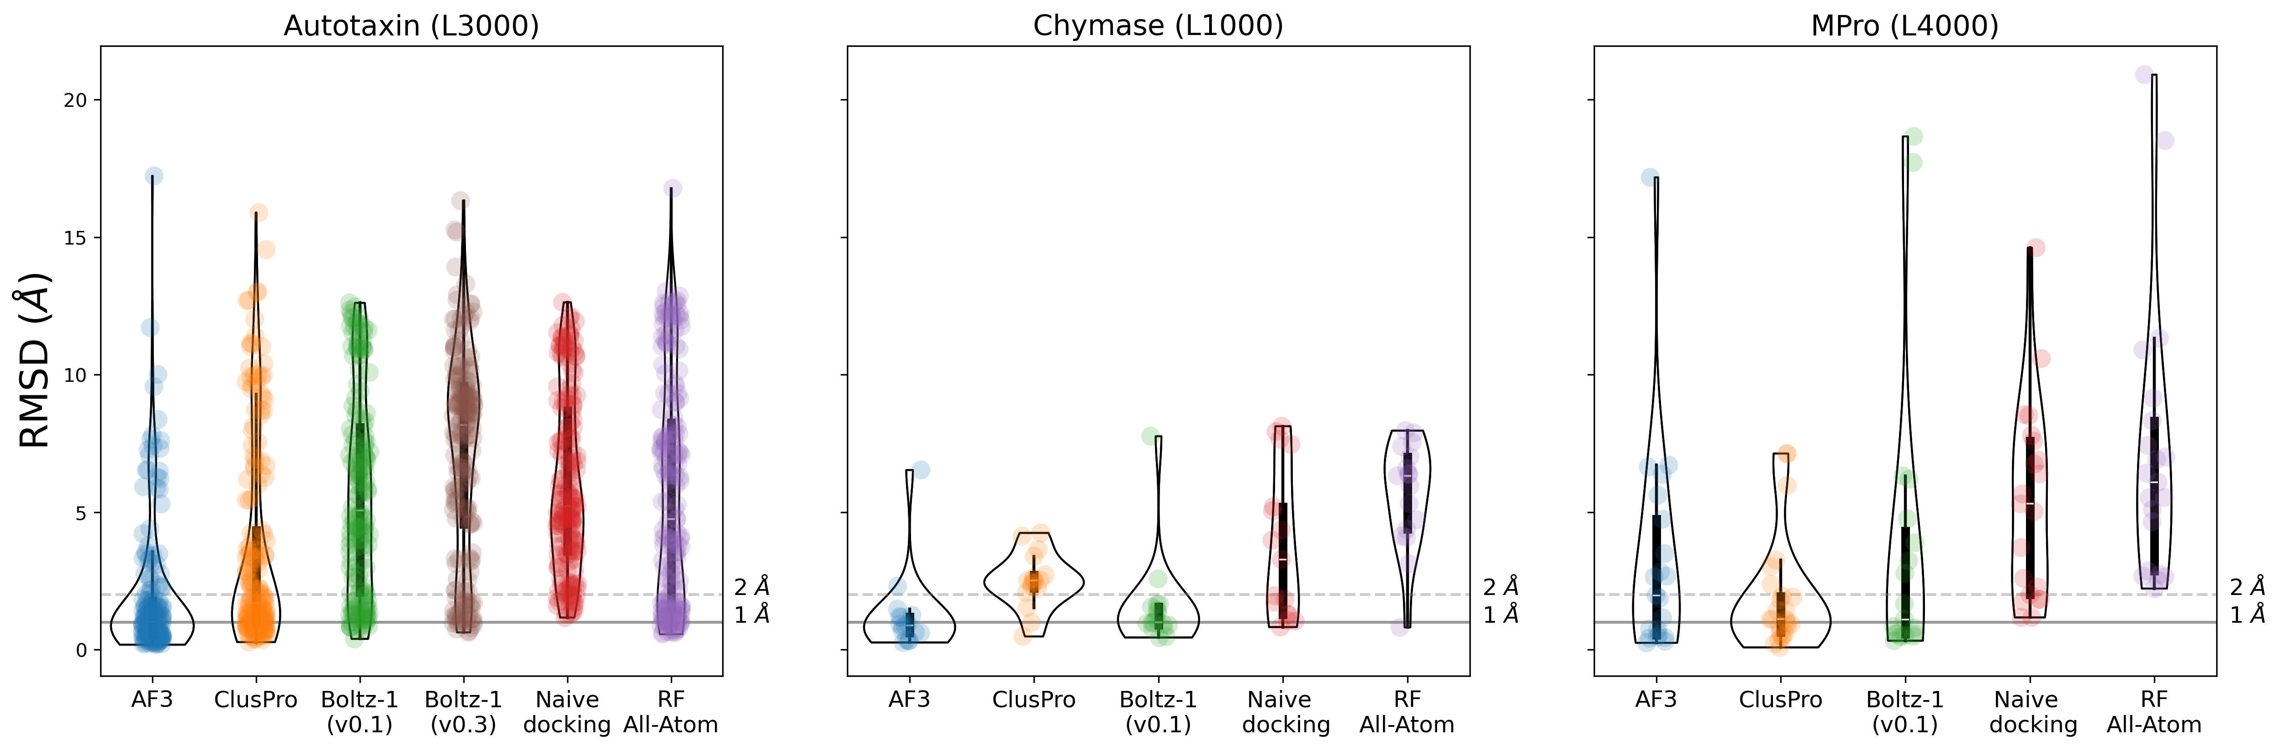
Overall RMSD performances per target protein
I GUESS YOU GOT IT NOW, DOES NOT SHOW IT GENERALIZES!

Slide 49
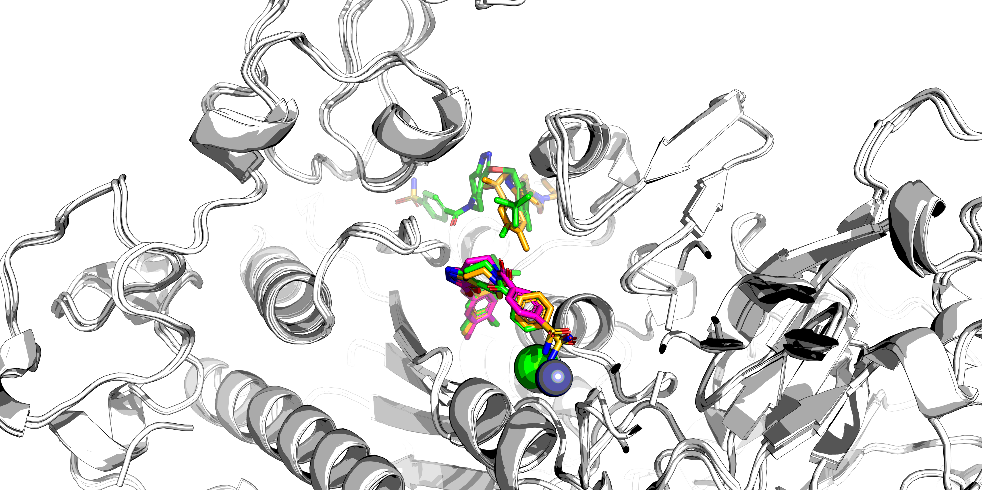
One example from the Autotaxin dataset
Target ID: L3019 – 2 copies of the same ligand (X-Ray: green, AF3: orange, ClusPro: pink)

Slide 50
What did we learn from these baselines?
Template-based methods are strong baselines!
Why is AlphaFold3 performing so well on the Autotaxin target?
  39 targets < 0.5 Å, 93 targets < 1 Å
  Different time cutoff?
  What is different between the paper version, the server and the public release?
AF3 and template-based can be complementary methods (ex: Mpro)
  If experimental data with close templates are available, use that
  Otherwise AF3/Boltz can save you, but proceed with caution

Slide 51

© chatGPT 2024

Slide 52
END

Slide 53
Two Metrics of Pose Accuracy
RMSD vs lDDT_PLI, Model 1 predictions
(0.66, 6.70)
2.5 A “success” cutoff

Slide 54
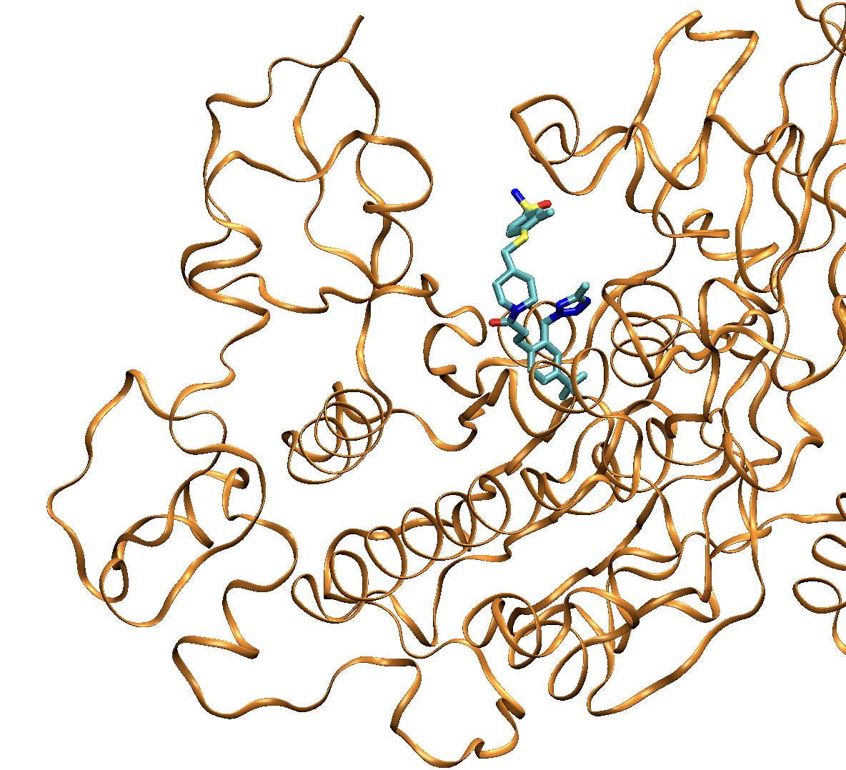
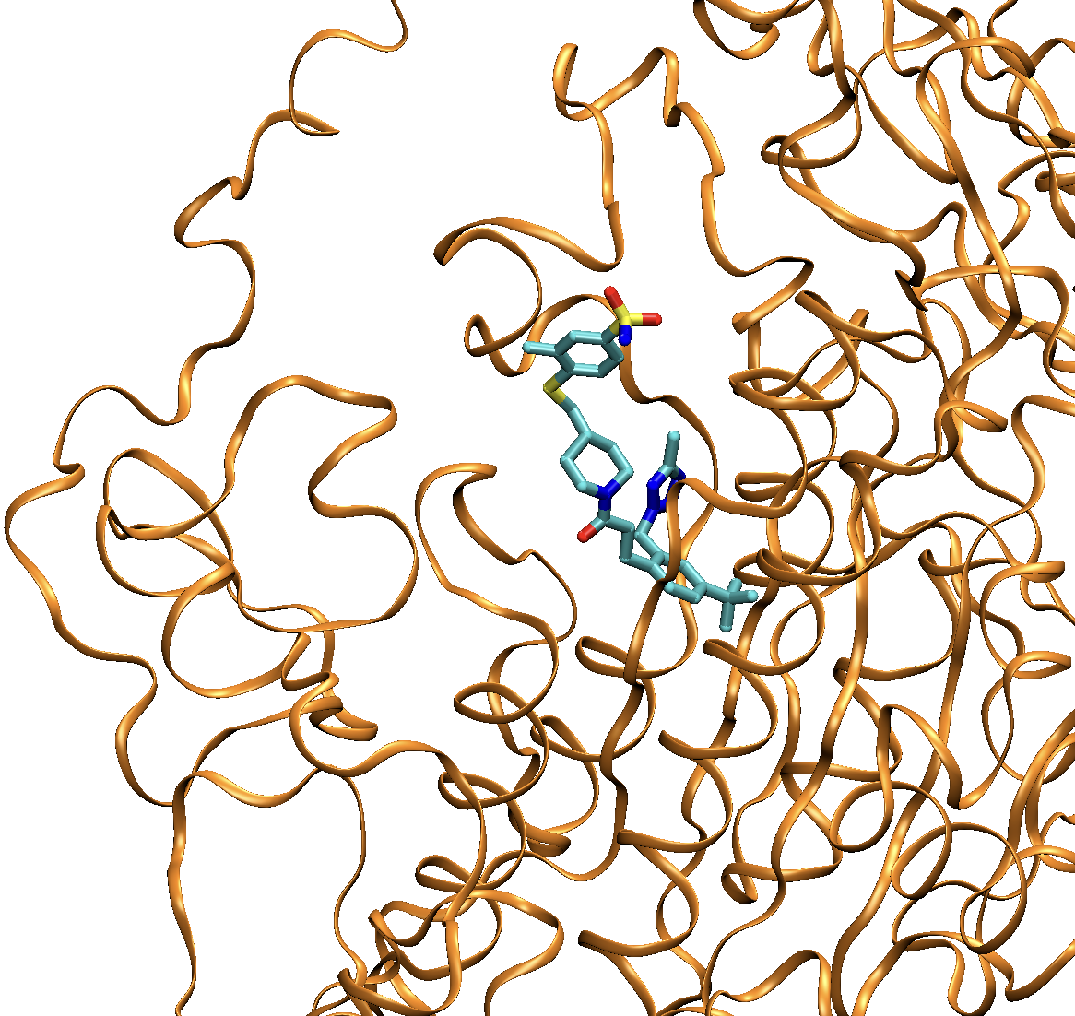
Sample Outlier from RMSD vs lDDT_PLI Scatter Plot
lDDT_PLI = 0.66, RMSD = 6.70 Angstroms
Crystal
Model

Slide 55
Overall lDDT_PLI Performance for Best Model Pose Predictions

Slide 56
Overall RMSD Success Rates for Best-Model Pose Predictions

Slide 57
RMSD vs lDDT_PLI of Incidental Ligands
Both should report accuracy of ligand pose
good correlation, two outliers with RMSD identically zero
deleting these rows

Slide 58
bb_RMSD vs lDDT_LP
Both should report accuracy of ligand pocket, presumably of the incidental ligand
Unexpected that RMSD can be zero with zero native contacts

Slide 59
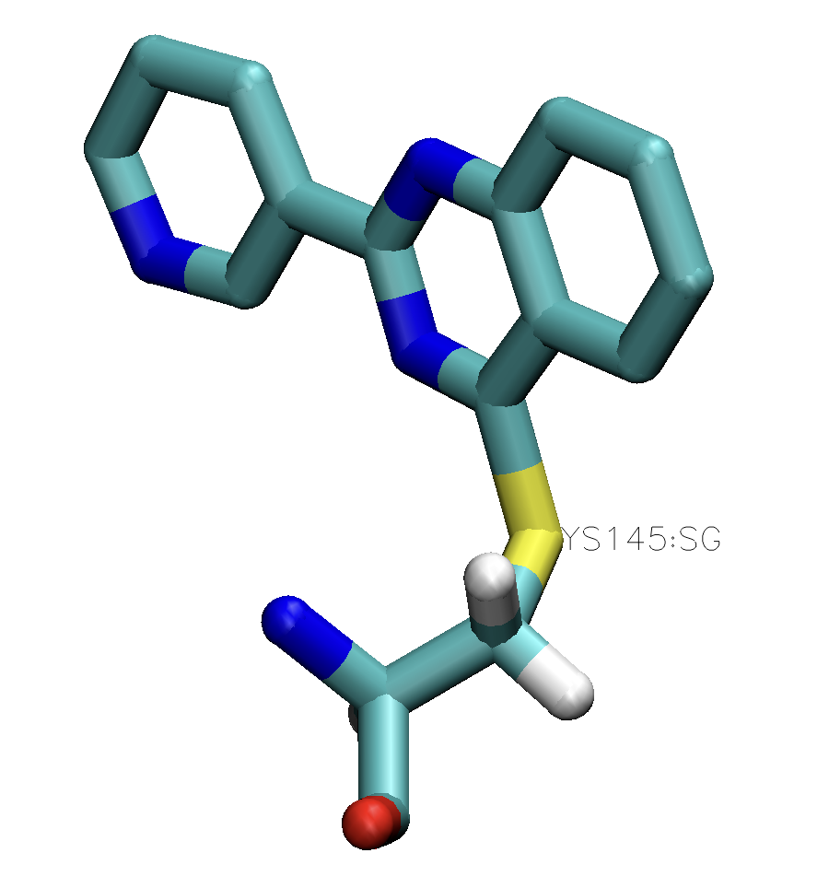
Covalent Ligands in Mpro
spot-checks shows bonding often absent
Group 494, target L4003 (covalent), Model 1
Appropriate S-C bond lengths also seen for 4013, 4019, 4023 in Group 494 predictions

Slide 60
Incidental Ligands in Pharma Targets
Accuracy of Model 1 Pose Predictions: RMSD
Top Groups: 91, 274, 494, 408, 39

Slide 61
Mean RMSD success rate (<2.5 Angstroms) for each CASP Group
Model 1, Skip-penalized mean across all 233 targets
Top 5 Groups: ClusPro, kozakovvajda, Huang-HUST, CoDock, DIMAIO

Slide 62
Ranking of Stage 1 Affinity Predictions for Autotaxin (L3000)
Kendall’s tau, N=123, Model 1

Slide 63
Ranking of Stage 1 Affinity Predictions for Autotaxin (L3000)
Kendall’s tau, N=123, Model 1

Slide 64
Ranking of Stage 1 Affinity Predictions for Chymase (L1000)
Kendall’s tau, N=17

Slide 65
Ranking of Stage 1 Affinity Predictions for Chymase (L1000)
Kendall’s tau, N=17

Slide 66
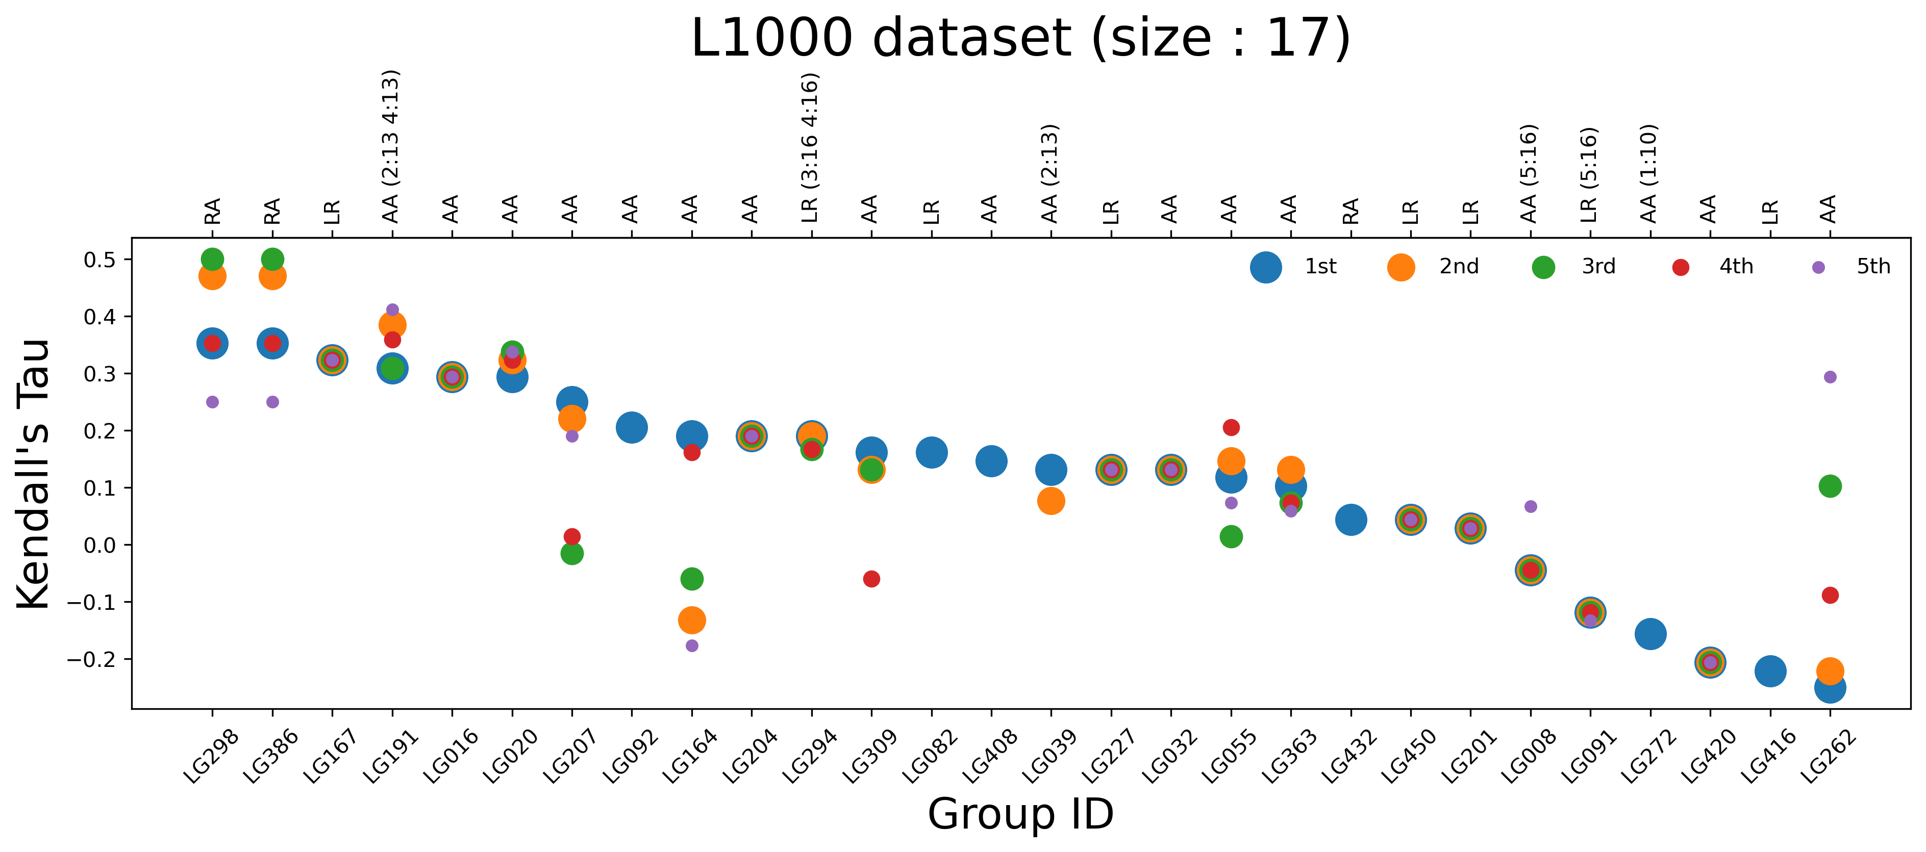
Accuracy of Other Affinity Prediction Models from each Group
stage 1 chymase
Other Models sometimes yield notably different results, but no strong influence on ranking

Slide 67
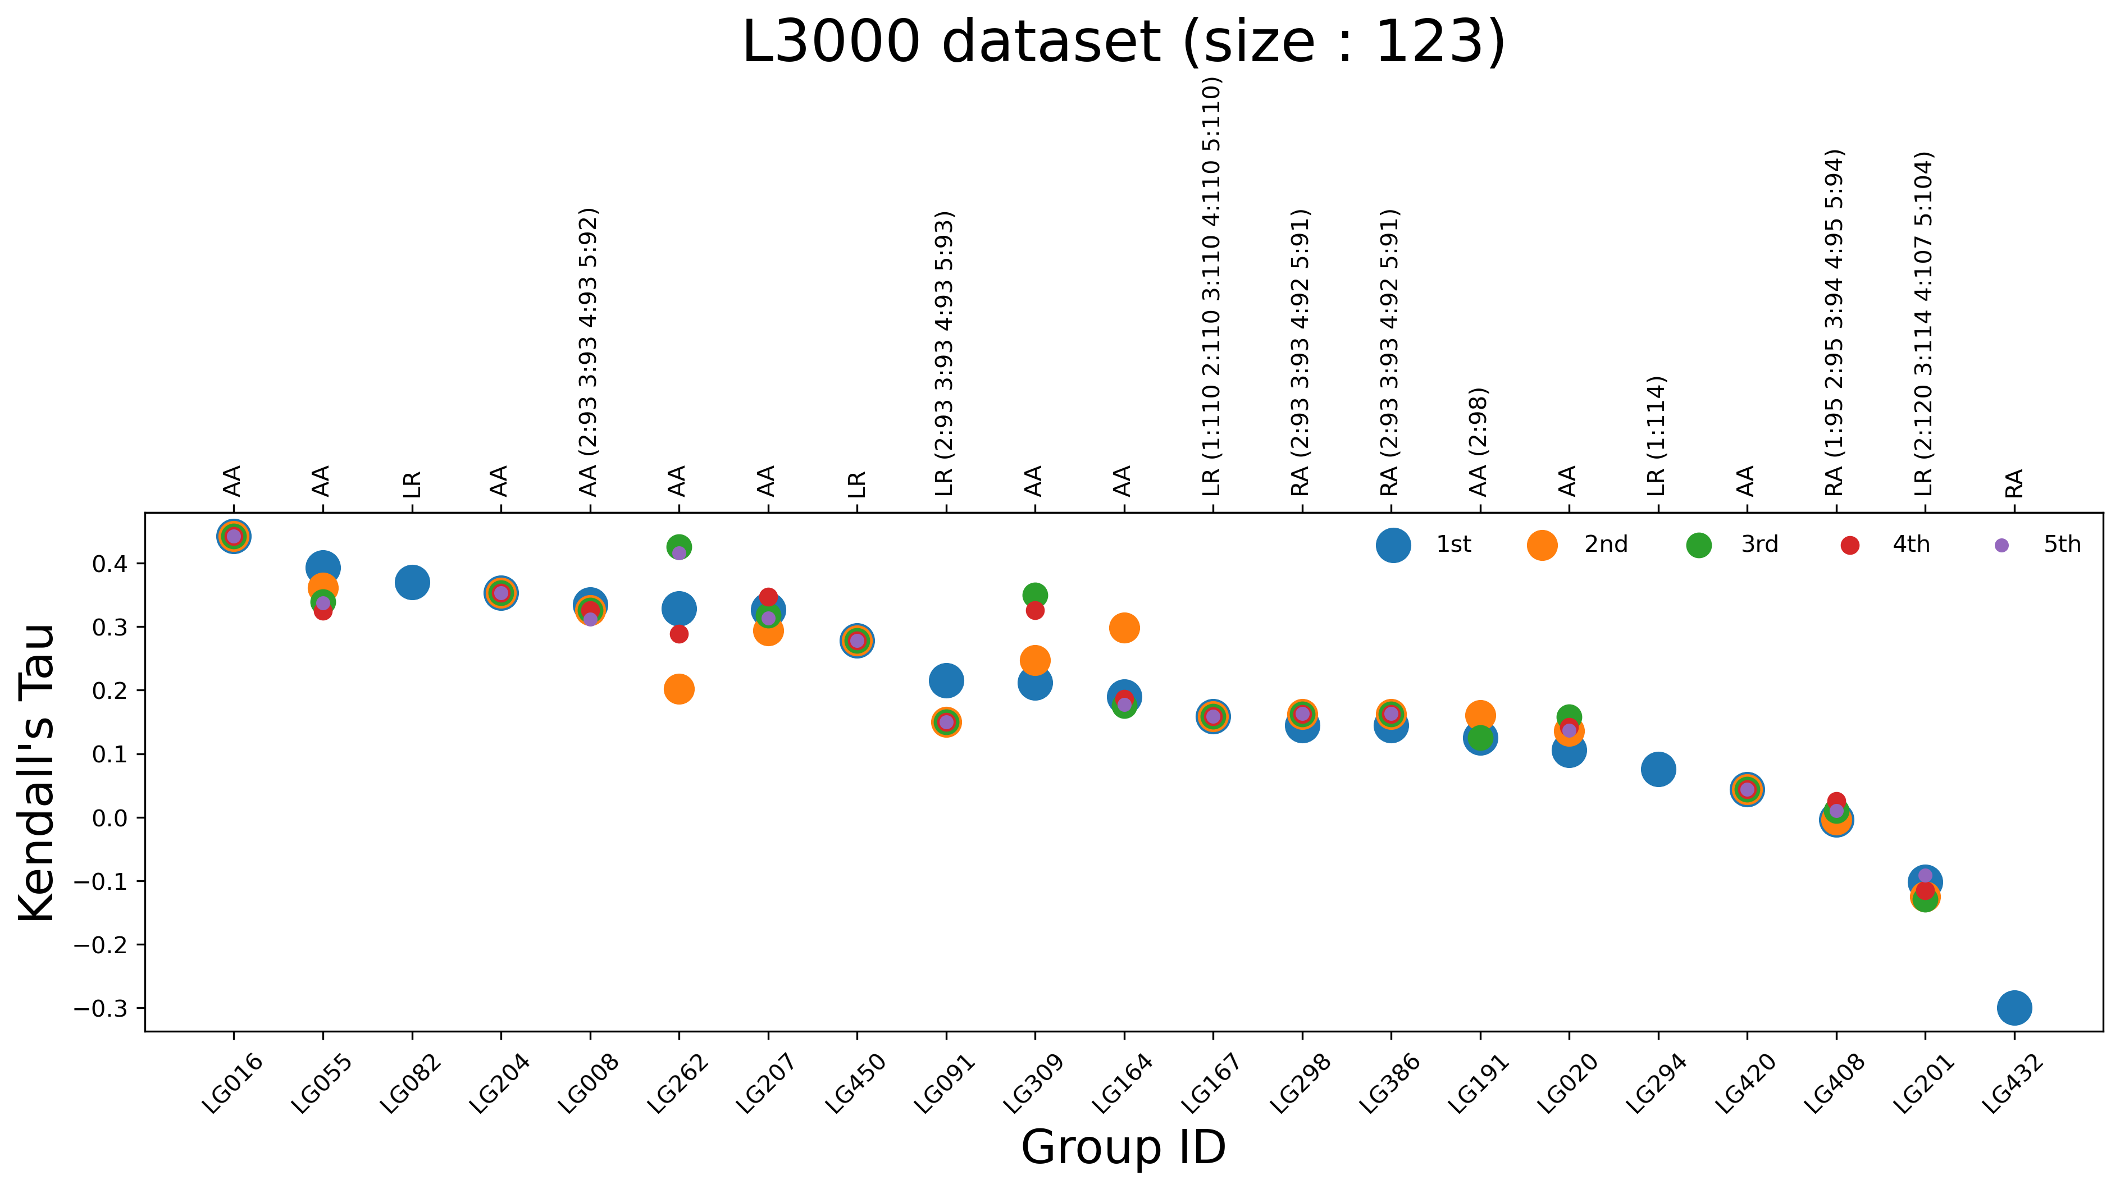
Accuracy of Other Affinity Prediction Models from each Group
stage 1 autotaxin
Other Models could yield two rerankings

Slide 68
Ranking of Stage 2 Affinity Predictions for Chymase (L1000)
Kendall’s tau, N=17
*
*
*
*
*
*
*
*
* group not in stage 1

Slide 69
Ranking of Stage 2 Affinity Predictions for Autotaxin (L3000)
Kendall’s tau, N=93
*
*
*
*
*
*
*
*
*
*
* group not in stage 1

Slide 70
Ranking of Stage 2 Affinity Predictions for Both Targets by Group
N- and skip-weighted Kendall’s tau
*
*
*
*
*
*
*
*
*
*
* group not in stage 1
* overall KT >0.3 in stage 1

Slide 71
Two Metrics of Binding Site Accuracy
bb_RMSD vs lDDT_PL, Model 1 predictions

Slide 72
 | Model 1 Poses, Pharma Ligands |  | Best of Model Poses, Pharma Ligands |  | Model 1 Poses, NonPharma Ligands |  | Stage 1 Affinities |  | Stage 2 Affinities |  | Lscore Pearson
Rank | lDDT_PLI | RMSD <2.5 rate | lDDT_PLI | RMSD <2.5 rate | lDDT_PLI | RMSD <2.5 rate | Chymase Affinity N=17 | Autotaxin Affinity N=123 | Chymase Affinity N=17 | Autotaxin Affinity N=93 | LScore
1 | 494 | 494 | 274 | 204 | 39 | 39 | 298 | 16 | 30 | 167 | 8 (0.47)
2 | 274 | 274 | 494 | 274 | 91 | 91 | 386 | 55 | 298 | 450 | 164 (0.40)
3 | 262 | 91 | 204 | 494 | 274 | 274 | 167 | 82 | 386 | 39 | 207 (0.30)
4 | 91 | 262 | 432 | 420 | 494 | 494 | 191 | 204 | 408 | 408
5 | 207 | 420 | 420 | 91 | 408 | 408 | 16 | 8 | 92 | 128
6 | 432 | 432 | 262 | 262 |  |  | 20 | 262 | 469 | 16
7 | 420 | 55 | 207 | 432 |  |  | 207 | 207 | 204 | 207
8 | 55 | 204 | 408 | 408 |  |  | 92 | 450 | 16 | 353
9 | 204 | 207 | 91 | 55 |  |  | 164 | 91 | 207 | 91
10 | 408 | 408 | 55 | 207 |  |  | 204 | 309 | 39 | 237
11 | 8 | 8 | 16 | 309 |  |  | 294 | 164 | 128 | 469
12 | 294 | 309 | 8 | 8 |  |  | 309 | 167 | 295 | 295
13 | 309 | 294 | 309 | 16 |  |  | 82 | 298 | 172 | 204
14 | 16 | 298 | 298 | 167 |  |  | 408 | 386 | 363 | 18
15 | 82 | 386 | 294 | 298 |  |  | 39 | 191 | 353 | 298
Pharma and other ligand pose predictions:
  No added info from Best of Model
  No added info from RMSD
➔ simplified table
Skip-averages
LSCORE listed only for N>1000 and rho at least 0.30
Notes:
For both pharma and incidental predictions:
Minimal new information from Best of Model vs Model 1
Minimal new information from RMSD vs lDDT_PLI

Slide 73
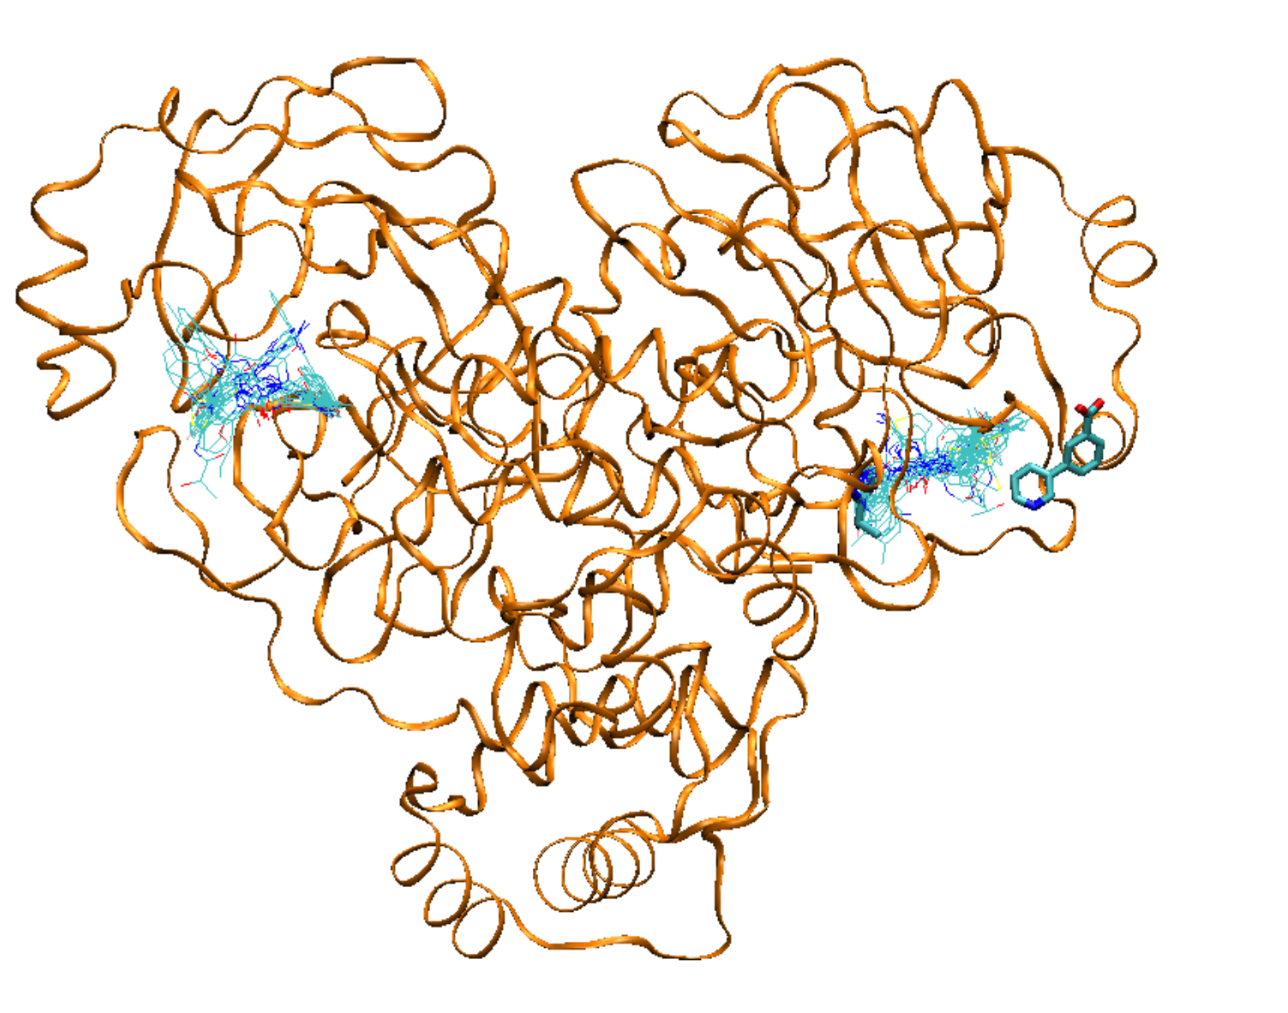
All Mpro ligands except the one for L4024, which is on a non-aligned protein
puzzling that ligand 1501 in L4006 is not in a canonical binding site.
L4006, ligand 1501

Slide 74
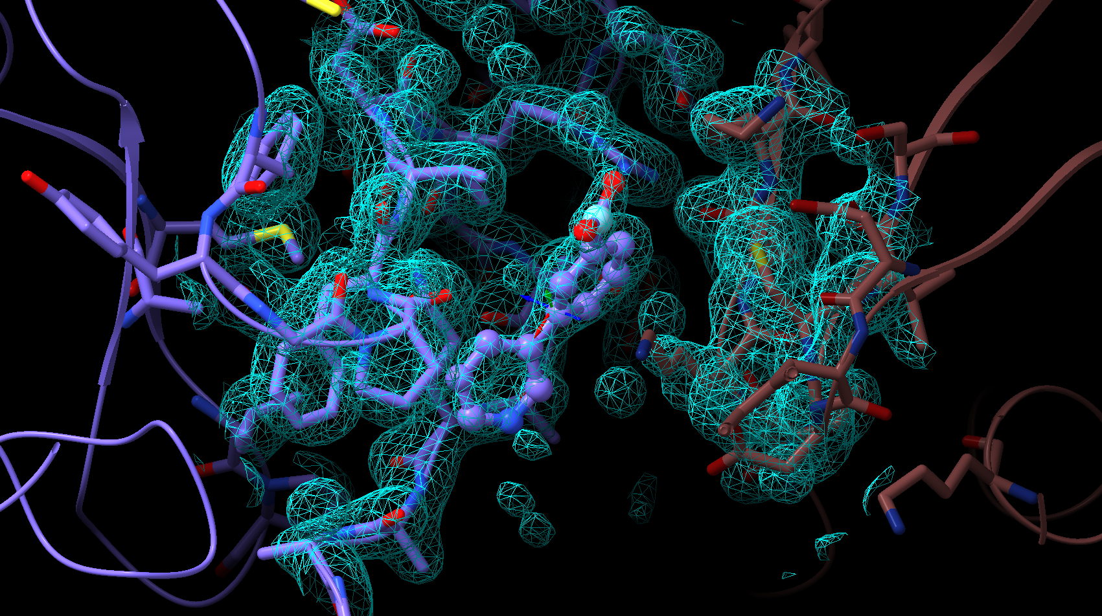
L4006 is situated at a crystal contact→ exclude from statistics

Slide 75
Are Certain Supertargets Easier than Others?
Model 1 data
 | Supertarget
 | Chymase | cathepsin G | autotaxin | Mpro
Number of Targets | 17 | 2 | 189 | 24
lDDT_PLI | 0.44 | 0.49 | 0.28 | 0.4
Success rate | 0.26 | 0.41 | 0.17 | 0.21
skip-penalized means
maybe, but numbers are probably too small to be sure

Slide 76
Pharma | Incidental | Affinity Stage 1 N_{group}=28 |  | Affinity Stage 2 N_{group}=27, 8 new
Ligand Poses | Ligand Poses | Chymase | Autotaxin | Chymase | Autotaxin | L-Score
N_{group}=34 | N_{group}=18 | N_{group}=28 | N_{group}=21 | N_{group}=27, 8 new to C | N_{group}=24, 10 new to A | N_{group}=10
8 | 16 | 8 | 8 | 16 | 16 | 8
16 | 20 | 16 | 16 | 18 | 18 | 16
20 | 39 | 20 | 20 | 30 | 39 | 32
32 | 55 | 32 | 55 | 39 | 91 | 164
39 | 91 | 39 | 82 | 91 | 128 | 204
55 | 164 | 55 | 91 | 92 | 164 | 207
82 | 167 | 82 | 164 | 128 | 167 | 262
91 | 191 | 91 | 167 | 164 | 172 | 272
92 | 207 | 92 | 191 | 167 | 204 | 309
164 | 227 | 164 | 201 | 172 | 207 | 420
167 | 262 | 167 | 204 | 204 | 227
189 | 274 | 191 | 207 | 207 | 237
191 | 294 | 201 | 262 | 227 | 262
201 | 298 | 204 | 294 | 237 | 294
204 | 309 | 207 | 298 | 262 | 295
207 | 408 | 227 | 309 | 294 | 298
227 | 450 | 262 | 386 | 295 | 353
261 | 494 | 272 | 408 | 298 | 386
262 |  | 294 | 420 | 353 | 408
272 |  | 298 | 432 | 363 | 416
274 |  | 309 | 450 | 386 | 420
294 |  | 363 |  | 408 | 432
298 |  | 386 |  | 416 | 450
309 |  | 408 |  | 420 | 469
363 |  | 416 |  | 432
386 |  | 420 |  | 450
408 |  | 432 |  | 469
416 |  | 450
420
432
450
464
474
494
Bold: stage 2 but no stage1 predictions for this target
Yellow: stage 2 but no stage 1 predictions at all
30 distinct research groups
Colored pairs come from same research group
Notes:
274/494 - Kozakov
204/420 - Zou
189/261 - Liwo
167/450 - OpenFold
CleanedPosePredictionData-Analysis-1a.xlsx

Slide 77
 | All Pose Targets | Chymase | Cathepsin G | Autotaxin | Mpro | WDR55
Group | N_{targets}=233 | N_{targets}= 17 | N_{targets}= 2 | N_{targets}=189 | N_{targets}=24 | N_{targets}=1
55 | 233 | 17 | 2 | 189 | 24 | 1
207 | 233 | 17 | 2 | 189 | 24 | 1
227 | 233 | 17 | 2 | 189 | 24 | 1
262 | 233 | 17 | 2 | 189 | 24 | 1
274 | 233 | 17 | 2 | 189 | 24 | 1
432 | 233 | 17 | 2 | 189 | 24 | 1
464 | 233 | 17 | 2 | 189 | 24 | 1
494 | 233 | 17 | 2 | 189 | 24 | 1
8 | 232 | 17 | 2 | 189 | 24 | 0
16 | 232 | 17 | 2 | 189 | 24 | 0
91 | 232 | 17 | 2 | 189 | 23 | 1
164 | 232 | 17 | 2 | 189 | 23 | 1
191 | 232 | 17 | 2 | 189 | 24 | 0
201 | 232 | 17 | 2 | 188 | 24 | 1
309 | 232 | 17 | 2 | 189 | 24 | 0
450 | 232 | 17 | 2 | 189 | 24 | 0
298 | 231 | 17 | 2 | 188 | 24 | 0
82 | 230 | 17 | 0 | 189 | 24 | 0
204 | 228 | 17 | 2 | 189 | 19 | 1
420 | 228 | 17 | 2 | 189 | 19 | 1
294 | 217 | 17 | 2 | 173 | 24 | 1
408 | 215 | 17 | 2 | 172 | 23 | 1
167 | 210 | 17 | 2 | 167 | 24 | 0
386 | 207 | 17 | 2 | 188 | 0 | 0
20 | 62 | 3 | 2 | 35 | 22 | 0
39 | 44 | 17 | 2 | 0 | 24 | 1
474 | 24 | 0 | 0 | 0 | 24 | 0
272 | 22 | 11 | 1 | 10 | 0 | 0
32 | 19 | 17 | 2 | 0 | 0 | 0
363 | 17 | 17 | 0 | 0 | 0 | 0
416 | 17 | 17 | 0 | 0 | 0 | 0
92 | 8 | 7 | 1 | 0 | 0 | 0
189 | 2 | 0 | 2 | 0 | 0 | 0
261 | 2 | 0 | 2 | 0 | 0 | 0
Pose Targets Predicted by Each Group
Ranked by All then Group

Slide 78
Affinity Targets Predicted by Each Group
 | All Affinities | Chymase S1 | Autotaxin S1 | Chymase S2 | Autotaxin S2
Group | N_{targets}=250 | N_{targets}= 17 | N_{targets}= 123 | N_{targets}=17 | N_{targets}=93
16 | 250 | 17 | 123 | 17 | 93
91 | 250 | 17 | 123 | 17 | 93
164 | 250 | 17 | 123 | 17 | 93
204 | 250 | 17 | 123 | 17 | 93
207 | 250 | 17 | 123 | 17 | 93
262 | 250 | 17 | 123 | 17 | 93
298 | 250 | 17 | 123 | 17 | 93
386 | 250 | 17 | 123 | 17 | 93
420 | 250 | 17 | 123 | 17 | 93
432 | 250 | 17 | 123 | 17 | 93
450 | 250 | 17 | 123 | 17 | 93
294 | 241 | 17 | 114 | 17 | 93
167 | 237 | 17 | 110 | 17 | 93
408 | 222 | 17 | 95 | 17 | 93
8 | 140 | 17 | 123 | 0 | 0
20 | 140 | 17 | 123 | 0 | 0
55 | 140 | 17 | 123 | 0 | 0
82 | 140 | 17 | 123 | 0 | 0
191 | 140 | 17 | 123 | 0 | 0
201 | 140 | 17 | 123 | 0 | 0
309 | 140 | 17 | 123 | 0 | 0
39 | 127 | 17 | 0 | 17 | 93
227 | 127 | 17 | 0 | 17 | 93
416 | 127 | 17 | 0 | 17 | 93
18 | 110 | 0 | 0 | 17 | 93
128 | 110 | 0 | 0 | 17 | 93
172 | 110 | 0 | 0 | 17 | 93
237 | 110 | 0 | 0 | 17 | 93
295 | 110 | 0 | 0 | 17 | 93
353 | 110 | 0 | 0 | 17 | 93
469 | 110 | 0 | 0 | 17 | 93
92 | 34 | 17 | 0 | 17 | 0
363 | 34 | 17 | 0 | 17 | 0
30 | 17 | 0 | 0 | 17 | 0
32 | 17 | 17 | 0 | 0 | 0
272 | 10 | 10 | 0 | 0 | 0

Slide 79
Total Model 1 Pose Predictions per Group
34 groups total
How to score groups that skipped predictions?

Slide 80
MKG: provide focused look at the results from those who will be speaking and my precis of their methods.
None of the methods here look familiar to me from what I know of industry. Should pharma be looking more at these methods? Should academia be more familiar with industrial methods and workflows?
Methods of speakers
Vajda/Kozakov: Template based, both whole-ligand and ligand fragments.
Huang: template based, traditional docking if no template
Zhang: Seems like conventional docking followed by a graph-based neural network method to identify the best docked poses
Morehead/Cheng: PoseBench script invoking multiple DL methods (e.g. DiffDock and Neuralplexer) and then some method of choosing models

Slide 81
Mean lDDTI_PLI for each CASP Group
Model 1, Skip-penalized mean across all 233 pose targets
Citizen-scientists (DockIt)
Top 5 Groups: 494, 274, 262, 91, 207

Slide 82
Incidental Ligands in Pharma Targets
Accuracy of Model 1 Pose Predictions: lDDT_PLI
Top Groups: 39, 91, 274, 494

Slide 83
Ranking of Stage 1 Affinity Predictions for Both Targets by Group
N- weighted Kendall’s tau
Top Group: 16

Slide 84
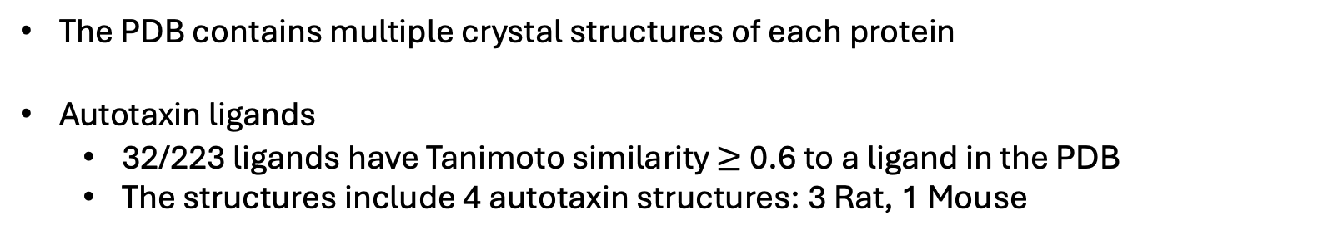
How Hard Are These Challenges?
The PDB contains multiple crystal structures of each protein
Autotaxin ligands
  32/223 ligands have Tanimoto similarity $≥$ 0.6 to a ligand in the PDB
  The structures include 4 autotaxin structures: 3 Rat, 1 Mouse
5L0B, 5S9M, 5S9N, 6LEH
Non-autotaxin proteins: enoyl reductase, HIV RT, dipeptidyl peptidase, transthyretin, DDR1, mitogen-activated protein kinase 1, EGFR, albumin, bromodomains, SARS-CoV-2 3CLpro
Sebastian Bittrich, RCSB PB
Notes:
20 different ligands in 26 PDB structures

Slide 85
Similarities of the 223 CASP Autotaxin Ligands
to the ligands in autotaxin structures 5LOB, 5S9M, 5S9N, 6LEH
Computed with OpenEye, using OEFPType Tree as fingerprint
Sebastian Bittrich, RCSB PB

Slide 86
Mean lDDTI_PLI for each CASP Group
Model 1, skip-penalized mean across all 233 pose targets
Citizen-scientists (DrugIt)
Top Groups: ClusPro, Kozakov/vajda, CoDock, Huang-HUST, MULTICOM_ligand

Slide 87
Assessment Principles-- Poses
Assess pose predictions based purely on Model 1 predictions
  Best-of-5 predictions correlate with Model 1 predictions
  Many high-performing predictors submitted only Model 1
Assess pose predictions based purely on lDDT_PLI
  correlates with RMSD and RMSD success rate
  not clear that RMSD measures tell us something different or better (though more common in the CADD community)
  binding site structure accuracy largely follows ligand pose accuracy. (Could revisit this for analysis)
Assign zero score (lDDT_PLI=0) for skipped predictions
  avoids giving high credit to groups that submitted only e.g. 17 predictions
  little effect on ranking of most high-performing groups
  avoids giving credit for “cherry-picking”
Weight pharmaceutical pose accuracy more than incidental ligand accuracy
  Some groups had decent success with this
  Many groups ignored it
  Less practical importance than pharmaceutical ligands

Slide 88
Assessment Principles-- Affinities
Assess pose predictions based purely on Model 1 predictions
  Best-of-5 predictions correlate with Model 1 predictions
  Many high-performing predictors submitted only Model 1
More weight on Stage 1 than Stage 2 predictions
  many groups did only Stage 1
  stage 1 is a scenario of more practical significance

