Slide 1
RNA Structure Prediction in CASP16
KiharaLab (294)
https://kiharalab.org

Slide 2
Overall Pipeline
RNA models are generated using seven DL-based methods _{(next page)}
  Those methods were not good at handling larger RNAs / complexes
AlphaFold3 was extremely helpful for RNA structure prediction in general
Structure Modeling
Predictions using DL-based methods
Initial Scoring
RankSum score
  ARES
  Rosetta
AF3 score
Human re-ranking
Template information
Literature information
  Secondary structure
Model diversity
Manual Modeling
TBM
assemble monomer or partial complex manually

Slide 3
Overall pipeline
List of methods we used
Monomer RNA
  NuFold (Kagaya et al. 2023)
  trRosettaRNA (Wang et al. 2023)
  RhoFold (Shen et al. 2024)
  DRfold (Li et al. 2023)
  DeepFoldRNA (Pearce et al. 2022)
Monomer / Multimer / Protein-NA
  (RosettaFoldNA (Baek et al. 2024) )
  AlphaFold3 (Abramson et al. 2024)
input MSAs
  rMSA (Zhang et al. 2023)
    Search on Rfam, RNAcentral, and NCBI nr
  Metagenome MSAs
    Search on NCBI env_nt, TARA, MGnify, and MGnify assembly (~ 3.2 TB)
Scoring
  Monomer: Ranksum (ARES (Townshend et al. 2021) + Rosetta score)
  Multimer: AF3

Slide 4
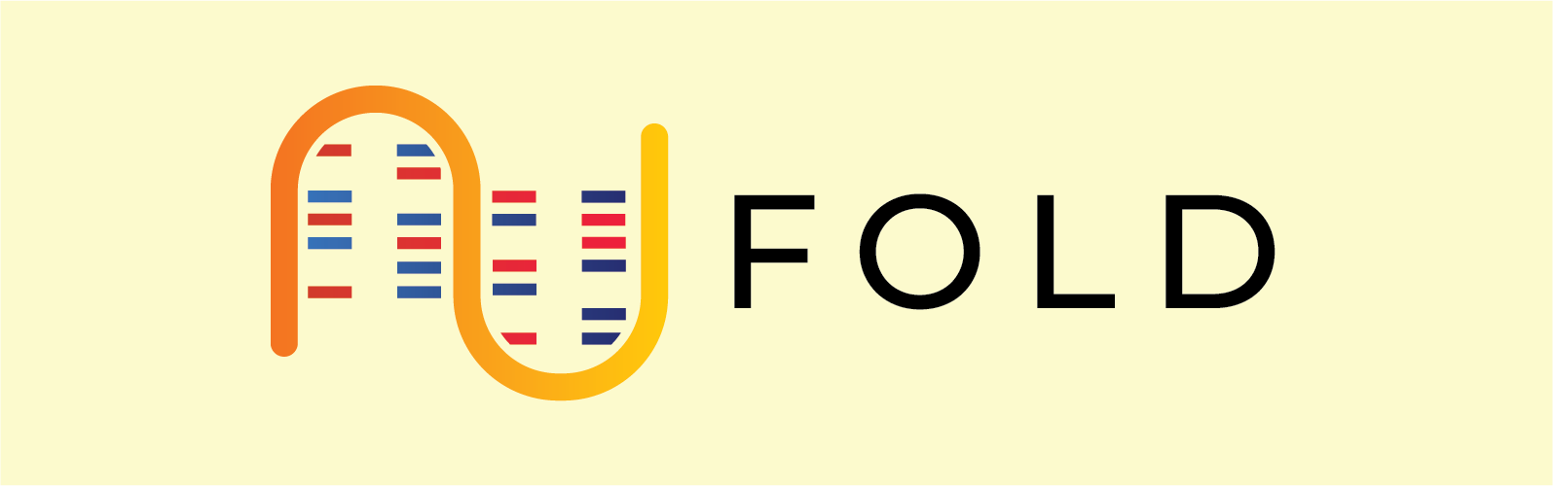
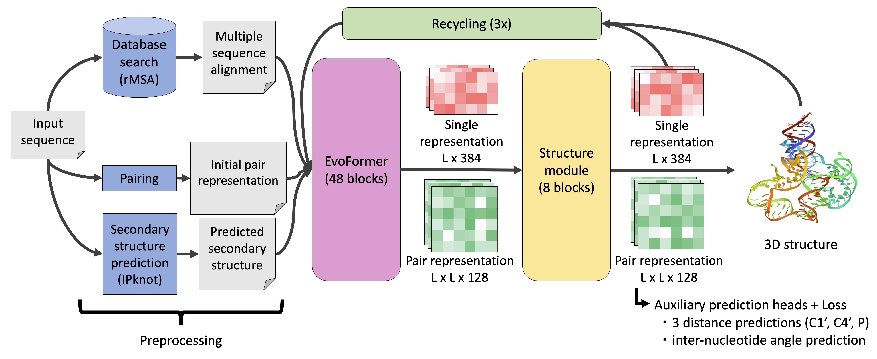
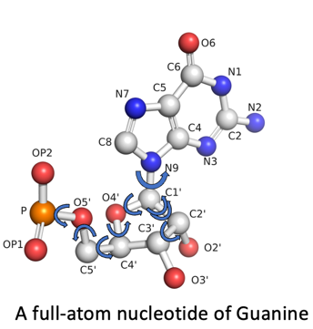
NuFold (Kagaya et al.)
RNA structure prediction method developed in Kihara Group
NuFold is an end-to-end RNA structure prediction method
  Input is MSA and predicted secondary structure, and output full-atom structure
Works on monomers
Kagaya,Y., et al. "NuFold: A Novel Tertiary RNA Structure Prediction Method Using Deep Learning with Flexible Nucleobase Center Representation”. bioRxiv (2023) https://doi.org/10.1101/2023.09.20.558715

Slide 5
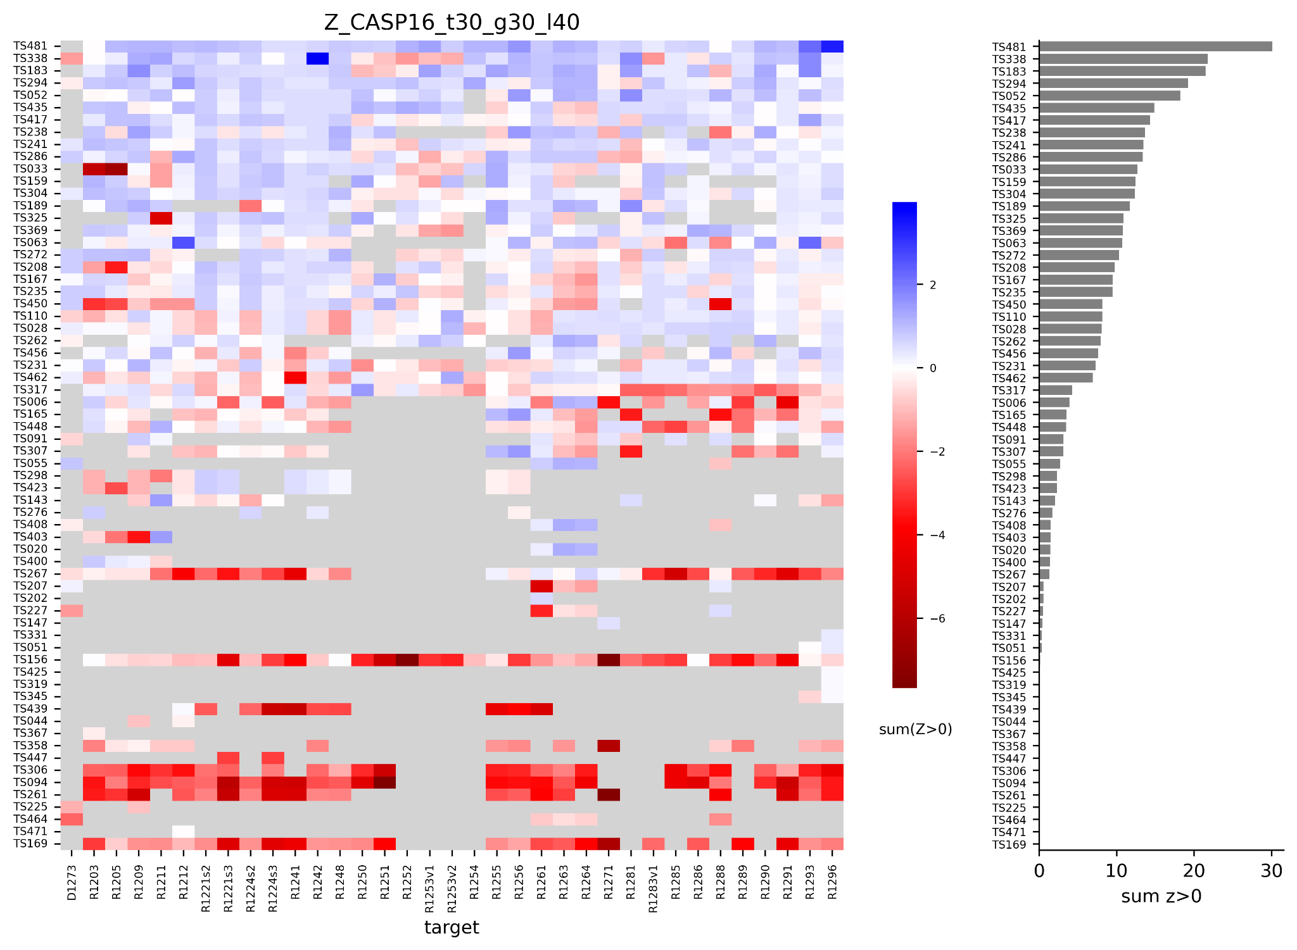
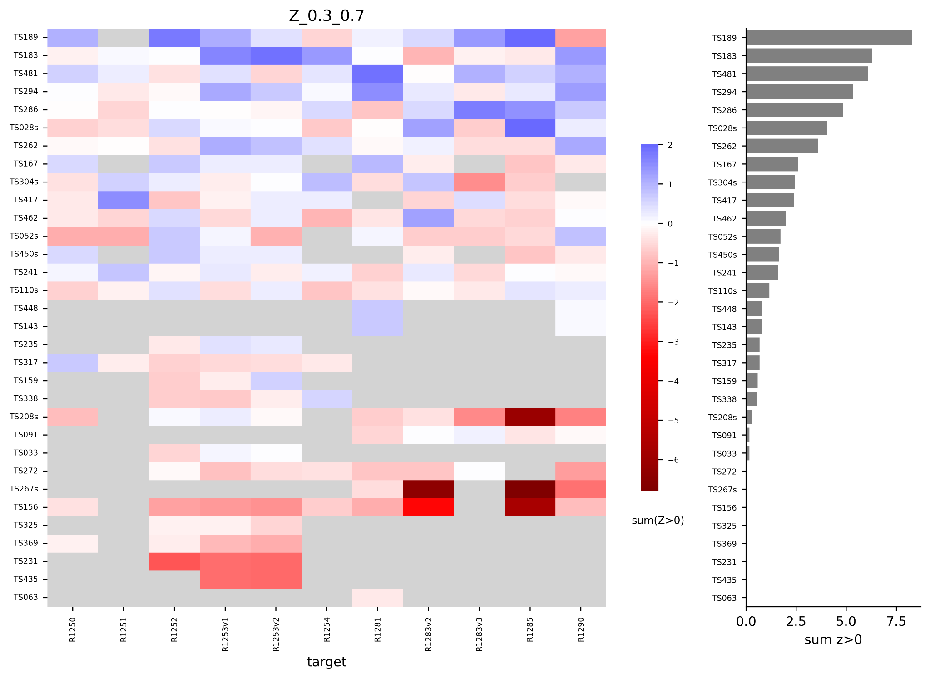
Our performance (TS294)
single
multimer
We achieved positive Z-score on majority of targets

Slide 6
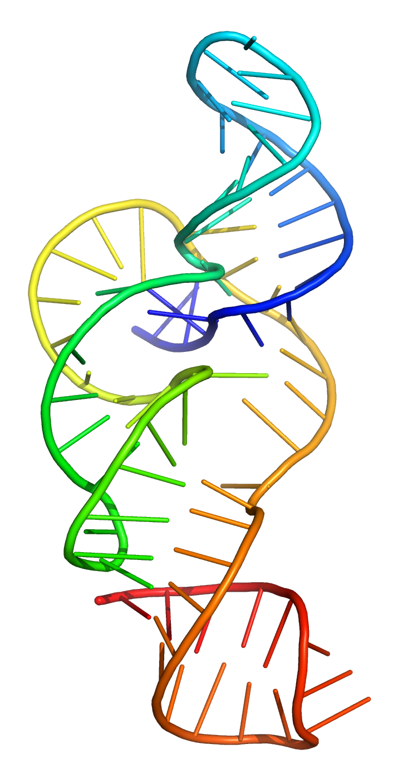
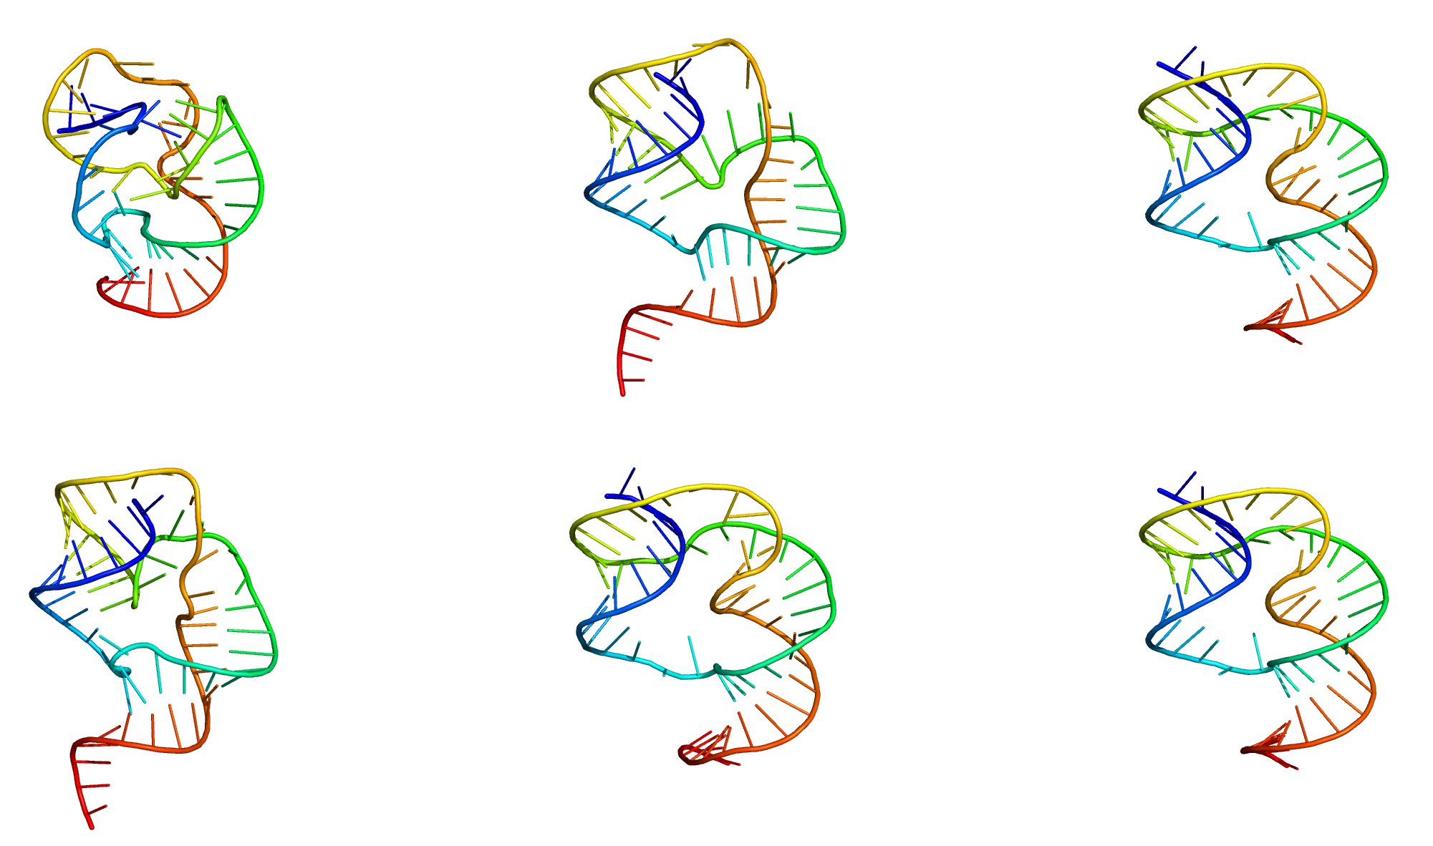
R1205: xrRNA (Exoribonuclease-resistant RNAs)
Small ncRNA (59 nt.), monomer
5’ terminal penetrate a loop to create a knot structure (the key for the function)
Native
AF3: 11.3 Å
NuFold: 11.5 Å
e.g. PDB: 5TPY
xrRNA from Zika virus
What went right?
Both NuFold and AF3 predicted knot structure which is key for its function
NuFold and AF3 agrees well
What went wrong?
inaccurate loop conformation
inaccurate
NuFold: 12.2 Å
NuFold: 11.5 Å
AF3: 12.3 Å

Slide 7
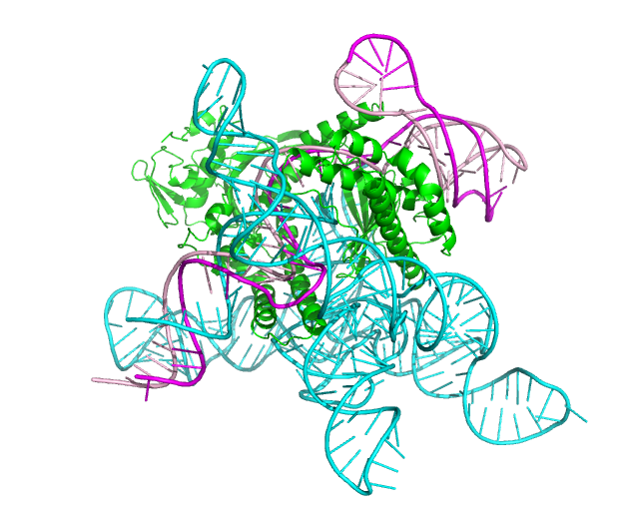
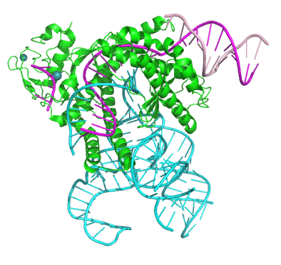
M1212(R1212) Protein-RNA-2DNAs
Literature information?
How DNA was modified in Strategy 1
AlphaFold3 model
●Protein
● ● DNA
●RNA
Native
●Protein
● ● DNA
●RNA
Overlapped?
Overlapped?
AlphaFold3 failed to predict the DNA-RNA interaction
  Two DNA strands overlap and clash each other

Slide 8
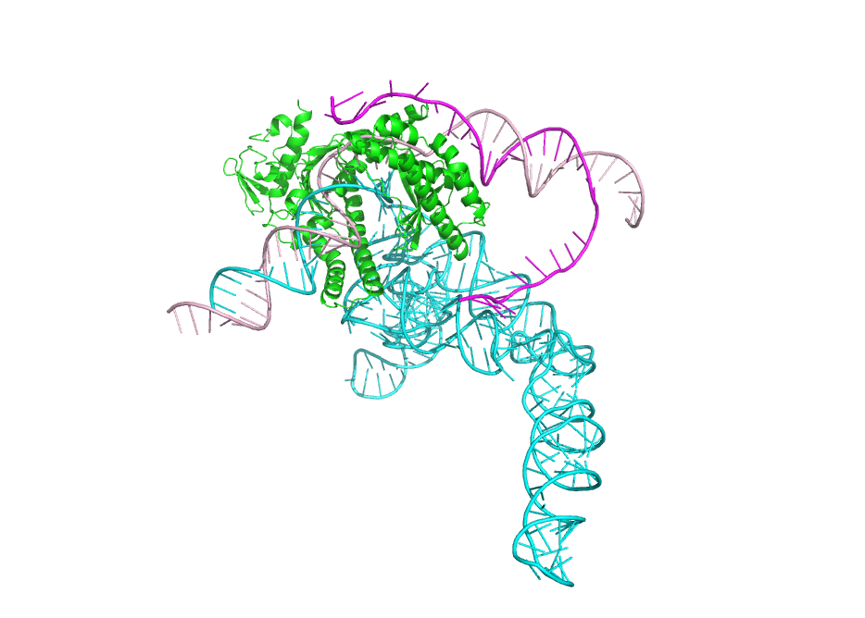
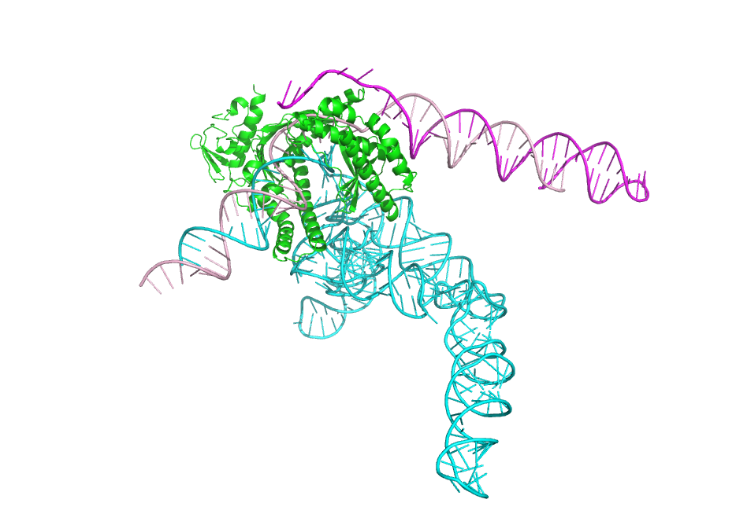
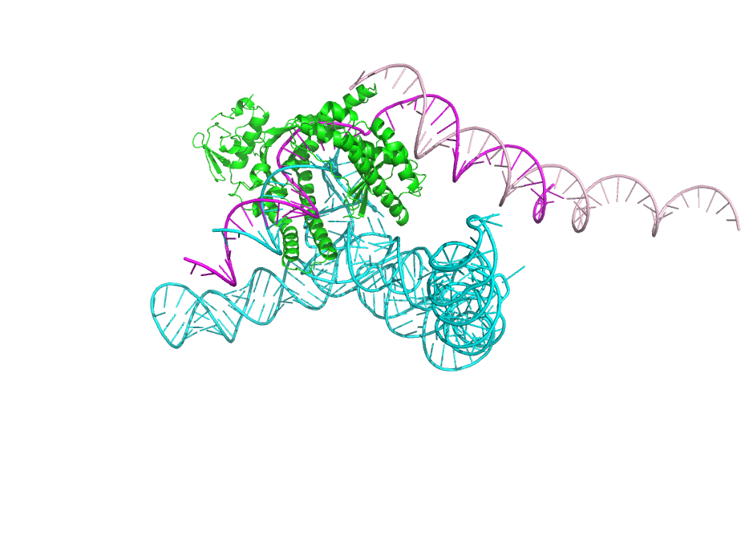
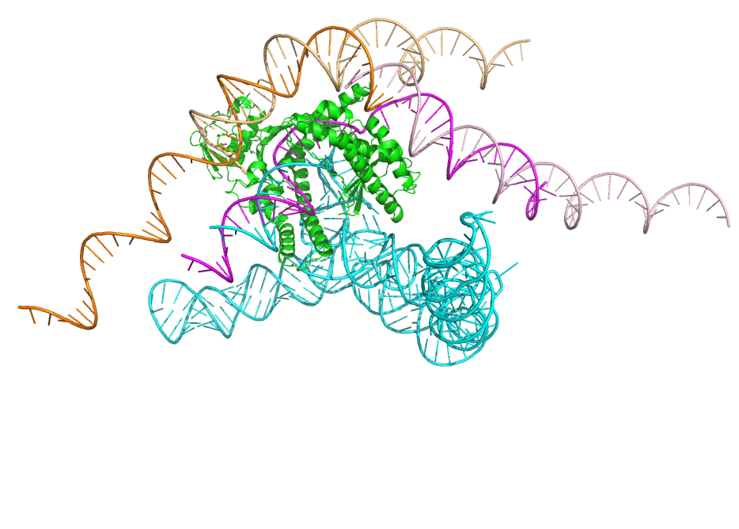
M1212(R1212) Protein-RNA-2DNAs
Literature information?
How DNA was modified in Strategy 1
>D1212s3, M1212 subunit 3, DNA 48 residues
CGGCCCAATAACAAGGAGGTGGCTGCCCCGACCGTCGCTCGGGCGTCG
>D1212s4, M1212 subunit 4, DNA 48 residues
CGGCCCAATAACAAGGAGGTGGCTGCCCCGAGCGACGGTCGGGCGTCG
Strategy 1: Remove DNAs 1-16/1-14 nucleotides from the input for AF3
●Protein
● ● DNA
●RNA
Native
Manual
Refinement
Model #1 ~ #3
RMSD: 22.9 Å
DNA-RNA interactions
Strategy 2: Add two more DNA sequences as input of AF3
Model #4~#5
RMSD: 24.8 Å
What went right?
Using AlphaFold3 with customized sequences.
Assessing models manually.
Remove additional 2DNAs
Additional DNAs

Slide 9
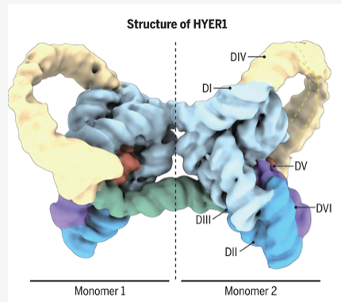
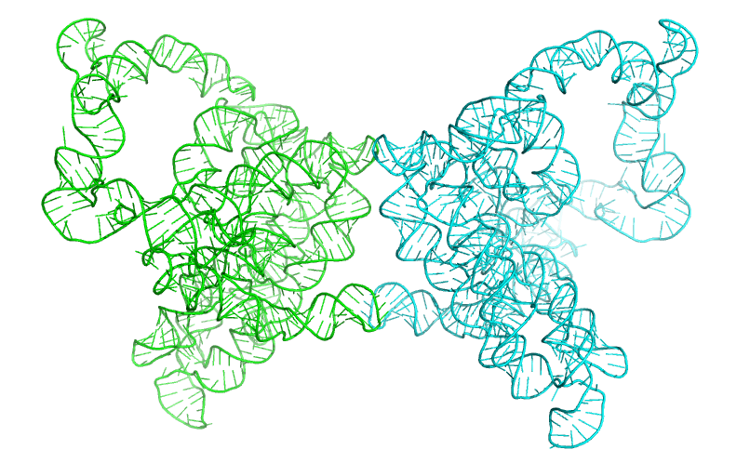
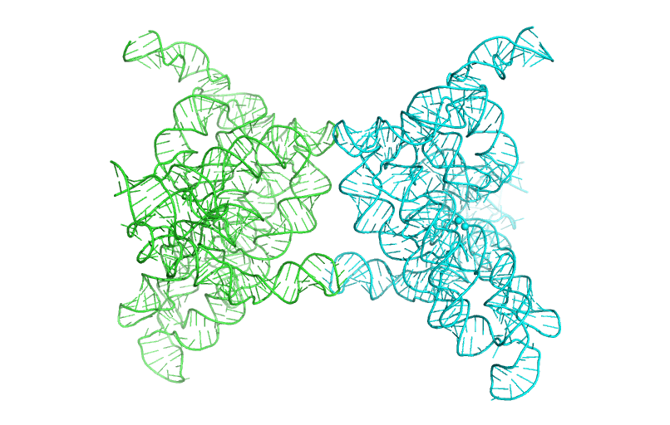
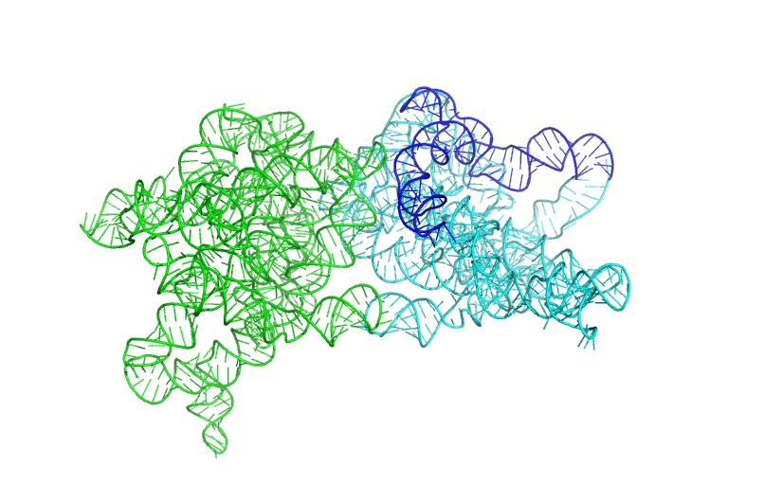
R1290: HYER1-withoutTRS, RNA homodimer
interaction between 197-203 and 463-469
Missing long loops
https://www.science.org/doi/full/10.1126/science.adh4859
Template: 8K0P
(SeqID 99%)
ModeRNA^{[1]}
no interactions between the loops
What went right?
Using a part of the AlphaFold3 model as a loop fragment.
Assessing the consistency between the predicted model and the template (8K0P)
Use the loop structure (403-509 in the AF3 model
AF3 model
1. Rother et al. Nucl. Acids Res. 2011
https://pubmed.ncbi.nlm.nih.gov/21300639/
Notes:
We don’t have native structure of this target
MODERNA referece

Slide 10
Summary
NuFold (and other DL-based methods) works well for small targets
  Large RNAs are still challenging
    it takes too much time to run
    it runs, but poor performance
We performed template based modeling for some large targets
  e.g. R1290 (as we discussed)
AlphaFold3 worked, but still have issues such as
  larger complexes (poor performance or beyond 5K tokens)
  higher-order homo oligomer
    Chains overlap (physically impossible)

Slide 11
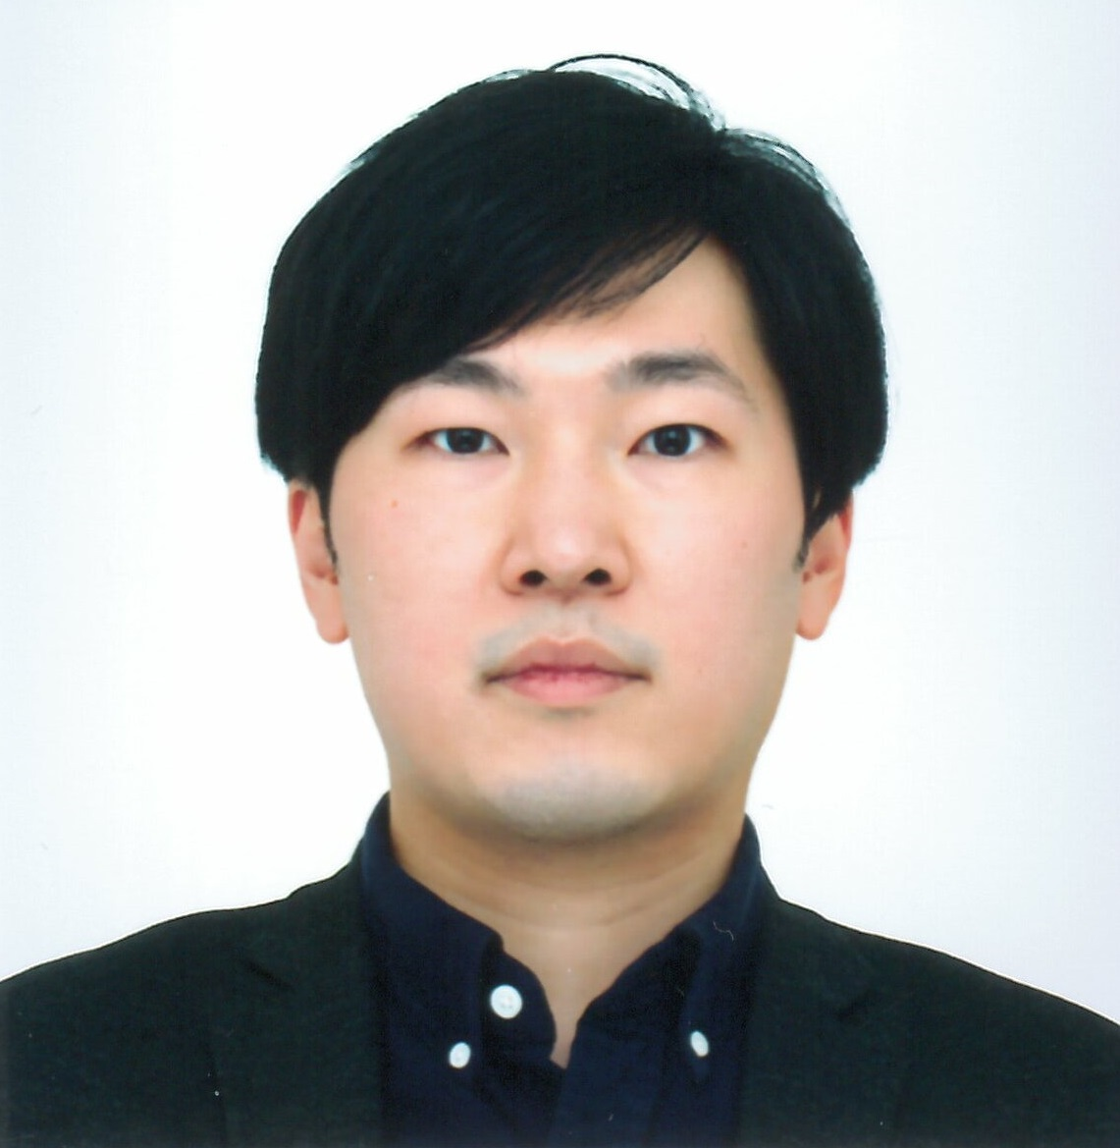

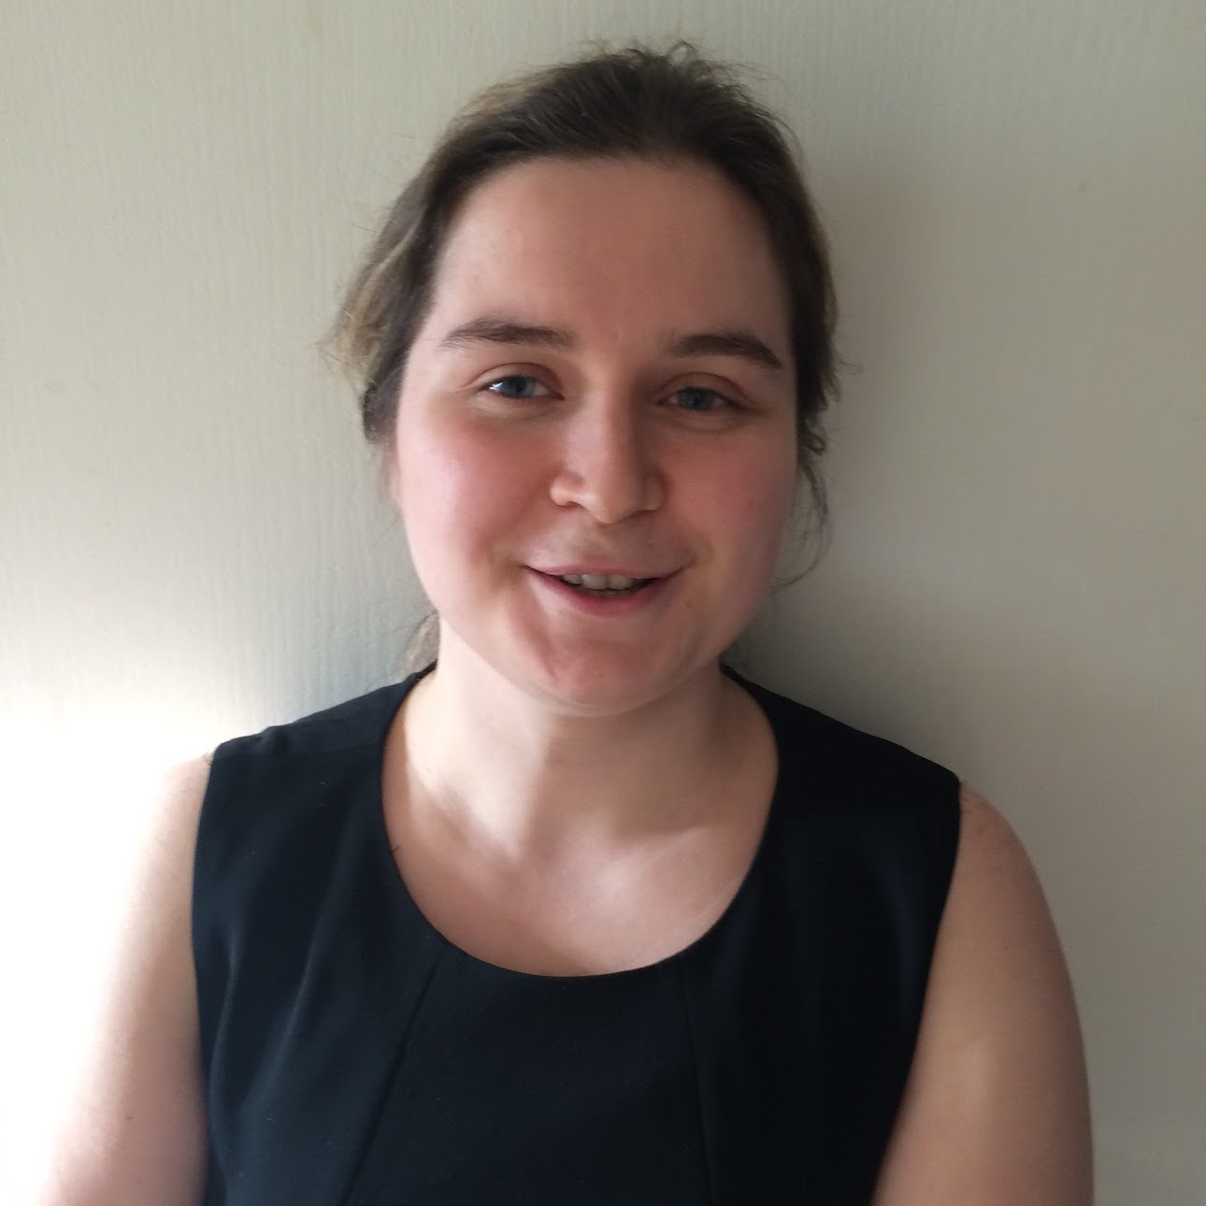
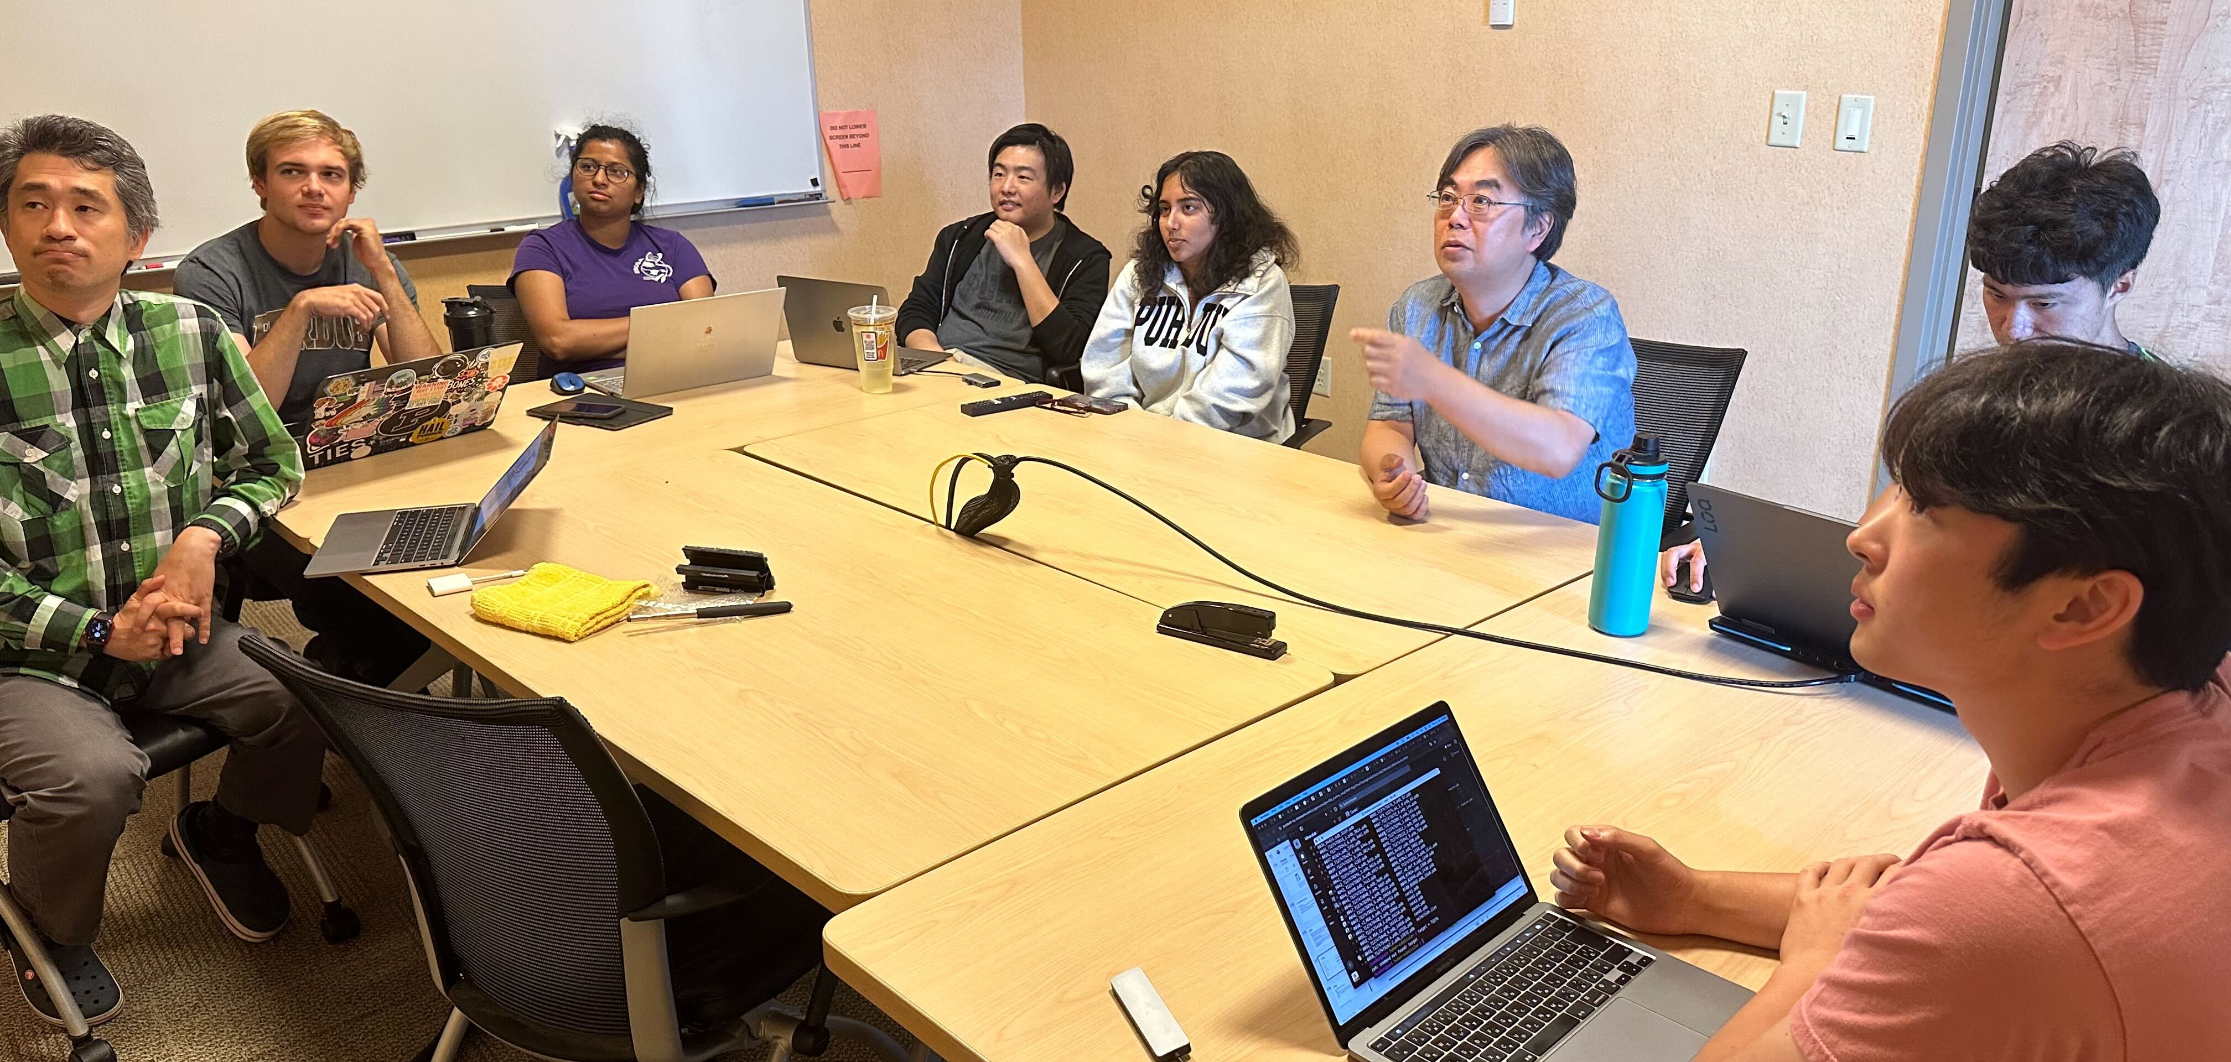



Team Members &
Acknowledgement
Dr. Tsukasa Nakamura
Pranav Punuru
Emilia Tugolukova
One day in submission selection meeting

