Slide 1
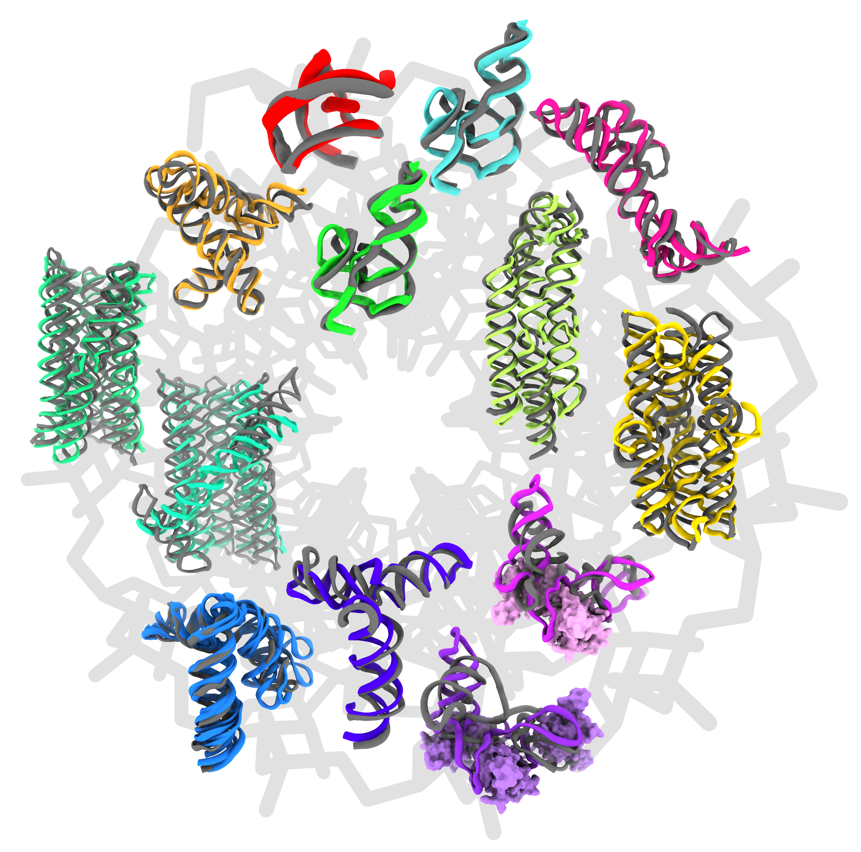


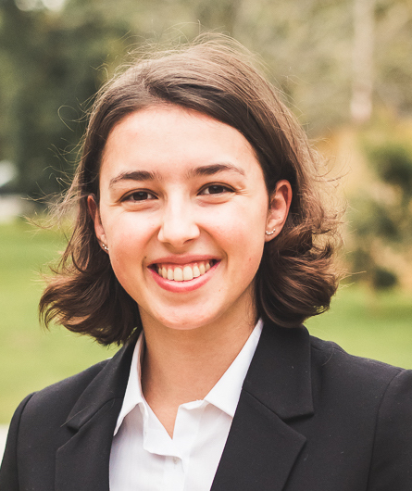
Nucleic Acid Assessment
CASP16
Rhiju Das, Shujun He, Alissa Hummer, Rachael Kretsch
3 December 2024
Poster on the prediction of RNA tertiary motifs

Slide 2
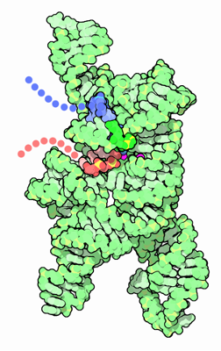
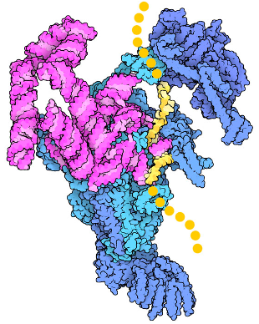
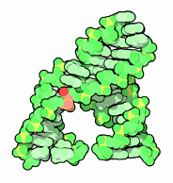
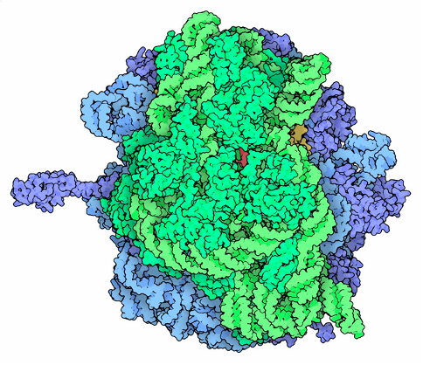
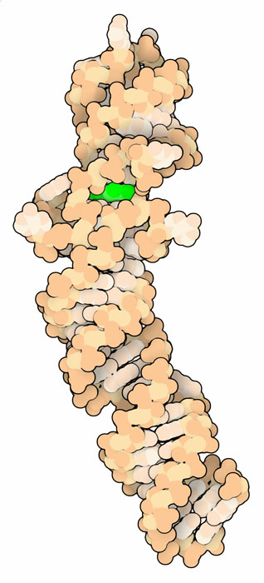
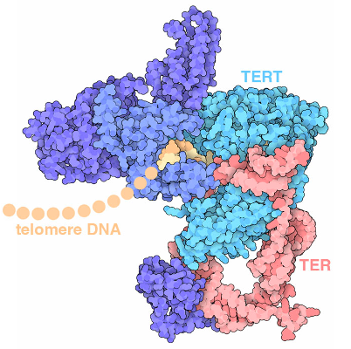
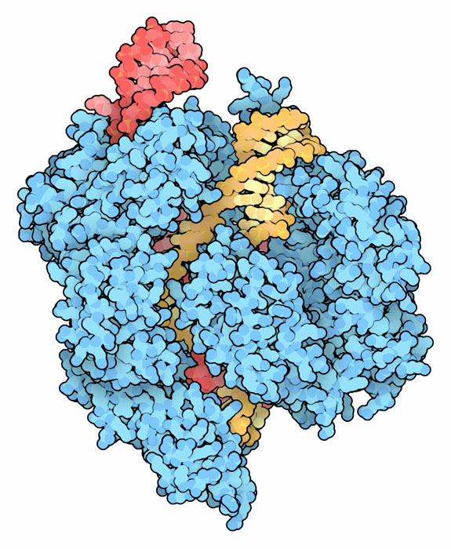
Nucleic acids
Bacterial and viral RNA
RNA-protein machines
Can we predict nucleic acid (+) structure using:
Structural homology
Evolutionary data
Chemistry/physics?
Self-splicing intron
Spliceosome
RNA in engineering
Ribosome
Telomerase
Fluorescent aptamer
Cas9
PDB molecule of the month, David Goodsell

Slide 3
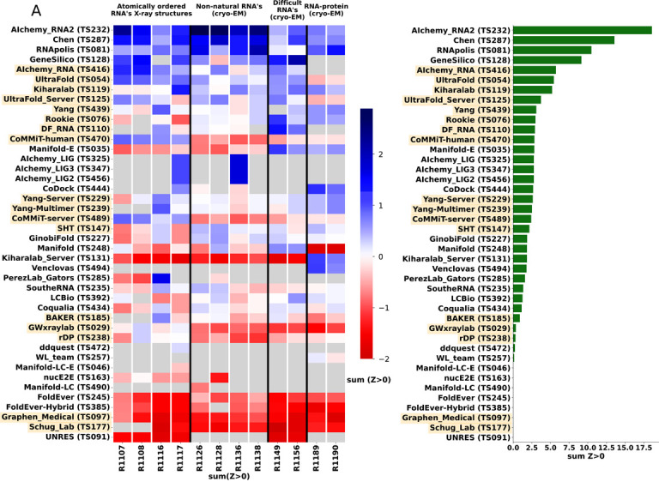
History - CASP15 results and outlook
Topology predicted for all RNA targets
RNP remains challenging
Top 4 teams used no DL

Slide 4
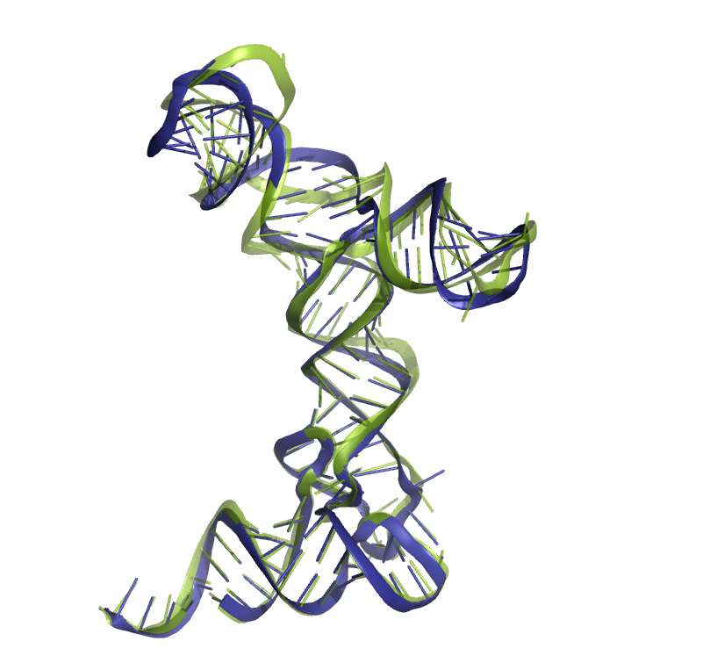
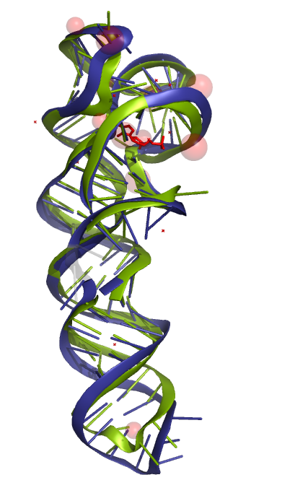
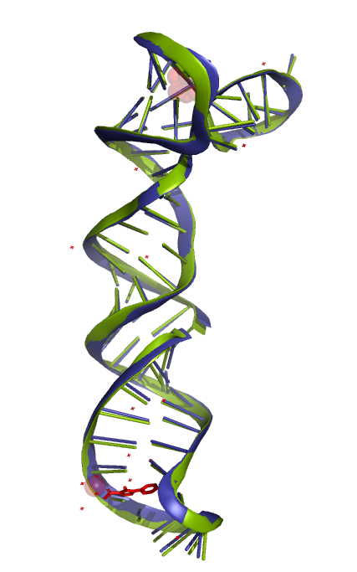
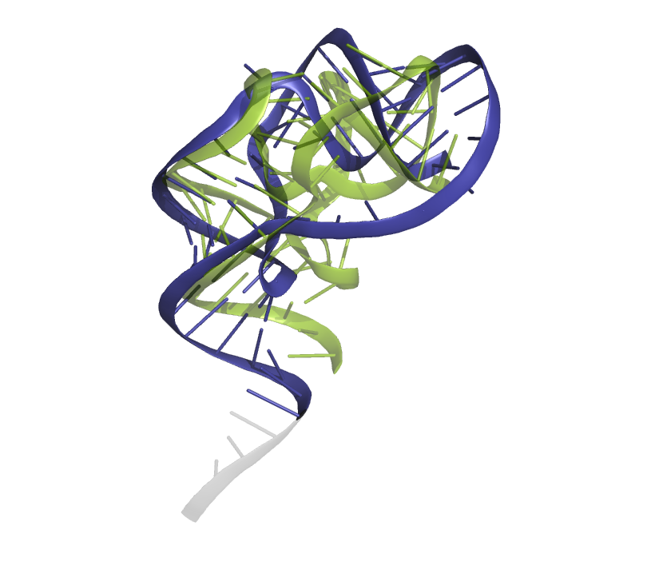
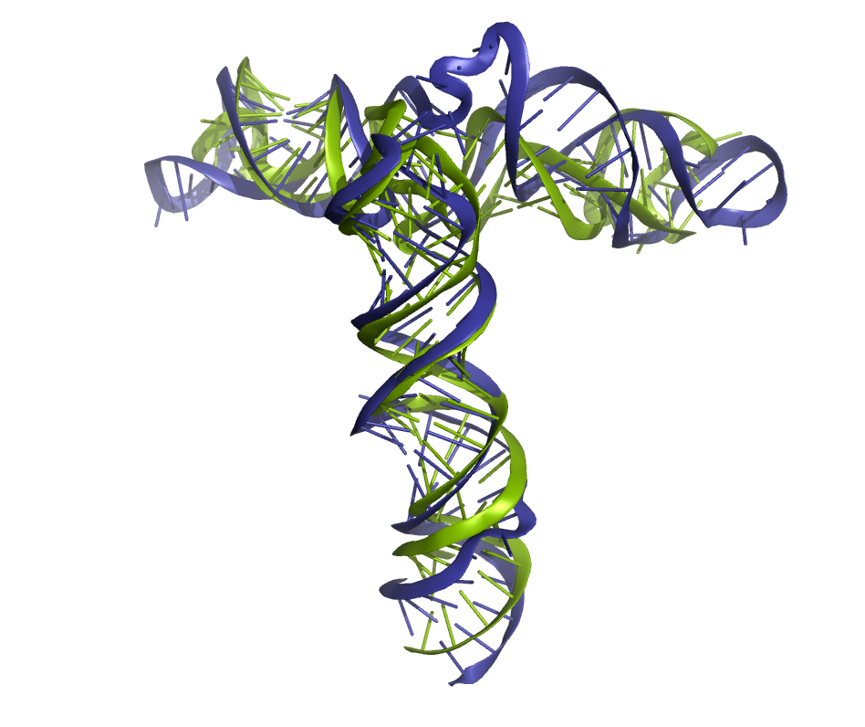
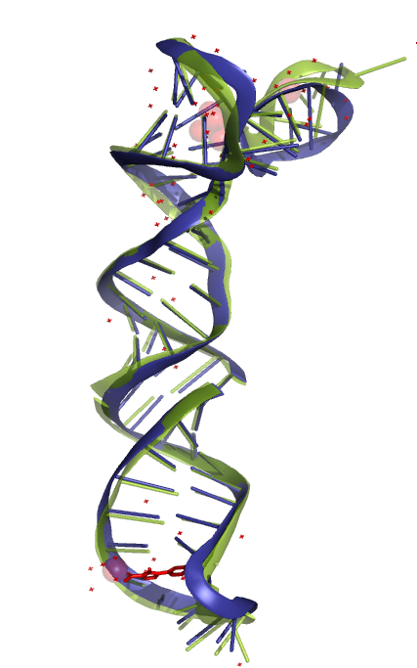
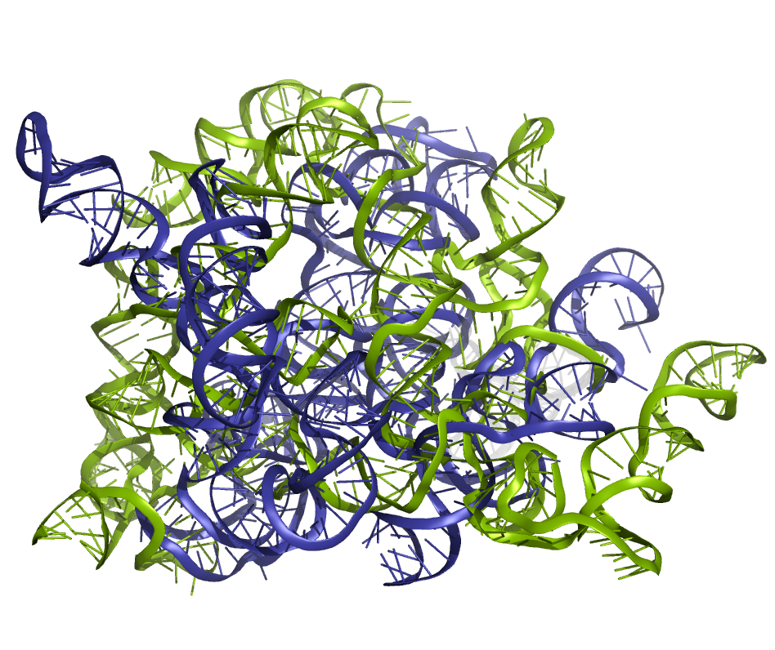
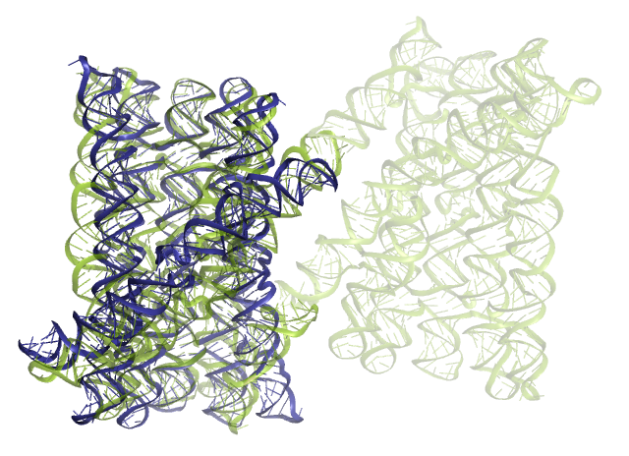
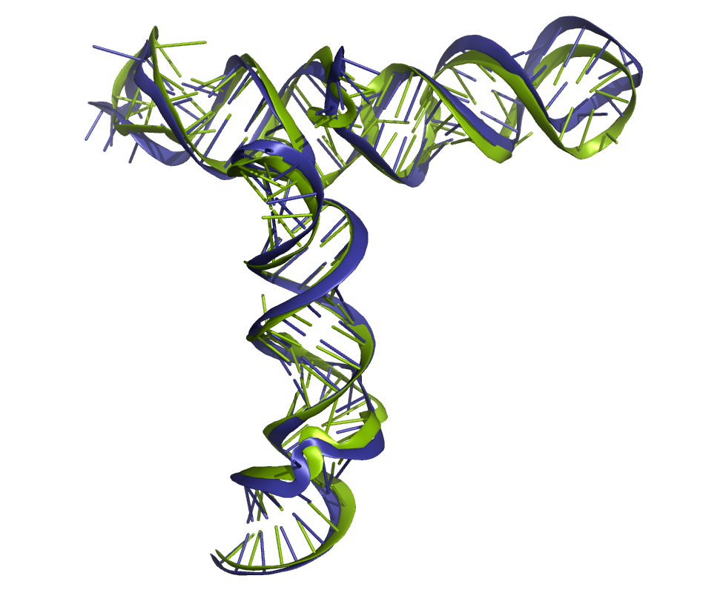
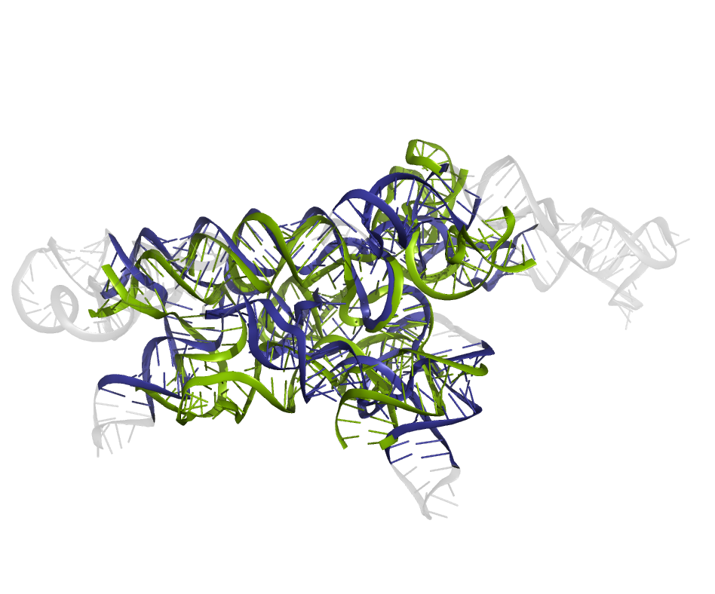
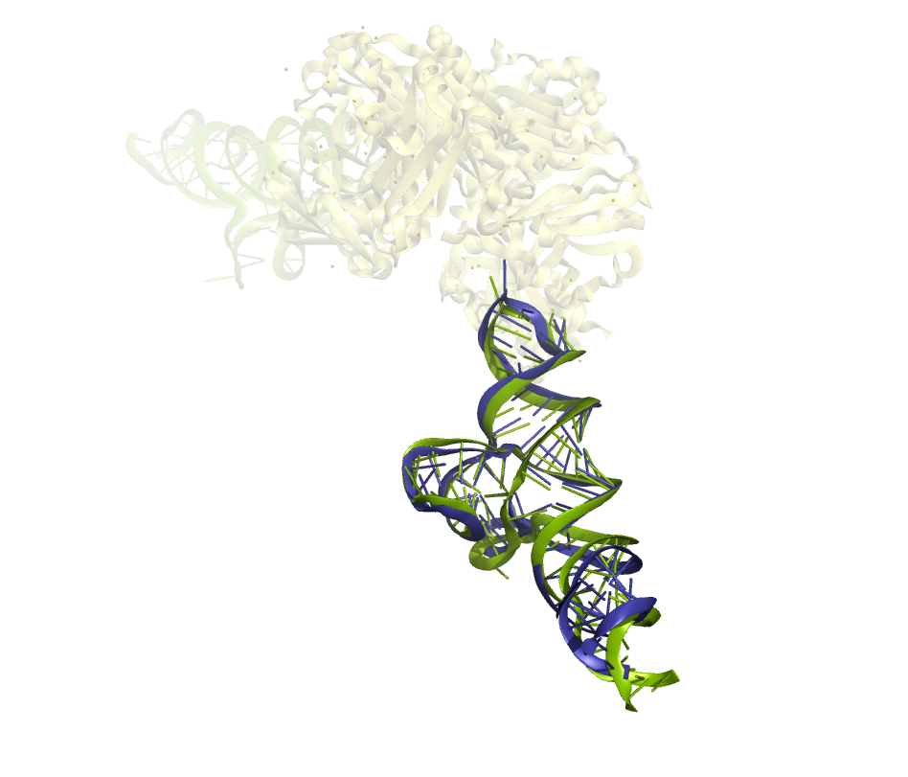
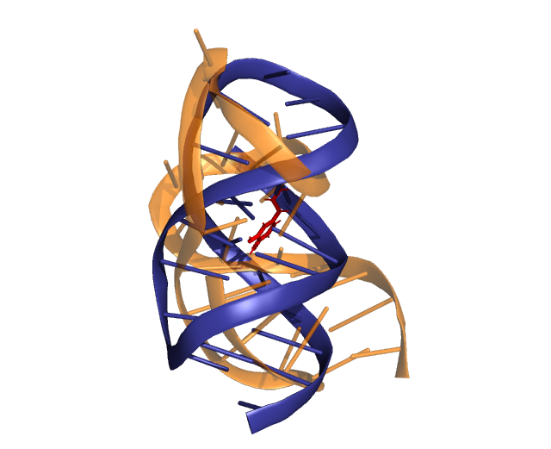
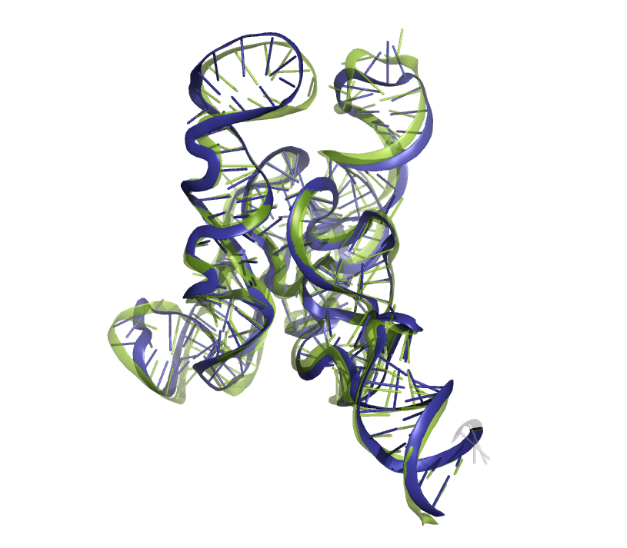
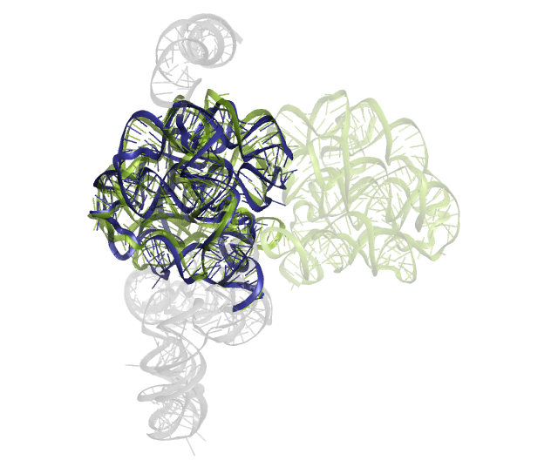
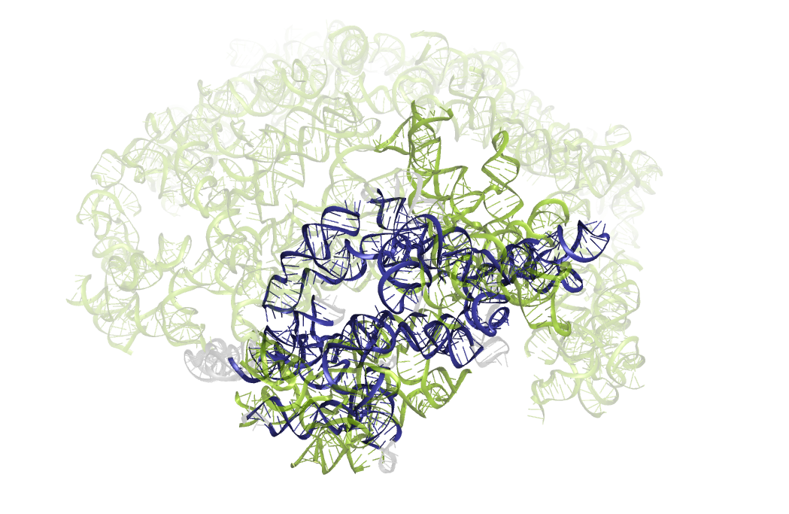
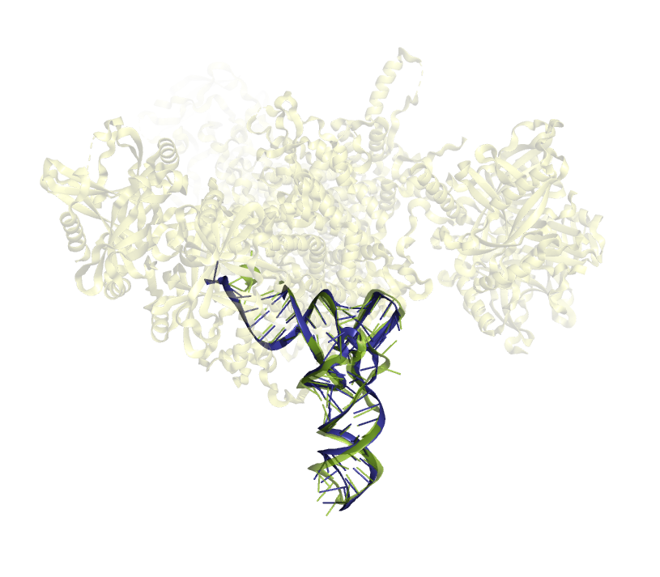
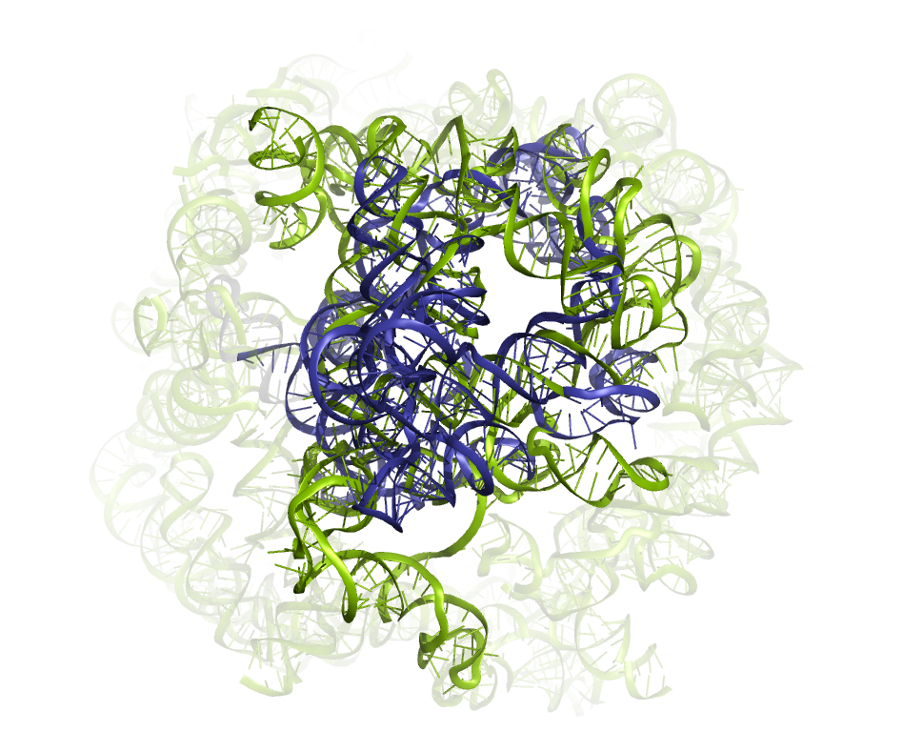
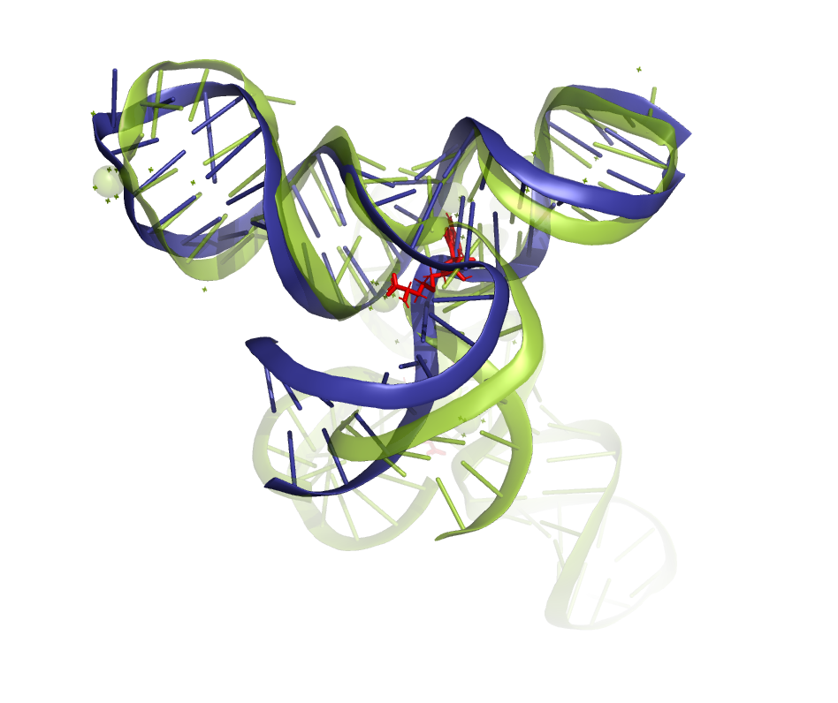
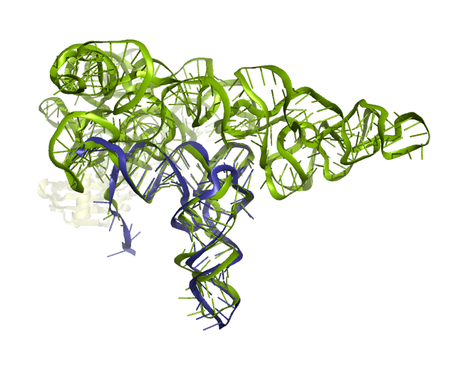
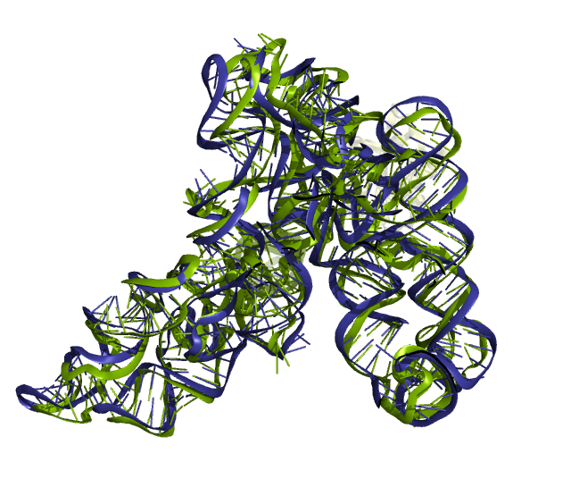
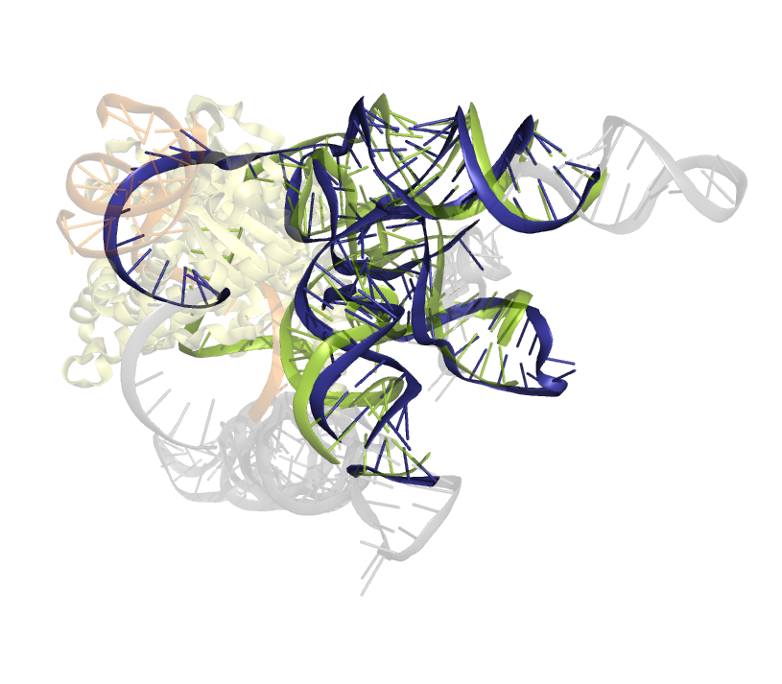
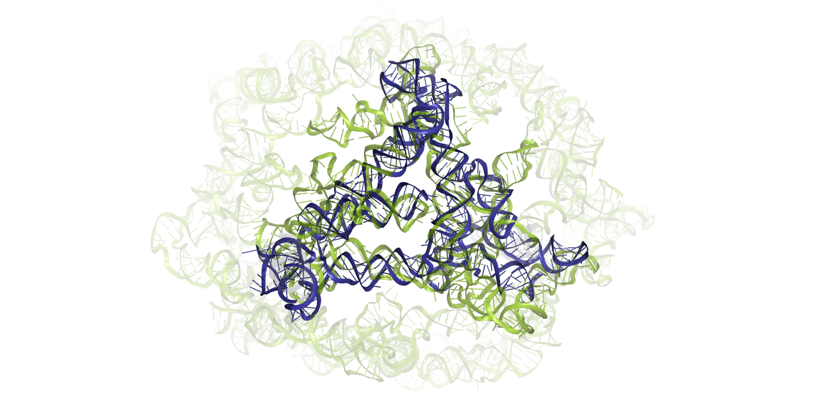
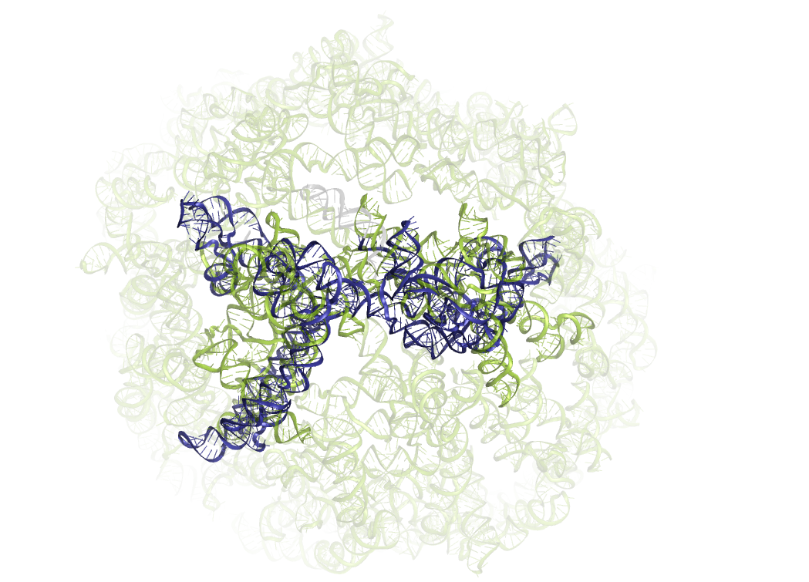
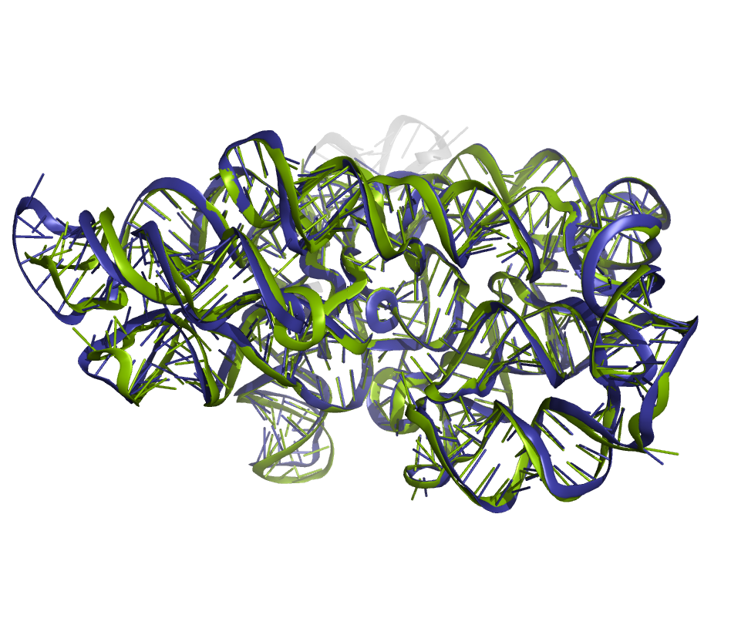
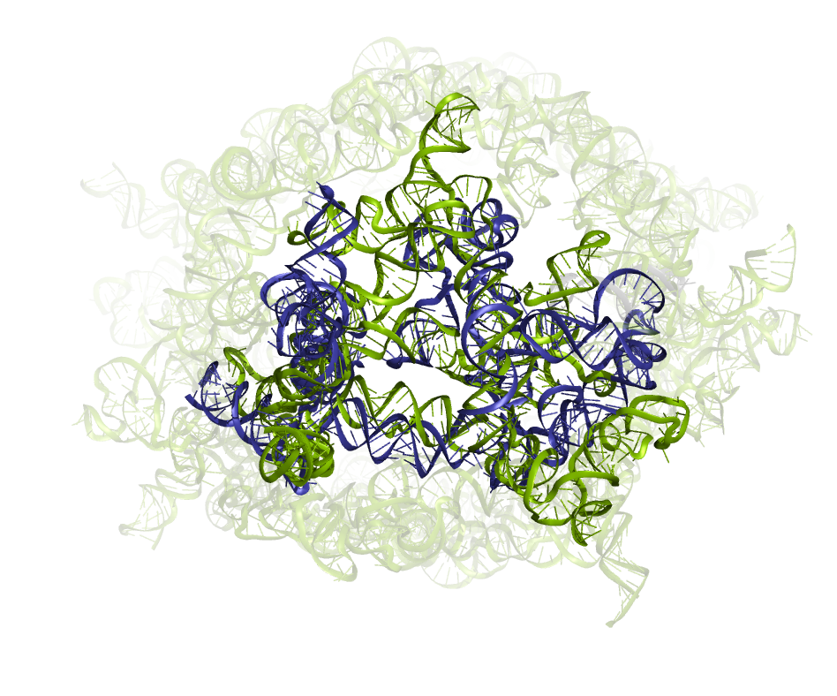
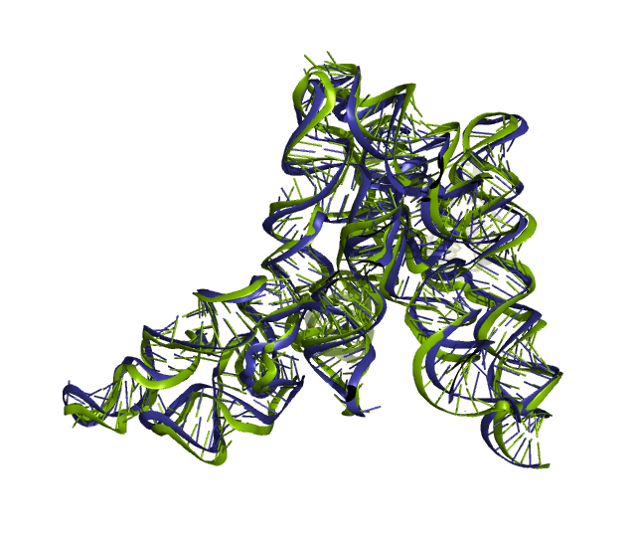
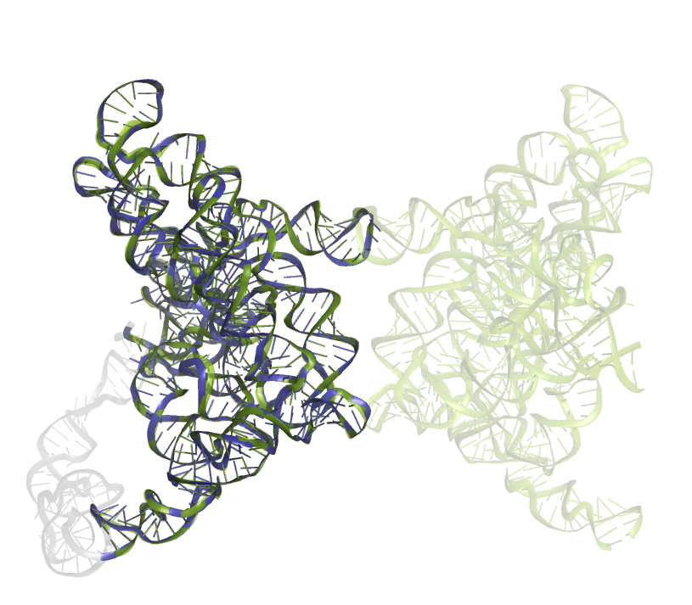
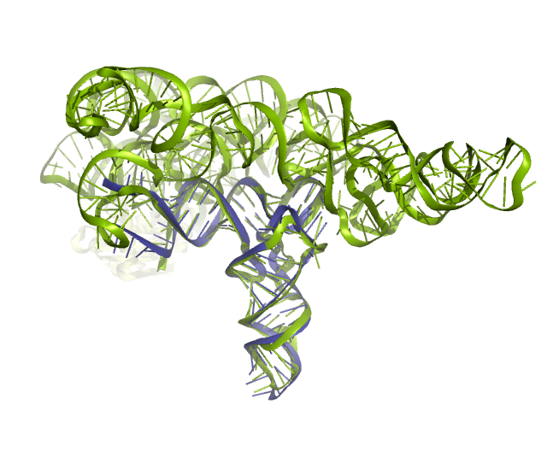
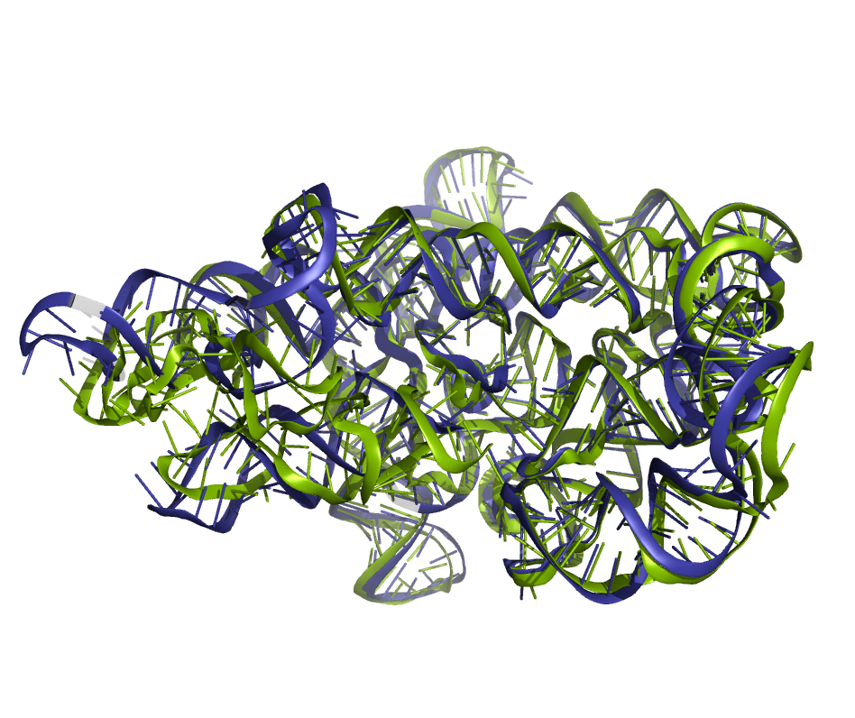
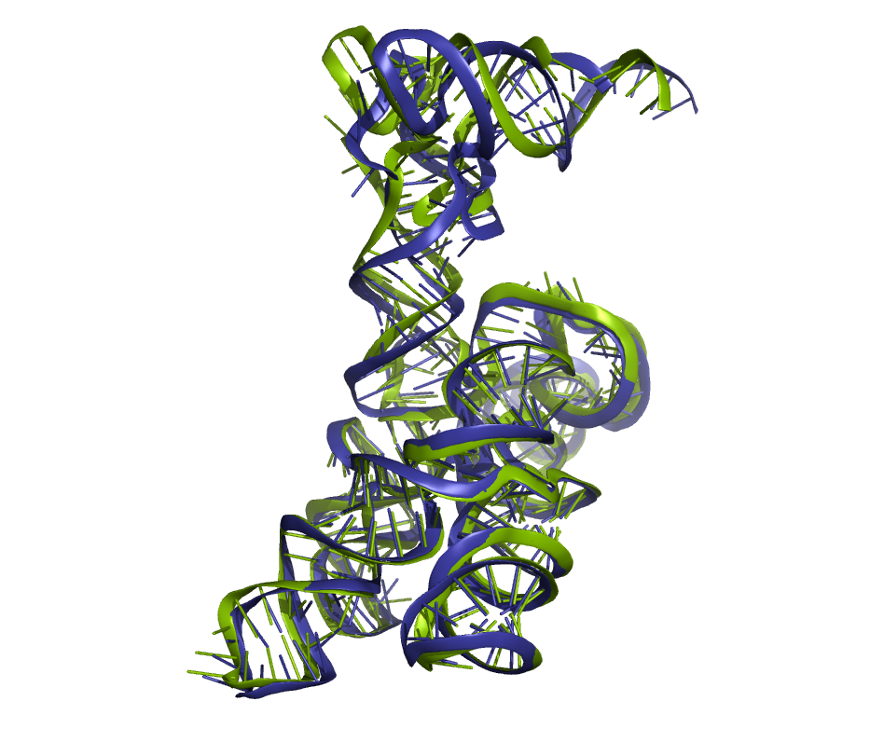
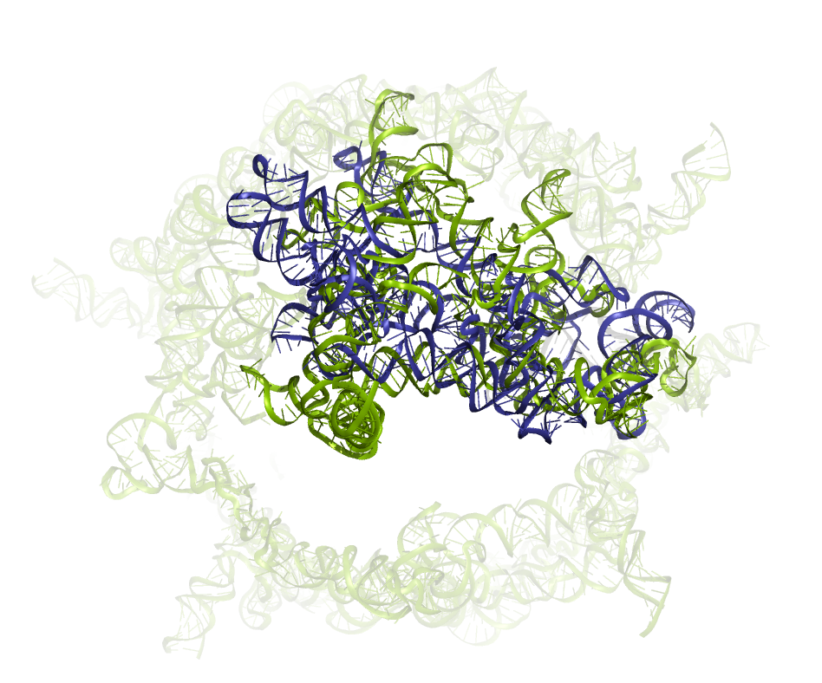
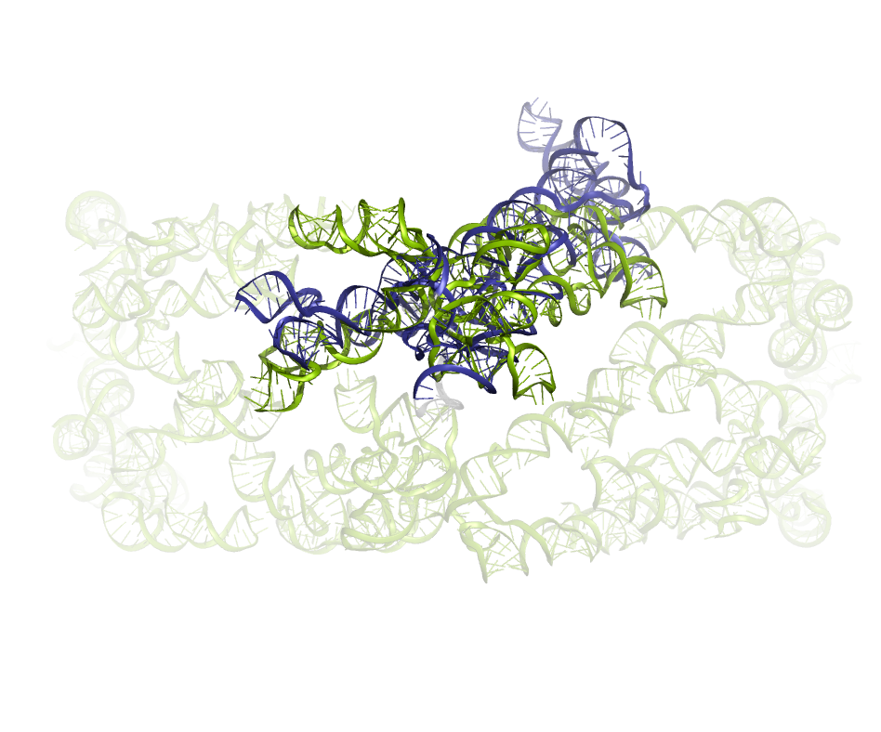
CASP16 Nucleic acid targets
Best predicted model experimentally unresolved
Experimental structure RNA ligand DNA protein
Chosen by TM-score
Riboswitch/DNA aptamers
Viral RNA
Bacterial ncRNA of unknown function
Synthetic
R1205TS417_1
R1203TS159_1
R1263TS189_5
R1255TS183_2
R1256TS052_1
R1261TS338_1
R1264TS189_5
R1286TS481_4
R1248TS238_5
R1281TS052_3
R1211TS143_5
R1209TS238_1
R1296TS481_3
D1273TS272_4
R1293TS063_3
R1242TS338_3
R1285TS033_5
Ribozymes / introns
R1250TS325_2
R1271TS369_3
R1288TS094_5
R1252v1TS189_3
R1221s3TS481_5
R1221s2TS481_1
R1212TS063_5
R1283v1TS304_3
R1291TS481_2
R1251TS167_1
R1253v1TS435_5
R1224s3TS325_2
R1224s2TS417_3
R1290TS238_5
R1241TS183_4
R1289TS028_3
R1253v2TS159_2
R1254TS294_3

Slide 5
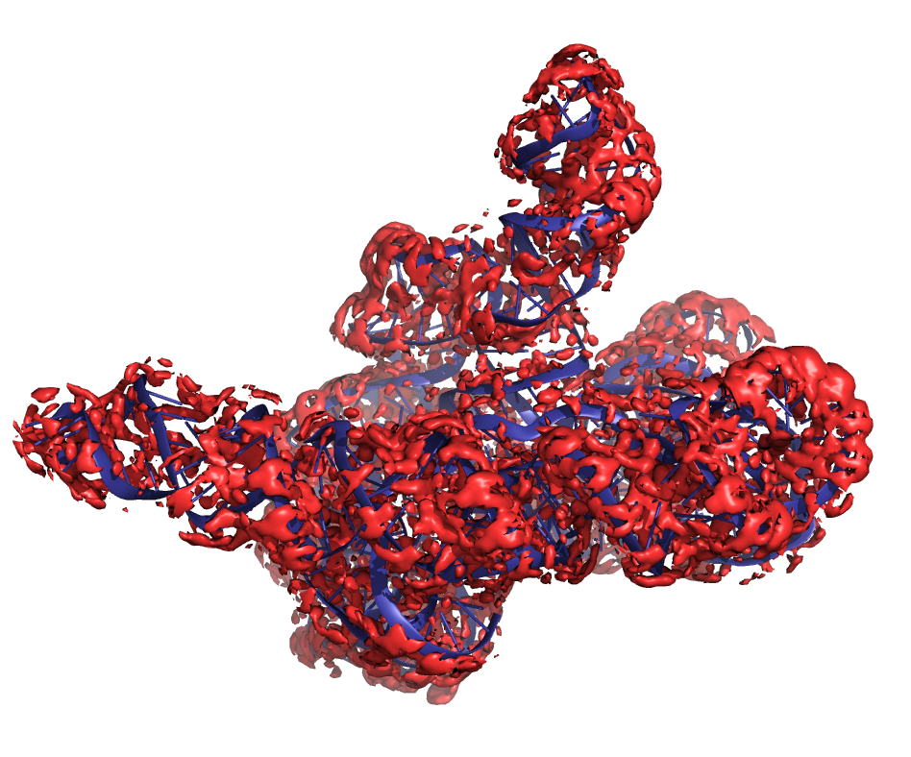
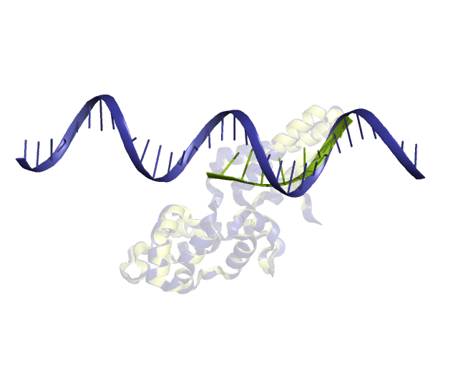
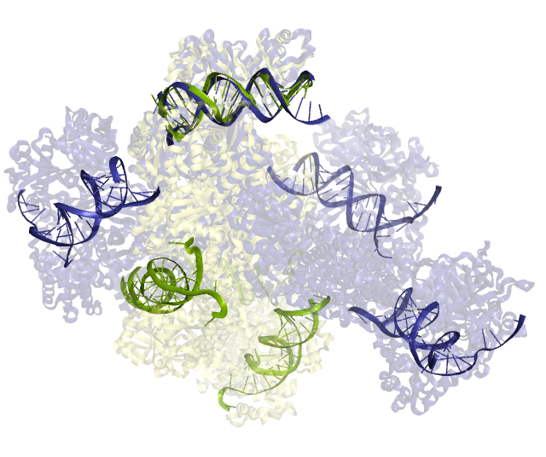
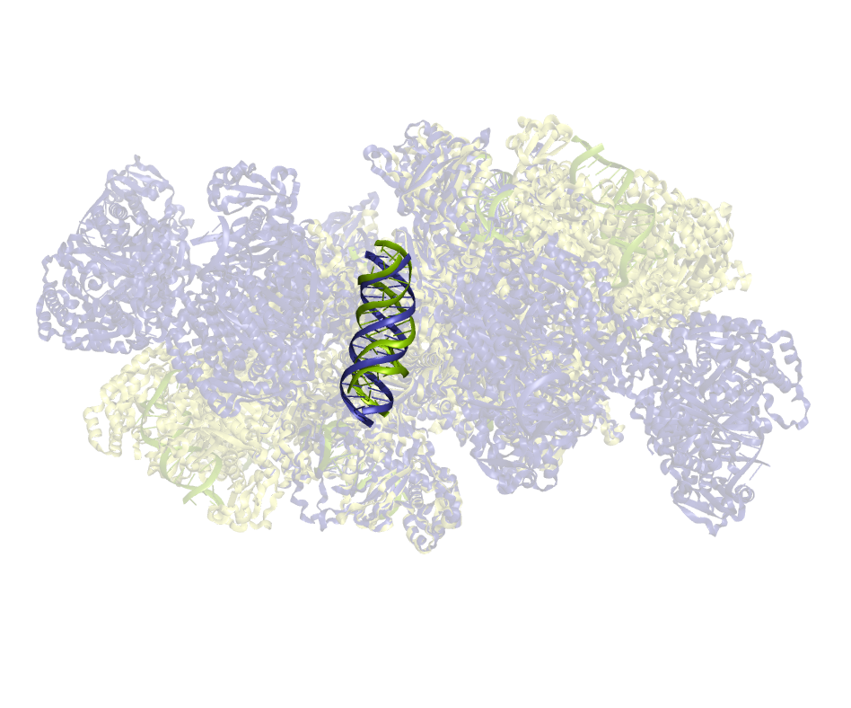
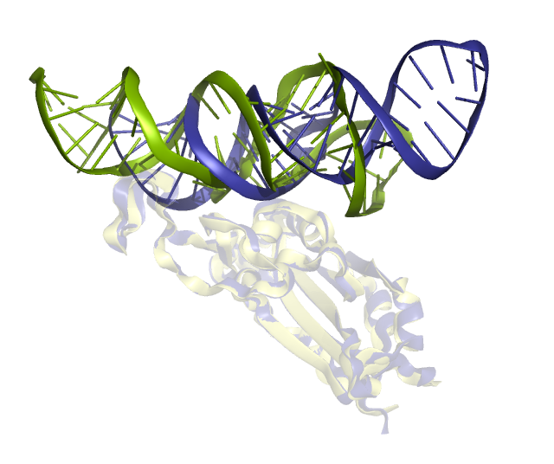
CASP16 Nucleic acid targets
Best predicted model experimentally unresolved
Experimental structure RNA ligand DNA protein
Chosen by TM-score
*water and ion*
NA monomer
NA ligand
RNA multimer
Viral RNA
Hybrid
R1260TS391
R1203TS159_1
R1263TS189_5
R1205TS417_1
R1255TS183_2
R1256TS052_1
R1261TS338_1
R1264TS189_5
R1286TS481_4
R1248TS238_5
R1281TS052_3
DNA
M1297TS286_2
M1276TS304_3
R1211TS143_5
R1209TS238_1
R1296TS481_3
D1273TS272_4
R1242TS338_3
R1293TS063_3
R1285TS033_5
Ribozymes / introns
R1250TS325_2
M1287TS462_5
M1216TS462_3
R1271TS369_3
R1288TS094_5
R1252v1TS189_3
R1221s3TS481_5
R1221s2TS481_1
M1268TS262_1 v2
M1268TS481_2 v1
R1212TS063_5
R1283v1TS304_3
R1251TS167_1
R1291TS481_2
R1253v1TS435_5
R1224s3TS325_2
R1224s2TS417_3
M1228v2TS481_1
R1290TS238_5
M1282TS294_3
R1241TS183_4
R1289TS028_3
R1253v2TS159_2
R1254TS294_3
M1228v1TS262_1
M1239v2TS235_4
M1239v1TS294_1

Slide 6
CASP16 Nucleic acid targets
Best predicted model experimentally unresolved
Experimental structure RNA ligand DNA protein
Chosen by TM-score
NA monomer
R1205TS417_1
R1255TS183_2
R1256TS052_1
R1203TS159_1
R1263TS189_5
R1261TS338_1
R1264TS189_5
R1286TS481_4
R1281TS052_3
R1248TS238_5
M1297TS286_2
M1276TS304_3
R1211TS143_5
R1209TS238_1
R1296TS481_3
D1273TS272_4
R1242TS338_3
R1293TS063_3
R1285TS033_5
R1250TS325_2
M1287TS462_5
M1216TS462_3
R1271TS369_3
R1288TS094_5
R1252v1TS189_3
R1221s3TS481_5
R1221s2TS481_1
M1268TS262_1 v2
M1268TS481_2 v1
R1212TS063_5
R1283v1TS304_3
R1251TS167_1
R1291TS481_2
R1253v1TS435_5
R1224s3TS325_2
R1224s2TS417_3
M1228v2TS481_1
R1290TS238_5
M1282TS294_3
R1241TS183_4
R1289TS028_3
R1253v2TS159_2
R1254TS294_3
M1228v1TS262_1
M1239v2TS235_4
M1239v1TS294_1

Slide 7
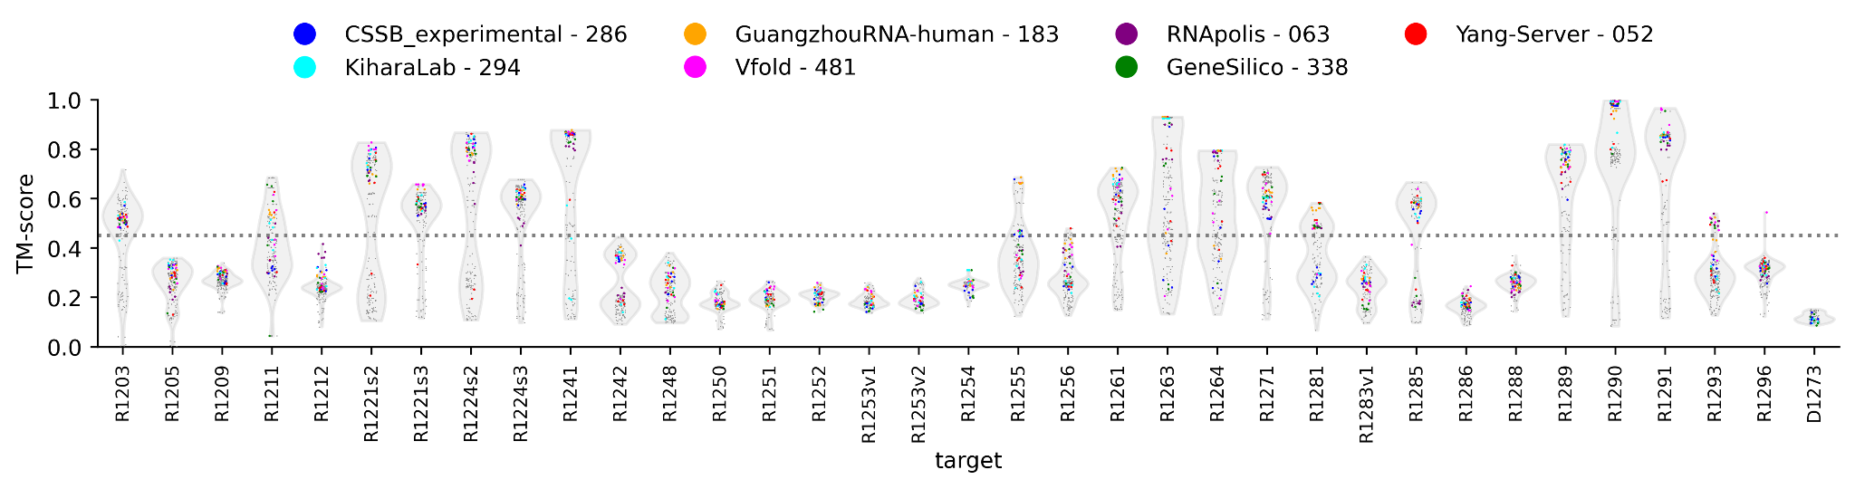
RNA monomers - Overview performance
CASP15 TM>0.45: 9/12 (75%)
CASP16 TM>0.45: 20/35 (57%)

Slide 8
RNA monomers - Overview performance
CASP15 TM>0.45: 9/12 (75%)
CASP16 TM>0.45: 20/35 (57%)
CASP16 no template with TM>0.45
TM>0.45: 2/17 (12%)

Slide 9
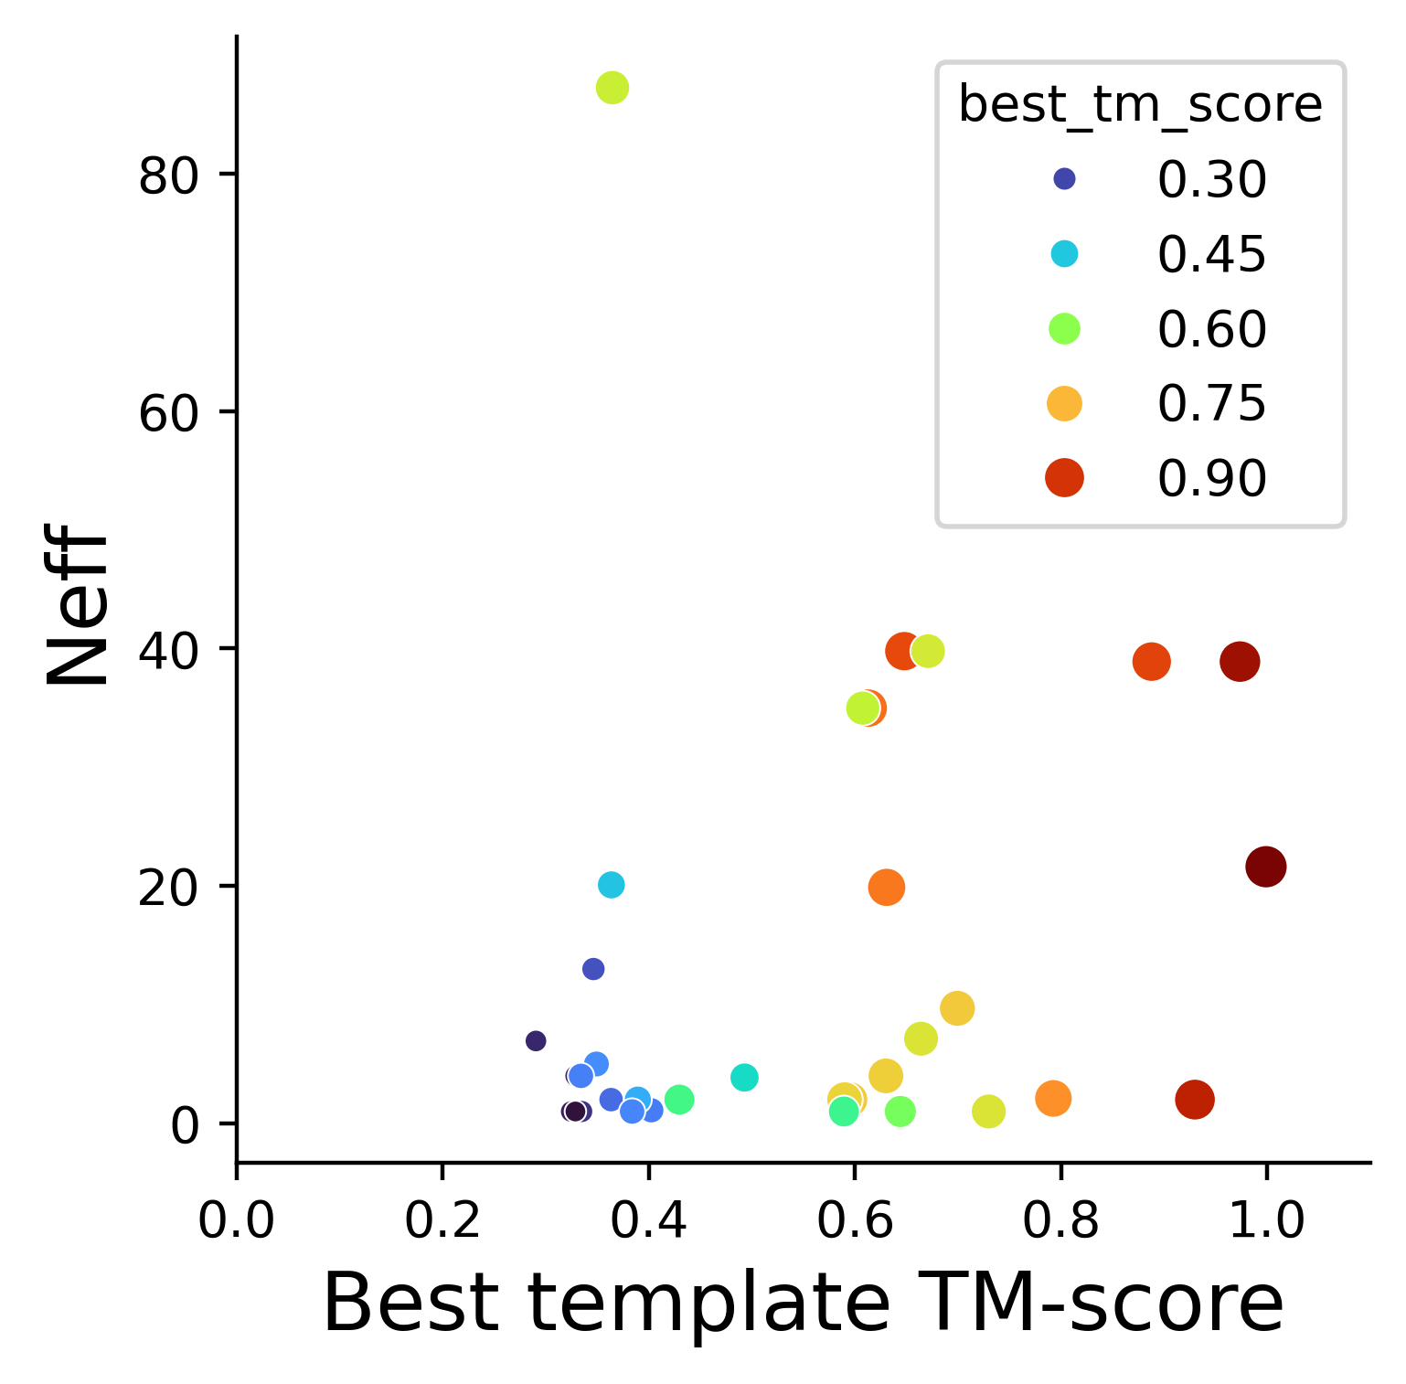
RNA monomers - Overview performance
Best predicted TM
Best predicted TM = 0.966 Best template TM + 0.003 Neff

Slide 10
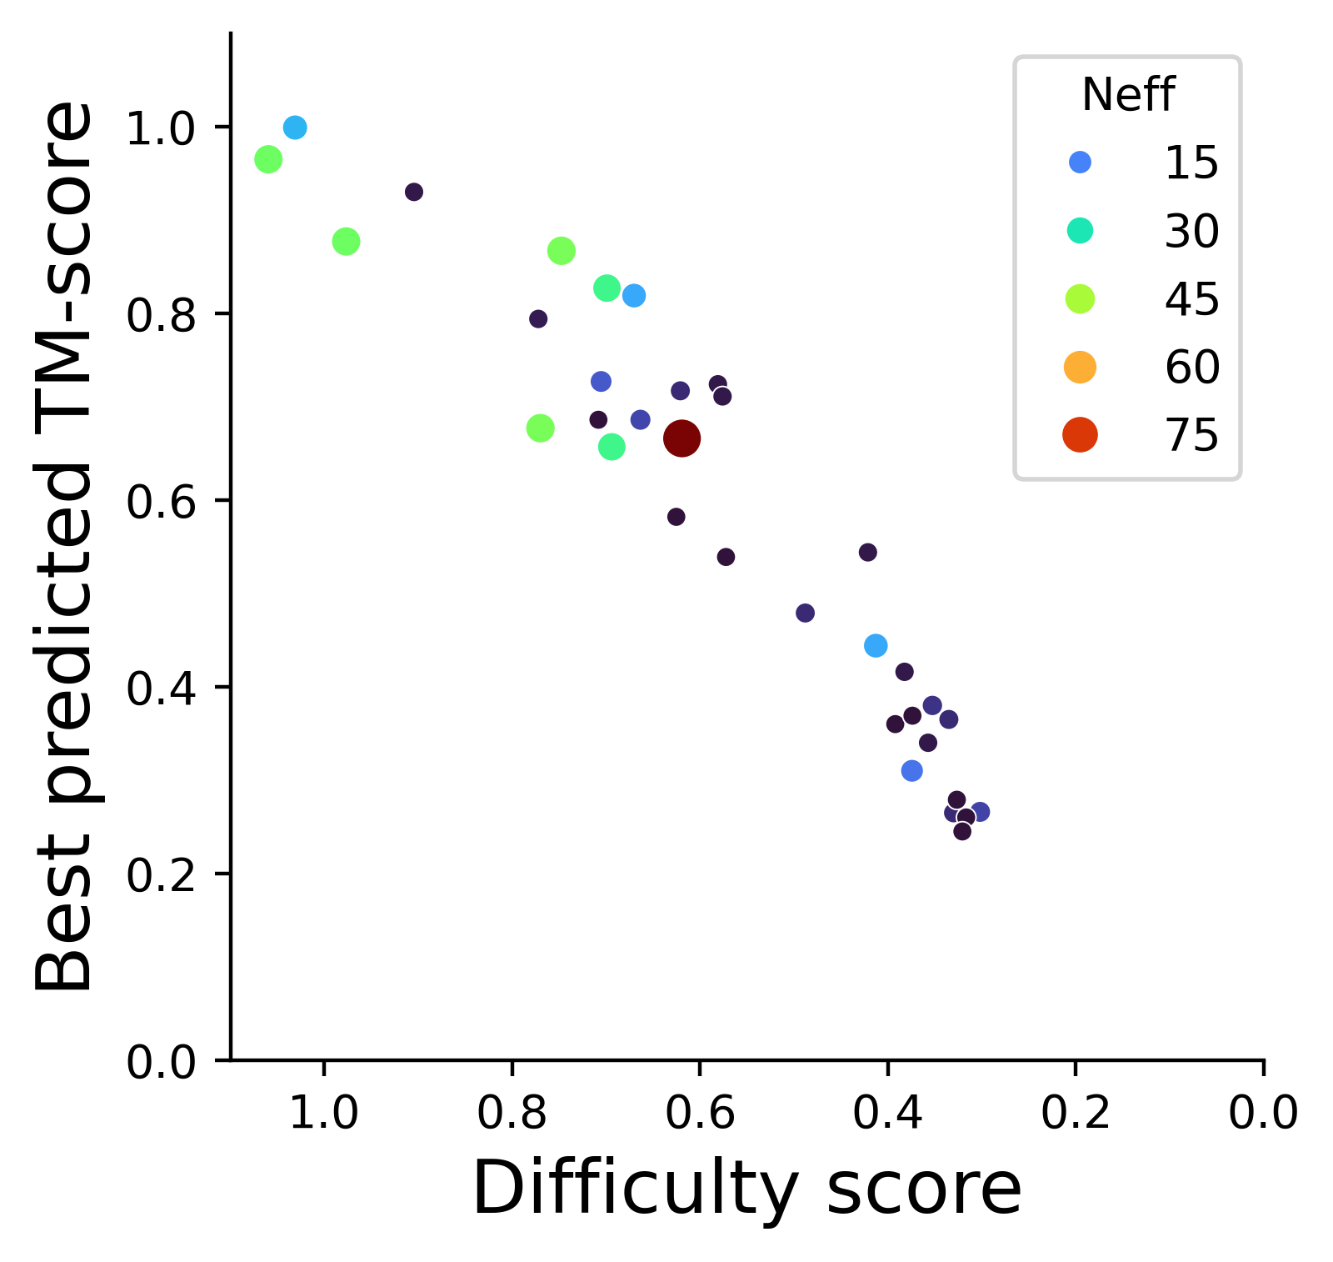
RNA monomers - Overview performance
Difficulty score = 0.966 Best template TM + 0.003 Neff

Slide 11


RNA monomers - Metrics
Global scores
Local environment scores
RMSD - Excluded as in proteins
GDT-TS* - Fraction residues with x Å of experimental structure (x = 1,2,4,8)
TM-score* - Pairwise distance between predicted and experimental atom position, normalized by length dependent factor
*with sequence correspondence
INF - RNA-specific stacking + hydrogen bond prediction
lDDT* - Fraction of experimental pairwise distances (up to 15 Å) predicted within x Å (x = 1,2,4,8)
* with steric check
lDDT is sufficiently correlated to INF, to favor the generalization capability of lDDT
For large RNAs, GDT-TS discriminates between high accuracy models
R1291 - 480 nt
R1263 - 64 nt
For large RNAs, TM-score discriminates between low accuracy models
R1291 - 480 nt
R1263 - 64 nt
steric checks)
Zemla (2003) 10.1093/nar/gkg571
Zhang Skolnick (2004) 10.1002/prot.20264
Gong et al. (2019) 10.1093/bioinformatics/btz282
Zhang et al. (2020) 10.1038/s41592-022-01585-1
Clashscore - steric clashes penalized
Parisien et al. (2009) 10.1261/rna.1700409
Mariani et al. (2013) 10.1093/bioinformatics/btt473

Slide 12
RNA monomers - Proposed Z-score ranking
Unifying evaluation for all nucleic acid containing targets
* best of all 5 models

Slide 13

RNA monomers - Rankings
RNApolis
Only took best Z of these 2 “duplicates”

Slide 14
RNA monomers - Rankings
Model generation
Physics-based modeling
Template-based modeling
Explorative modeling
Manual MSA-based editing
Model selection
Human model selection guided by
physics-based scoring
literature/functional knowledge
DL scoring
Automated, DL: trRosettaRNA

Slide 15






DNA - D1273: Synthetic dopamine aptamer (NMR)
No group predicted a reasonable DNA aptamer
D1273TS338_4
RMSD = 10.16 Å
D1273TS272_4
TM-score = 0.152
Reference
D1273TS055_1
lDDT = 0.359
D1273TS241_1
GDT-TS = 0.38
Nakatsuka et al. (2018) 10.1126/science.aao6750
Liu et al. (2021) 10.1016/j.bios.2020.112798

Slide 16
CASP16 Nucleic acid targets
Best predicted model experimentally unresolved
Experimental structure RNA ligand DNA protein
Chosen by TM-score
RNA multimer
R1205TS417_1
R1255TS183_2
R1256TS052_1
R1203TS159_1
R1263TS189_5
R1261TS338_1
R1264TS189_5
R1286TS481_4
R1281TS052_3
R1248TS238_5
DNA
M1297TS286_2
M1276TS304_3
R1211TS143_5
R1209TS238_1
R1296TS481_3
D1273TS272_4
R1242TS338_3
R1293TS063_3
R1285TS033_5
R1250TS325_2
M1287TS462_5
M1216TS462_3
R1271TS369_3
R1288TS094_5
R1252v1TS189_3
R1221s3TS481_5
R1221s2TS481_1
M1268TS262_1 v2
M1268TS481_2 v1
R1212TS063_5
R1283v1TS304_3
R1251TS167_1
R1291TS481_2
R1253v1TS435_5
R1224s3TS325_2
R1224s2TS417_3
M1228v2TS481_1
R1290TS238_5
M1282TS294_3
R1241TS183_4
R1289TS028_3
R1253v2TS159_2
R1254TS294_3
M1228v1TS262_1
M1239v2TS235_4
M1239v1TS294_1

Slide 17



RNA-only multimers - basic overview – Round 0 Stoichiometry
Dimers!
2-mer
14-mer

Slide 18

RNA-only multimers - metrics Interface scores
Lafita et al (2018) 10.1002/prot.25408
Ozden et al. (2023) 10.1002/prot.26598

Slide 19
RNA-only multimers - Proposed Z-score ranking
Global
Interface
* best of all 5 models

Slide 20

RNA-only multimers - Rankings
Top RNA-monomer predictors also best here:
GuangzhouRNA-human
Vfold
KiharaLab
LcBio and NKRNA-server, impressive performance on target without structural homology but large MSA

Slide 21


RNA-only multimers - Target highlight: R1285 OLE
Best predicted model
Experimental structure
Expirementally unresolved
R1285TS028_4o

Slide 22
RNA-only multimers - Target highlight: R1285 OLE
No kissing loop
Kissing loop between self-complementary loops
Best predicted model
Experimental structure
Expirementally unresolved
R1285TS028_4o

Slide 23
CASP16 Nucleic acid targets
Best predicted model experimentally unresolved
Experimental structure RNA ligand DNA protein
Chosen by TM-score
Hybrid
R1205TS417_1
R1255TS183_2
R1256TS052_1
R1203TS159_1
R1263TS189_5
R1261TS338_1
R1264TS189_5
R1286TS481_4
R1281TS052_3
R1248TS238_5
DNA
M1297TS286_2
M1276TS304_3
R1211TS143_5
R1209TS238_1
R1296TS481_3
D1273TS272_4
R1242TS338_3
R1293TS063_3
R1285TS033_5
R1250TS325_2
M1287TS462_5
M1216TS462_3
R1271TS369_3
R1288TS094_5
R1252v1TS189_3
R1221s3TS481_5
R1221s2TS481_1
M1268TS262_1 v2
M1268TS481_2 v1
R1212TS063_5
R1283v1TS304_3
R1251TS167_1
R1291TS481_2
R1253v1TS435_5
R1224s3TS325_2
R1224s2TS417_3
M1228v2TS481_1
R1290TS238_5
M1282TS294_3
R1241TS183_4
R1289TS028_3
R1253v2TS159_2
R1254TS294_3
M1228v1TS262_1
M1239v2TS235_4
M1239v1TS294_1

Slide 24

“Hybrid” - Overview performance

Slide 25

“Hybrid” - Overview performance
Crystallization FAB
DNA duplexes
Viral Spike-RBD RNA Aptamer

Slide 26
“Hybrid” - Proposed Z-score ranking
Global
Interface
Global
Interface
* best of all 5 models
* excluded models missing chains

Slide 27

“Hybrid” - Rankings
Kihara lab and MIEnsemble server
Vfold and CSSB_experimental
DL with manual selection
Automated pipeline

Slide 28
CASP16 Nucleic acid targets
Best predicted model experimentally unresolved
Experimental structure RNA ligand DNA protein
Chosen by TM-score
NA ligand
R1205TS417_1
R1255TS183_2
R1256TS052_1
R1203TS159_1
R1263TS189_5
R1261TS338_1
R1264TS189_5
R1286TS481_4
R1281TS052_3
R1248TS238_5
M1297TS286_2
M1276TS304_3
R1211TS143_5
R1209TS238_1
R1296TS481_3
D1273TS272_4
R1242TS338_3
R1293TS063_3
R1285TS033_5
R1250TS325_2
M1287TS462_5
M1216TS462_3
R1271TS369_3
R1288TS094_5
R1252v1TS189_3
R1221s3TS481_5
R1221s2TS481_1
M1268TS262_1 v2
M1268TS481_2 v1
R1212TS063_5
R1283v1TS304_3
R1251TS167_1
R1291TS481_2
R1253v1TS435_5
R1224s3TS325_2
R1224s2TS417_3
M1228v2TS481_1
R1290TS238_5
M1282TS294_3
R1241TS183_4
R1289TS028_3
R1253v2TS159_2
R1254TS294_3
M1228v1TS262_1
M1239v2TS235_4
M1239v1TS294_1

Slide 29



Nucleic acid - ligand
*
TM-score<<0.45
→ little chance of success for ligand
*
Excellent template
R1261 (RNA ligand)
6WZS (RNA ligand)
*
*
*
*
*
*
*
*
Ligand at dimer interface

Slide 30

Nucleic acid - ligand
* best of all 5 models
Only took best Z of this “duplicate”

Slide 31
CASP16 Nucleic acid targets
Best predicted model experimentally unresolved
Experimental structure RNA ligand DNA protein
Chosen by TM-score
NA monomer
NA ligand
RNA multimer
Hybrid
R1205TS417_1
R1255TS183_2
R1256TS052_1
R1203TS159_1
R1263TS189_5
R1261TS338_1
R1264TS189_5
R1286TS481_4
R1281TS052_3
R1248TS238_5
DNA
M1297TS286_2
M1276TS304_3
R1211TS143_5
R1209TS238_1
R1296TS481_3
D1273TS272_4
R1242TS338_3
R1293TS063_3
R1285TS033_5
R1250TS325_2
M1287TS462_5
M1216TS462_3
R1271TS369_3
R1288TS094_5
R1252v1TS189_3
R1221s3TS481_5
R1221s2TS481_1
M1268TS262_1 v2
M1268TS481_2 v1
R1212TS063_5
R1283v1TS304_3
R1251TS167_1
R1291TS481_2
R1253v1TS435_5
R1224s3TS325_2
R1224s2TS417_3
M1228v2TS481_1
R1290TS238_5
M1282TS294_3
R1241TS183_4
R1289TS028_3
R1253v2TS159_2
R1254TS294_3
M1228v1TS262_1
M1239v2TS235_4
M1239v1TS294_1

Slide 32

All nucleic acid containing targets
Vfold
Kihara lab
GuangzhouRNA
Yang-Server
AF3

Slide 33
Conclusions
Nucleic acid prediction is still in “template” phase
  First hints evolutionary data can be utilized without template
No huge leap in scores for nucleic acid prediction compared to CASP15
  Still mostly human based intuition, distilling of multiple sources of information
  Atomic level accuracy generally not achieved
  All hard without template
Increased number + variety of targets
  DNA-aptamers
  RNA-only multimers
  Nucleic-acid-protein complexes
  Nucleic-acid ligand
  All hard without template

Slide 34




Acknowledgements
Experimental groups
Andersen
Chiu
Choi
Das
Hoebartner
Liu (J.)
Liu (Y.)
Jones
Kellogg
Koirala
Mackereth
RNA assessors
Rachael Kretsch
Shujun He
Alissa Hummer
Rhiju Das
Das lab members
Organizing and assessor teams
Andriy Kryshtafovych
Gabriel Studer
Jérôme Eberhardt
Xavier Robin
Torsten Schwede
Maya Topf
Krzysztof Fidelis
John Moult
Marcia
Marcus
Nguyen
Piccirilli
Rice
Steckelberg
Su
Taylor
Zaremba
Zhang (J.)
Zhang (K.)

Slide 35










CASP16 Nucleic acid targets
Best predicted model experimentally unresolved
Experimental structure RNA ligand DNA protein
*water and ion*
NA monomer
NA ligand
RNA multimer
Hybrid
R1260TS391
R1203TS159_1
R1263TS189_5
R1205TS417_1
R1255TS183_2
R1256TS052_1
R1261TS338_1
R1264TS189_5
R1286TS481_4
R1248TS238_5
R1281TS052_3
DNA
M1297TS286_2
M1276TS304_3
Questions
R1211TS143_5
R1209TS238_1
R1296TS481_3
D1273TS272_4
R1293TS063_3
R1242TS338_3
R1285TS033_5
R1250TS325_2
M1287TS462_5
M1216TS462_3
R1271TS369_3
R1288TS094_5
R1252v1TS189_3
R1221s3TS481_5
R1221s2TS481_1
M1268TS262_1 v2
M1268TS481_2 v1
R1212TS063_5
R1283v1TS304_3
R1251TS167_1
R1291TS481_2
R1253v1TS435_5
R1224s3TS325_2
R1224s2TS417_3
M1228v2TS481_1
R1290TS238_5
M1282TS294_3
R1241TS183_4
R1289TS028_3
R1253v2TS159_2
R1254TS294_3
M1228v1TS262_1
M1239v2TS235_4
M1239v1TS294_1

