Slide 1
Poster Flash Talks
Day 1

Slide 2
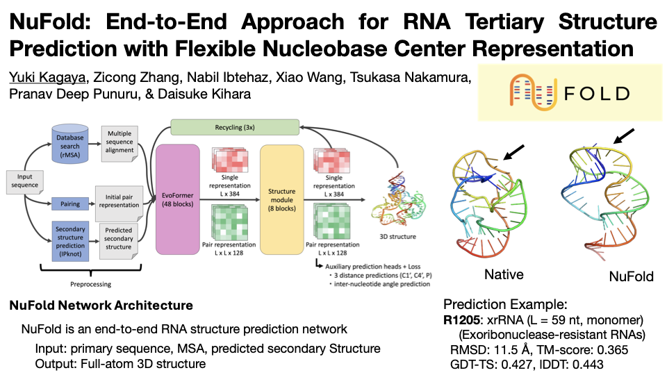

Slide 3
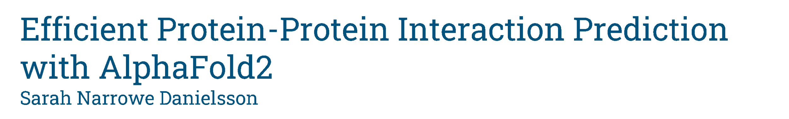
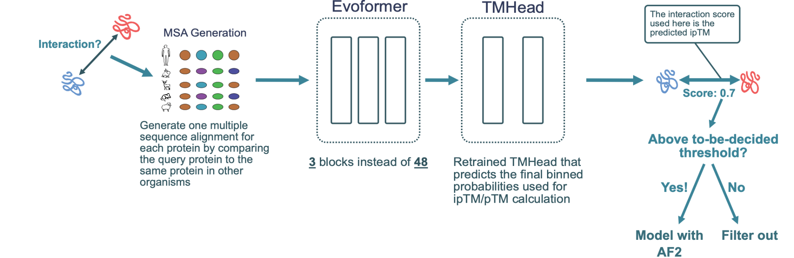



Slide 4

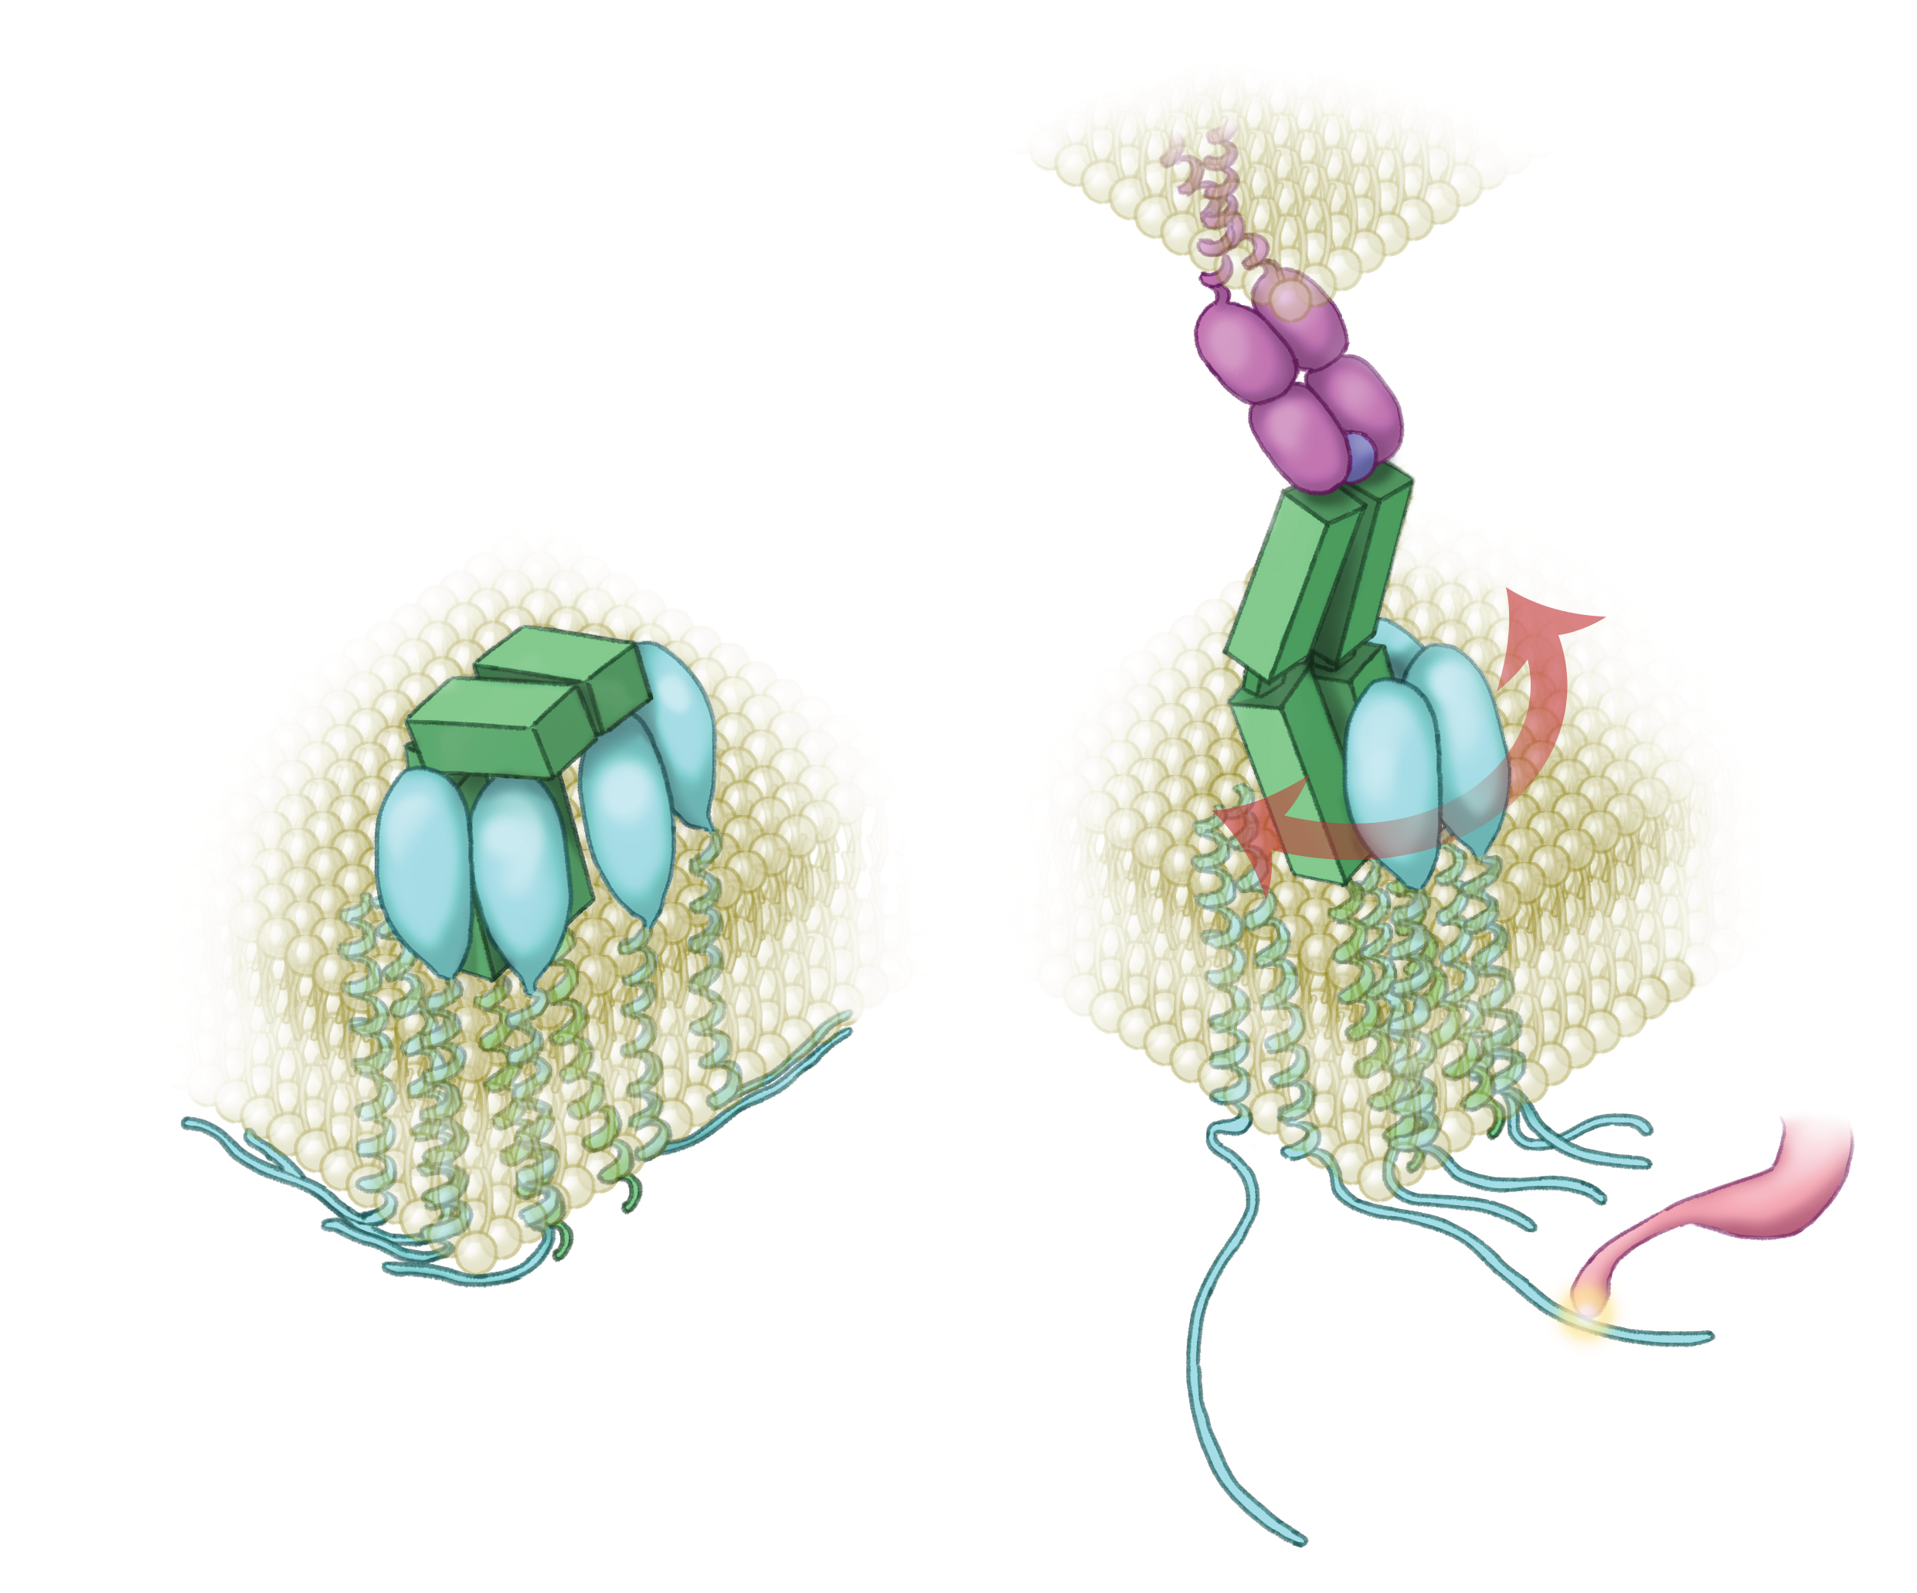
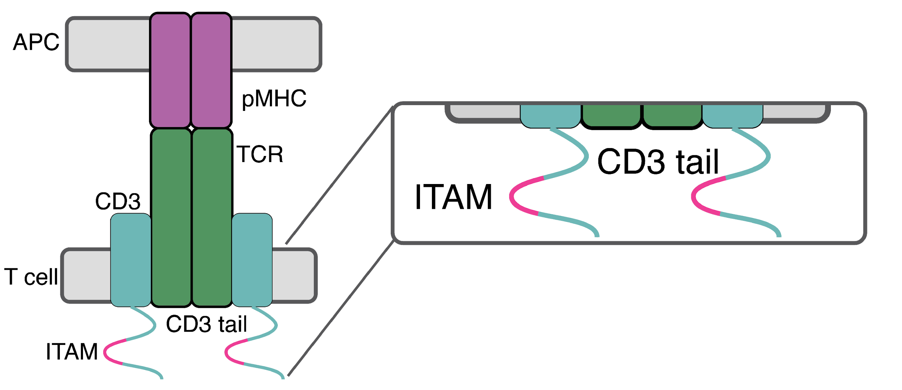
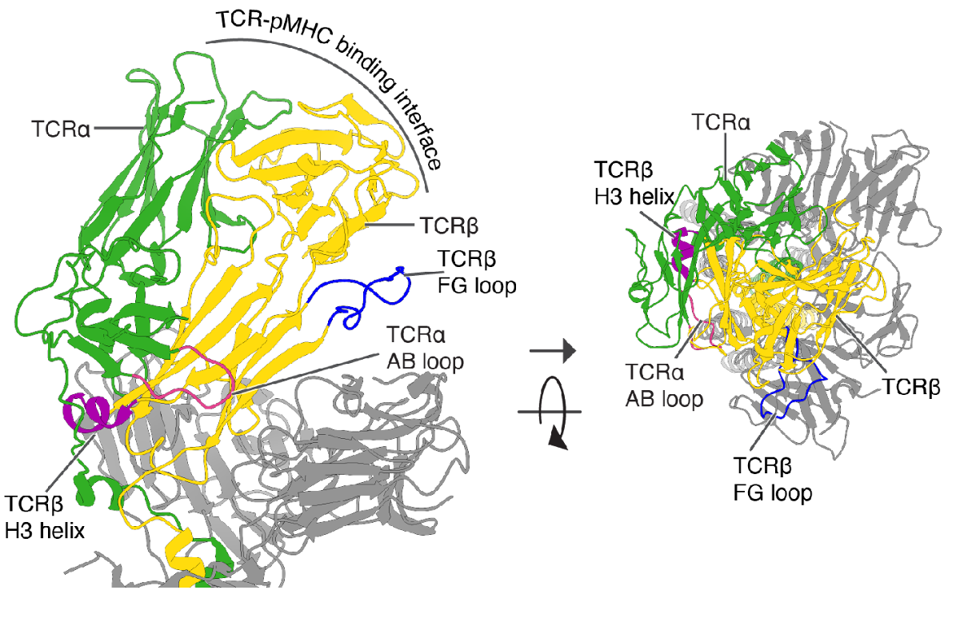
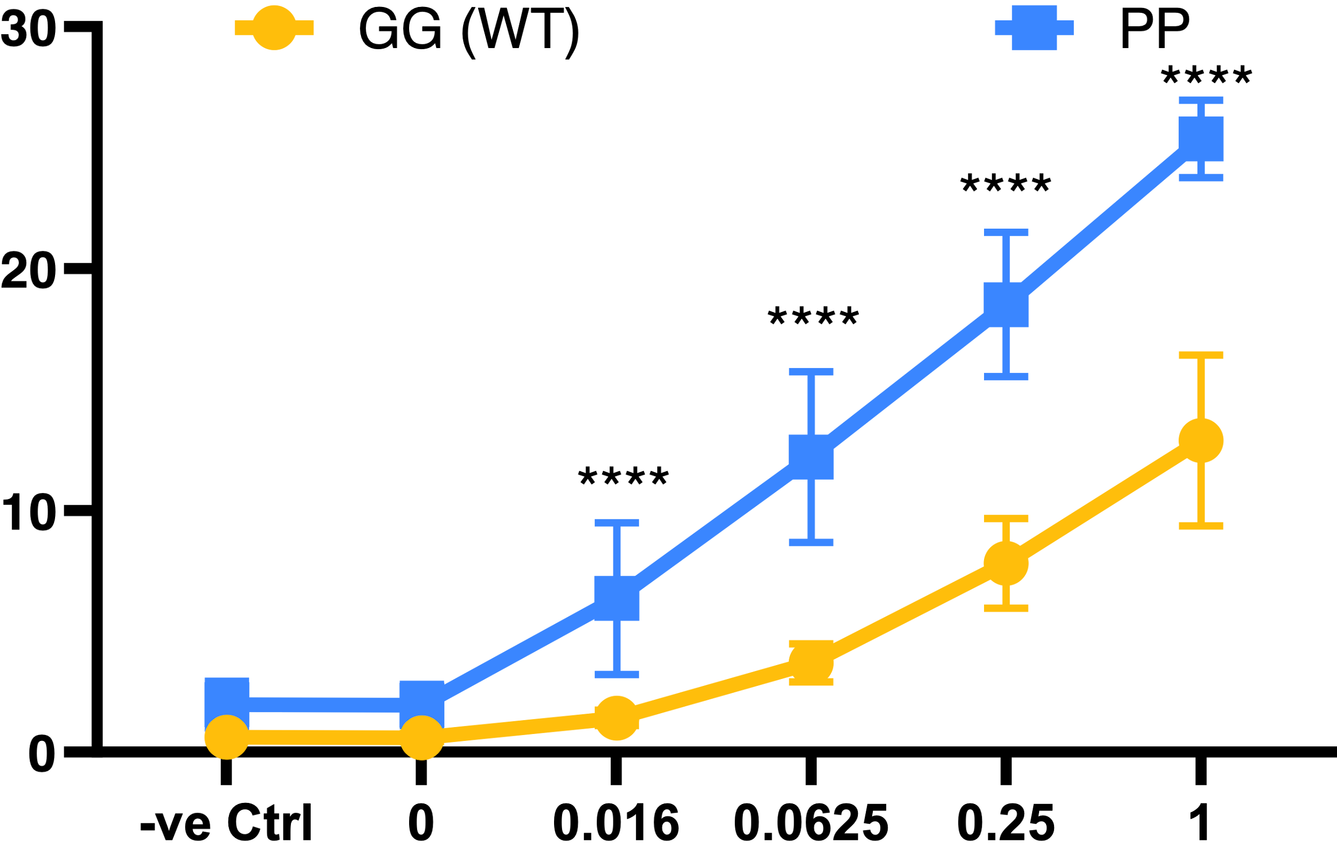
T cell receptor signals via a conformational change resulting in an increase in CD3 mobility

Slide 5
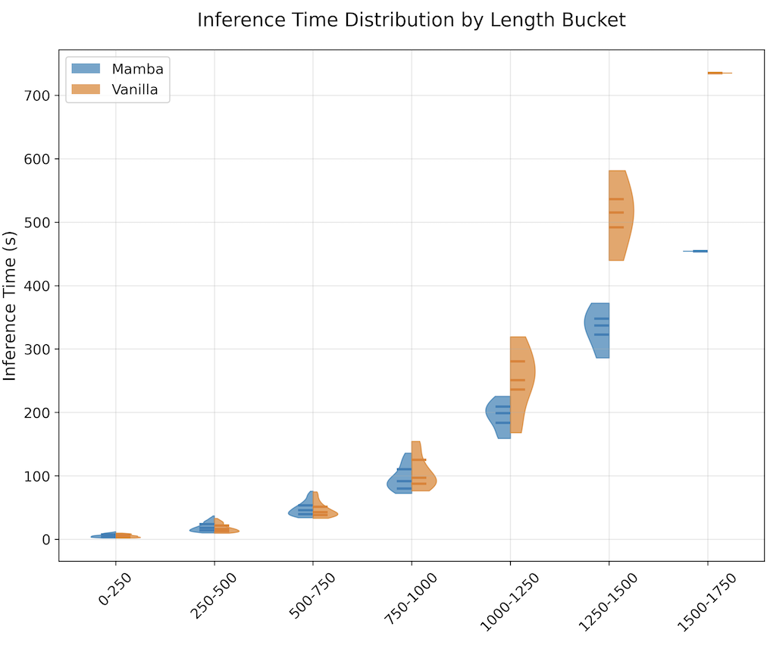
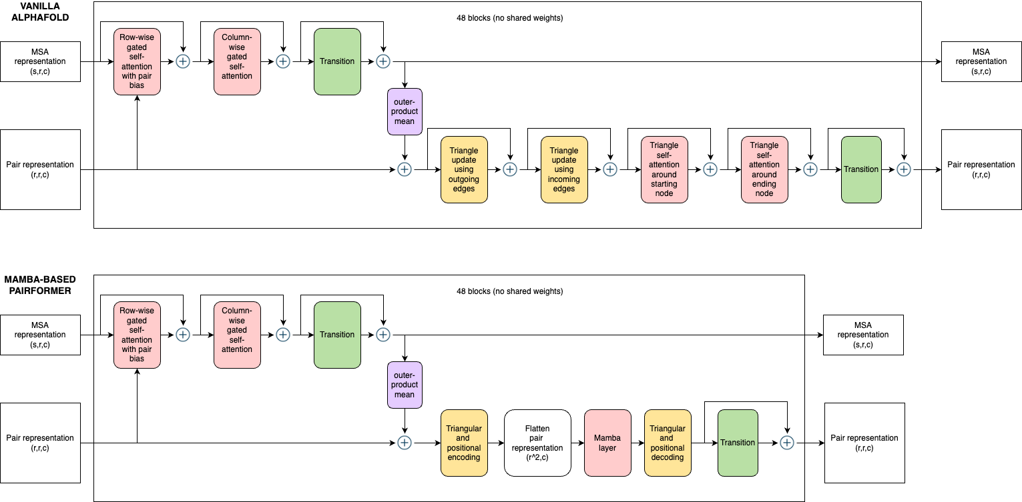
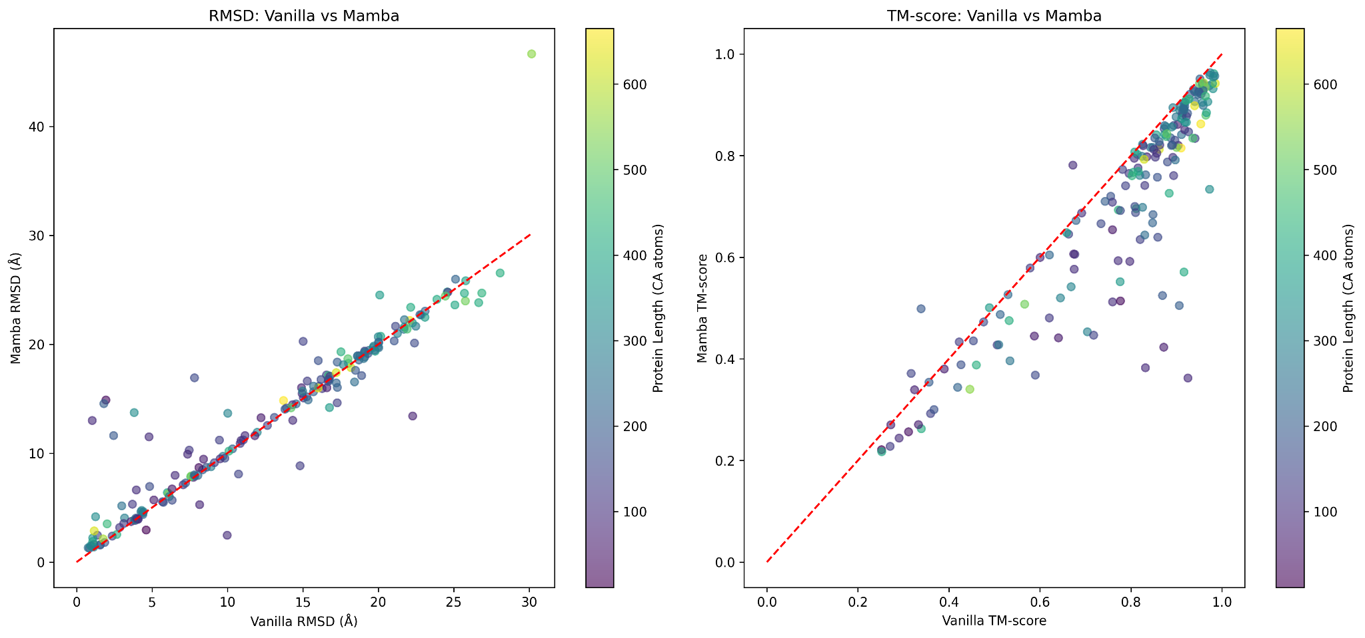
Improving AlphaFold for Efficient Protein Structure Prediction
Improving AlphaFold for Efficient Protein Structure Prediction
Matteo Tadiello
Matteo Tadiello
Notes:
Improving AlphaFold for Efficient Protein Structure Prediction
Abstract:
AlphaFold has transformed protein structure prediction, but its attention-based architecture poses challenges for large protein predictions due to high computational and memory demands. This project presents a mamba-based pair representation module to replace the attention mechanism in the Evoformer/Pairformer block. This should reduce computational complexity, optimizing AlphaFold’s performance for large proteins. This improvement aims to accelerate prediction time and reduce memory usage, enhancing the scalability of AlphaFold for complex biological systems.

Slide 6
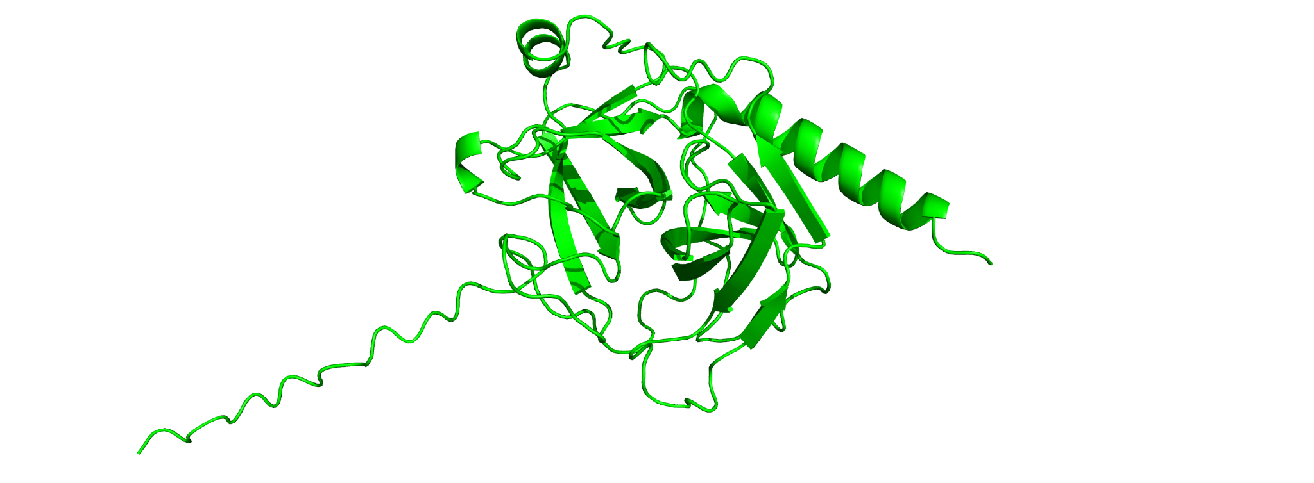
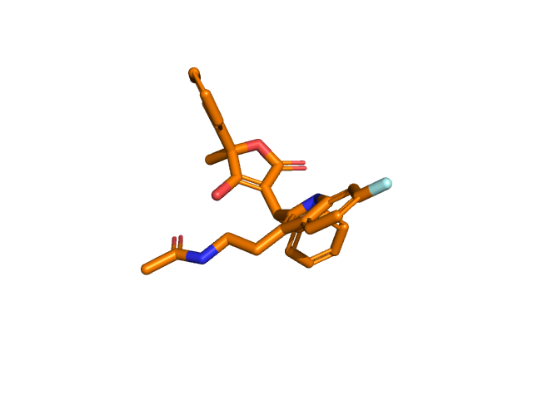
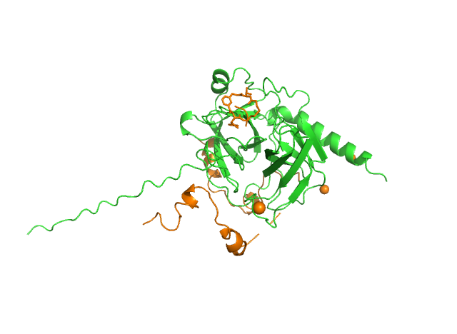

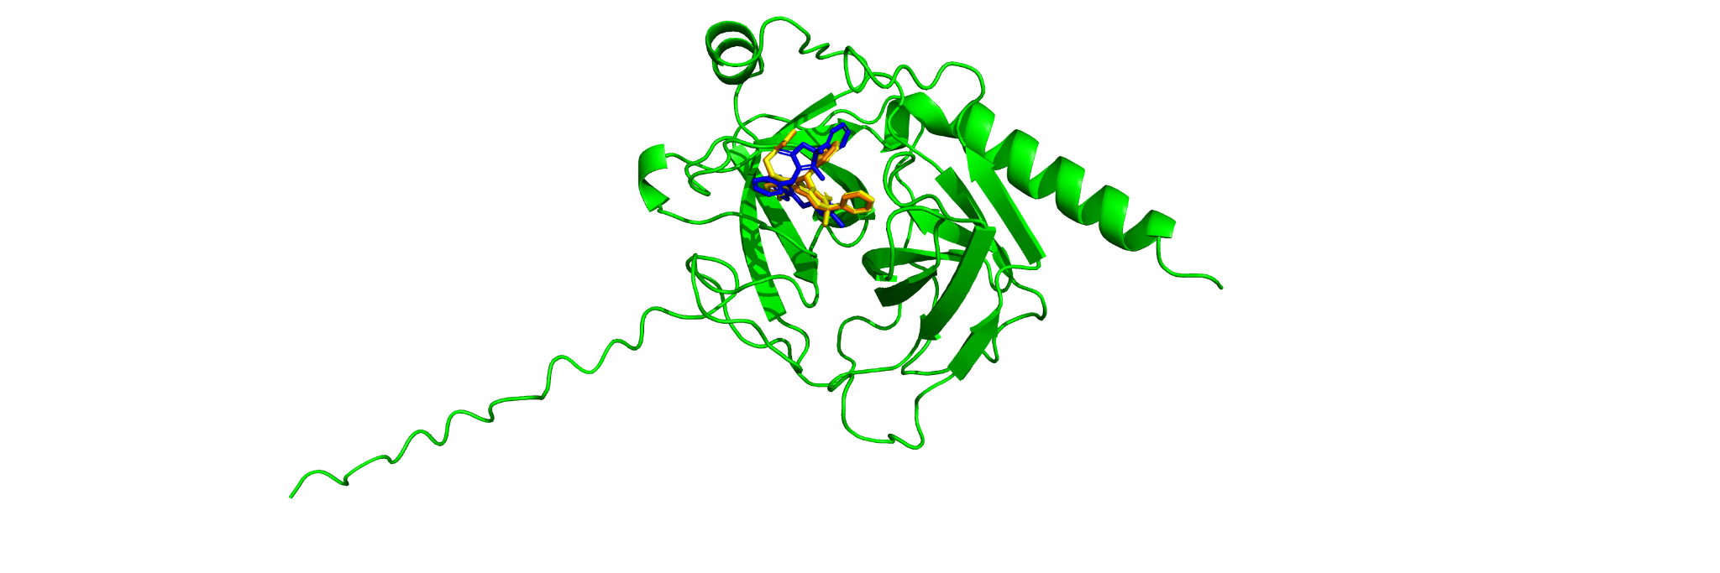
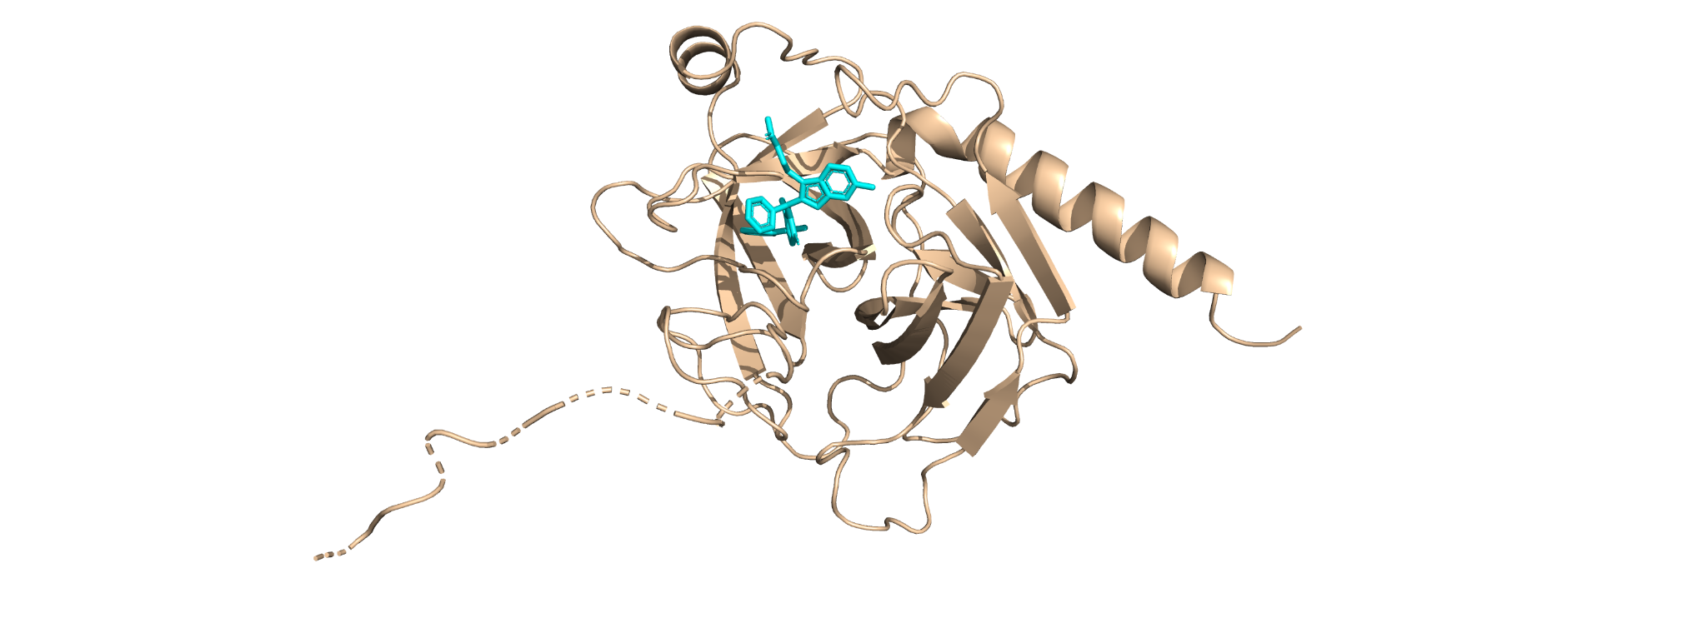
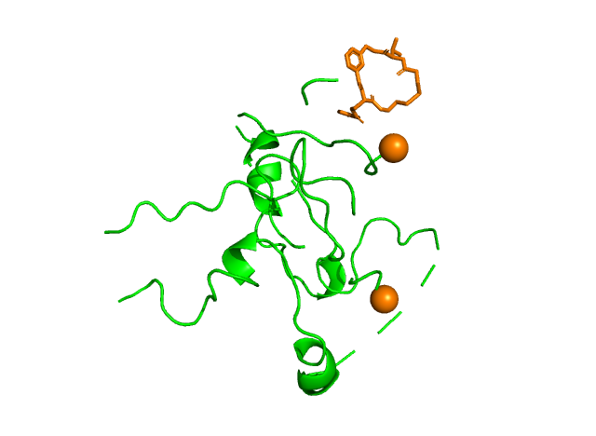
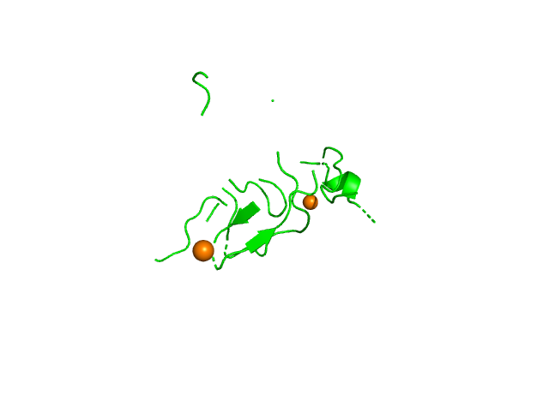
FunFOLD5 McGuffin Group
c) Protein 3D model predicted by MultiFOLD2
d) 3D conformation of target ligand
b) Protein 3D model predicted by MultiFOLD2
c) FunFOLD output on the entire protein 3D model
e) The identification of potential binding sites
f) The generation of potential binding poses
g) The modelling of target protein ligand complex
d) FunFOLD output on the first local binding site
Additional ligand found
in the second round
e) FunFOLD output on the
second local binding site
Template-based protocol
Template-free protocol

Slide 7
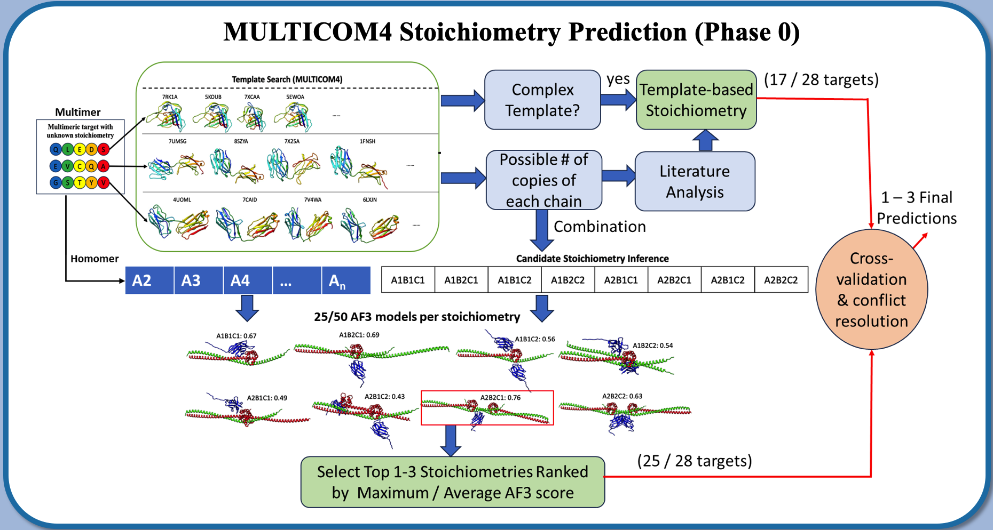
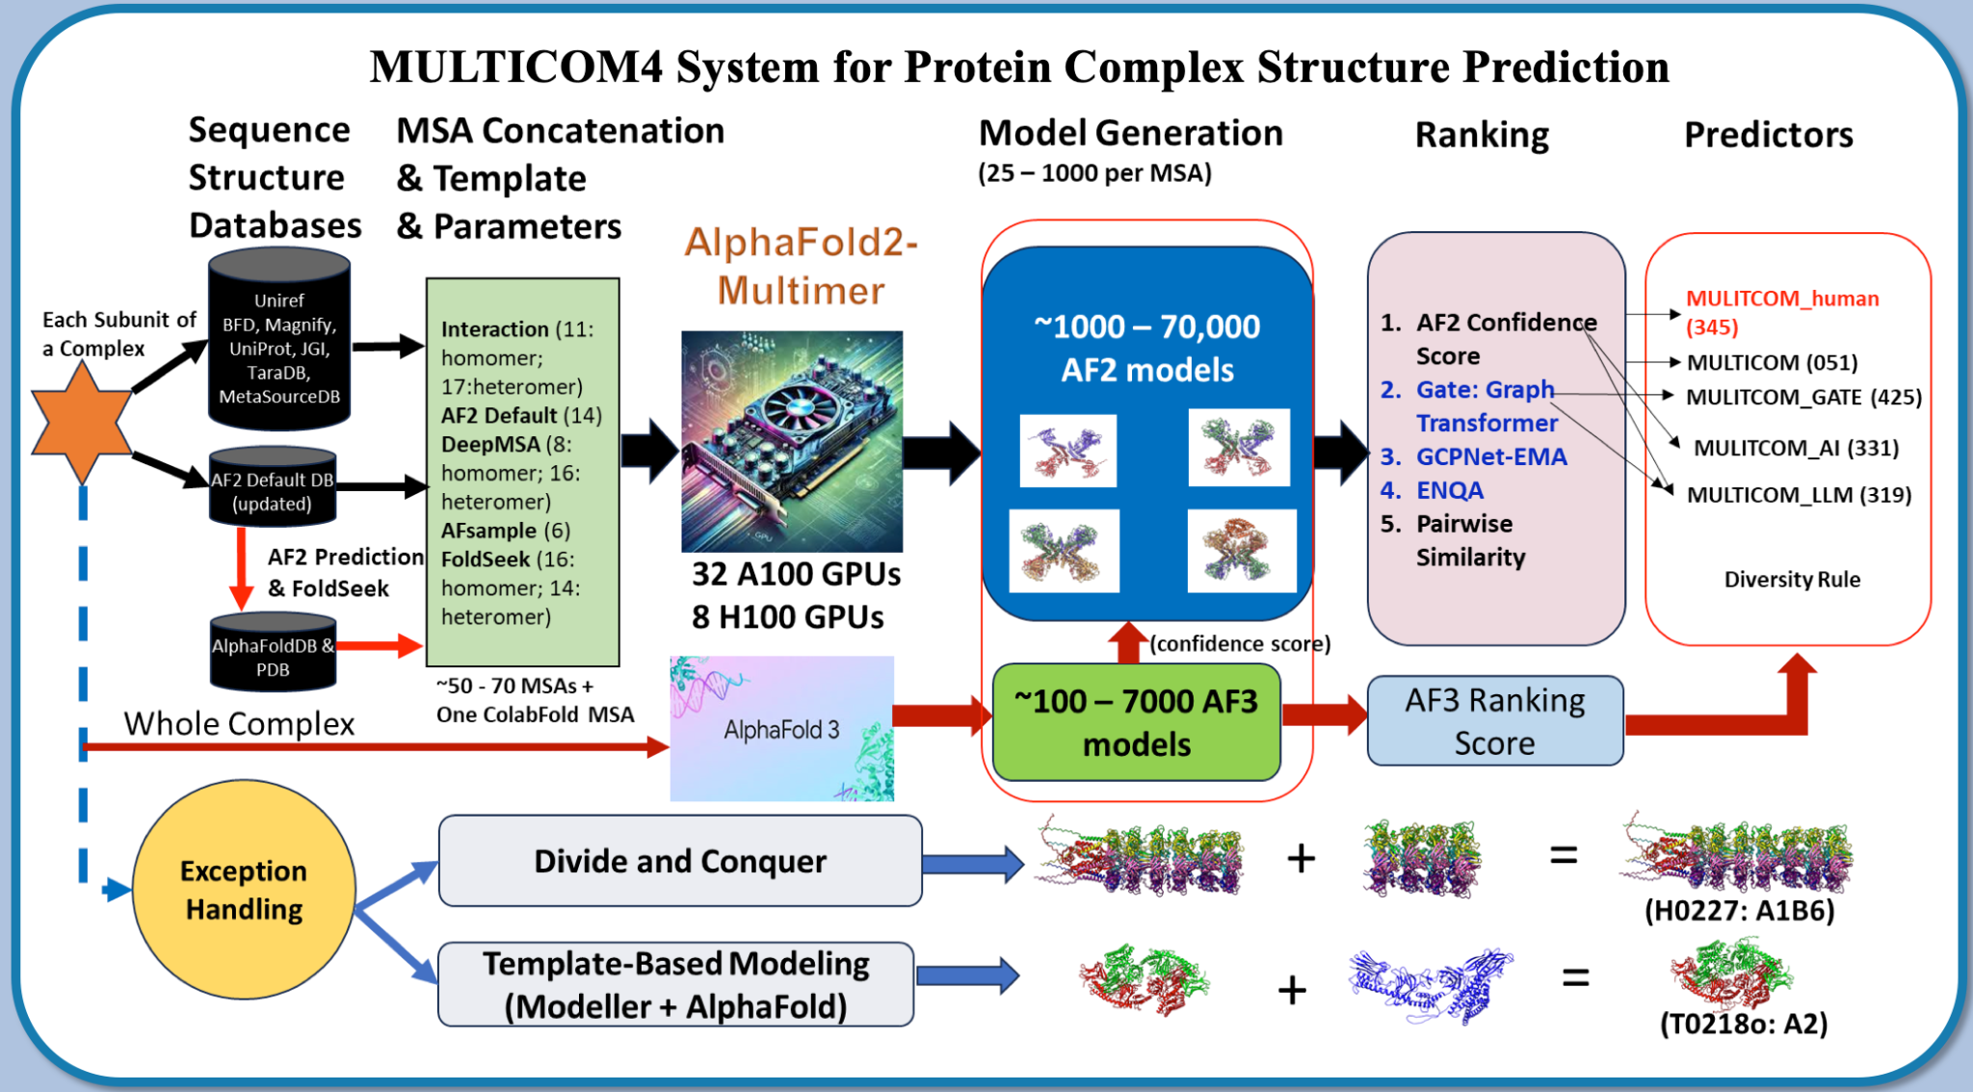
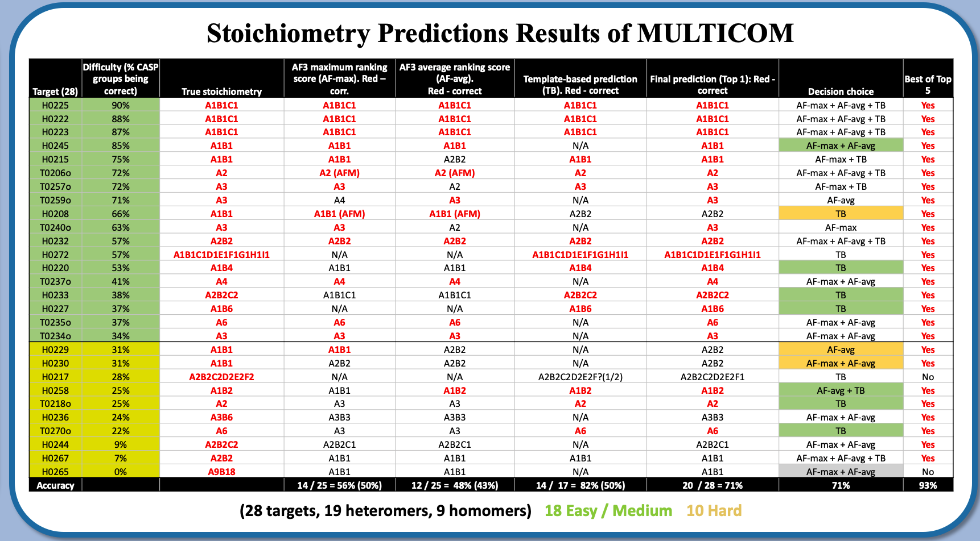
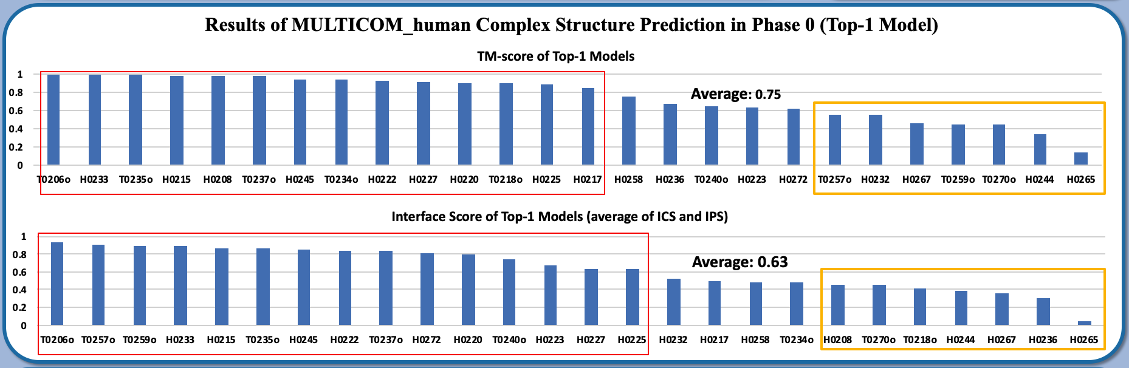
MULTICOM4 : Cheng group

