Slide 1
Best QA strategy?: Quantify the bad parts
Quantify the good parts
Arguments for focusing on the “good” parts
Many more ways to get it wrong.
How to quantify magnitude of a problem?
Experimental data on mutants of small proteins
that can fold retain as much of the good as possible.

Slide 2
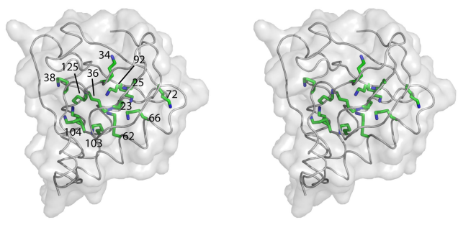
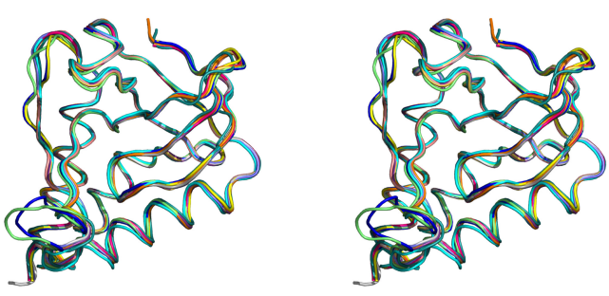
X-ray structures of 15 single mutants of
staphylococcal nuclease that fold:
Accommodate one buried and protonated
LYS with minimal change in global structure.
➔ small deviations in global structure
are probably too high in energy to fold.
Structure (2012) 20:1071-85. Garcia-Moreno E. lab

Slide 3
Strategy to Assess the Good Parts
Scores based on the statistics of diverse structural features of high resolution PDB models, then combine
atom overlap, summed of different subsets of atoms
phi/psi/chi1 angles
Conventional atom-pair statistical potentials
structural environment surrounding single atoms
a. average local neighborhood, e.g. solvent exclusion
b. compact groupings formed with 2 or 3 nearest neighbors

Slide 4
sum linear atom-atom overlap
r
i to all i > 5
δθ
i to i (self); plus i to i+1
atom overlap
resolution of x-ray data in Angstroms

Slide 5
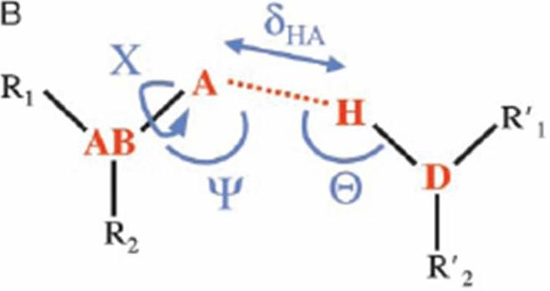
Statistical potentials
observed
ΔG’ ~ log
random
hydrogen bonds (Baker Lab)
Hbond donor-acceptor pairs
(86 atom types)
atom – atom pairs (86 types)
backbone hydrogen bonds
R²= 0.092
R² = 0.249
R² = 0.195
resolution of x-ray data in Angstroms

Slide 6
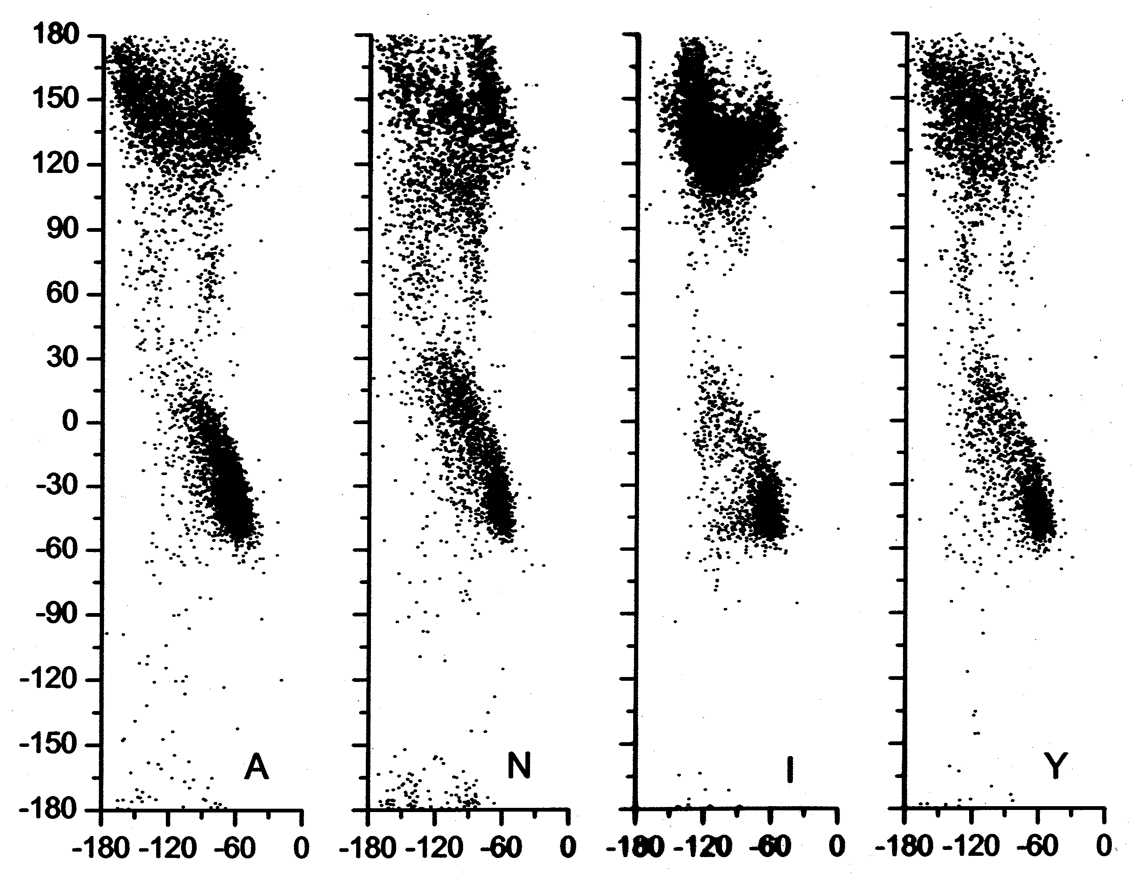
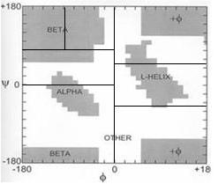
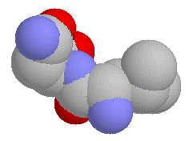
Ramachandran statistical potentials
dipeptides 26x26 bins
single turn residues ➔137 bins
i-1 and i+1 residues ➔ 5 or 7 bins
turn helix/strand junctions ➔ 26 bins
beta strand dipeptides ➔ 13 bins
log 10
resolution of x-ray data in Angstroms

Slide 7
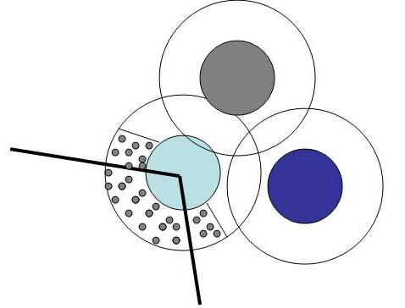
local neighborhoods of atoms
less than1.5A
not covalent,
1 residue, separation > 4
Solvent exclusion
triangle count
R² = 0.082
R² = 0.065
resolution of x-ray data in Angstroms

Slide 8
normalize scores as percentiles relative to values for x-ray models resolution 1.5A or better
0
. . . . . . . . . .
lowest
energy
10
highest
energy
average percentile X0.1 of 13
statistical parameters
R-factor of x-ray data
2 linear overlap
4 Ramachandran
1 rotamers
4 atom-atom
1 solvation
1 triangle count
resolution of x-ray data in Angstroms
R-free of x-ray data

Slide 9
A strategy for protein model QA:
Develop scoring parameters for quantifying diverse
structural features found in high resolution proteins
and combine
Advantage over AI-based methods:
Insight into where modeling errors have
smaller/ large effects on structure quality.

