Slide 1

ModFOLDdock2, ModFOLDdock2R
& ModFOLDdock2S
McGuffin Group, University of Reading
l.j.mcguffn@reading.ac.uk

Slide 2
Methods: Overview
3 server variants for QMODE1/2:
ModFOLDdock2 - global scores optimised for positive linear correlations with the observed scores.
ModFOLDdock2R - global scores optimised for Ranking, i.e. the top-ranked models (top 1) should have higher observed overall accuracy.
ModFOLDdock2S - a Single model approach to score models. Reference multimer models were generated using our new MultiFOLD2 method. Each model was compared individually against the reference model set.
2 manual variants for QMODE3 (McGuffin group):
ModFOLD9Q - Quick version of ModFOLD9 for monomer ranking.
ModFOLDdock2Q - Quick version of ModFOLDdock2R for multimer ranking

Slide 3
Differences from ModFOLDdock version 1
Integration of new component scores
  OST version 2.7 global and local scores for jury scores and target functions
  VoroIF single model method (weighted_average_pcadscore)
Optimisation for new target functions
  Based on assessors’ scores from CASP15
    Interface - mean of QS-best and DockQ-wave
    Fold - mean of Oligo-GDT and TM-score
    Local - mean of the local lDDT, CAD, PatchQS and PatchDockQ scores
Reference model sets generated by MultiFOLD2 for ModFOLDdock2S
NN trained for interface residue scoring (ModFOLDdock2S)

Slide 4
Methods: Components
Consensus model scoring:
QS-bestJury, DockQ-waveJury, TM-scoreJury, Oligo-GDTJury, lDDTJury, CADJury, PatchQSJury, PatchDockQJury, and ModFOLDIA
Single-model scoring:
VoroIF, VoroMQA, CDA (Contact Distance Agreement)
Quasi-single model scoring:
Above scores plus MultiFOLD2 (single models compared with reference models)

Slide 5
Methods: Fold, interface & local quality scores
3 variants, 3 sets of scores each:
ModFOLDdock2
  Fold: TM-scoreJury, Oligo-GDTJury
  Interface: QS-bestJury, DockQ-waveJury, VoroIF
  Local: lDDTJury, CADJury, PatchQSJury, PatchDockQJury
ModFOLDdockR
  Fold: DockQ-waveJury, lDDTJury, VoroIF
  Interface: DockQ-waveJury,VoroIF, VoroMQA
  Local: lDDTJury, CADJury, PatchQSJury, PatchDockQJury
ModFOLDdockS
  Fold: TM-scoreJury, VoroIF, NN global score
  Interface: QS-bestJury, VoroIF, NN global score
  Local: NN local score
(B) QMODE2. Residue-based Interface Assessment
PFRMAT QA
TARGET T0999
AUTHOR 1234-5678-9000
REMARK Reliability of residues being in Interfaces
METHOD Description of methods used
MODEL 1
QMODE 2
T1031TS000_1o 0.8 0.4 A1:0.9 A3:0.9 A17:0.7 A19:0.7 B45:0.7 B49:0.4
B50:0.4 B53:0.8
T1031TS999_1o 0.7 X A15:0.5 A17:0.9 A44:0.7 A46:0.7 B4:0.3 B9:0.4
END
Fold
Score
(SCORE)
Interface score
(QSCORE)
Local scores

Slide 6
ModFOLDdock2 (Group 441)
QS-bestJury
Scores optimised for global correlations
DockQ-waveJury
TMscoreJury
All models
Oligo-GDTJury
Interface score
VoroMQA
VoroIF
Fold score
lDDTJury
CADJury
PatchQSJury
Local scores
Single Models
PatchDockQJury
ModFOLDIA
Sequences
CDA

Slide 7
ModFOLDdock2R (Group 027)
QS-bestJury
Scores optimised for global ranking or model selection
DockQ-waveJury
TMscoreJury
All models
Oligo-GDTJury
Interface score
VoroMQA
VoroIF
Fold score
lDDTJury
CADJury
PatchQSJury
Local scores
Single Models
PatchDockQJury
ModFOLDIA
Sequences
CDA

Slide 8
ModFOLDdock2S (Group 074)
QS-bestJury
A quasi-single model approach using MultiFOLD2
Sequences
DockQ-waveJury
MultiFOLD2
TMscoreJury
55 models
Oligo-GDTJury
Interface score
VoroMQA
VoroIF
Fold score
lDDTJury
CADJury
PatchQSJury
NN
Local scores
Single Models
PatchDockQJury
ModFOLDIA
Sequences
CDA

Slide 9
MultiFOLD2 for generating reference models
Sequences
Stoich. prediction
LocalColabFold 1.0.0
LocalColabFold 1.5.2
RoseTTAFold2
RoseTTAFoldAA
45 models
ModFOLDdock2
Up to 55 reference models
Top 5 models
Sequences
LocalColabFold 1.5.2
10 models

Slide 10
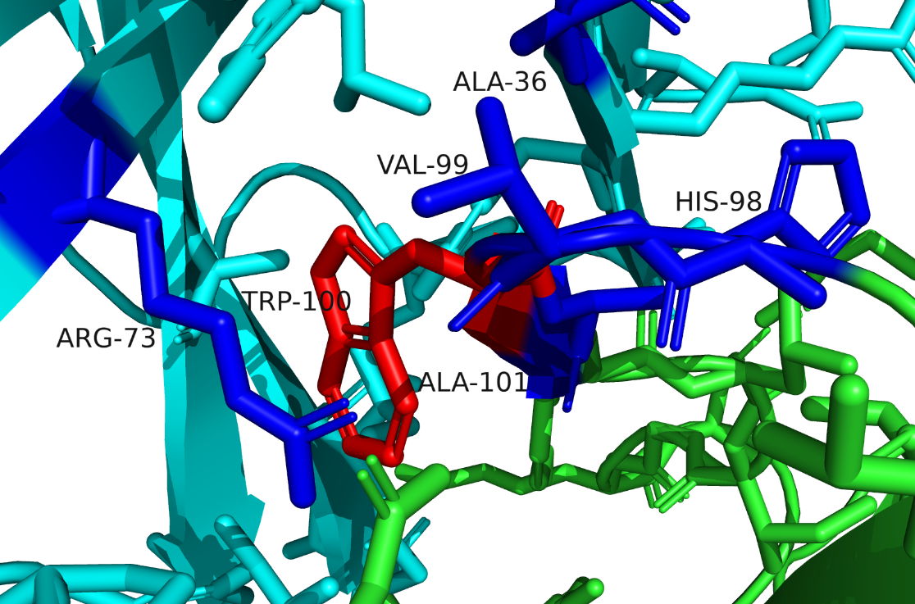
ModFOLDdock2S MLP for local scores
A100,B36,A99,B73,A101,A98
<< The scores for the 5 closest contacting interface residues (≤8Å) in order of their proximity to A100
lDDTJury
CADJury
PatchQSJury
Mean of local lDDT, CAD, PatchQS and PatchDockQ
PatchDockQJury
ModFOLDIA
CDA
6 hidden neurons
E.g.,
Chain A = green,
Chain B = cyan,
A100 (residue being scored) = red sticks,
5 closest interface residues = blue sticks
VoroMQA
VoroIF
48 input neurons
(6 residues x 8 scores ranging 0-1, zeros are used for padding for columns 2-6 if there are insufficient contacting interface residues)

Slide 11
McGuffin group submissions for QMODE3
Not fully automated - manual data collection from MassiveFold site and submission of top 5 ranked models
ModFOLD9Q - Quick version of ModFOLD9 for monomer ranking:
Top 40 ModFOLD9 ranked server models for Phase 1 (T1) targets were used as reference sets for comparison against the MassiveFold models.
MassiveFold models were then ranked by the mean of the GDTJury and lDDTJury scores.
ModFOLDdock2Q - Quick version of ModFOLDdock2R for multimer ranking:
Top N (5≤N≤40) MassiveFold models were selected using VoroIF(sum_of_gnn_scores) and used as reference sets for comparison against the MassiveFold models.
MassiveFold models were ranked by the mean of the lDDTJury, DockQ-waveJury and VoroIF(weighted_average_pcadscore) scores.

Slide 12
What went right and what went wrong?
Local score rankings (QMODE2)
 |  | PatchQS
Method | group_id | rank by roc_auc | rank by spearman_r | rank by pearson_r
ModFOLDdock2 | 441 | 1st | 1st | 1st
ModFOLDdock2R | 27
ModFOLDdock2S | 74 | 4th | 4th | 4th
 |  | PatchDockQ
Method | group_id | rank by roc_auc | rank by spearman_r | rank by pearson_r
ModFOLDdock2 | 441 | 1st | 1st | 1st
ModFOLDdock2R | 27
ModFOLDdock2S | 74 | 4th | 4th | 4th
 |  | CAD
 | group_id | rank by roc_auc | rank by spearman_r | rank by pearson_r
ModFOLDdock2 | 441 | 2nd | 2nd | 3rd
ModFOLDdock2R | 27
ModFOLDdock2S | 74 | 7th | 5th | 5th
 |  | lDDT
Method | group_id | rank by roc_auc | rank by spearman_r | rank by pearson_r
ModFOLDdock2 | 441 | 3rd | 3rd | 3rd
ModFOLDdock2R | 27
ModFOLDdock2S | 74 | 7th | 6th | 5th
N.B. Ranks are tied for ModFOLDdock2 and ModFOLDdock2R because they use same code for local scores.
Global score rankings (QMODE1)
 |  | QS-best (Interface)
Method | group_id | rank by roc_auc | rank by loss | rank by pearson_r
ModFOLDdock2 | 441 | 1st | 3rd | 3rd
ModFOLDdock2R | 27 | 2nd | 2nd | 6th
ModFOLDdock2S | 74 | 5th | 4th | 4th
 |  | DockQ-Wave (Interface)
Method | group_id | rank by roc_auc | rank by loss | rank by pearson_r
ModFOLDdock2 | 441 | 1st | 2nd | 2nd
ModFOLDdock2R | 27 | 3rd | 1st | 5th
ModFOLDdock2S | 74 | 20th | 14th | 6th
 |  | TM-score (Fold)
Method | group_id | rank by roc_auc | rank by loss | rank by pearson_r
ModFOLDdock2 | 441 | 1st | 7th | 3rd
ModFOLDdock2R | 27 | 8th | 8th | 8th
ModFOLDdock2S | 74 | 19th | 19th | 12th
 |  | Oligo-GDT-TS (Fold)
Method | group_id | rank by roc_auc | rank by loss | rank by pearson_r
ModFOLDdock2 | 441 | 4th | 11th | 3rd
ModFOLDdock2R | 27 | 11th | 8th | 7th
ModFOLDdock2S | 74 | 18th | 16th | 12th
N.B. Ranks for predictor groups only, i.e. excluding AC.

Slide 13
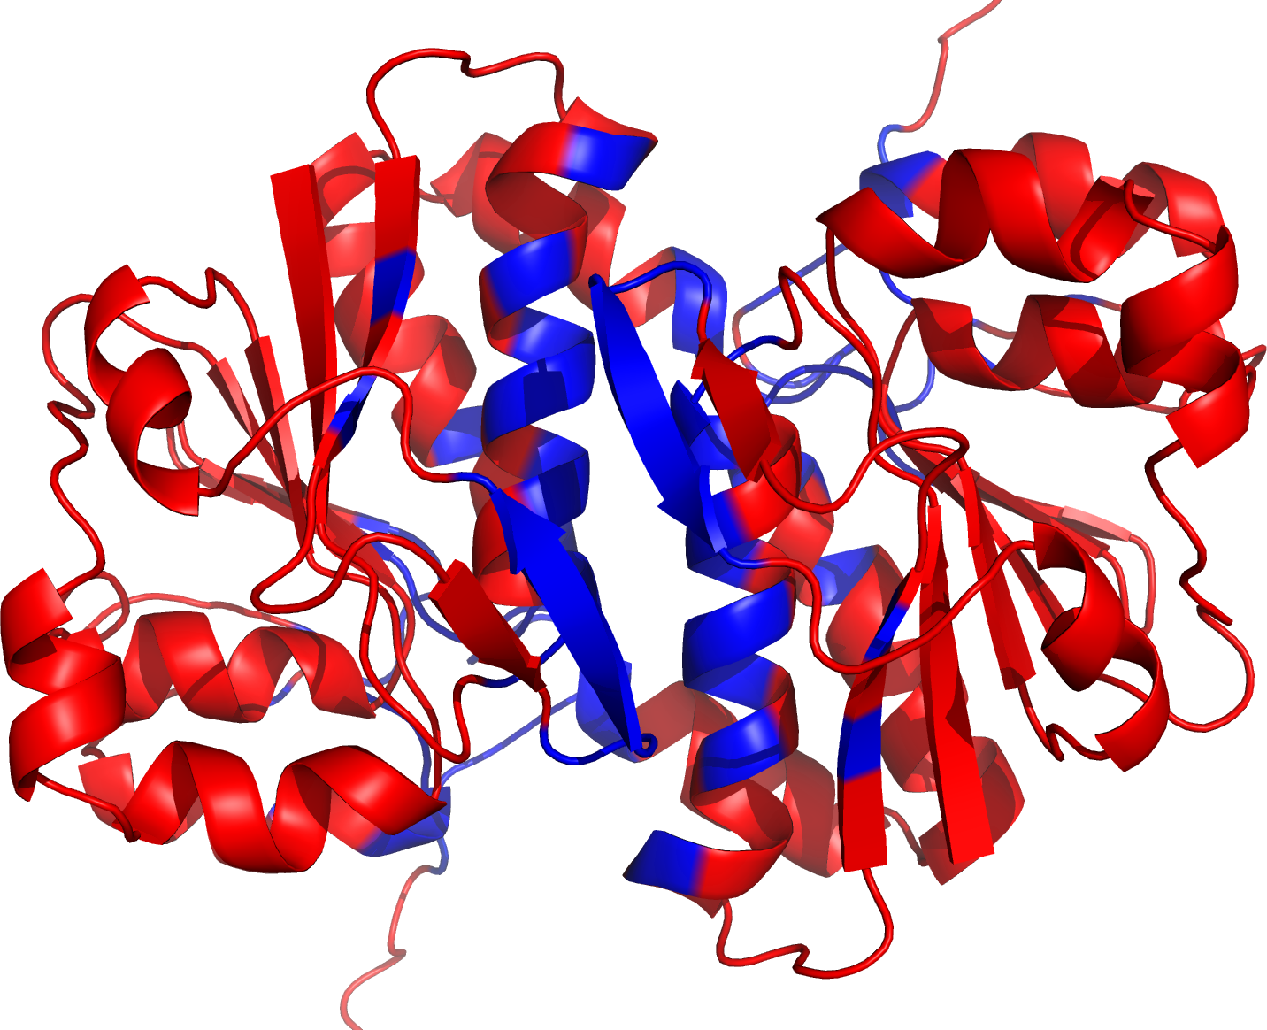
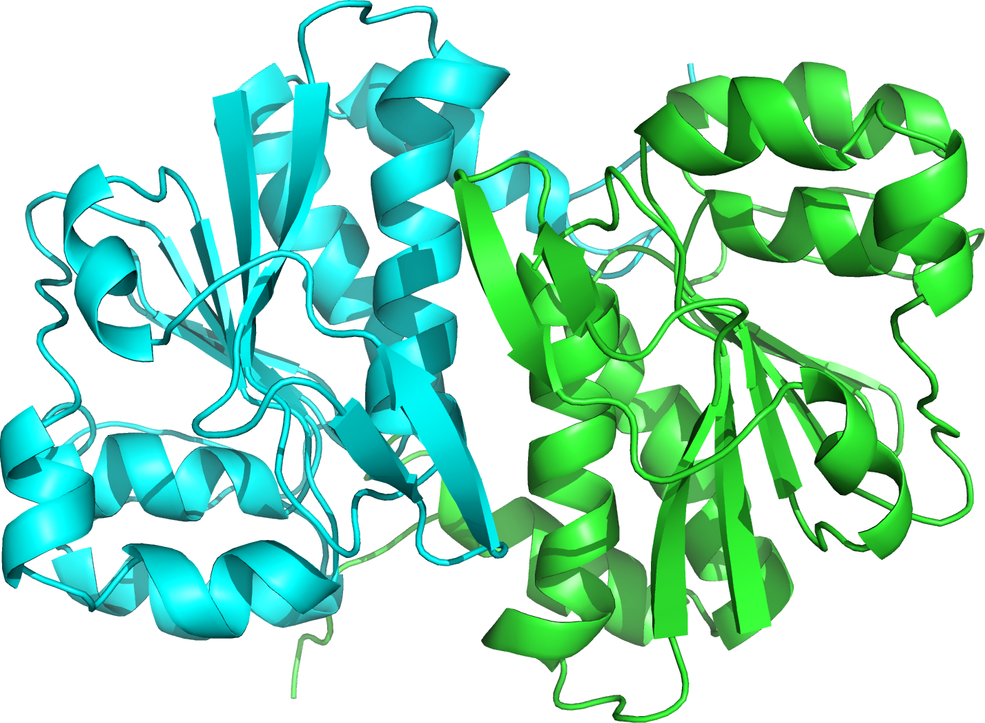
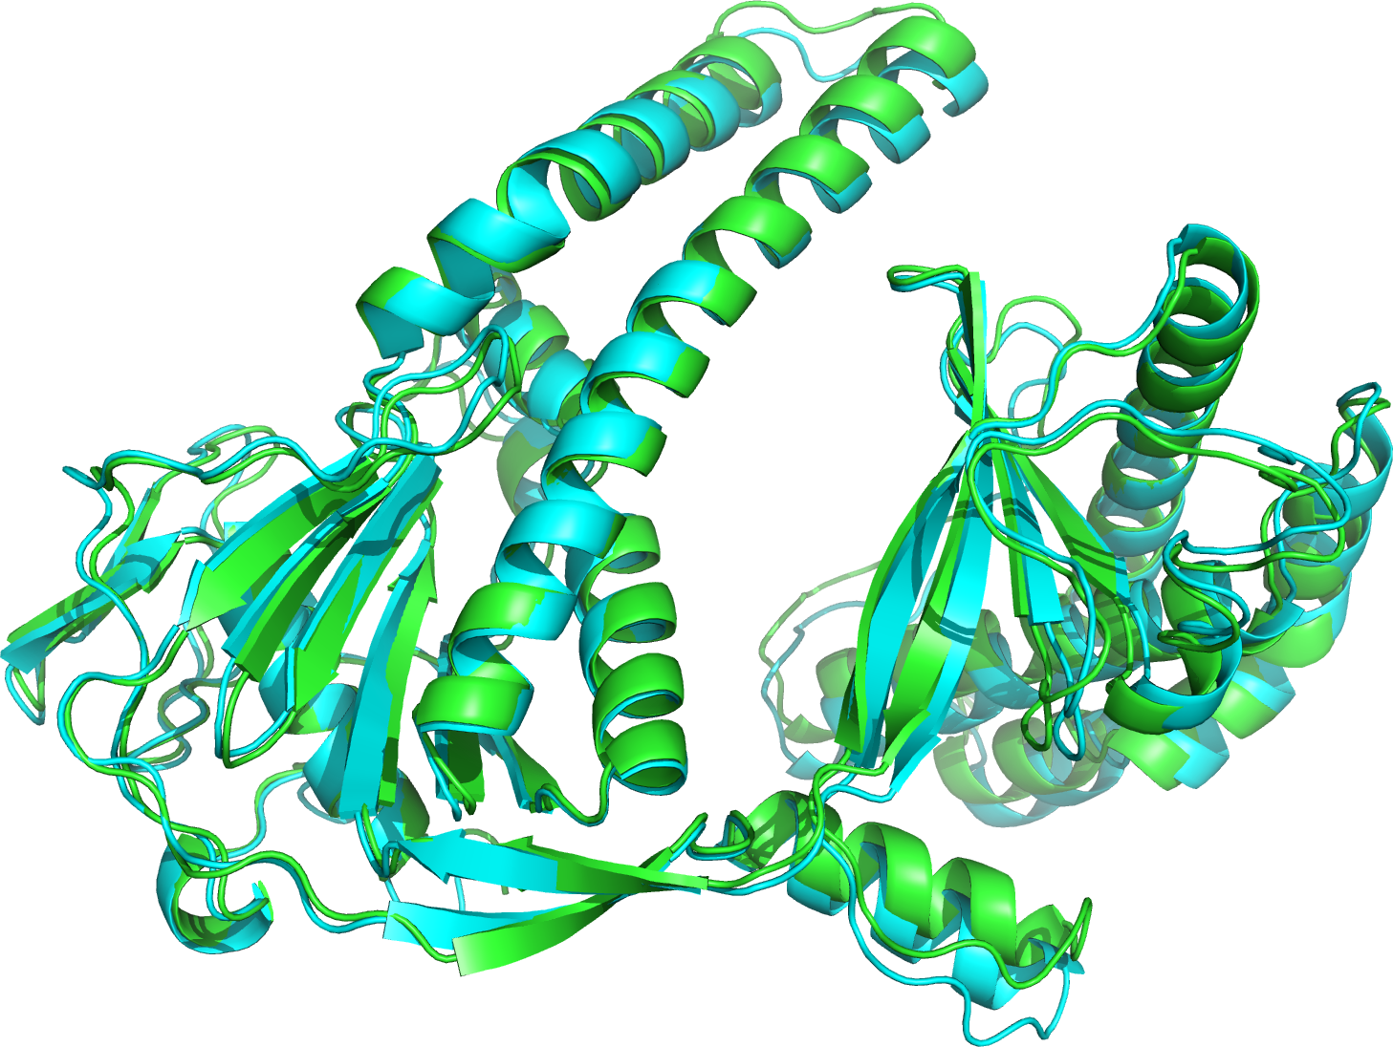
What went right?
target | pearson_r | spearman_r | roc_auc | loss
T1292o | 0.9727 | 0.9253 | 0.9987 | 0.005
1st place in both global interface accuracy (QMODE1, QSCORE) and local interface accuracy (QMODE2)
T1292o - an example of excellent ModFOLDdock2 performance according to QS-best score
Near perfect loss and ROC scores and very strong correlations
T1292o QMODE2 top model (local score in blue shades)
T1292o native
2nd place method for QMODE3 on monomers - our ModFOLD9 method was very reliable for selection of reference setsmonomer models
T1212 QMODE3 top model (cyan) versus native (green)

Slide 14
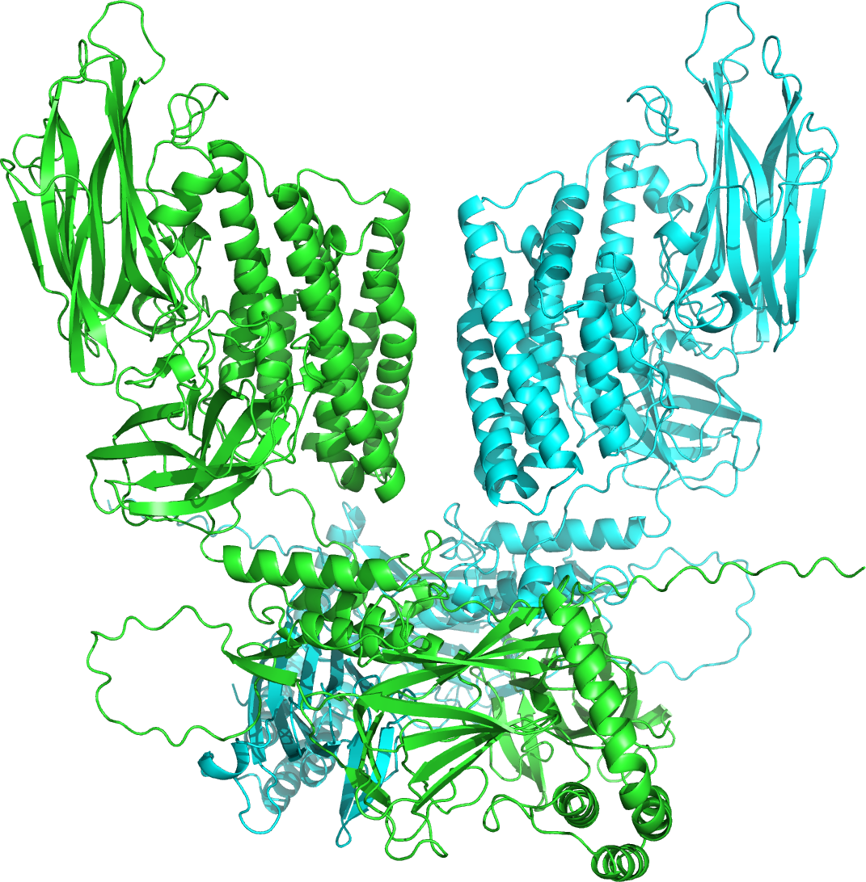
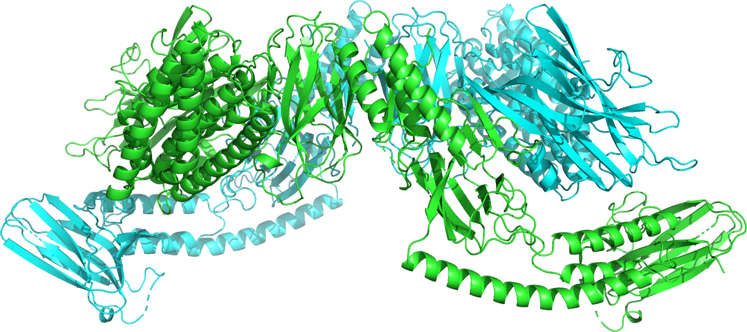
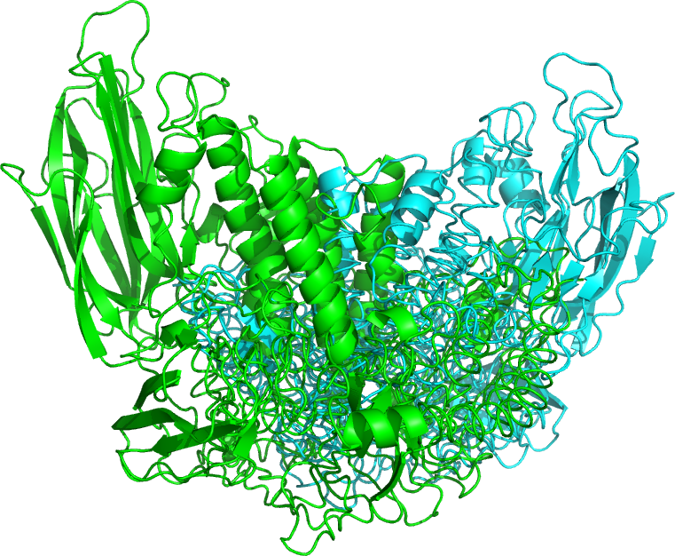
What went wrong?
T1218o - the worst ModFOLDdock2 performance (QS-best score)
Incorrect confirmation selected
Negative correlations, random ROC and large loss
target | pearson_r | spearman_r | roc_auc | loss
T1218o | -0.5414 | -0.6015 | 0.5 | 0.841
T1218o QMODE2 top model
T1218o native
QMODE3 for multimers - we relied on VoroIF for rapid selection of reference models, but some top selected models with severe clashes.
T1218o QMODE3 top model

Slide 15
Answers to other specific questions…
Why did ModFOLDdock2 do substantially better in QMODE1 than ModFOLDdock2R?
  ModFOLDdock2 better reflects the absolute observed model quality scores, leads to better Pearson, Spearman correlations and ROC scores
  ModFOLDdock2R does better according to the loss, the relationship between the observed and predicted scores is not linear so slightly worse on the Pearson, Spearman and ROC scores
In CASP15, the QSCORE was significantly lower than the baseline assembly consensus (AC) measure. Those positions are reversed in CASP16. Why?
  We optimised for different target functions and included more input scoring methods that better reflect those target functions
  We improved handling of larger structures
Can you understand why your results were so much better for monomer targets than for multimer targets in QMODE3?
  ModFOLD9 was very reliable producing excellent sets of reference models, but it can’t be used for multimers
  VoroIF was unreliable at scoring some multimer models with clashes, leading to poor quality reference sets for some targets

Slide 16

McGuffin Group Members
Nick Edmunds - PhD student
Shaima Alhaddad - PhD student
Ahmet Genc - PhD student
Dr Recep Adiyaman - Postdoc
Prof. Liam McGuffin - PI
MultiFOLD2 and ModFOLDdock2 web servers:
https://www.reading.ac.uk/bioinf/ModFOLDdock/ModFOLDdock2_form.html
https://www.reading.ac.uk/bioinf/MultiFOLD/MultiFOLD2_form.html
Docker package coming soon…
https://hub.docker.com/r/mcguffin/multifold

