Slide 1

PLMFold: Enhancing Protein Structure Prediction through MSA Quality Improvement with PLM-MSA
Reporter: Wei Liu
Department of Quantitative and Computational Biology
University of Southern California
Homepage: https://maovshao.github.io/

Slide 2
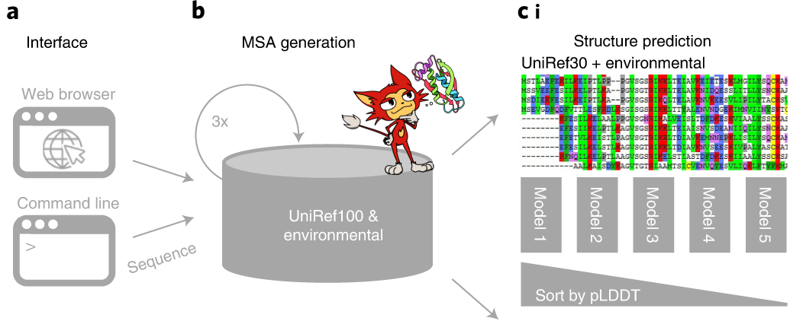
Previous work: ColabFold
ColabFold [1] speeds up single predictions by replacing AlphaFold2’s homology search with the 40–60-fold faster MMseqs2 (Many-against-Many sequence searching)
[1] Mirdita, M., Schütze, K., Moriwaki, Y. et al. ColabFold: making protein folding accessible to all. Nat Methods 19, 679–682 (2022).

Slide 3
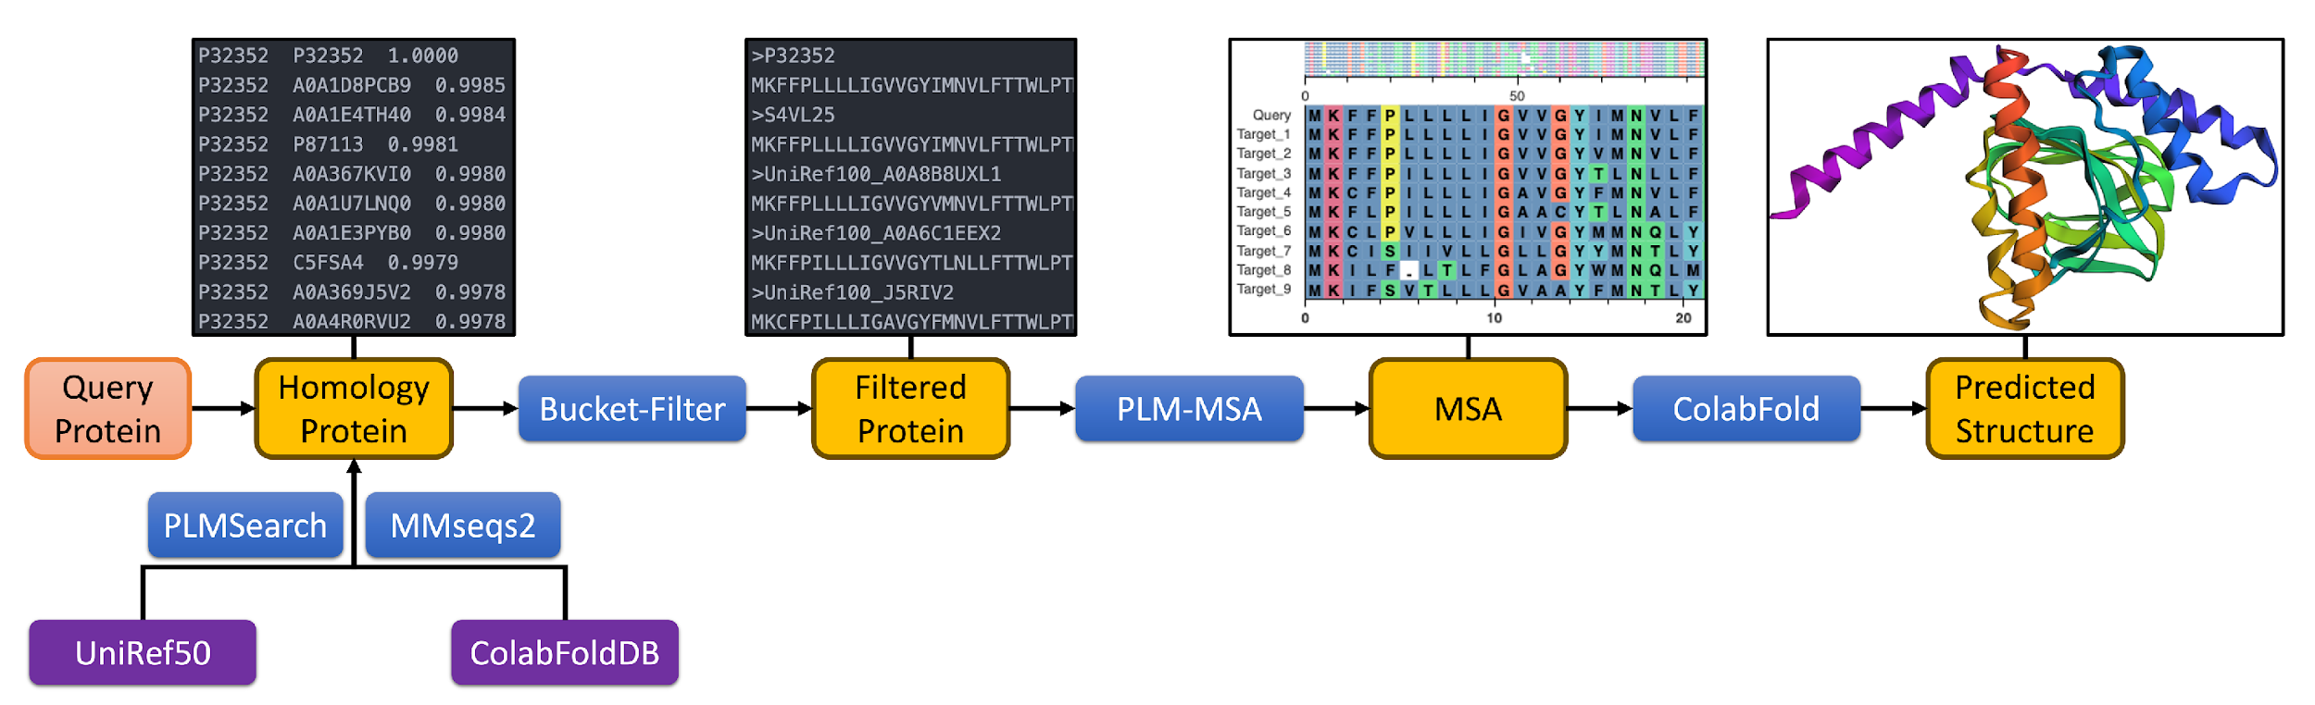
PLMFold
We only optimize the input MSA
The backend structure prediction method should supports custom MSA
Including AlphaFold2, Colabfold, AlphaFold3
The coordinates of non-alpha carbon atoms are optimized with AlphaFold3

Slide 4
PLMSearch --- accurate and fast homologous protein search

Slide 5
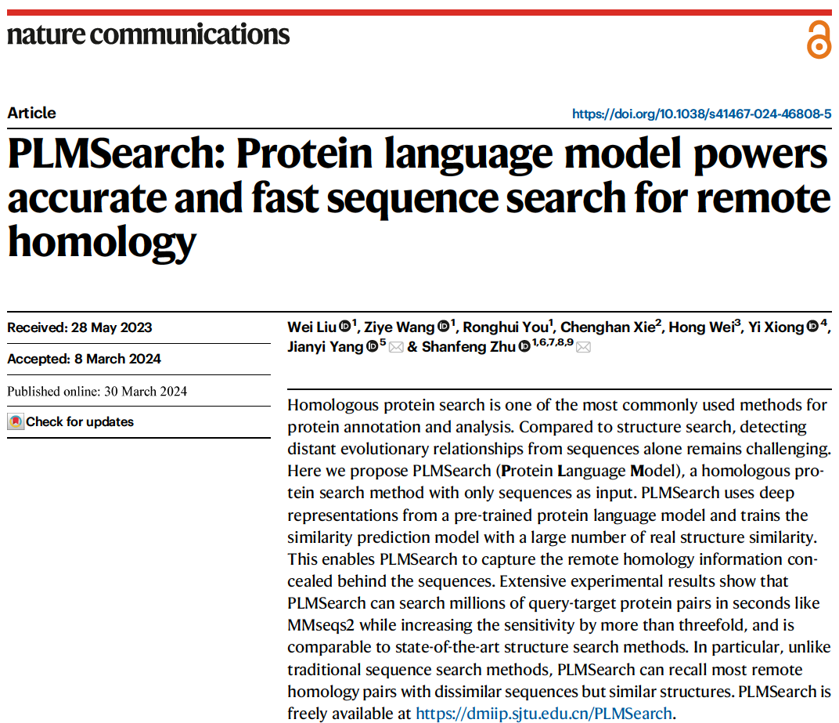

Homologous protein search
For each query protein, find the homologous proteins from the target dataset (generally a large-scale standard dataset like UniRef).
The target protein with a higher probability of homology should be ranked higher.
[2] Liu, W., Wang, Z., You, R. et al. PLMSearch: Protein language model powers accurate and fast sequence search for remote homology. Nat Commun 15, 2775 (2024).

Slide 6
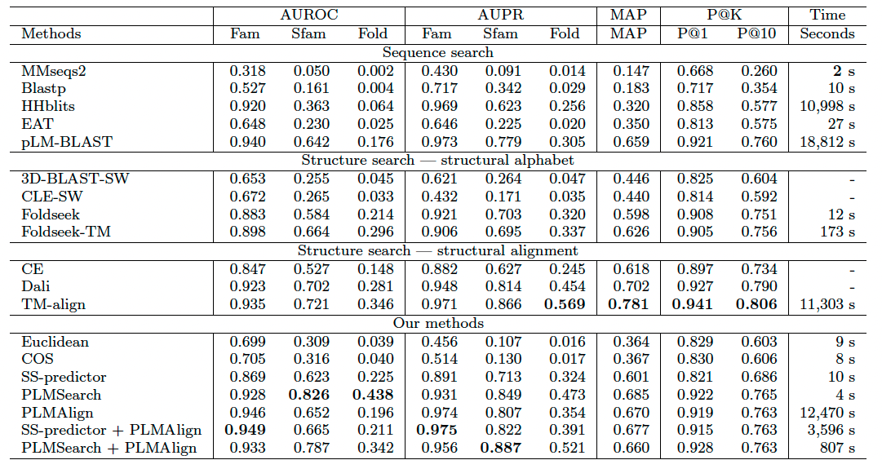
PLMSearch reaches similar sensitivities as structure search methods
PLMSearch outperforms MMseqs2 in terms of sensitivity and is comparable to the state-of-the-art structural search approaches.
PLMSearch, on the other hand, is capable of searching millions of query-target protein pairs in seconds.

Slide 7
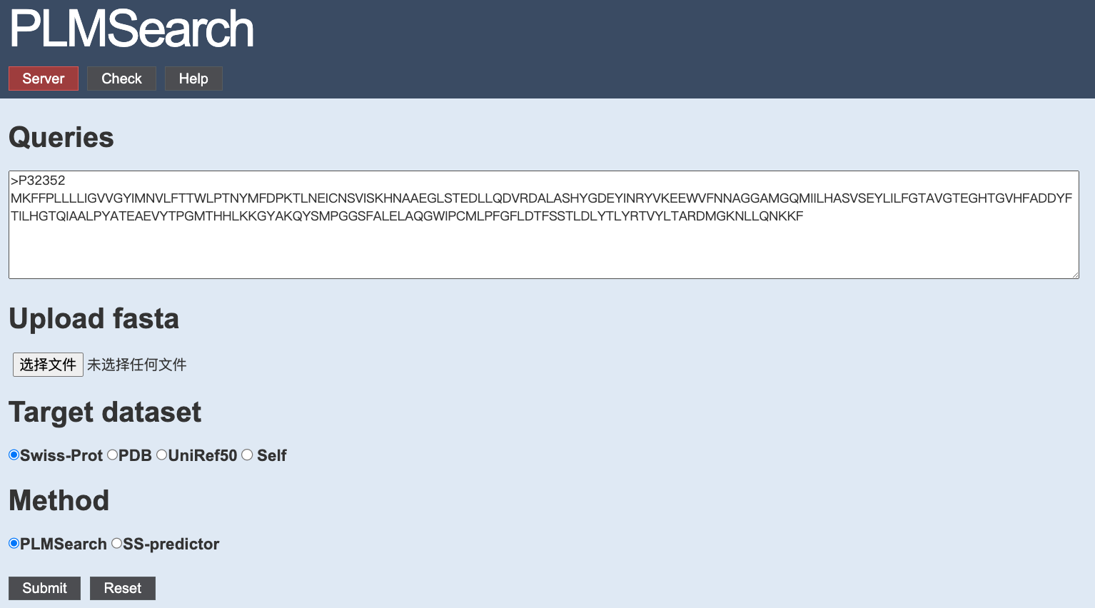
Webserver of PLMSearch
https://dmiip.sjtu.edu.cn/PLMSearch/

Slide 8
From PLMAlign (PSA) to PLM-MSA (MSA)

Slide 9
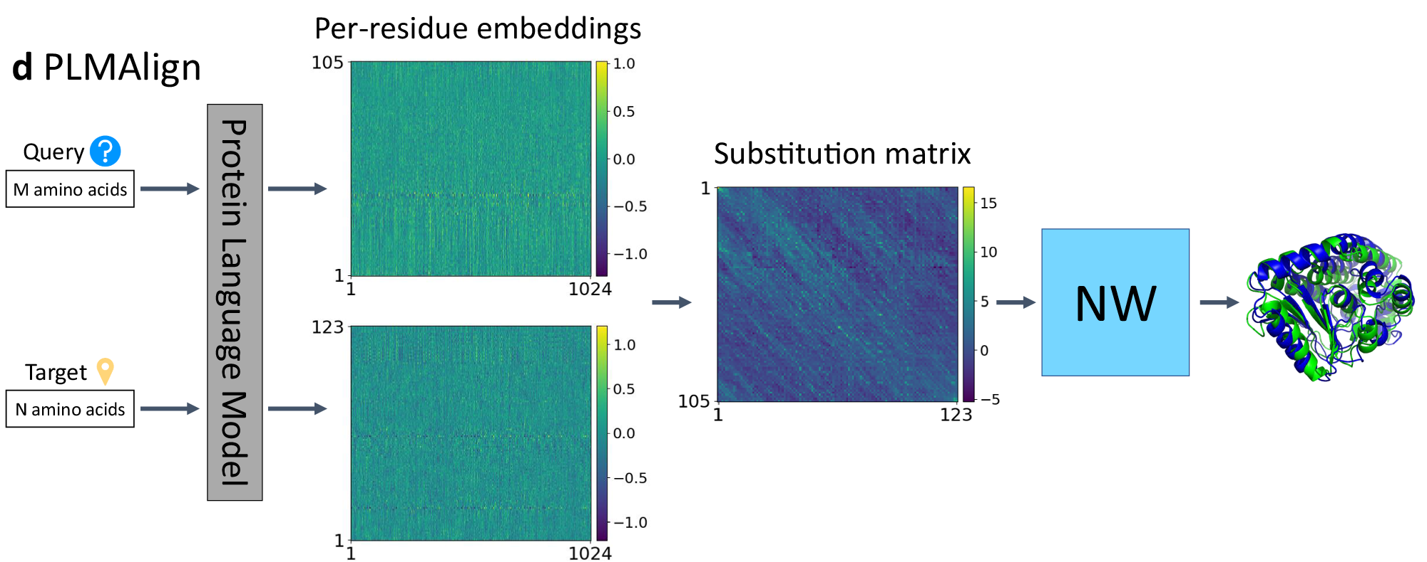
PLMAlign
d, PLMAlign utilizes per-residue embeddings as input to compute a substitution matrix. This substitution matrix is then employed to Smith-Waterman (SW) or Needleman-Wunsch (NW) algorithm, enabling the local or global sequence alignment.

Slide 10
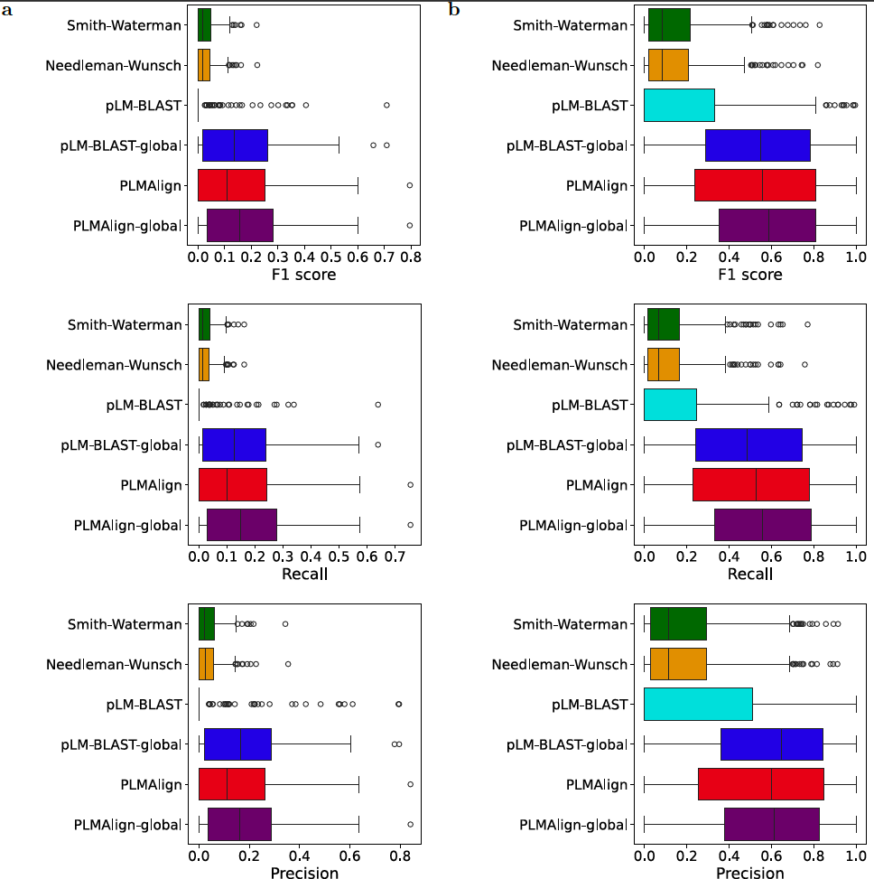
PLMAlign performs better on remote homology alignment
Owing to the use of dot products of protein embeddings to calculate similarity instead of the original fixed substitution matrix, PLMAlign outperforms the SW and NW algorithm.

Slide 11
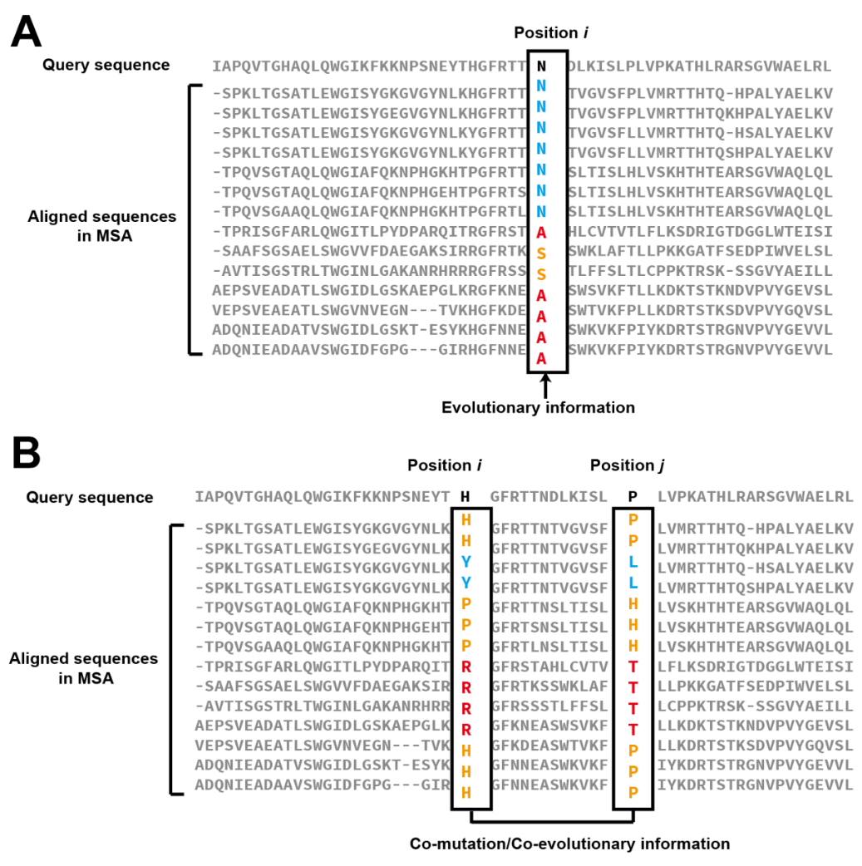
What is “Good” MSA?
Evolutionary information
Co-evolutionary information
[3] Zheng, W., Wuyun, Q., Li, Y. et al. Improving deep learning protein monomer and complex structure prediction using DeepMSA2 with huge metagenomics data. Nat Methods 21, 279–289 (2024). https://doi.org/10.1038/s41592-023-02130-4

Slide 12
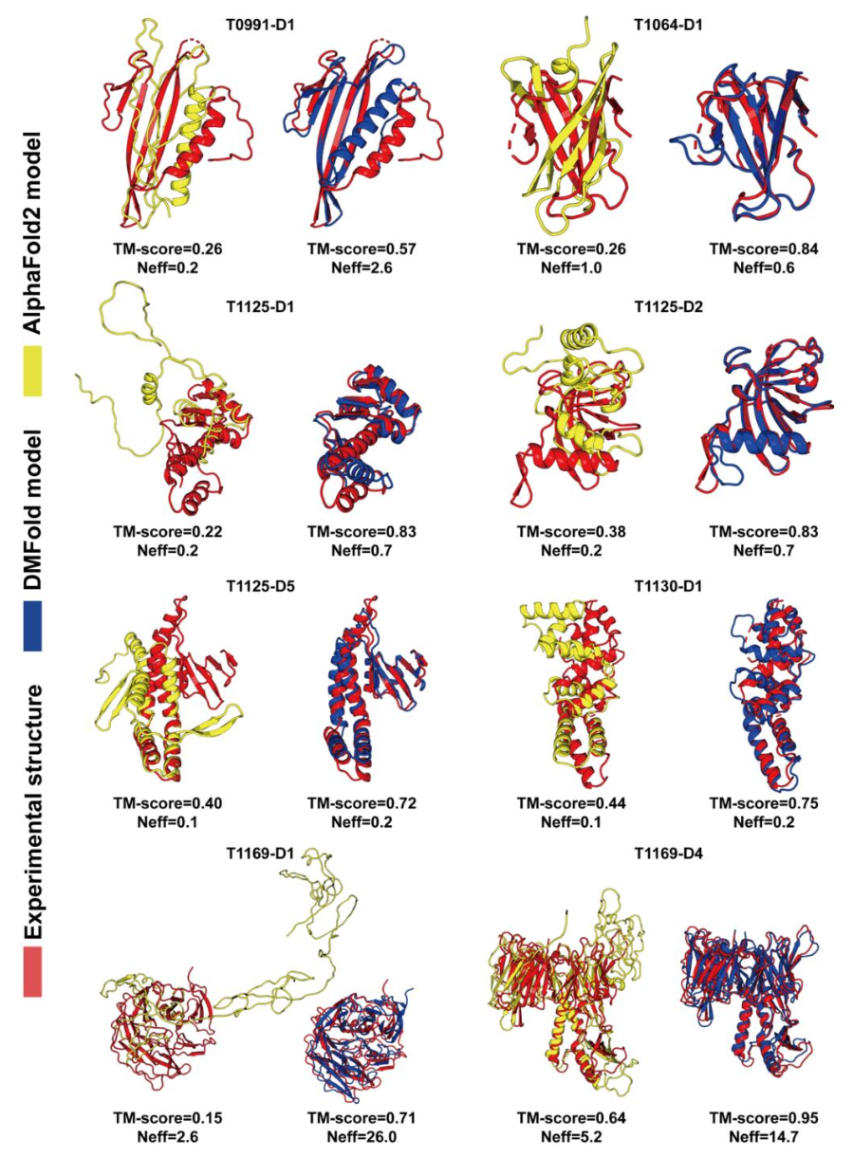
What is “Good” MSA?
Balanced alignment coverage (covers a reasonable region of the query sequence).
Higher Neff (Number of effective sequences in the MSA)
[3] Zheng, W., Wuyun, Q., Li, Y. et al. Improving deep learning protein monomer and complex structure prediction using DeepMSA2 with huge metagenomics data. Nat Methods 21, 279–289 (2024). https://doi.org/10.1038/s41592-023-02130-4

Slide 13
Bucket-Filter
buckets=[0, 0.2, 0.4, 0.6, 0.8, 1.0], max_bucket_num=2
Filtered
Target 1 Sim=0.99
Target 2 Sim=0.91
Target 3 Sim=0.88
Target 4 Sim=0.83
Target 5 Sim=0.81
Target 6 Sim=0.76
Target 7 Sim=0.73
Target 8 Sim=0.72
Target 9 Sim=0.61
Target 10 Sim=0.55
Target 11 Sim=0.45
Query
Target 12 Sim=0.31
Target 13 Sim=0.19
Target 14 Sim=0.18
Target 15 Sim=0.11

Slide 14
PLM-MSA
From MSA to Query Centered MSA
Index | Sequence | PSA (PLMAlign) | MSA (Star Alignment) | MSA (PLM-MSA)
Query | MRRSYYMRR | ------ | MRRSYYMRR-- MRSSYYMRR-- MRY–YMMRRRR MRYRRY-RR-- | MRRSYYMRR MRSSYYMRRMRY–YMMRR MRYRRY-RR
Target1 | MRSSYYMRR | MRRSYYMRR MRSSYYMRR
Target2 | MRYYMMRRRR | MRRSYYMRR-- MRY–YMMRRRR
Target3 | MRYRRYRR | MRRSYYMRR MRYRRY-RR

Slide 15
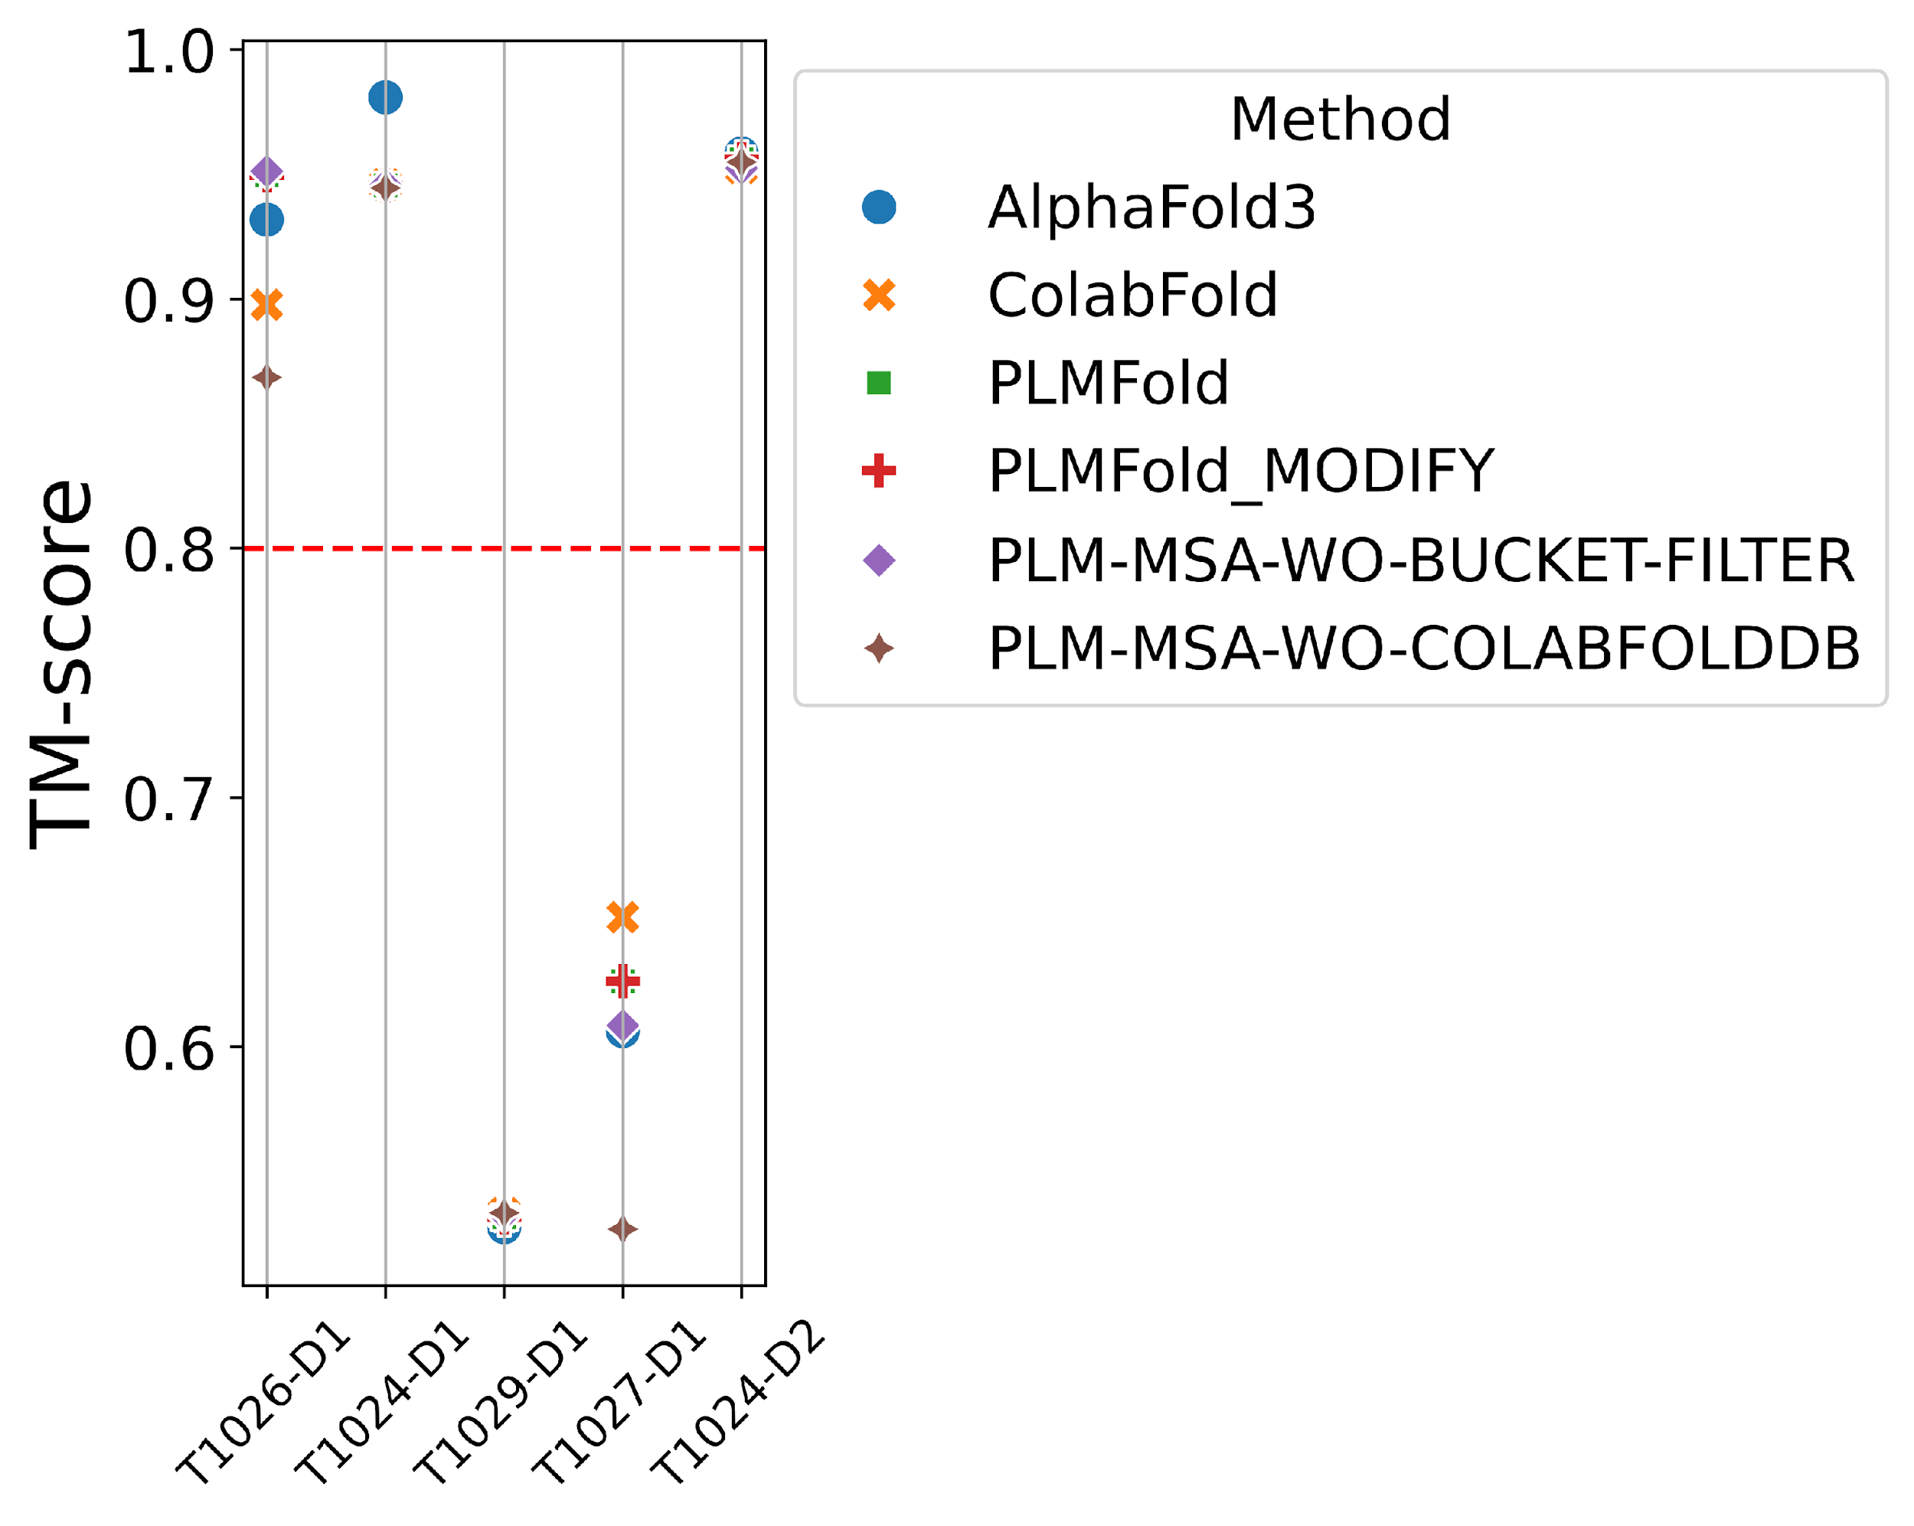
Ablation experiment
Method | TM-score
 | T1026-D1 | T1024-D1 | T1029-D1 | T1027-D1 | T1024-D2 | AVERAGE
AlphaFold3 | 0.93184 | 0.98092 | 0.52769 | 0.60639 | 0.95836 | 0.8010
ColabFold | 0.89768 | 0.94601 | 0.53331 | 0.65202 | 0.95254 | 0.7963
PLMFold | 0.94962 | 0.94558 | 0.53158 | 0.62638 | 0.95607 | 0.8018
PLMFold_MODIFY | 0.94962 | 0.94558 | 0.53158 | 0.62638 | 0.95607 | 0.8018
PLM-MSA-WO-BUCKET-FILTER | 0.95126 | 0.94567 | 0.53282 | 0.60861 | 0.95244 | 0.7982
PLM-MSA-WO-COLABFOLDDB | 0.86853 | 0.94451 | 0.53342 | 0.52689 | 0.95489 | 0.7656

Slide 16
Future Plans

Slide 17
Future Plans
Improve the performance of PLMFold, especially on protein multimers.
Design a indicator for measuring MSA quality (MSA score)
Quantify the improvement of MSA on accuracy estimates

Slide 18
Thanks for your attention

