Slide 1
“Protein structure” assessment
Qian Cong -- Marc Lensink -- Nick Grishin

Slide 2

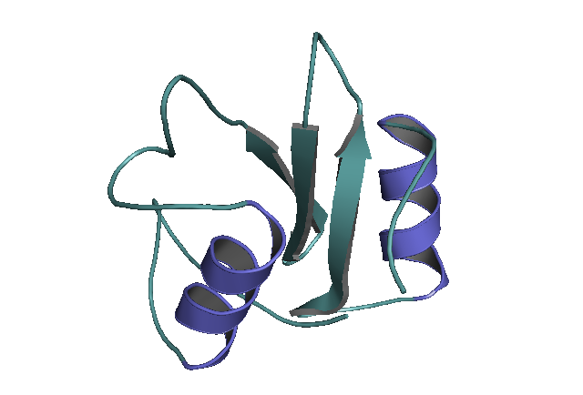
The folding problem
aa sequence
ANDTHISISASILLYPRTEINSEKVENCETHATFLDSINCMPTER
Solved !
computation
3D fold
All images are taken from internet, may be subject to copyright, and are quoted here for the purpose of this presentation delivered to a limited audience

Slide 3
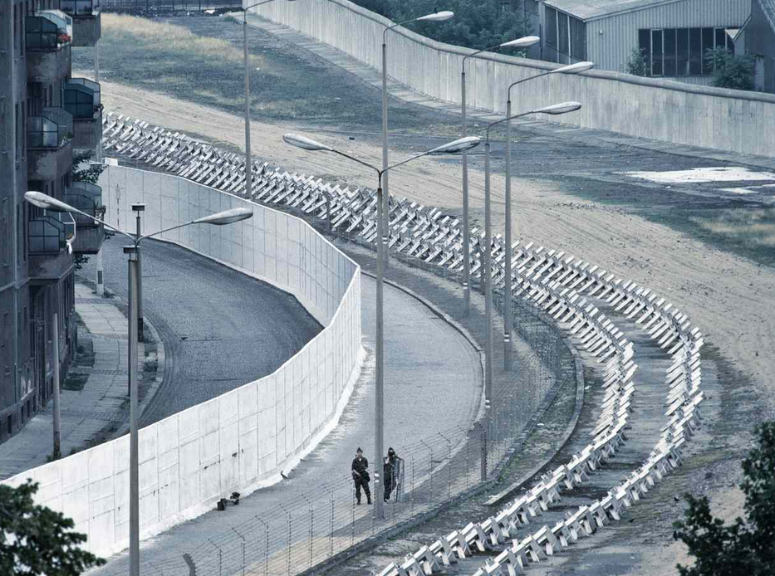

A no-template barrier
Template-based modeling
Free modeling
All images are taken from internet, may be subject to copyright, and are quoted here for the purpose of this presentation delivered to a limited audience

Slide 4

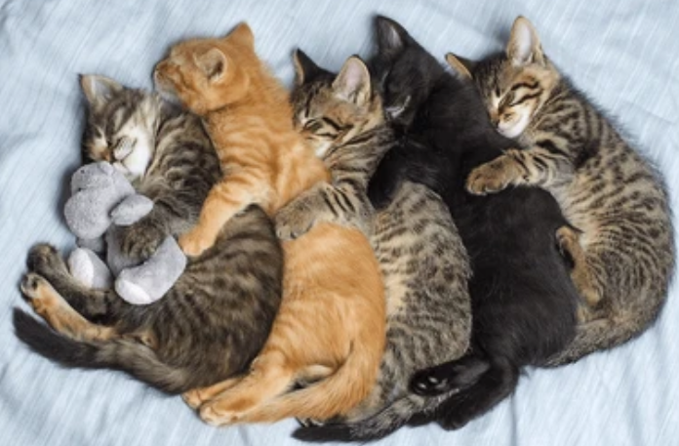
Proteins vs. protein complexes
Still assessed separately, but all by us
Intra-chain interactions:
“folding”
Inter-chain interactions:
“assembly”
All images are taken from internet, may be subject to copyright, and are quoted here for the purpose of this presentation delivered to a limited audience

Slide 5

CASP & CAPRI collaboration
Working separately together
for the benefit of all, providing
complementary insights
All images are taken from internet, may be subject to copyright, and are quoted here for the purpose of this presentation delivered to a limited audience

Slide 6
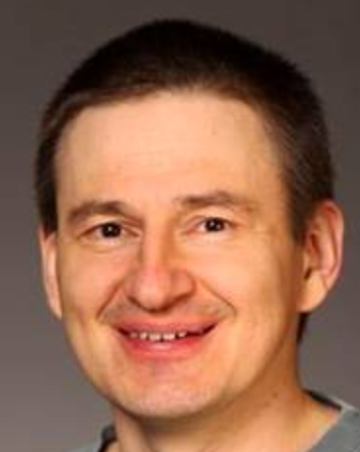
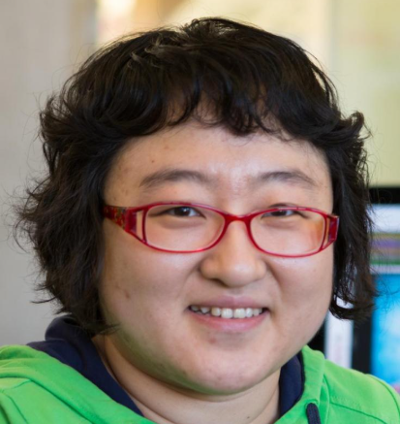
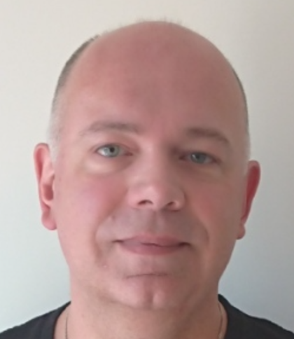
Nick Grishin -- Introduction
Qian Cong -- Monomers (aka “Proteins domains” = evaluation units)
Marc Lensink -- Oligomers CAPRI style (aka “Interactions”)
Qian Cong -- Oligomers CASP style (aka “Protein complexes”)
All images are taken from internet, may be subject to copyright, and are quoted here for the purpose of this presentation delivered to a limited audience

Slide 7
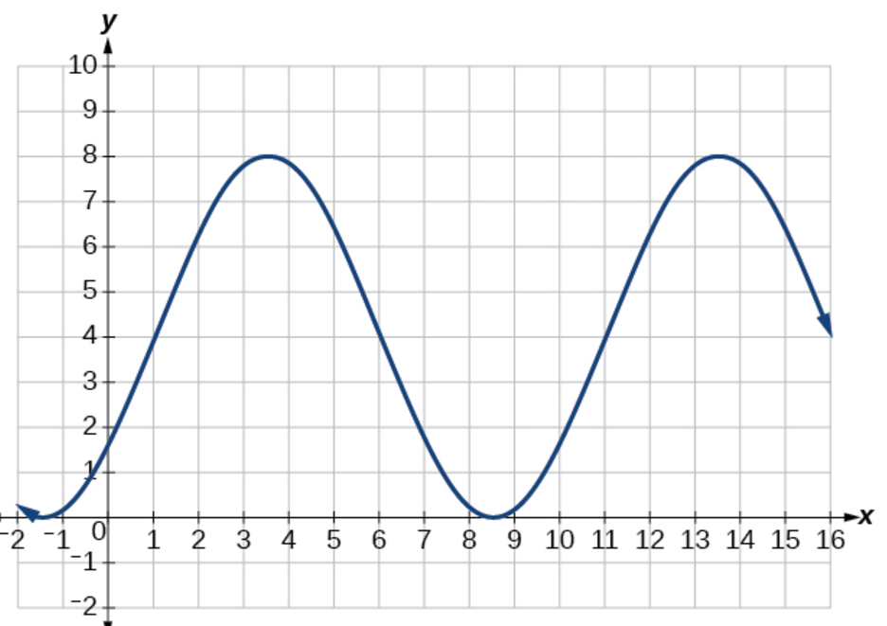


2
3
1
All images are taken from internet, may be subject to copyright, and are quoted here for the purpose of this presentation delivered to a limited audience

Slide 8
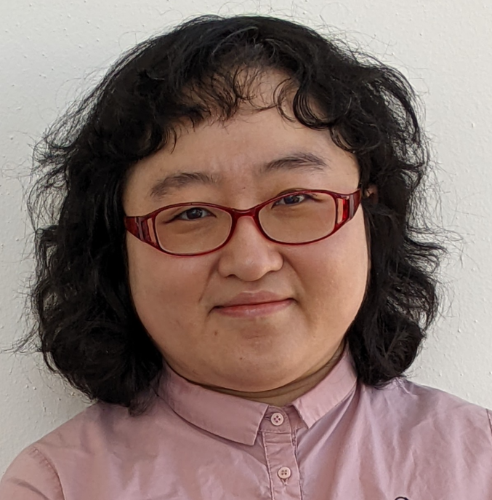
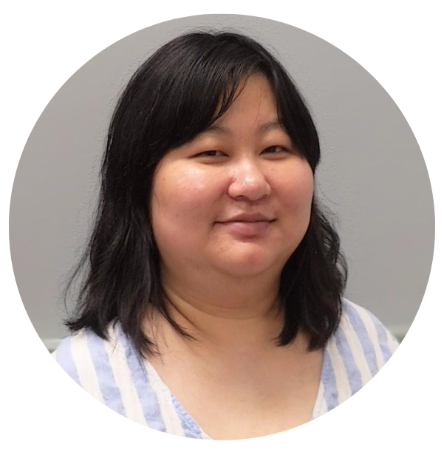
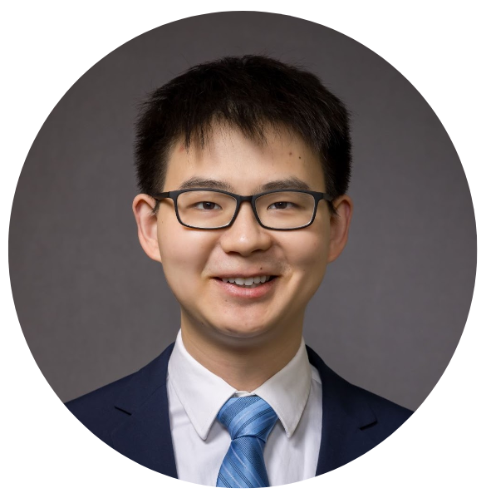
Qian Cong
(pronounced smth. like
Tsien Tsong)
Assistant Professor (tenure track)
Eugene McDermott Center
for Human Growth and Development
UT Southwestern
Jing Zhang
A postdoc in
Qian’s group
Rongqing Yuan
A grad student in
Qian’s group
All images are taken from internet, may be subject to copyright, and are quoted here for the purpose of this presentation delivered to a limited audience

