Slide 1
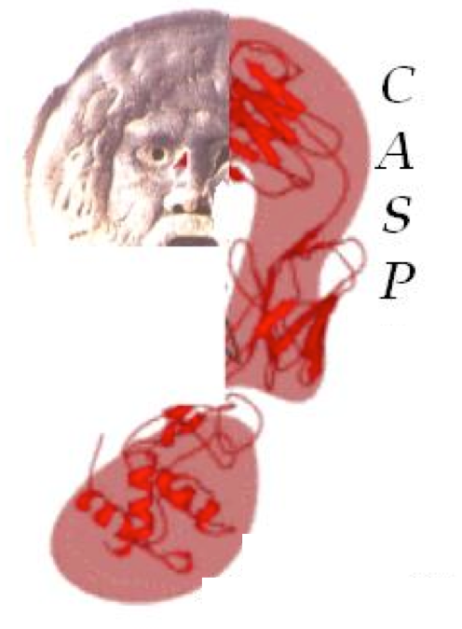

Advancing solutions to the Potein Folding Problem
Advancing solutions in Computational Structural Biology
Rigor
Transparency
Communication
Collaboration
CASP16
Critical Assessment of Structure Prediction
Notes:
Schematic from Fabio Pietrucci (online

Slide 2
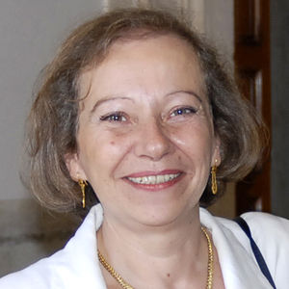
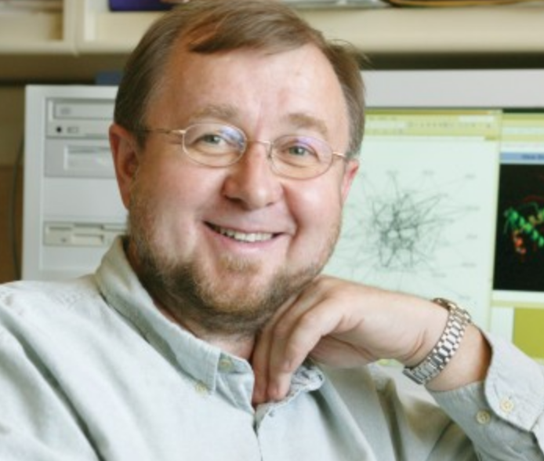
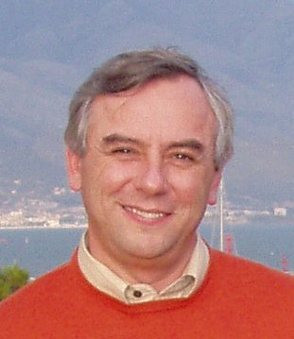
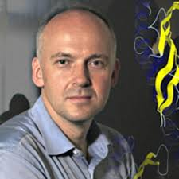
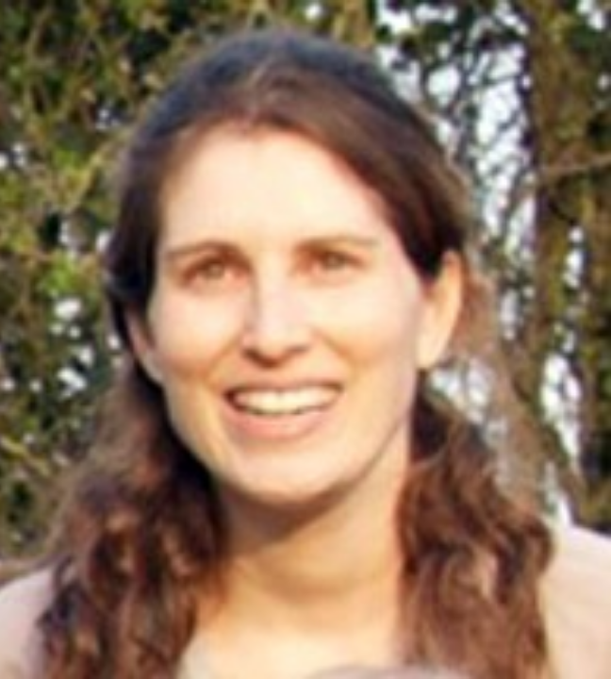

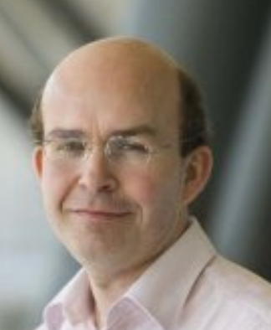
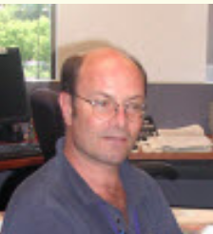
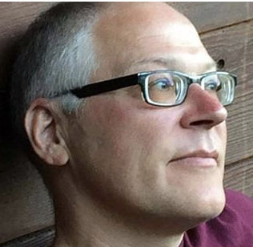
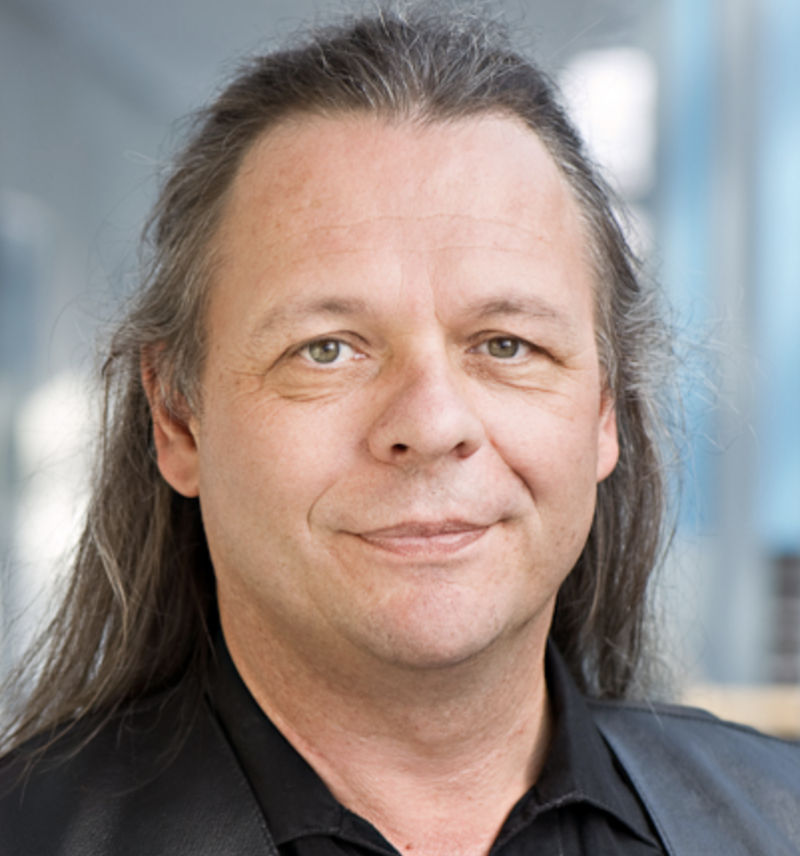
Founders and Organizers
Anna Tramontano
Krzysztof Fidelis
Andriy Kryshtafovych
Torsten Schwede
Maya Topf
Jan Pedersen
Tim Hubbard
Steve Bryant
Burkhard Rost

Slide 3
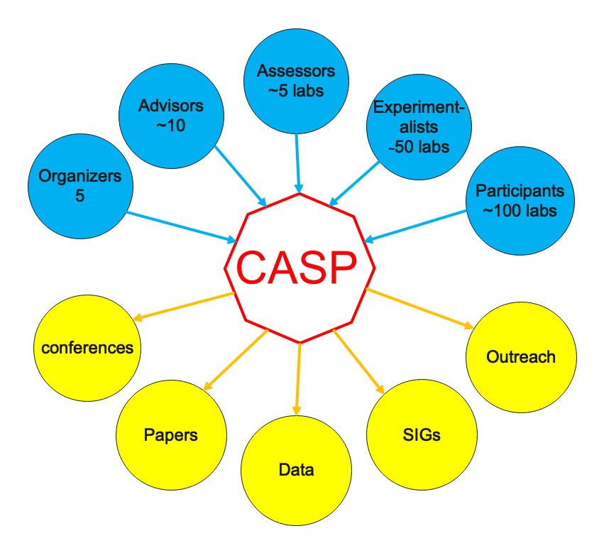
Notes:
From “Using Tensor Analysis to characterize Contact-map Dynamics of Proteins". Christopher James Langmead

Slide 4
Previous CASP ASSESSORS
Mike James, Shoshana Wodak, Fred Cohen, Janet Thornton, Michael Levitt, Alwyn Jones, Alexey Murzin, Christine Orengo, Arthur Lesk, Anna Tramontano, Manfred Sippl, Nick Grishin, Rob Russell, Alfonso Valencia, Roland Dunbrack, BK Lee, Neil Clark, Torsten Schwede, Randy Read, Mike Tress, Jane Richardson, Joel Sussman, Ken Dill, Justin MacCallum, Gaetano Montelione, David Jones, Alexandre Bonvin, Matteo Dal Peraro, Francesco Gervasio, Aleix Lafita, Russ Altman, Jose Duarte, Andras Fiser, Susan Tsutakawa, Chaok Seok, Ezgi Karaca, Andrei Lupas, Daniel Rigden, Sandor Vajda, Marc Lensink, Eric Westhof, Rhiju Das, Pat Walters, Gabriel Studer.

Slide 5
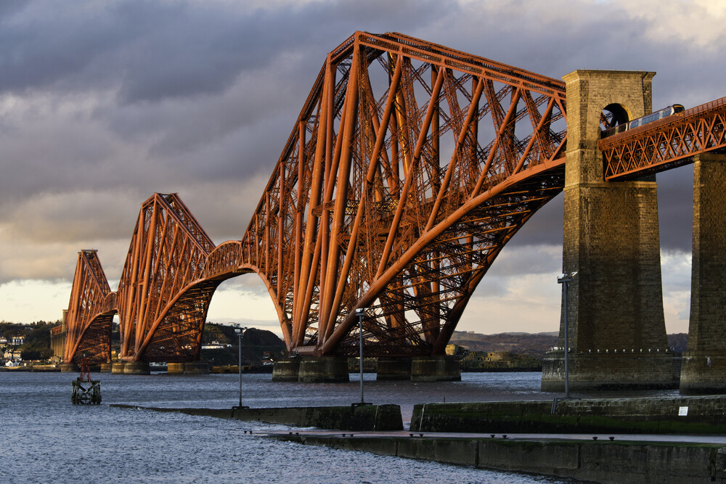
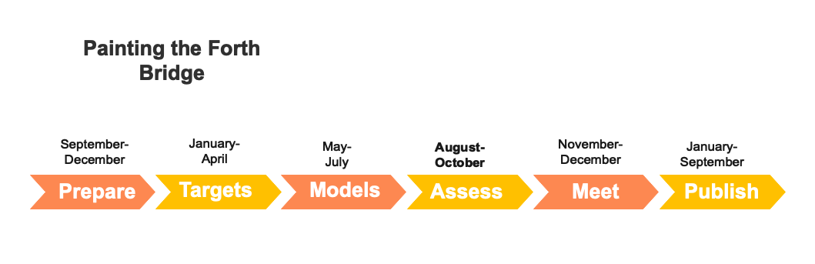
Notes:
From “Using Tensor Analysis to characterize Contact-map Dynamics of Proteins". Christopher James Langmead

Slide 6
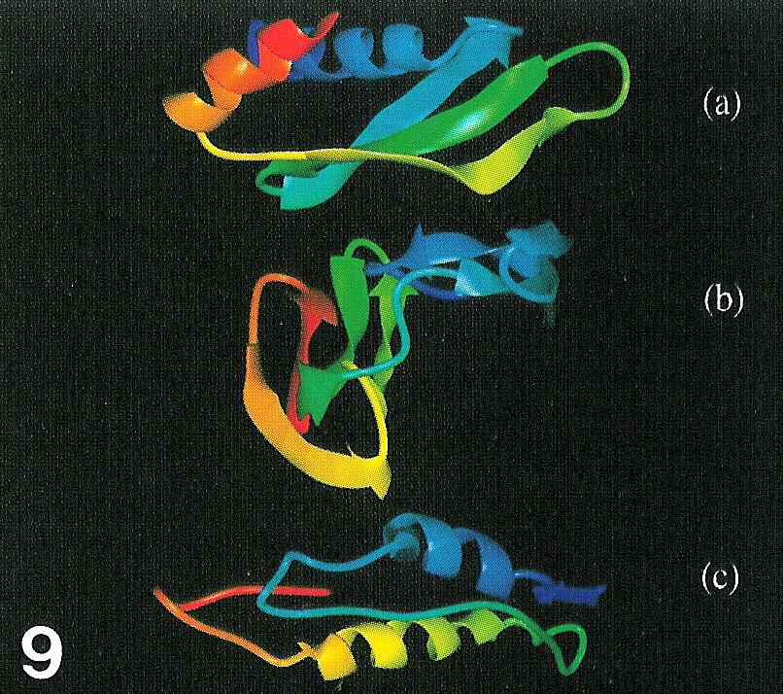
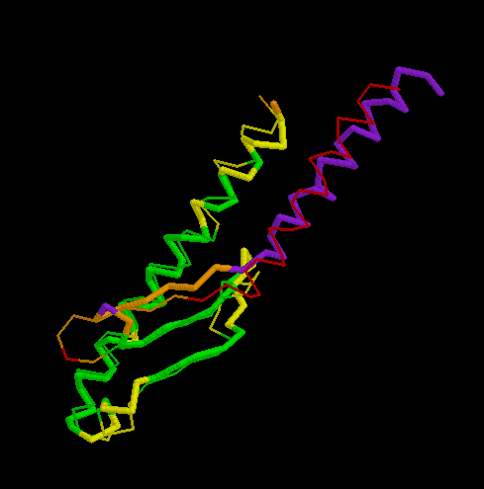
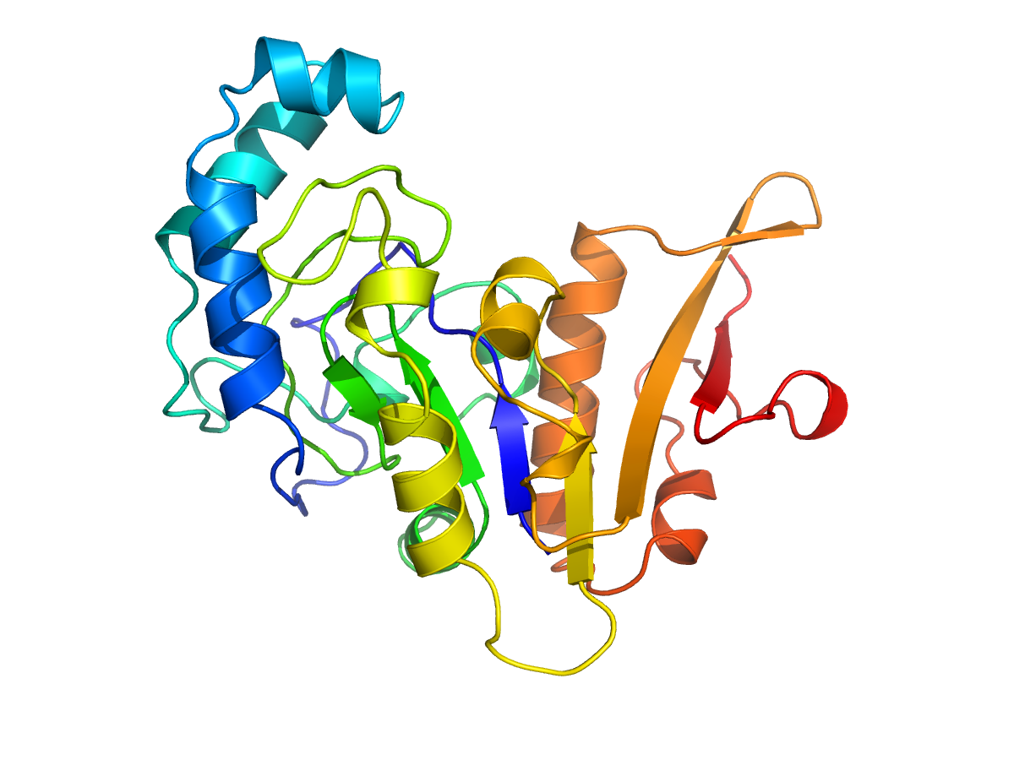
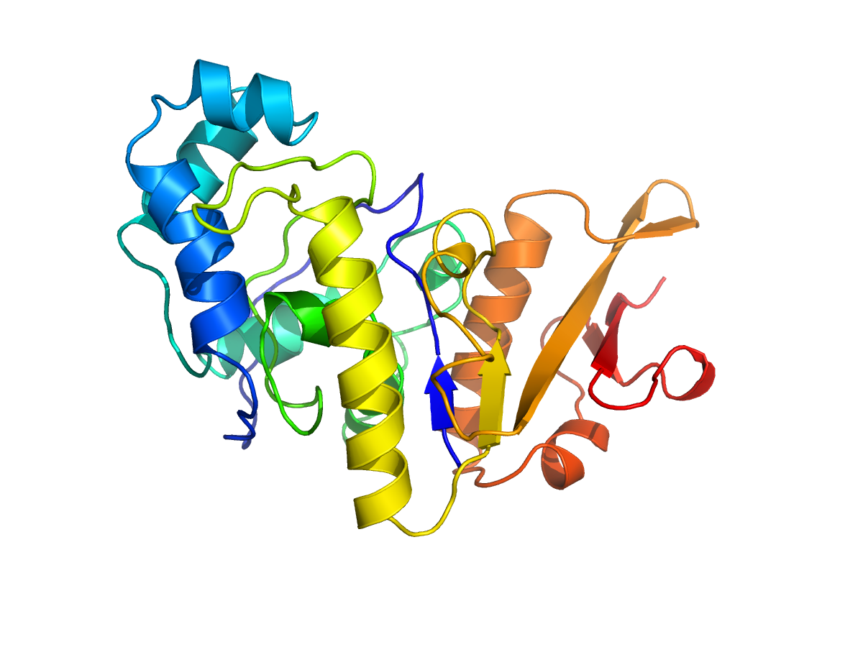
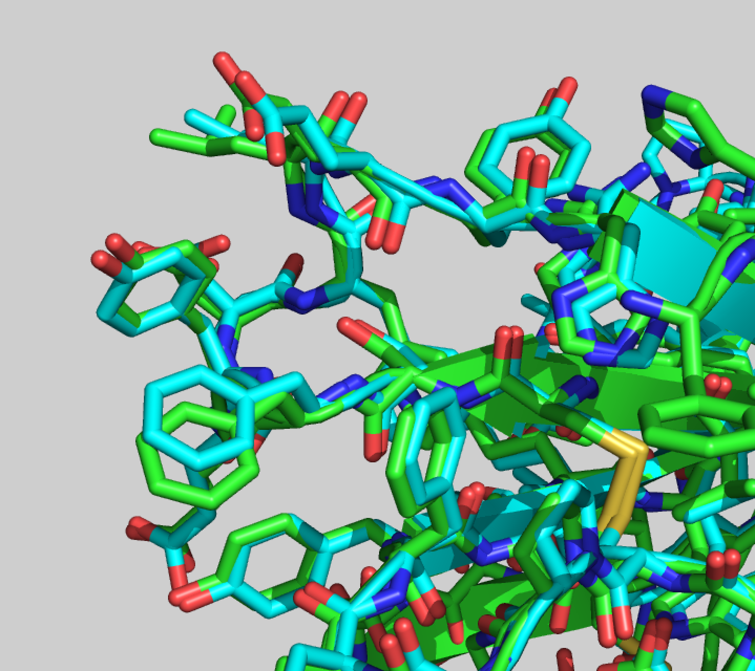
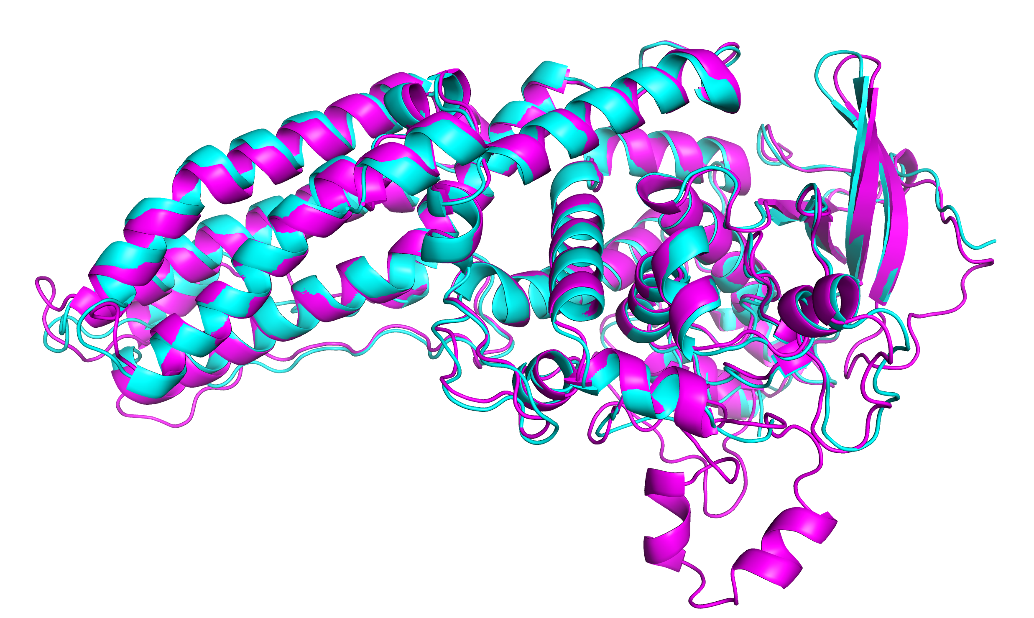
1990s
2000s
2010s
2020s

Slide 7
Notes:
Progress in calculated protein structure accuracy over CASP experiments. ‘Difficulty’ is related to the extent to which homology modeling could be used. A GDT_TS of about 90 approaches the limit of possible agreement with experiment, given experimental uncertainty. A GDT_TS of ~50 roughly corresponds to a correct fold. Random depends on the fold but is ~20 -> 30. 1994: The Dark Ages;, 2002: progress for difficult targets partly due to fragment assembly methods; 2016: progress partly due to improved classical contact prediction methods; 2018: first used of deep learning (convolutional networks); 2020: near experimental accuracy from a transformer based method, AlphaFold2. Copyright CASP organizers. Not for distribution.

Slide 8
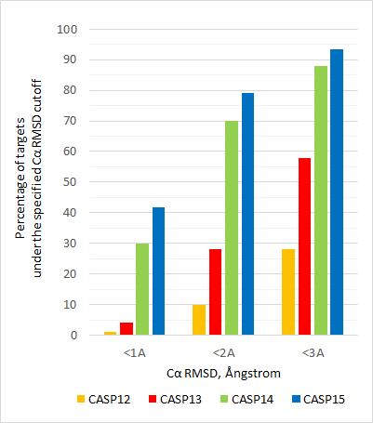

Slide 9
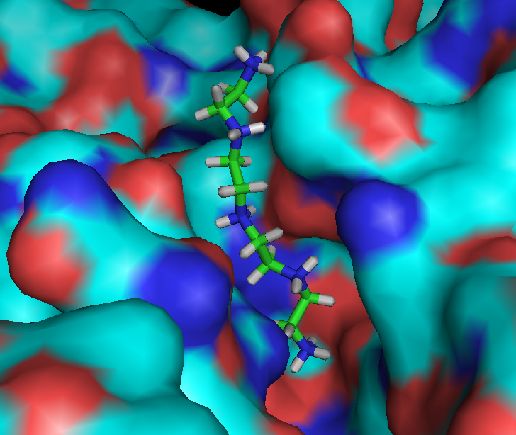
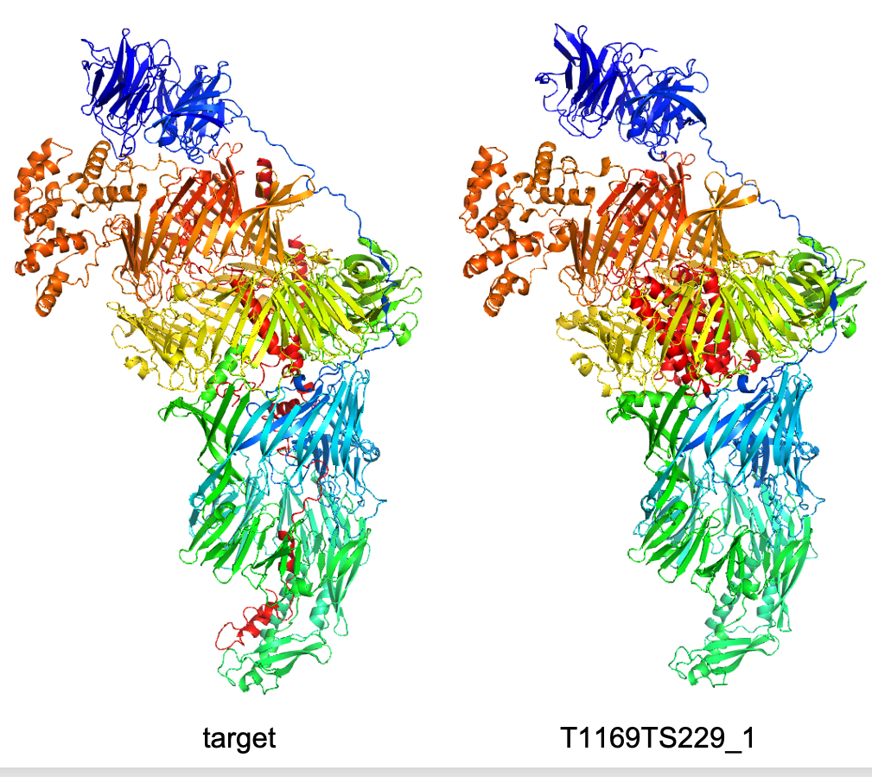
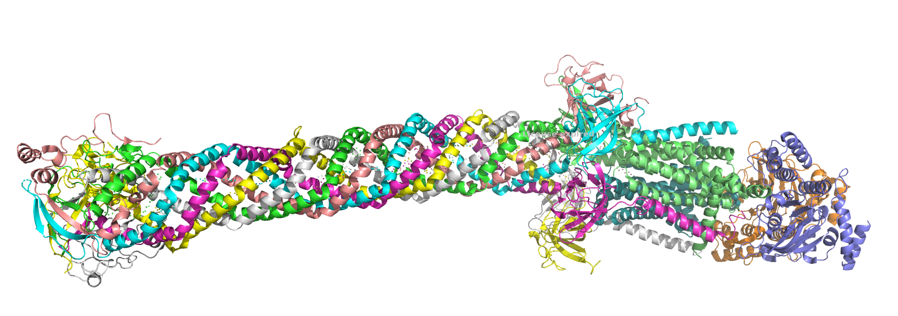
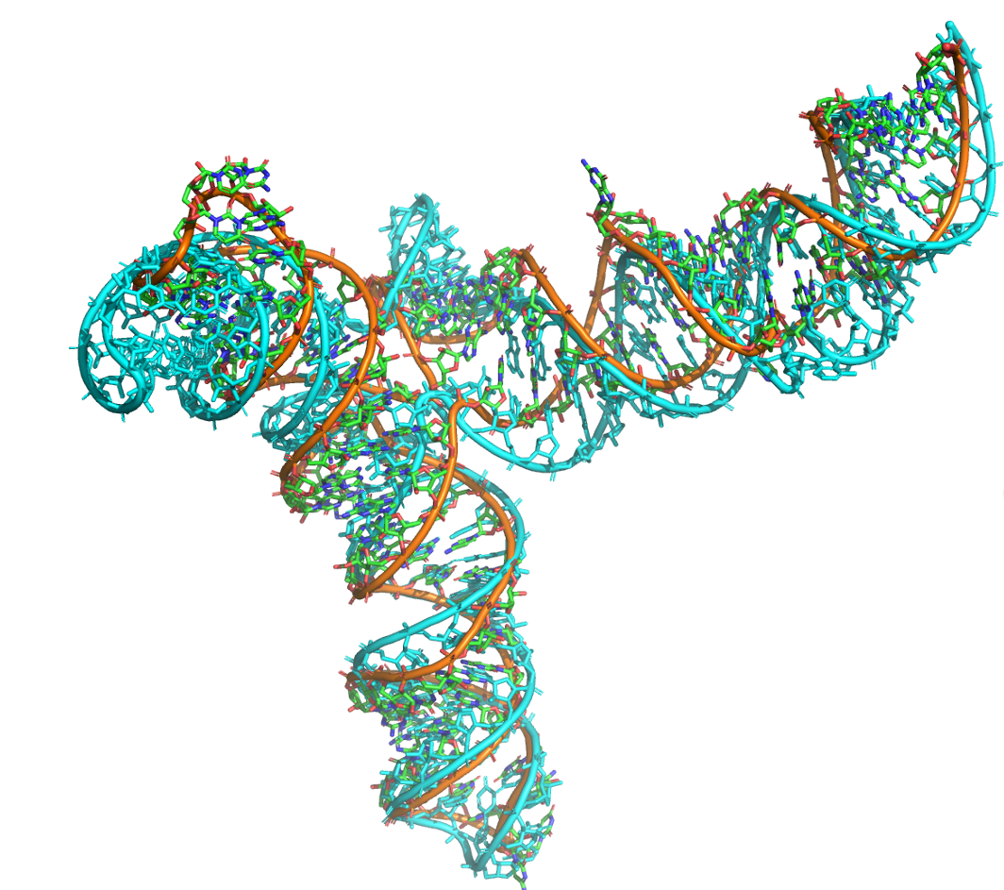
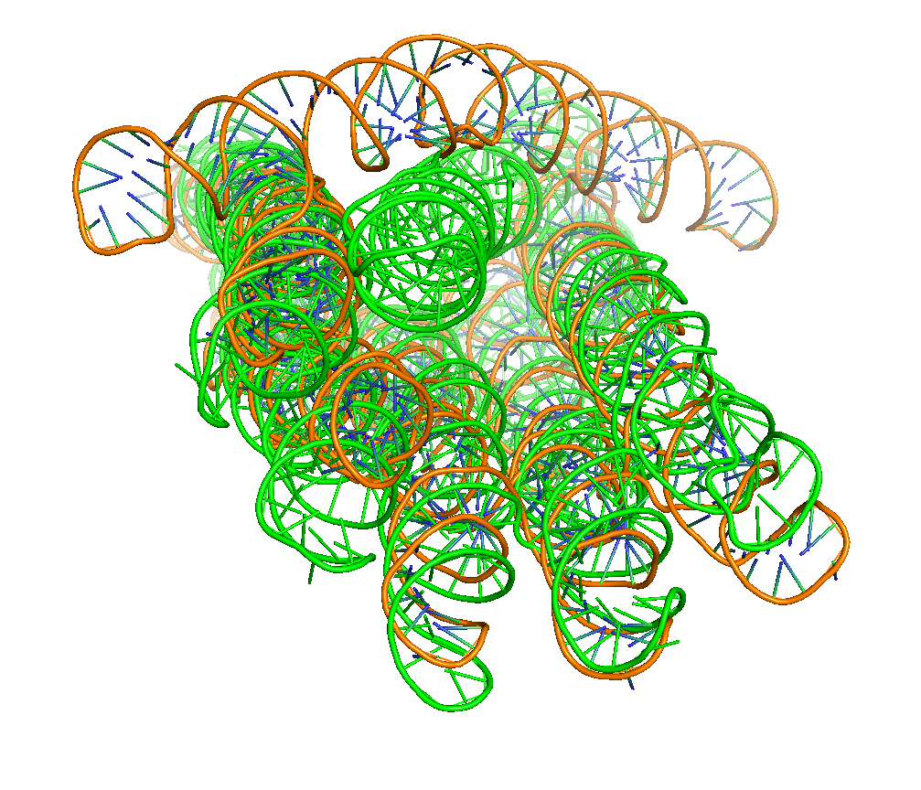
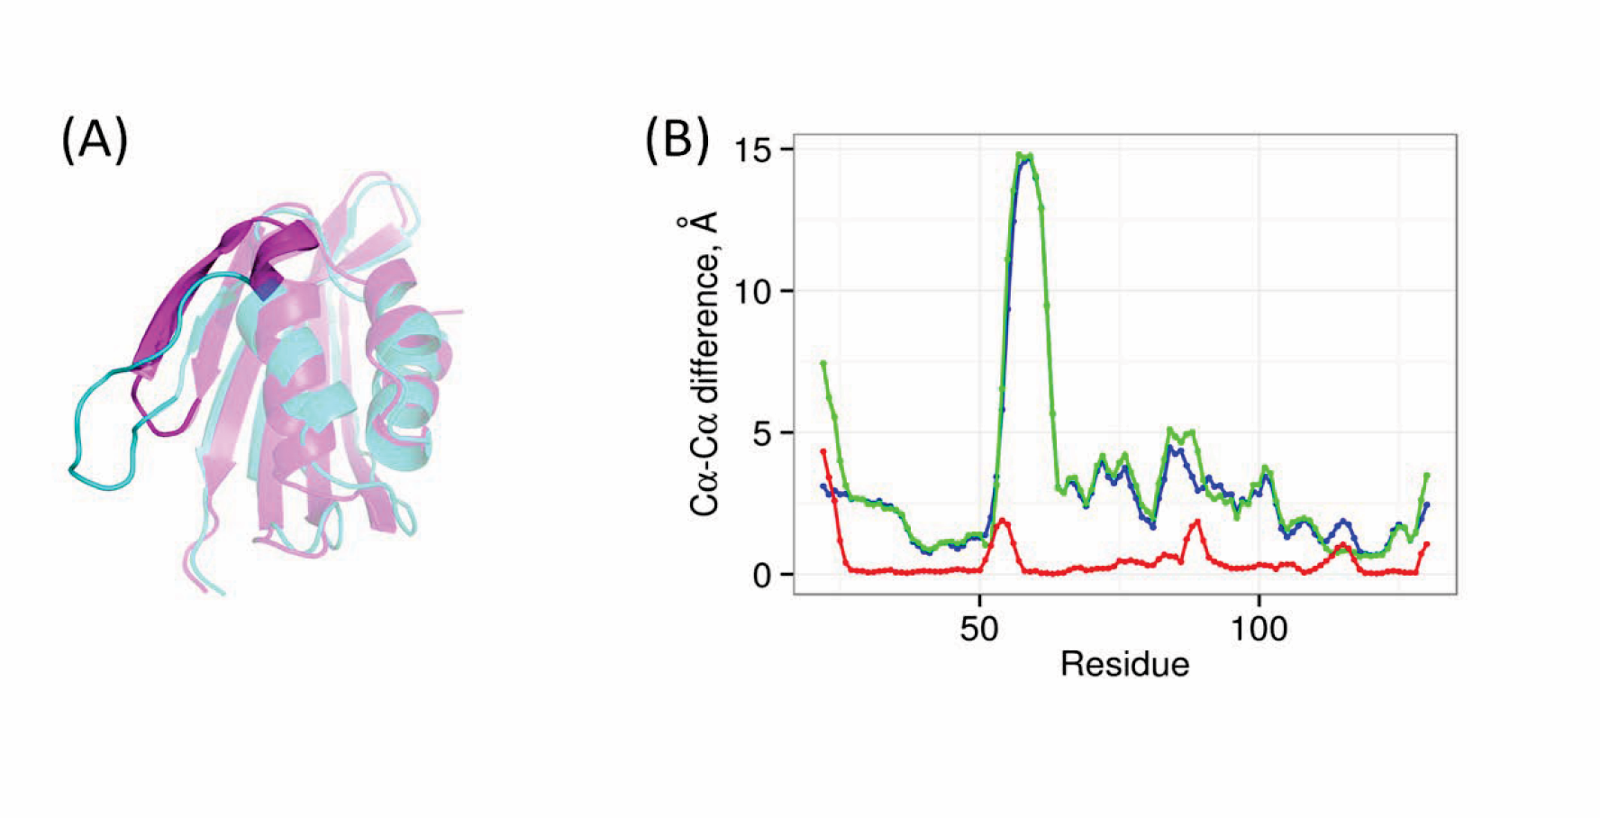
CASP15 Categories
Single proteins
Protein Assemblies (with CAPRI)
Ligand binding
Accuracy estimation
RNA (with RNA Puzzles)
Conformational ensembles

Slide 10
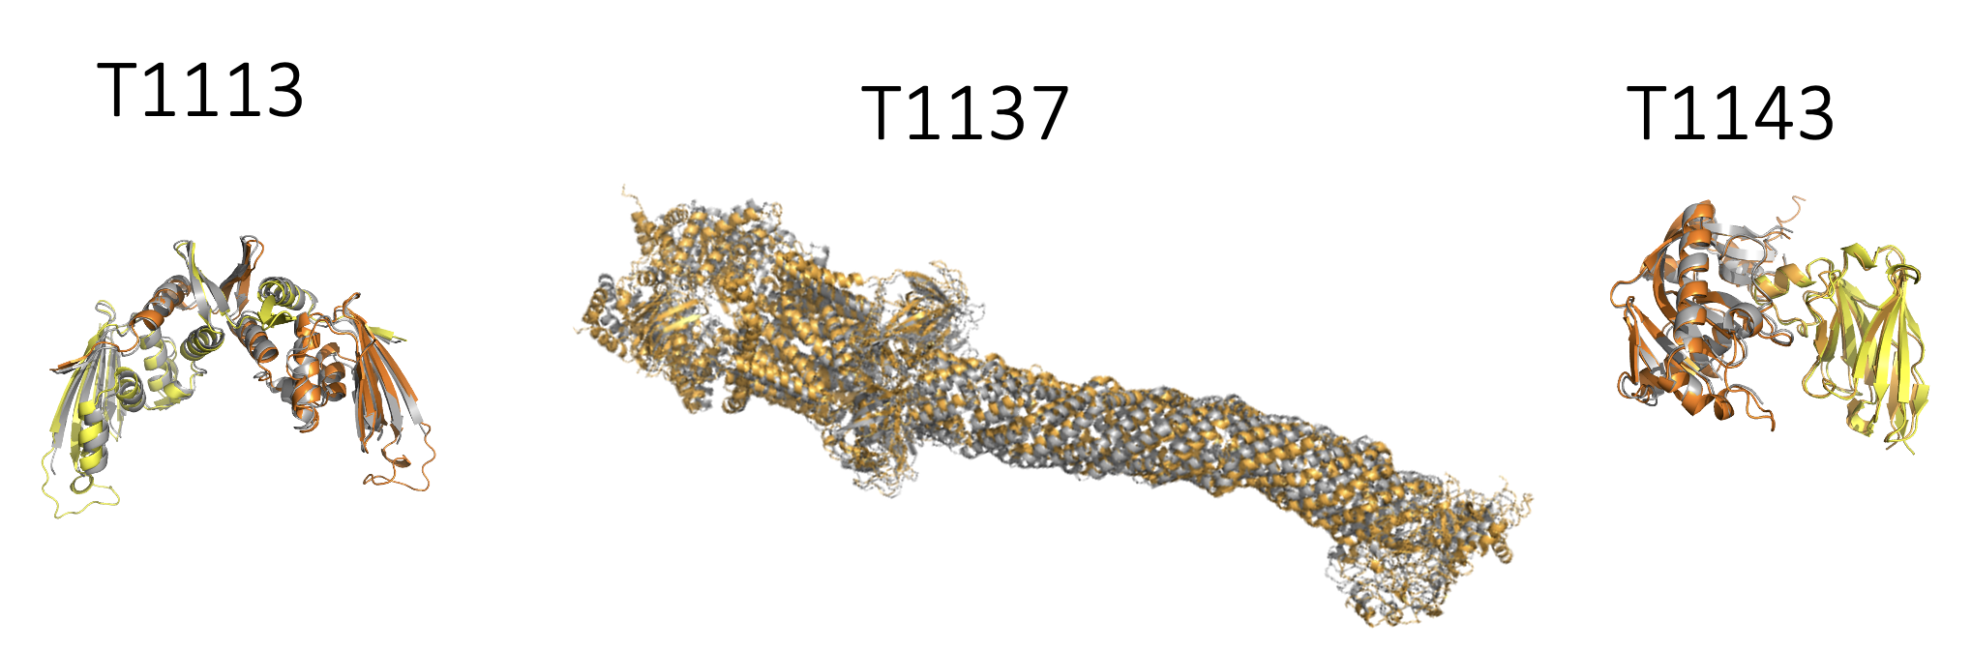
Ezgi Karaca et al

Slide 11
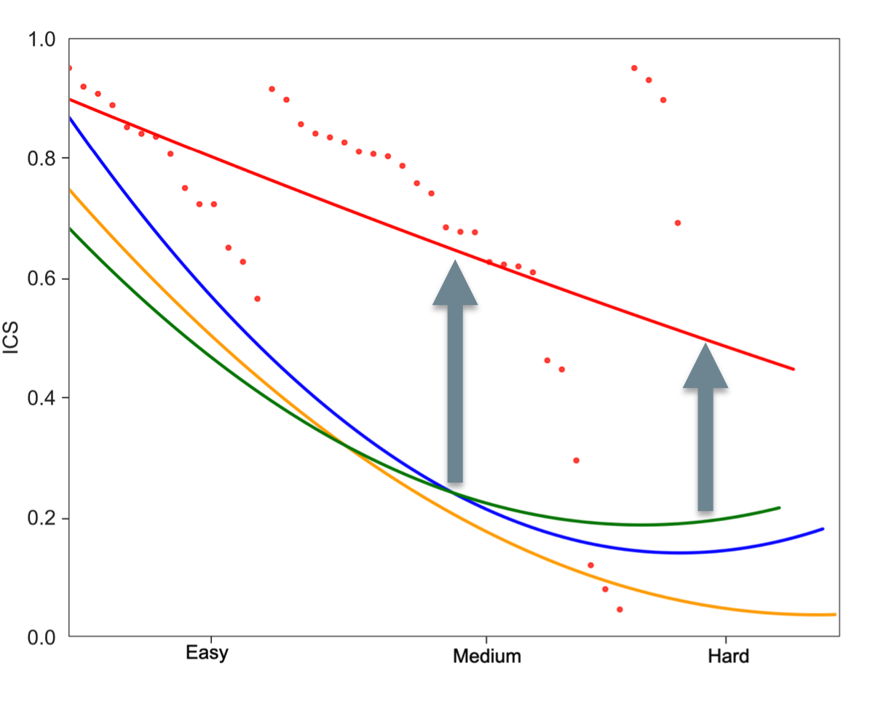
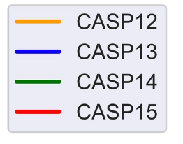
Ezgi Karaca et al

Slide 12
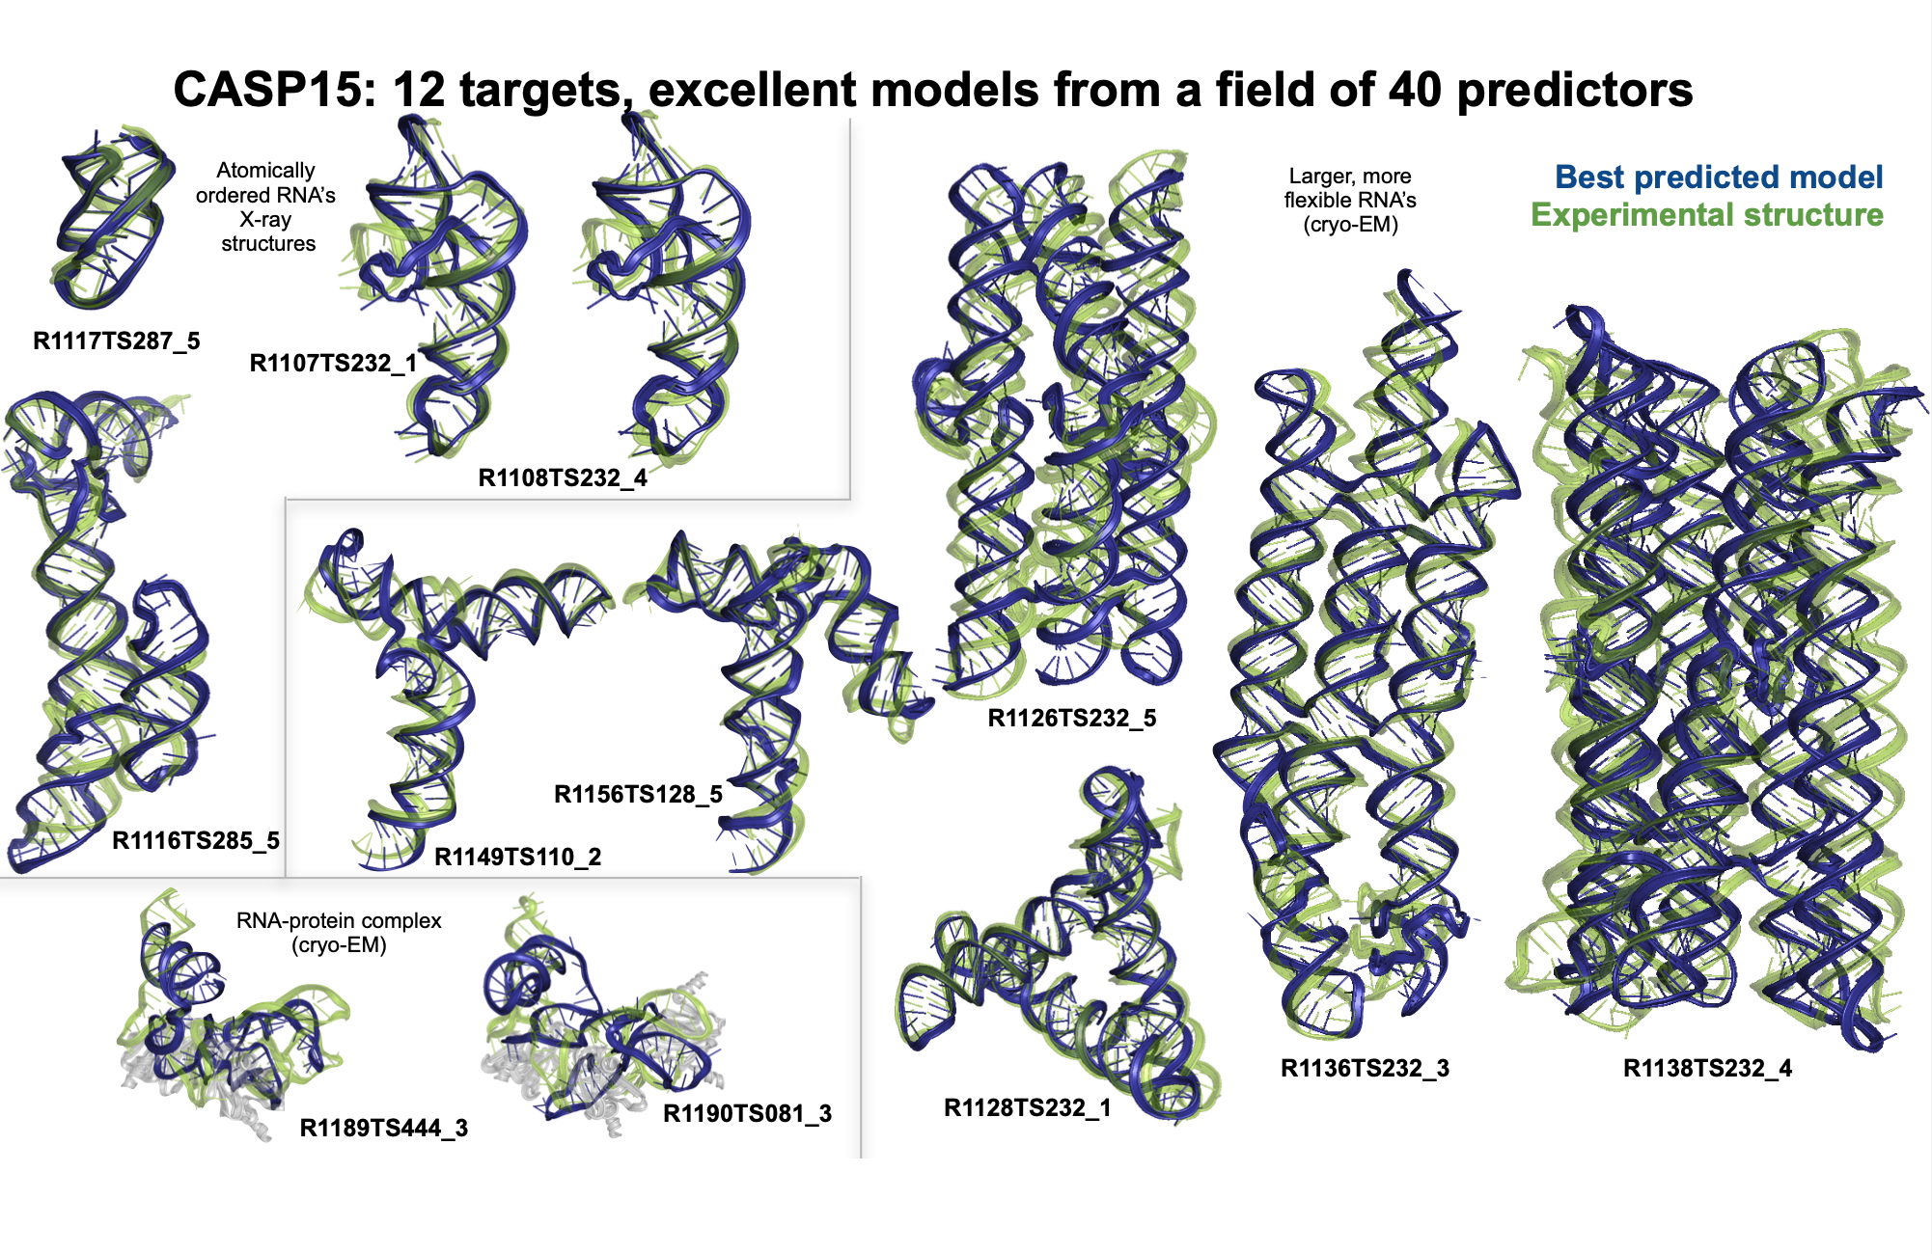
86,73
30,69
67,73
65,76
55,67
44,74
47,73
38,78
29,74
22,54
24,58
53,87
Rhiju Das et al

Slide 13
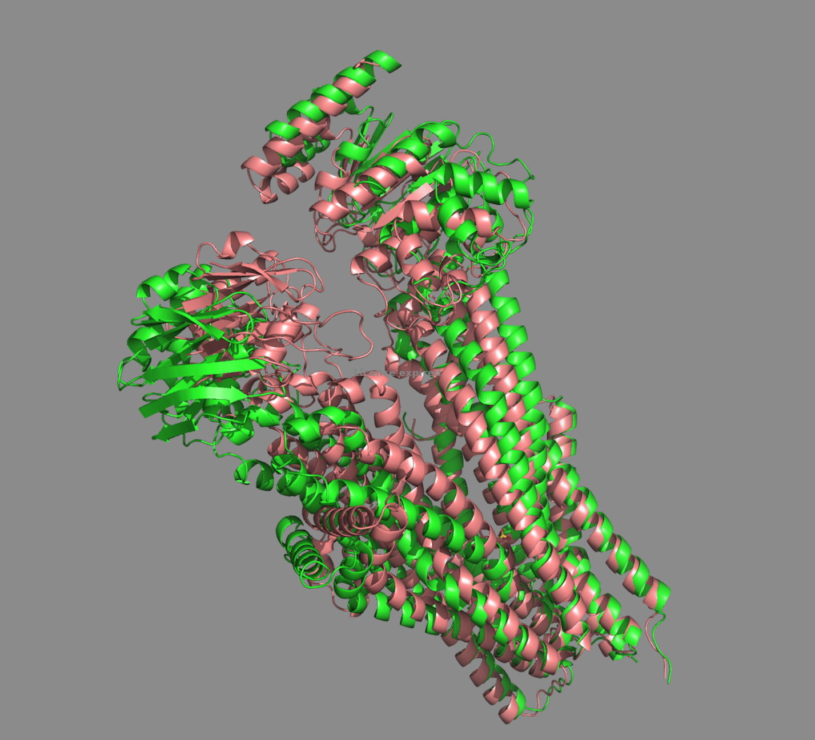
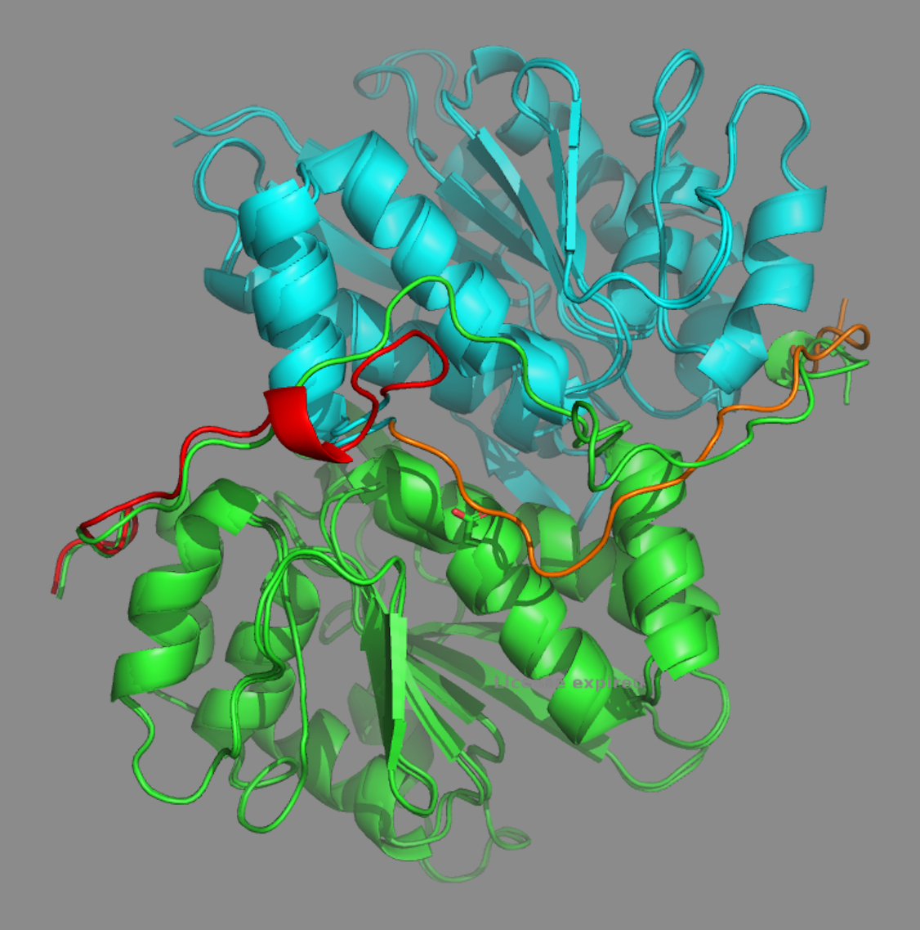
Ligand induced change
Mutation induced change
Notes:
T1158 (green and T1158V3_lig (brown). V1, V2, and V3 are similar but different from the apo structure, V4 is different from all the others. I.e three different inter-domain angles overall.

Slide 14
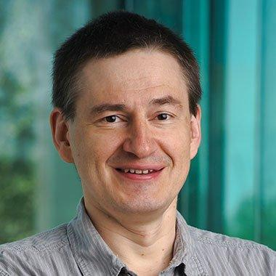
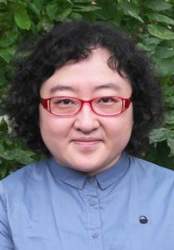
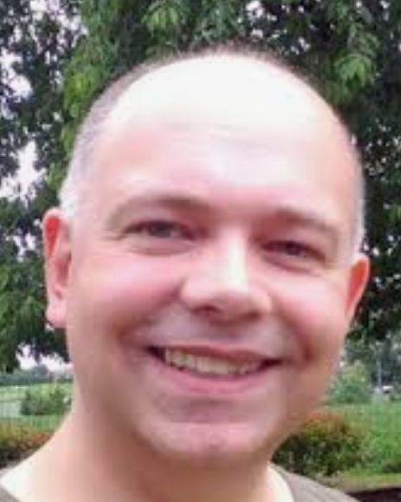
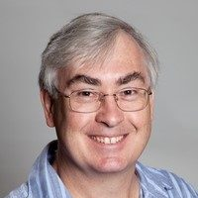
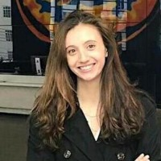
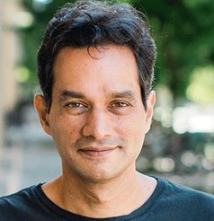
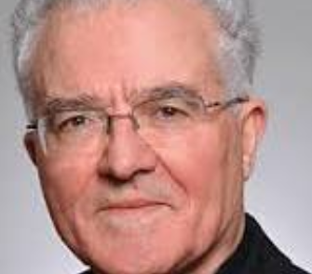
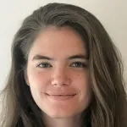
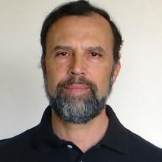
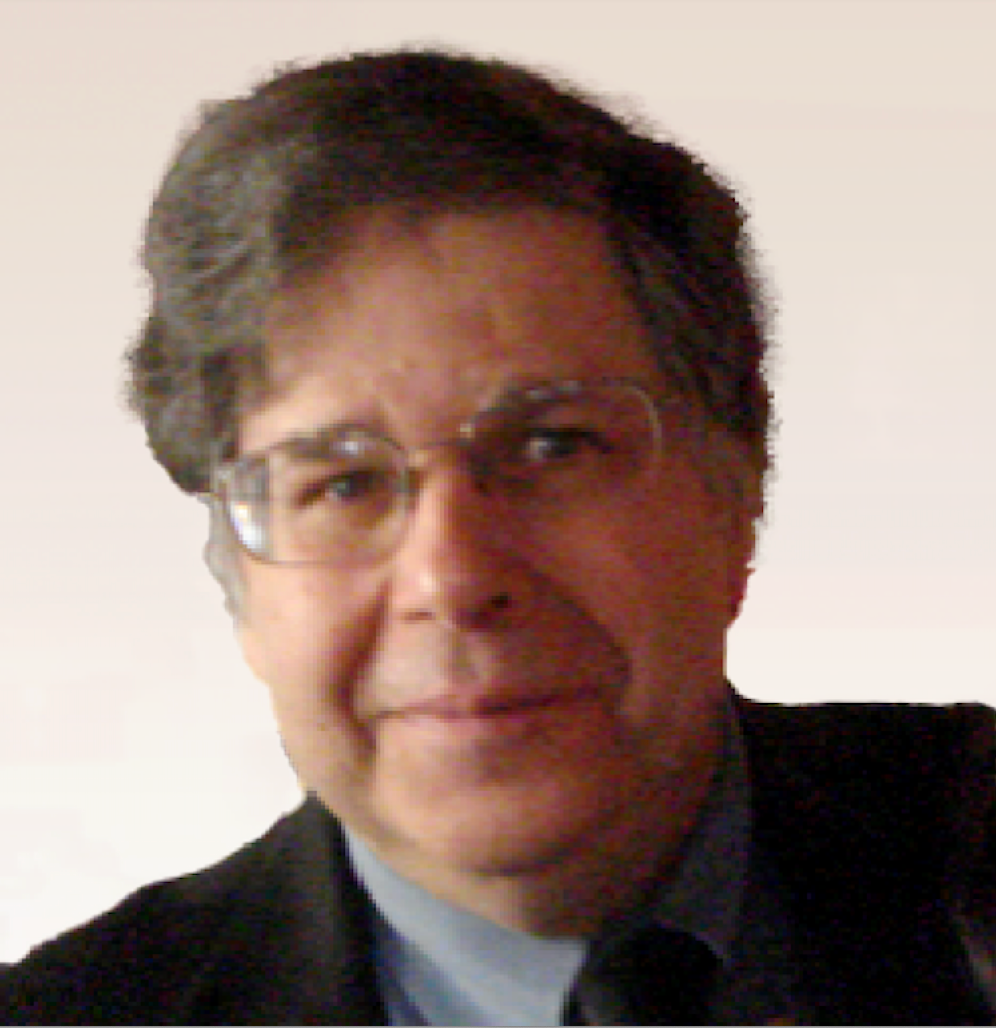
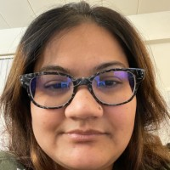
CASP16 ASSESSORS
Protein structure/complexes (CASP) Nick Grishin and Qian Cong
Protein complexes (CAPRI) Marc Lensink
Accuracy estimation Randy Read and Alisia Fadini
RNA structure (CASP) Rhiju Das and Rachael Kretsch
RNA structure (RNA puzzles) Eric Westhof
Protein/Ligand complexes Michael Gilson
Macromolecule Ensembles Gaetano Montelione and Namita Dube

Slide 15
CASP16 What’s on
Keynotes: Jumper, Baker
Assessment talks
Participant talks
Follow-up discussions
Flash talks and Poster sessions
Wither AI methods discussion?
SIGs and outreach discussion
Participants meeting
Food, drink, and intense chat
Beach

Slide 16
What does Not yet work for proteins and protein complexes? Why, and is anyone doing anything about it? Really as good as experiment?
Are there good methods independent of AlphaFold(n)?
Are accuracy estimates as good as experimental ones?
Have RNA/DNA methods improved and are AI methods the best there?
What’s the state of the art of protein ligands on realistic pharma datasets. AI the best?
What limits performance on ensembles? How will those limits be overcome?
What will be the role (if any) for physics inspired methods going forward?
Things to watch out for.

